Slide 1
Review Game!!!
Directions:
To see the answer to the question, click on the space bar (or next arrow).
To go back to the main board, click on the sun.

Slide 2
India
Africa
Middle East
Maps
100
100
100
100
200
200
200
200
300
300
300
300
400
400
400
400
500
500
500
500

Slide 3
India 100 Which country did West Pakistan become?
Pakistan

Slide 4
India Bonus 50 Which country did East Pakistan become?
Bangladesh

Slide 5
India Super Bonus 25 Which country did Ceylon become?
Sri Lanka

Slide 6
India 200 What was the name of the political group that granted Indians a voice in government?
Indian National Congress

Slide 7
India Bonus 100 Who led the Indian National Congress in a campaign for Indian independence?
Mohandas Gandhi

Slide 8
India Super Bonus 50 What type of government and system was the Republic of India?
World’s largest democratic nation with a federalist system.

Slide 9
India 300 Define civil disobedience.
The refusal to obey certain laws as a peaceful form of peaceful protest.

Slide 10
India Bonus 150 Which action best illustrates Gandhi’s concept of civil disobedience?
Citizens in the United States went to jail for violating segregation laws

Slide 11
India 400 Which document attempted to end the caste system in India?
1950 Constitution of India

Slide 12
India Bonus 200 Why is there still continued discrimination based on the caste system?
Because there is clearly a gap between law and tradition.

Slide 13
India Super Bonus 100 Why was India divided into Pakistan and India?
Political division along Hindu-Muslim lines

Slide 14
India 500 Who was India’s first prime minister and what did he do?
Jawaharlal Nehru. He was a close associate of Gandhi and supported western-style industrialization.

Slide 15
India Bonus 250 Who was the next prime minister and what did she do?
Nehru’s daughter Indira Gandhi. She developed a closer relationship between India and the Soviet Union during the Cold War. She also developed a nuclear program.

Slide 16
Africa 100 Which document granted nations the right to self-determination?
UN Charter

Slide 17
Africa Bonus 50 When were there peaceful and violent revolutions for independence in Africa?
After World War II.

Slide 18
Africa Super Bonus 25 Define Pan-Africanism.
Pride in African culture and heritage.

Slide 19
Africa 200 Which French colony fought a War of Independence?
Algeria

Slide 20
Africa Bonus 100 How did the other French colonies in West Africa achieve independence?
Peaceful transition

Slide 21
Africa 300 Which European nations lost colonies in Africa?
Great Britain, France, Belgium, and Portugal

Slide 22
Africa Bonus 150 What influenced this loss?
Superpower rivalry during the Cold War

Slide 23
Africa Super Bonus 75 Why did many European colonies in Africa move towards independence?
Resentment of imperial rule and economic exploitation.

Slide 24
Africa 400 Who led the British colony of Kenya to independence?
Jomo Kenyatta

Slide 25
Africa Bonus 200 Who became the first black president of the Republic of South Africa?
Nelson Mandela

Slide 26
Africa 500 What was the name of the system of strict social segregation in South Africa?
Apartheid

Slide 27
Africa Bonus 250 Who led South Africa’s struggle against apartheid?
Nelson Mandela

Slide 28
Middle East 100 Which system was established by the League of Nations in the Middle East after WWI?
Mandate System

Slide 29
Middle East Bonus 50 Why did Nasser nationalize the Suez Canal?
He needed to raise money for the Aswan High Dam.

Slide 30
Middle East 200 Which countries within the French Mandate achieved independence after WWII?
Syria and Lebanon

Slide 31
Middle East Bonus 100 Which countries within the British Mandate achieved independence after WWII under new names?
Transjordan – Jordan
Palestine – Israel

Slide 32
Middle East 300 Who was the president of Egypt that established the country as a republic?
Gamal Abdul Nasser

Slide 33
Middle East Bonus 150 What major source of hydroelectric power did Nasser build for Egypt?
Aswan High Dam

Slide 34
Middle East 400 Who was the Prime Minister of Israel who led Israel to victory in the Yom Kippur War?
Golda Meir

Slide 35
Middle East Bonus 200 Which war saw Egypt lose the Sinai Peninsula, Jordan the West Bank, and Syria the Golan Heights?
Six Day War

Slide 36
Middle East 500 The conflict in the Middle East is based upon the differences between which two ideas?
Arab nationalism vs. Jewish nationalism

Slide 37
Middle East Bonus 250 What peoples living in Palestine were ultimately displaced and are the source of conflict in the Middle East today?
Palestinians

Slide 38
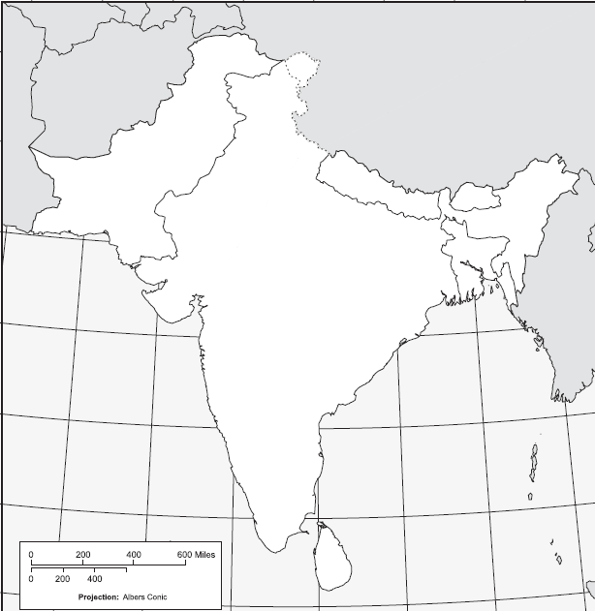
Maps 100
India
?

Slide 39
Maps Bonus 50
Pakistan
?

Slide 40
Maps Super Bonus 25
Bangladesh
?

Slide 41
Maps Super Duper Bonus 10
Sri Lanka
?

Slide 42
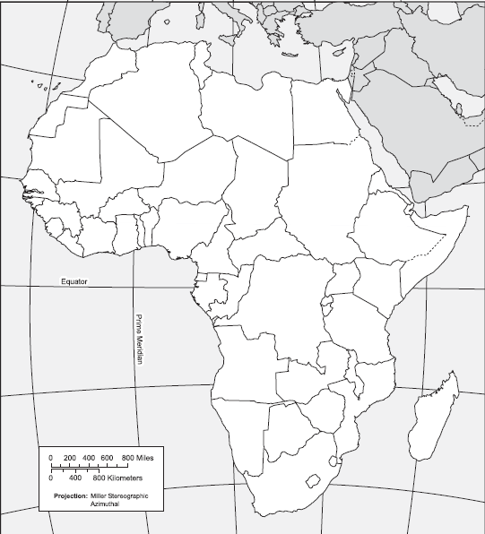
Maps 200
Egypt
?

Slide 43
Maps Bonus 100
Algeria
?

Slide 44
Maps Super Bonus 50
Libya
?

Slide 45
Maps 300
South Africa
?

Slide 46
Maps Bonus 150
Kenya
?

Slide 47
Maps Super Bonus 75
Mediterranean Sea
?

Slide 48
Maps Super Duper Bonus 30
Red Sea
?

Slide 49
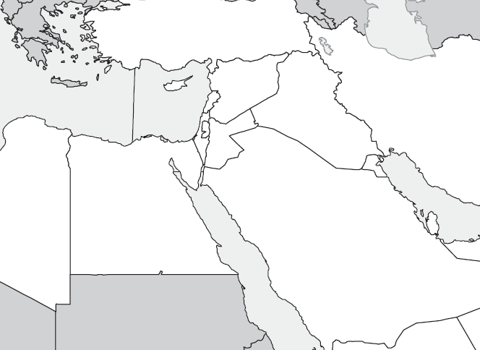
Maps 400
Israel
?

Slide 50
Maps Bonus 200
Jordan
?

Slide 51
Maps Super Bonus 100
Lebanon
?

Slide 52
Maps 500
Syria
?

Slide 53
Maps Bonus 250
Turkey
?

Slide 54
Maps Super Bonus 125
Iraq
?

Slide 55
Maps Super Duper Bonus 60
Saudi Arabia
?

