Slide 1
Do Now:
Grab today’s Agenda (10:1)
List (and be ready to explain) three causes of World War II.

Slide 2
Objective:
Causes of World War II
WHII.12a
TSWDK of the worldwide impact of World War II by explaining economic and political causes, describing major events, and identifying leaders of the war.

Slide 3
Causes of World War II
Economic Causes
Social Causes
Political Causes

Slide 4
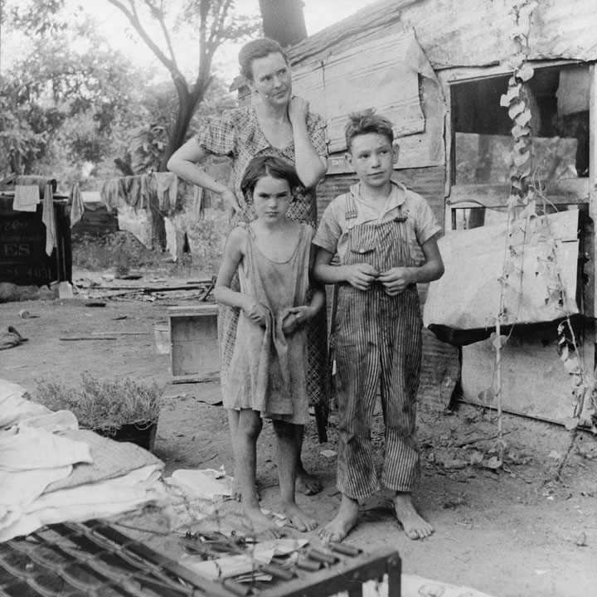
Economic Causes
The Great Depression
The economic catastrophe that hit Europe and the United States during the 1930s decimated their economies.
In Europe, the failure of governments to meet the growing needs of their people, now destitute opened the door for an authoritarian government with promises of hope.

Slide 5
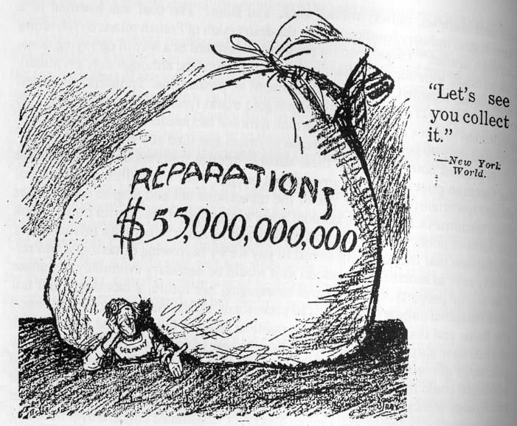
Economic Causes
War Debt
The Treaty of Versailles required that Germany pay reparations for the damage caused during the Great War.
These payments, on top of their own recovery from the war, made the situation worse in Germany.

Slide 6
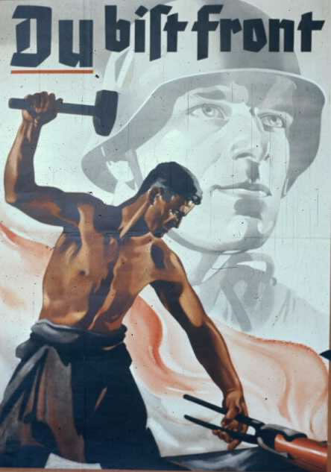
Social Causes
Nationalism
Germany
  The “War Guilt” Clause in the Treaty of Versailles destroyed the pride of the German people.
  The Nazi Party promised to bring back the glory of the German people – The Third Reich.
  “Living Space” for the growing German population.

Slide 7
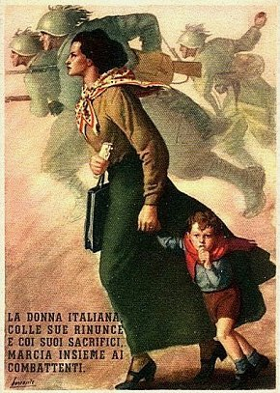
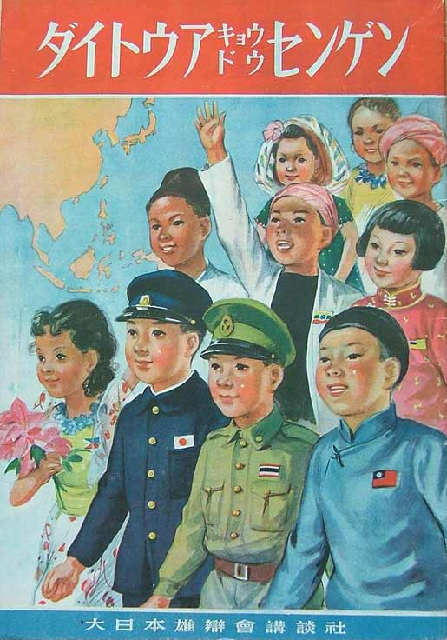
Social Causes
Nationalism
Italy
  Bring back the glory of Ancient Rome
Japan
  Needed raw materials for growing Japanese population
  Needed “living space” for the growing Japanese population.

Slide 8
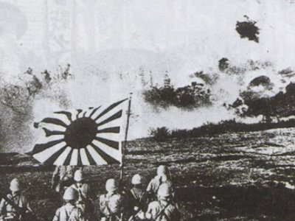
Political Causes
Japanese Aggression
World War II in the Pacific officially began with the Japanese expansion in East Asia in 1931 with the invasion of Manchuria. (Although WWII did not officially begin until 1939.)
It continued in 1937 with a brutal attack on China.

Slide 9
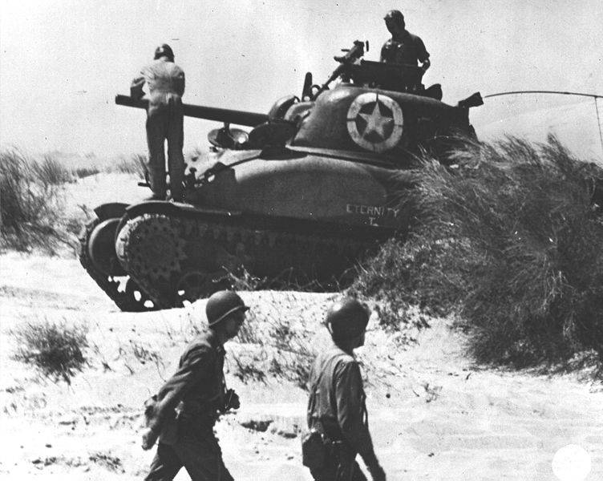
Political Causes
Italian Aggression
While Italy controlled some areas in Africa, it had failed several times to colonize Ethiopia.
In October 1935, Mussolini successfully takes control of Ethiopia.
  Over 400,000 Italian troops fought in Ethiopia.
  The poorly armed Ethiopians were no match for Italy’s modern tanks and airplanes.
  The Italians even used mustard gas!

Slide 10
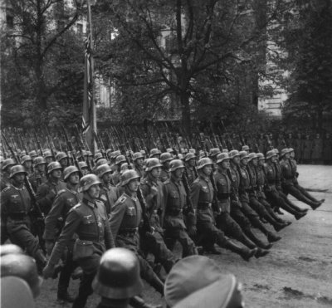
Political Causes
German Aggression
In 1933, in defiance of the Treaty of Versailles, as the new chancellor, Hitler ordered Germany to begin rebuilding its military.
Rearming thus began in 1933 and escalated in 1936 as part of Hitler’s plan to begin a war of aggression in which he would restore Germany to its mythical imperial glory.
In 1936, Germany moved into the Rhineland, which, according to the Treaty of Versailles, was supposed to be demilitarized.
In 1938, the Germany army invaded and annexed Austria – the Anschluss (“the union).
In 1939, Hitler annexes the Sudetenland – northwest portion of Czechoslovakia that was ethnically German.

Slide 11
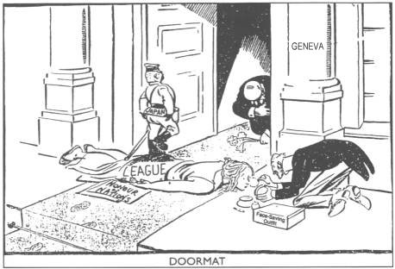
Political Causes
Weakness of the League of Nations
Manchuria
  China appealed to the League of Nations for assistance.
  The League condemned Japanese aggression and asked them to withdraw from China.
  Japan ignored and resigned from the League to continue its advance into China.
  The League took no further action.

Slide 12
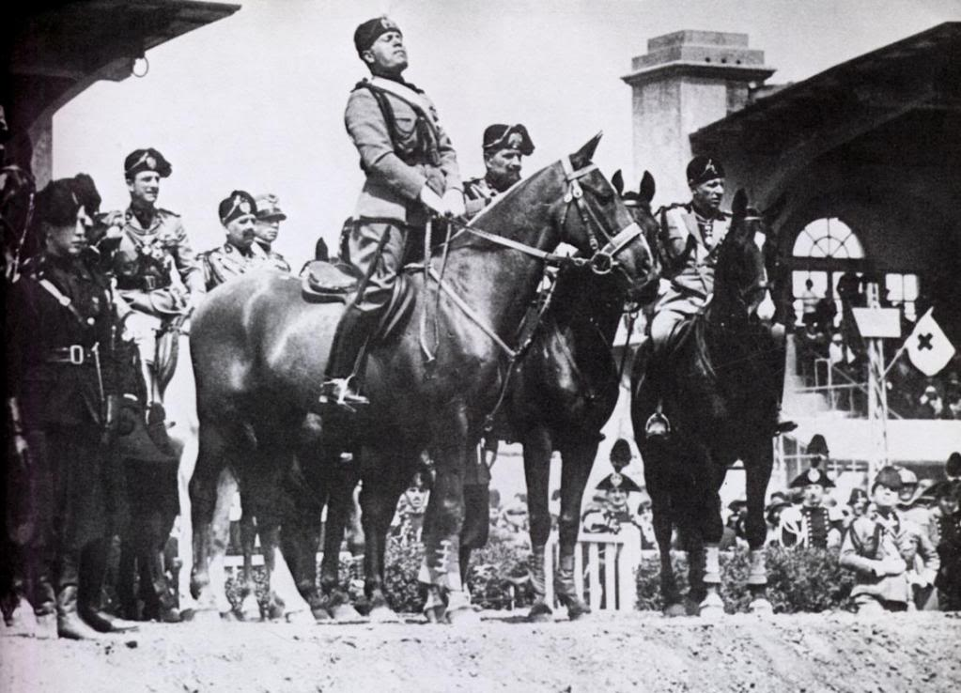
Political Causes
Weakness of the League of Nations
Ethiopia
  Ethiopia appealed to the League for assistance.
  The League condemned Italian aggression and imposed sanctions – but not very harsh sanctions because, it was thought, it would provoke war.

Slide 13
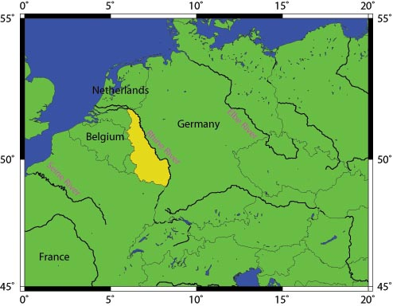
Political Causes
Weakness of the League of Nations
The Rhineland
  France protested to the League on German remilitarization of the Rhineland.
  The League took no action.

Slide 14
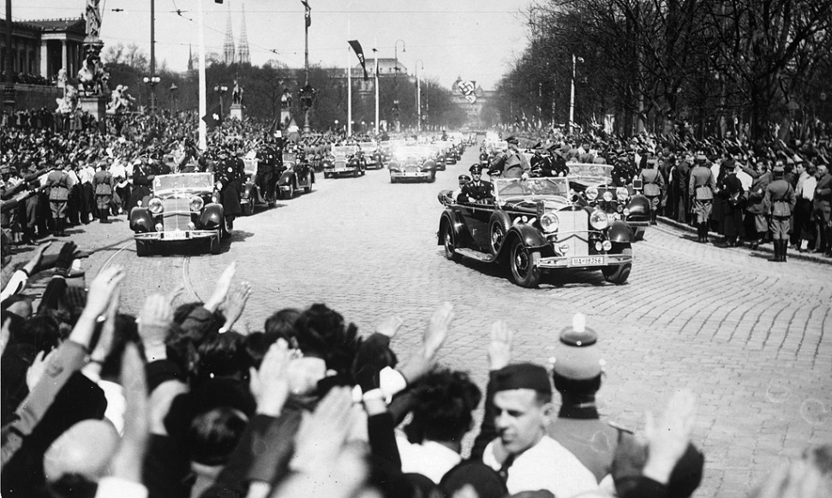
Political Causes
Weakness of the League of Nations
The Anschluss
  The Treaty of Versailles forbade the union between Austria and Germany.
  When Hitler annexed Austria, complaints were voiced in the League but nothing was backed by force.

Slide 15
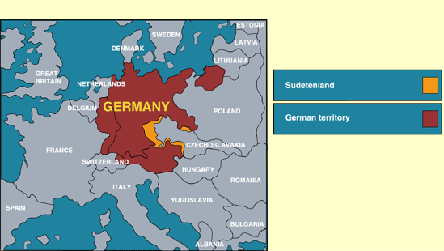
Political Causes
Weakness of the League of Nations
Sudetenland
  British Prime Minister Neville Chamberlain directly dealt with Hitler concerning his annexation of the Sudetenland.
  Munich Agreement – Germany would complete its occupation of the Sudetenland for the sake of “saving the peace.” If Czechoslovakia wanted to fight the occupation, they would be alone.

Slide 16
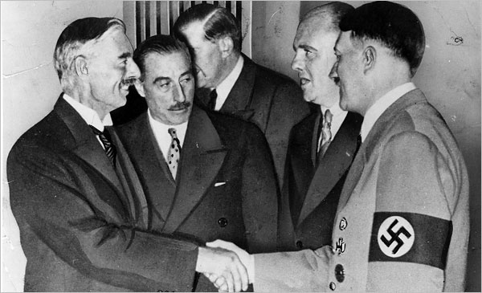
Political Causes
Appeasement
A diplomatic policy of making political or material concessions to an enemy power in order to avoid conflict.
The member nations of the League, particularly England under Prime Minister Chamberlain, took on a policy of appeasement in order to prevent another world war.
Hitler viewed this appeasement as a lack of power on the League of Nations and essentially an open invitation on taking whatever he wanted. He saw that he would not get much push-back on whatever he did.

Slide 17
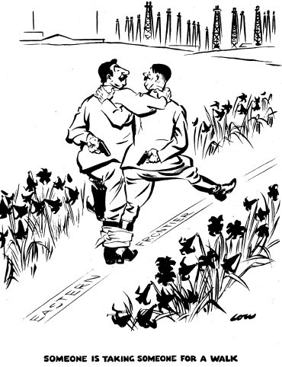
Political Causes
Appeasement
A diplomatic policy of making political or material concessions to an enemy power in order to avoid conflict.
The member nations of the League, particularly England under Prime Minister Chamberlain, took on a policy of appeasement in order to prevent another world war.
Hitler viewed this appeasement as a lack of power on the League of Nations and essentially an open invitation on taking whatever he wanted. He saw that he would not get much push-back on whatever he did.
Nazi-Soviet Pact
  Non-aggression pact with Stalin, 1939
  Stalin agreed not to interfere with Hitler’s plan as long as Hitler agreed to leave the USSR alone.
  Significance: Allowed Hitler to focus on his plans to dominate Western Europe.

Slide 18
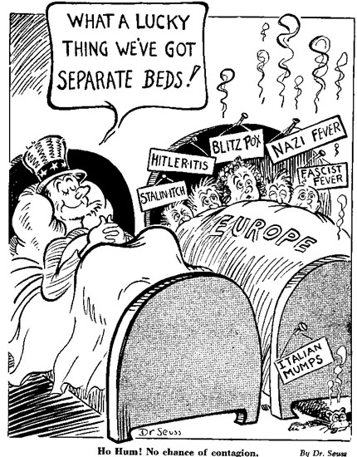
Political Causes
Isolationism and Pacifism
The United States
  Chose to remain isolationist
  They were still recovering from the Great Depression and could not afford to be concerned with the event sin Europe.
  While they did communicate with the aggressive powers to stop what they were doing, they took no action to enforce this policy.

Slide 19
Political Causes
Isolationism and Pacifism
The rest of Europe
  They were still recovering from the Great Depression and could not afford to be entrenched in yet another World War.
  While they did communicate (via the League) to the aggressive powers to stop what they were doing, they took no action to enforce this policy.
  Any further action, they feared, would begin another world war.
  They chose to pacify these aggressive leaders than risk World War II.

Slide 20
Conclusion
Many economic and political causes led to World War II.
Economic and political causes of WWII include:
  Aggression by the totalitarian powers of Germany, Italy and Japan.
  Nationalism
  Failures of the Treaty of Versailles
  Weakness of the League of Nations
  Appeasement
  Tendencies toward isolationism and pacifism in Europe and the United States.

