Slide 1
Do Now:
Grab today’s Agenda (10:3). Watch the cartoon. What are your thoughts?
The Thrifty Pig

Slide 2
Objective:
The War (1939-1945)
WHII.12a
TSWDK of the worldwide impact of World War II by explaining economic and political causes, describing major events, and identifying leaders of the war.

Slide 3
The War
The War Begins
The War Continues

Slide 4
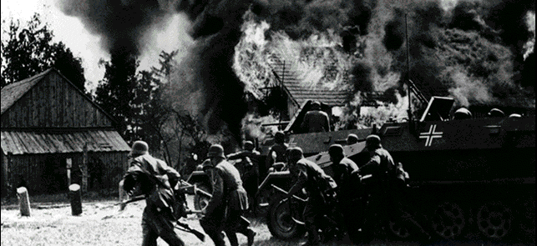
The War Begins
Germany Invades
September 1, 1939
Hitler invades Poland
Blitzkrieg
    “Lightning War”
    A German war tactic based on speed and surprise.
    Required a military forced based around light tank units supported by planes and infantry (foot soldiers).
    Tactic was meant to end the static war of neither side moving far, as in trench warfare.
British Prime Minister Neville Chamberlain gave Hitler an ultimatum: withdraw German troops from Poland or war will be declared. Of Course Hitler ignored the ultimatum.
September 3, 1939 – Britain and France declared war on Germany.
By September 27, 1939, Poland surrendered to Germany.
Significance: This is the start of World War II..

Slide 5
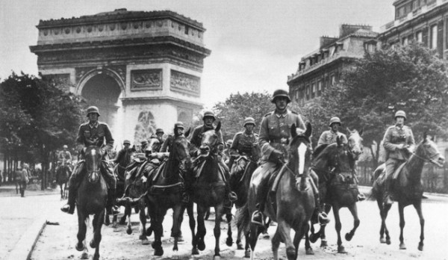
The War Begins
Fall of France
Because of the Nazi-Soviet Pact, Hitler was free to focus on the west.
May 1940, Germany invades France.
The Luftwaffe (German Air Force) bombs central cities throughout France, including Paris.
Mussolini declares war on France in June and attacks from the South.
By the end of the month, Paris fell and France was occupied by the Nazis.
June 22, 1940, France signs armistice with Germany.
Significance: France and Britain were the only two countries with armies capable of defeating Hitler. Without France, defeating the Nazis fell upon the British, who were having a hard time maintaining a war-time army because of the First World War and the Great Depression.

Slide 6
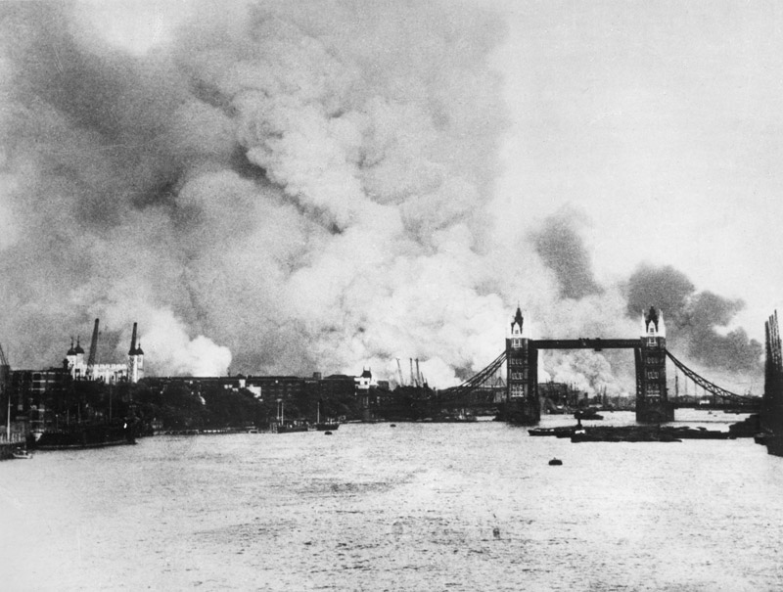
The War Continues
Battle of Britain
Now that France was out of the way, it was time to get rid of Britain.
The country had lost confidence in Prime Minister Chamberlain before France fell to the Germans. So in May 1940, Winston Churchill became Britain’s new prime minister.
July 1940, first German bombers attack over English Channel, hoping that Britain would make peace with Germany. Of course, Britain refuses.
So Hitler orders the Luftwaffe to begin air attacks on England.
September 7, 1940 – beginning of “London Blitz.” Continued into May 1941.
At the same time, British bombers were also conducting nightly air raids on central Berlin.
Britain fought off the German air raids for months; Hitler lost – gave up his focus on west and turned it to the east.
Significance: First major air battle; marked the first defeat of Hitler’s military.

Slide 7
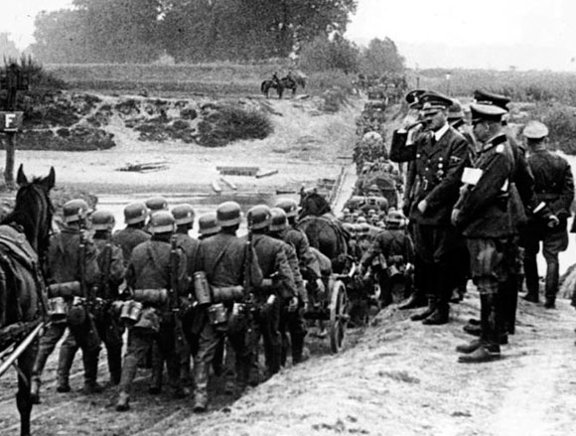
The War Continues
Invasion of Soviet Union
In June 1941, Hitler breaks the Nazi-Soviet Pact by invading the Soviet Union.

Slide 8
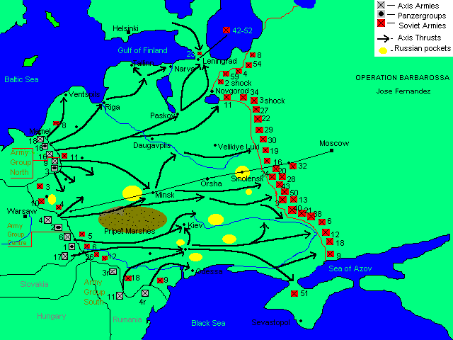
The War Continues
Invasion of Soviet Union
In June 1941, Hitler breaks the Nazi-Soviet Pact by invading the Soviet Union.
The problem was that the Eastern Front was about 1,000 miles long; spread Hitler’s army thin.

Slide 9
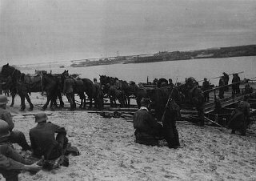
The War Continues
Invasion of Soviet Union
In June 1941, Hitler breaks the Nazi-Soviet Pact by invading the Soviet Union.
The problem was that the Eastern Front was about 1,000 miles long; spread Hitler’s army thin.
In July, Stalin orders scorched-earth policy - burn the farms and move east.
Hitler gets close to Moscow… and then winter hits. One of the harshest winters since Napoleon! Many Germans died. Hitler had no choice but to retreat, or risk losing the lives of many more German soldiers.
Significance: Largest German military operation of WWII.

Slide 10
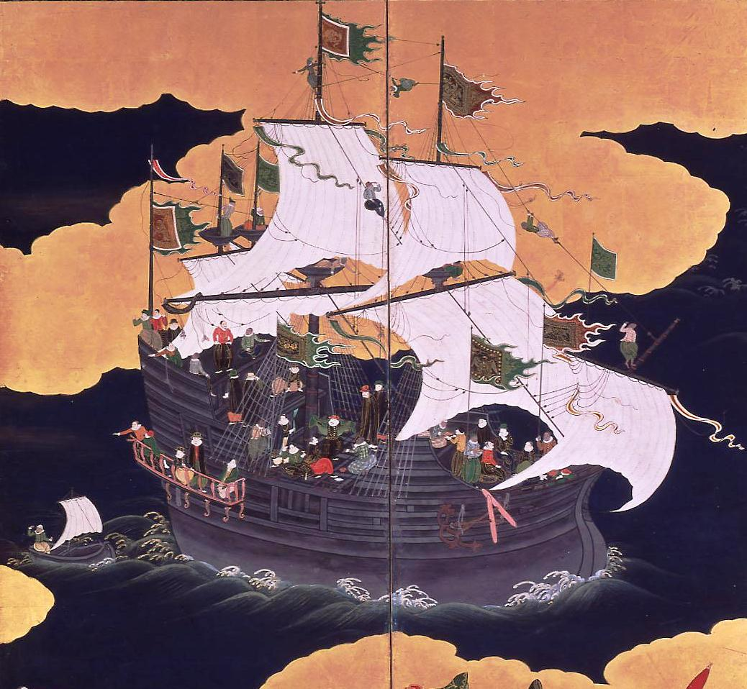
The War Continues
Pearl Harbor
In an attempt to get Japan out of China, the United States halted all trade with Japan.

Slide 11
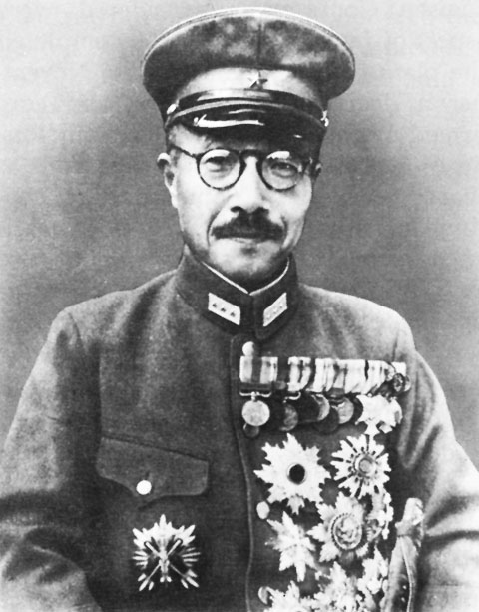
The War Continues
Pearl Harbor
In an attempt to get Japan out of China, the United States halted all trade with Japan.
General Tojo

Slide 12
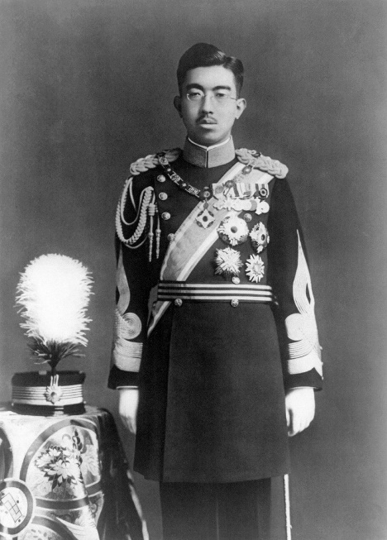
The War Continues
Pearl Harbor
In an attempt to get Japan out of China, the United States halted all trade with Japan.
General Tojo, with the approval of Emperor Hirohito, plans an attack on the American Naval Base in Pearl Harbor, Hawaii.

Slide 13
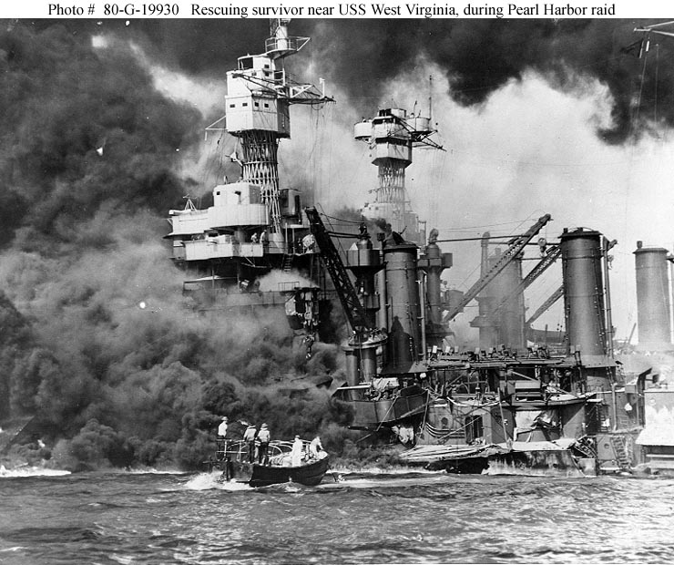
The War Continues
Pearl Harbor
In an attempt to get Japan out of China, the United States halted all trade with Japan.
General Tojo, with the approval of Emperor Hirohito, plans an attack on the American Naval Base in Pearl Harbor, Hawaii.
December 7, 1941

Slide 14
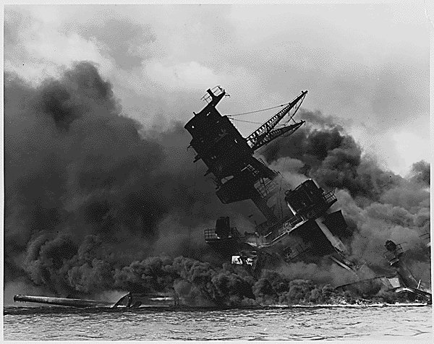
The War Continues
Pearl Harbor
In an attempt to get Japan out of China, the United States halted all trade with Japan.
General Tojo, with the approval of Emperor Hirohito, plans an attack on the American Naval Base in Pearl Harbor, Hawaii.
December 7, 1941 – Japan attacks Pearl Harbor

Slide 15
Japanese Attack on Pearl Harbor

Slide 16
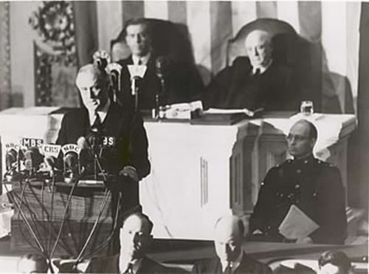
The War Continues
Pearl Harbor
In an attempt to get Japan out of China, the United States halted all trade with Japan.
General Tojo, with the approval of Emperor Hirohito, plans an attack on the American Naval Base in Pearl Harbor, Hawaii.
December 7, 1941 – Japan attacks Pearl Harbor
U.S. President Franklin D. Roosevelt – “A date that will live in infamy!”

Slide 17
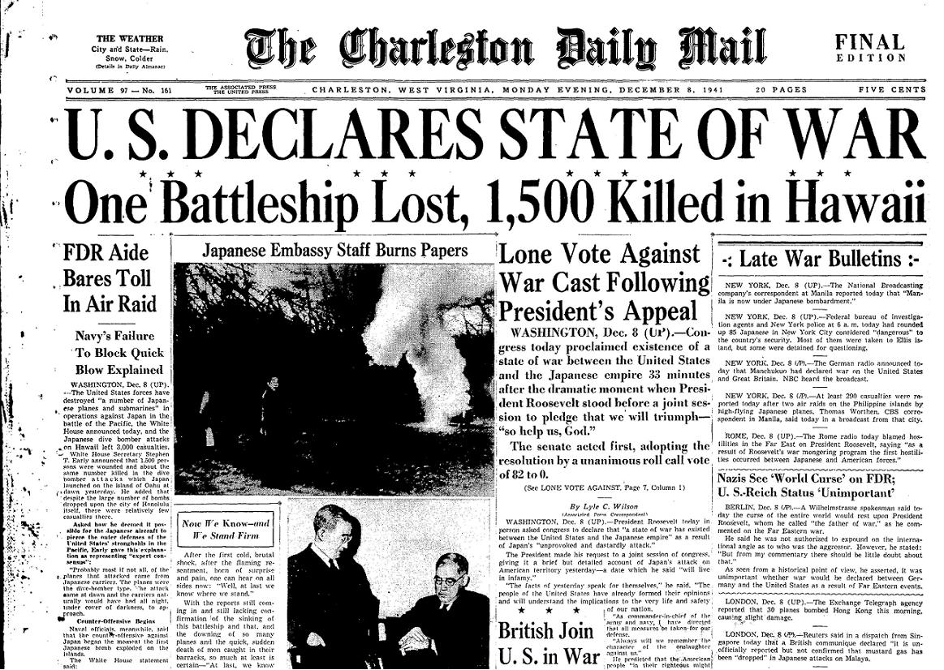
The War Continues
Pearl Harbor
In an attempt to get Japan out of China, the United States halted all trade with Japan.
General Tojo, with the approval of Emperor Hirohito, plans an attack on the American Naval Base in Pearl Harbor, Hawaii.
December 7, 1941 – Japan attacks Pearl Harbor
U.S. President Franklin D. Roosevelt – “A date that will live in infamy!”
By December 8, the U.S. declared war on Japan.

Slide 18
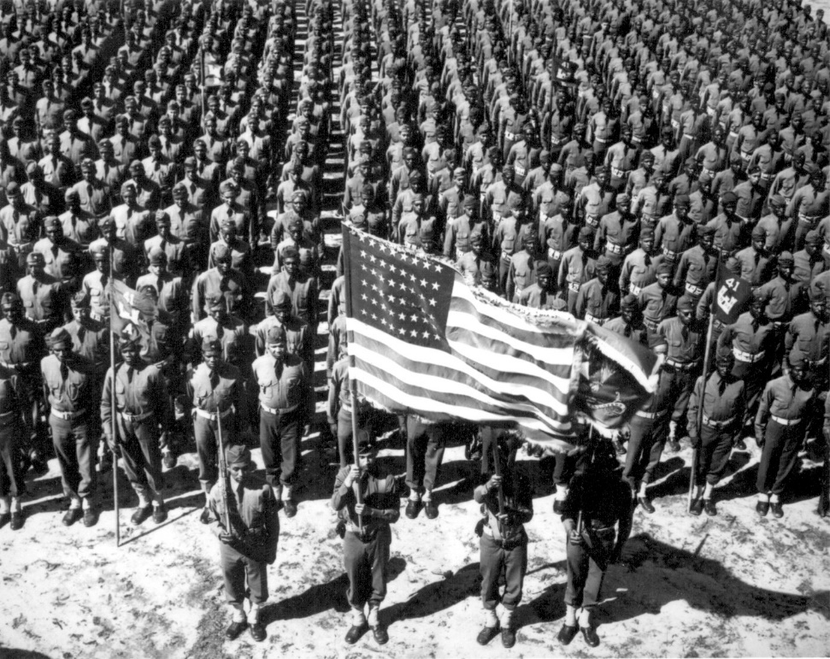
The War Continues
Pearl Harbor
In an attempt to get Japan out of China, the United States halted all trade with Japan.
General Tojo, with the approval of Emperor Hirohito, plans an attack on the American Naval Base in Pearl Harbor, Hawaii.
December 7, 1941 – Japan attacks Pearl Harbor
U.S. President Franklin D. Roosevelt – “A date that will live in infamy!”
By December 8, the U.S. declared war on Japan.
Significance: Got the United States to enter the war.

Slide 19
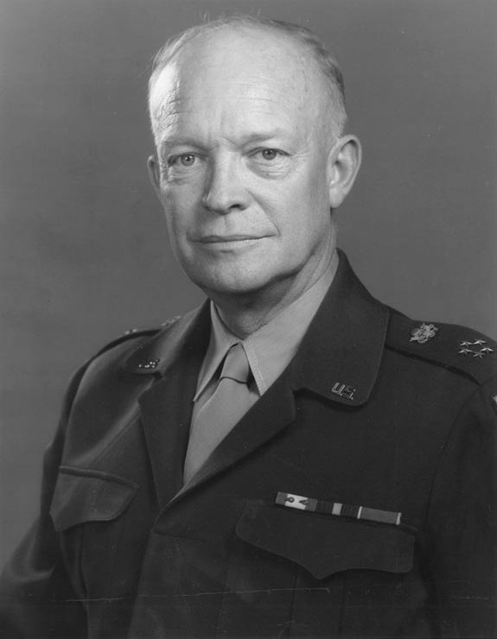
The War Continues
Pearl Harbor
In an attempt to get Japan out of China, the United States halted all trade with Japan.
General Tojo, with the approval of Emperor Hirohito, plans an attack on the American Naval Base in Pearl Harbor, Hawaii.
December 7, 1941 – Japan attacks Pearl Harbor
U.S. President Franklin D. Roosevelt – “A date that will live in infamy!”
By December 8, the U.S. declared war on Japan.
Significance: Got the United States to enter the war.
    Dwight D. Eisenhower was the Allied commander in Europe.

Slide 20
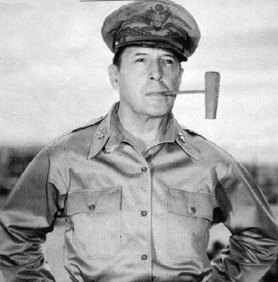
The War Continues
Pearl Harbor
In an attempt to get Japan out of China, the United States halted all trade with Japan.
General Tojo, with the approval of Emperor Hirohito, plans an attack on the American Naval Base in Pearl Harbor, Hawaii.
December 7, 1941 – Japan attacks Pearl Harbor
U.S. President Franklin D. Roosevelt – “A date that will live in infamy!”
By December 8, the U.S. declared war on Japan.
Significance: Got the United States to enter the war.
    Dwight D. Eisenhower was the Allied commander in Europe.
    Douglas MacArthur was a U.S. general and in command of the Allied forces in the Pacific.

Slide 21
Conclusion
World War II began with the Nazi invasion of Poland in 1939.
Hitler’s attempt to conquer Western Europe began with the fall of France but stopped short at their failed attempt on Britain.
Hitler’s attempt to conquer Eastern Europe stopped short beyond Poland as a brutal Russian winter stopped the Nazis from advancing to victory.
The Japanese invasion of Pearl Harbor brought the United States into another world war.
Major theaters of war included Africa, Europe, Asia, and the Pacific Islands.

