Slide 1
Do Now:
Grab today’s Agenda (10:5)
What is the message of the following poem by Martin Niemoller?
First they came for the communists, and I didn’t speak out because I wasn’t a communist.
Then they came for the trade unionists, and I didn’t speak out because I wasn’t a trade unionist.
Then they came for the Jews, and I didn’t speak out because I wasn’t a Jew.
Then they came for me and there was no one left to speak out for me.

Slide 2
Objective: Genocide
WHII.12b
TSWDK of the worldwide impact of WWII by examining the Holocaust and other examples of genocide in the 20th century.

Slide 3
Genocide
Genocide
20th Century Genocides

Slide 4
Genocide
Definition
The systematic and purposeful destruction of a racial, political, religious, or cultural group.

Slide 5
Genocide
Steps to Genocide
Classification
All cultures have categories to distinguish people into “us and them” by ethnicity, race, religion, or nationality.
The underlying principle of nationalism is a pride in “us” as opposed to “them.” This is not to say that nationalism is bad. However, extreme nationalism, such as in Nazi Germany, was the first step.

Slide 6
Genocide
Steps to Genocide
Symbolization
We give names or other symbols to the classifications.
We name people “Jews” or “Gypsies”
We distinguish them by colors or dress
When combined with hatred, symbols may be forced upon unwilling members of pariah groups.
Nazi Germany forced Jews to wear a yellow star.
To combat symbolization, hate symbols can be legally forbidden (swastikas) as can hate speech. Group markings like gang clothing or tribal scarring can be outlawed as well. The problem is that legal limitations will fail if unsupported by popular cultural enforcement. However, if widely supported, denial of symbolization can be powerful.
Bulgaria’s government refused to supply enough yellow badges and at least 80% of Jews did not wear them, depriving the yellow star of its significance as a Nazi symbol for Jews.
While classification and symbolization are universally human and do not necessarily result in genocide, they have potential to lead to the next step.

Slide 7
Genocide
Steps to Genocide
Discrimination
A dominant group uses law, custom, and political power to deny the rights of other groups.
The powerless group may not be accorded full civil rights or even citizenship.
The Nuremberg Laws of 1935

Slide 8
Genocide
Steps to Genocide
Dehumanization
One group denies the humanity of the other group. Members of it are equated with animals, vermin, insects or diseases.
Dehumanization overcomes the normal revulsion against murder. At this stage, hate propaganda in print and on hate radios is used to vilify the victim group.
Hitler’s “untermenschen” dehumanized the Jews to a level less than human.
By tattooing identification numbers onto the arms of the Jews in the camps, the Jews were no longer people with names… they were a number.

Slide 9
Genocide
Steps to Genocide
Organization
Genocide is always organized, usually by the state, often using militias (private armies) to provide deniability of state responsibility.
Sometimes organization is informal or decentralized (like a terrorist group). Special army units or militias are often trained and armed.
The Nazi Party established the SA and the SS to violently deal with the Jews.

Slide 10
Genocide
Steps to Genocide
Polarization
Extremists drive the groups apart. Hate groups broadcast polarizing propaganda.
Laws may forbid intermarriage or social interaction.
The Nazi Party had a very heavy propaganda campaign against the Jews. Laws concerning intermarriage and social interactions between Jews and non-Jews in Nazi Germany were part of the Nuremberg Laws.

Slide 11
Genocide
Steps to Genocide
Preparation
National or perpetrator group leaders plan the “Final Solution” to the targeted group “question.”
They often use euphemisms to cloak their intentions, such as referring to their goals as “ethnic cleansing” or “purification.”
They build armies, buy weapons, and train their troops and militias.
They indoctrinate the populace with fear of the victim group. Leaders often claim that “if we don’t kill them, they will kill us.”
The Nazis, among many other things, organized the Wannsee Conference.

Slide 12
Genocide
Steps to Genocide
Persecution
Victims are identified and separated out because of their ethnic or religious identity.
Death lists are drawn up.
In state sponsored genocide, members of victim groups may be forced to wear identifying symbols.
Their property is often taken. Sometimes they are even segregated into ghettos or deported to concentration camps.
The Jews in Nazi Germany (and Poland) were rounded up and placed into ghettos (segregated portions of the city – usually impoverished – with strict rules concerning movement and curfew) and concentration camps.
They were given identifying symbols like the yellow star and numbers were tattooed unto their arms.
Jewish property was taken. Today, claims are still being made for the return of these items.

Slide 13
Genocide
Steps to Genocide
Extermination
Mass killings. It is “extermination” to the killers because they do not believe their victims to be fully human.
Death camps and mass graves.

Slide 14
Genocide
Steps to Genocide
Denial
This is the final stage that lasts throughout and always follows a genocide.
The perpetrators of genocide dig up the mass graves, burn the bodies, try to cover up the evidence and intimidate the witnesses. They deny that they committed any crimes, and often blame what happened on the victims.
Towards the end of the war, the SS forced prisoners to reopen mass graves to cremate the bodies.
They block investigations of the crimes, and continue to govern until driven from power by force, when they flee into exile.
Late in the war, after word of the Holocaust had reached Britain and the United States (1944), the Nazi leadership sought to counter Allied condemnation of Nazi policies toward Jews with a coordinated campaign of disinformation.
In June 1944, the Nazis permitted an International Red Cross commission visit to a ghetto in what is today the Czech Republic. They hoped to mask Nazi killing operations in the occupied eastern territories by showcasing good conditions for Jews in this ghetto. And the Nazis put on a convincing show.
The visit had served its purpose: to confuse international public opinion about the true nature of Nazi policies towards Jews.

Slide 15
Genocide
Steps to Genocide
Denial
Most Germans did not know the Holocaust was happening while it was happening. Most orders were given verbally and only on a need-to-know basis.
This was partly done to facilitate the killing process by keeping the victims in the dark about their fate as long as possible. Widespread Jewish resistance was only possible once Jews understood that Nazi policy was to kill all of them.
However, records were kept to serve as proof for themselves that they committed this “great” act.
By the end of the war, the Germans destroyed much documentation. The documentation that survived was written in code words such as “action” to refer to a violent operation against a people, or “resettlement to the East” to refer to the forced deportation of Jewish civilians to concentration and death camps.
This gave fuel to Holocaust deniers.

Slide 16
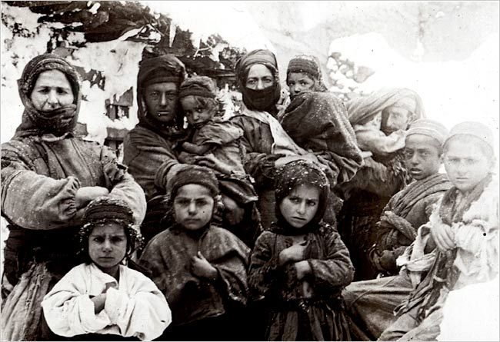
20th Century Genocide
Armenian Genocide
During and after WWI

Slide 17
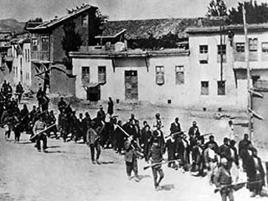
20th Century Genocide
Armenian Genocide
During and after WWI
By Ottoman government to Armenian subjects

Slide 18
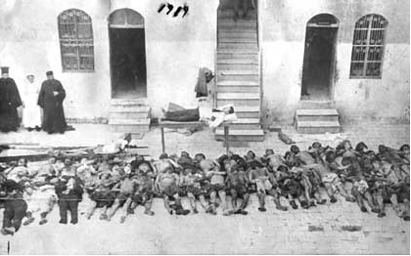
20th Century Genocide
Armenian Genocide
During and after WWI
By Ottoman government to Armenian subjects
1-1.5 million dead

Slide 19
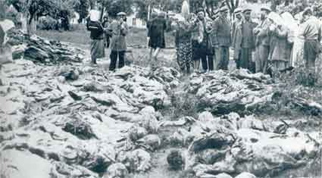
20th Century Genocide
Soviet Union under Stalin
Before, during, and after WWII

Slide 20
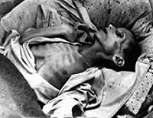
20th Century Genocide
Soviet Union under Stalin
Before, during, and after WWII
By Josef Stalin to his own people

Slide 21
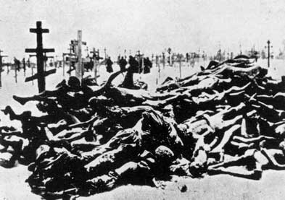
20th Century Genocide
Soviet Union under Stalin
Before, during, and after WWII
By Josef Stalin to his own people
6-20 million (numbers uncertain) dead

Slide 22
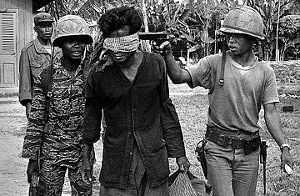
20th Century Genocide
Pol Pot in Cambodia
1975-1979

Slide 23
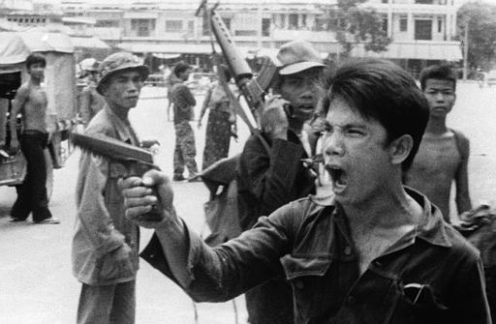
20th Century Genocide
Pol Pot in Cambodia
1975-1979
By the Khmer Rouge regime headed by Pol Pot to his own people (the educated, the wealthy, Buddhist monks, police, doctors, lawyers, teachers, and former government officials)

Slide 24
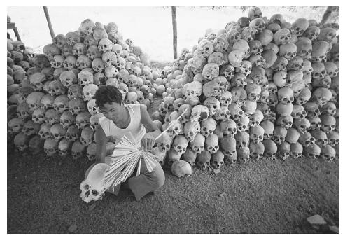
20th Century Genocide
Pol Pot in Cambodia
1975-1979
By the Khmer Rouge regime headed by Pol Pot to his own people (the educated, the wealthy, Buddhist monks, police, doctors, lawyers, teachers, and former government officials)
1.5 million dead

Slide 25
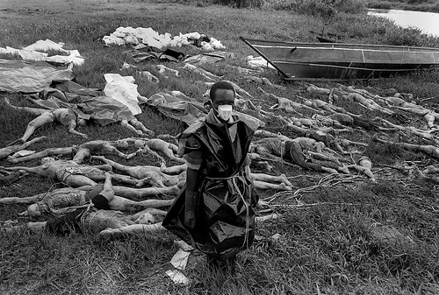
20th Century Genocide
Rwanda
1994

Slide 26
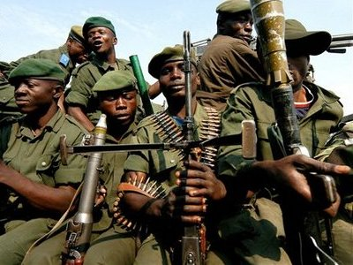
20th Century Genocide
Rwanda
1994
In Rwanda by the Hutus to the Tutsis

Slide 27
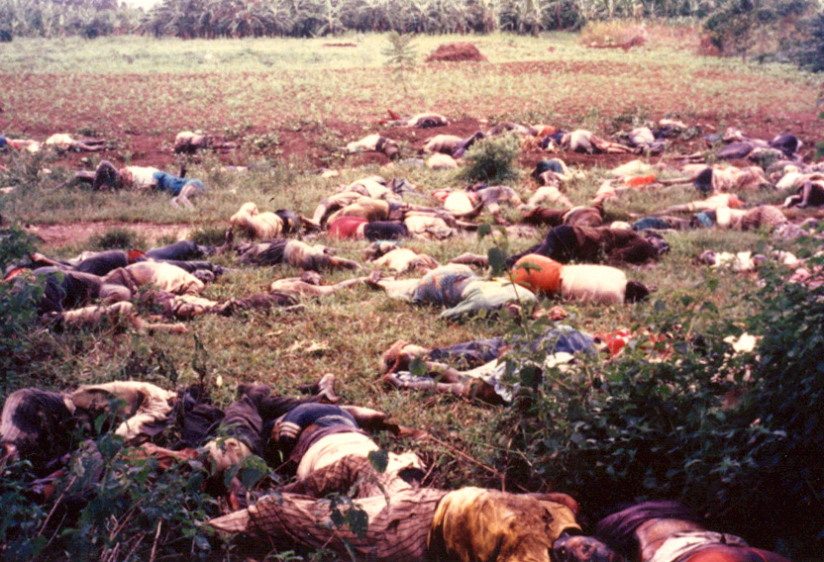
20th Century Genocide
Rwanda
1994
In Rwanda by the Hutus to the Tutsis
500,000 to 1 million dead

Slide 28
Conclusion
Genocides occur within environments created for it – it does not happen overnight.
Various instances of genocide occurred throughout the 20th century.
Despite lessons learned from the Holocaust, genocides continue to happen today.

