Slide 1
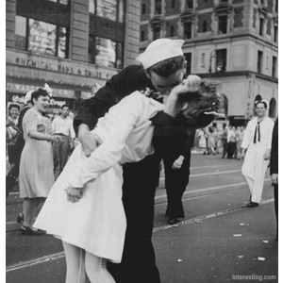
Do Now:
Grab today’s Agenda (10:6)
What effect do you think America’s entry into the war had on World War II? Explain.

Slide 2
Objective:
Ending the War
WHII.12c
TSWDK of the worldwide impact of World War II by explaining the terms of the peace, the war crimes trials, the division of Europe, and plans to rebuild Germany and Japan.

Slide 3
After the War
After America Enters the War
War Crimes Trials
The War Ends

Slide 4
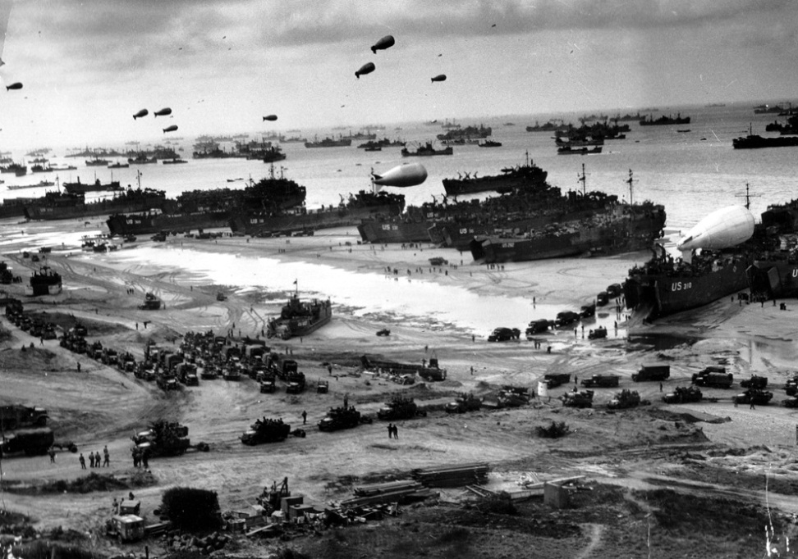
After America Enters the War
D-Day
June 6, 1944

Slide 5
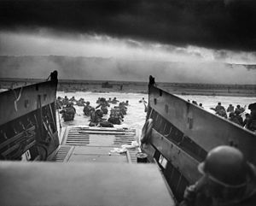
After America Enters the War
D-Day
June 6, 1944
Allied invasion of Europe

Slide 6
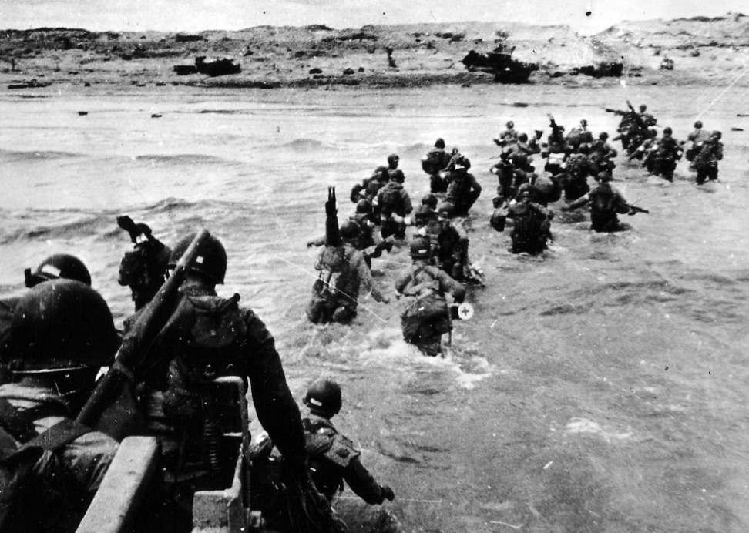
After America Enters the War
D-Day
June 6, 1944
Allied invasion of Europe
156,000 US troops landed on the beaches of Normandy, France. 12,000 died.

Slide 7
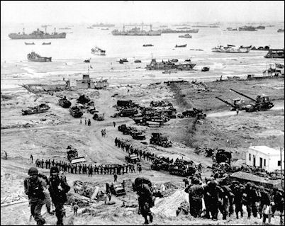
After America Enters the War
D-Day
June 6, 1944
Allied invasion of Europe
156,000 US troops landed on the beaches of Normandy, France. 12,000 died.
Significance: This was the start of the liberation of France and the beginning of the end for the Germany army.
Saving Private Ryan

Slide 8
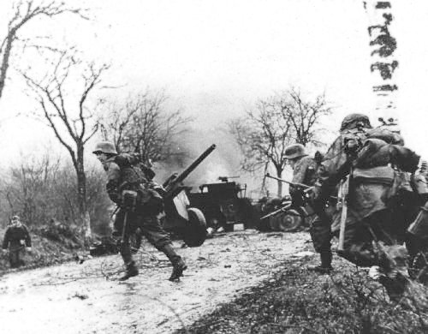
After America Enters the War
Battle of the Bulge
December 1944 – January 1945

Slide 9
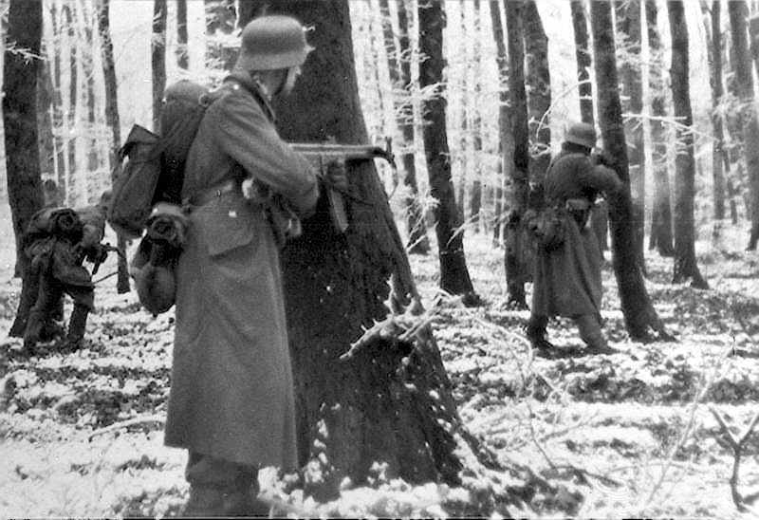
After America Enters the War
Battle of the Bulge
December 1944 – January 1945
Last major German counteroffensive of the war

Slide 10
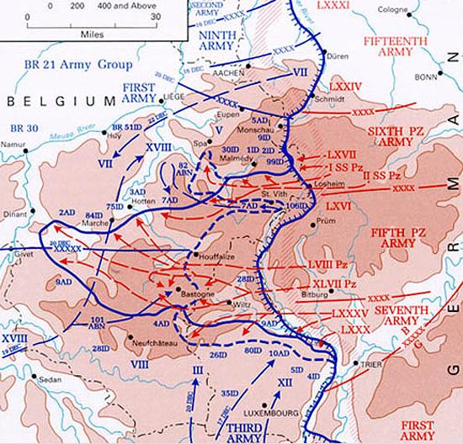
After America Enters the War
Battle of the Bulge
December 1944 – January 1945
Last major German counteroffensive of the war
At the beginning, the Germans were able to push through Belgium and surround Allied forces in France (making a distinct bulge in the front line that lent the battle its name).

Slide 11
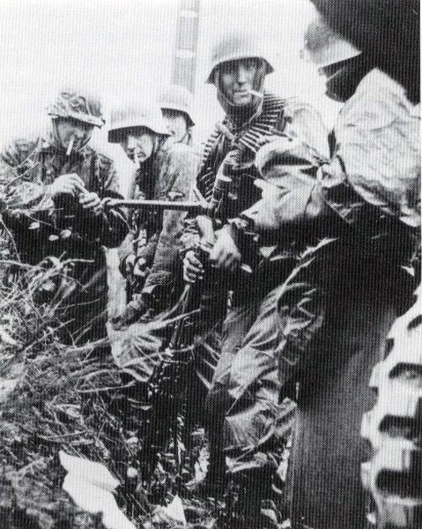
After America Enters the War
Battle of the Bulge
December 1944 – January 1945
Last major German counteroffensive of the war
At the beginning, the Germans were able to push through Belgium and surround Allied forces in France (making a distinct bulge in the front line that lent the battle its name).
But eventually the Allies regained the advantage and pushed the Germans into retreat.

Slide 12
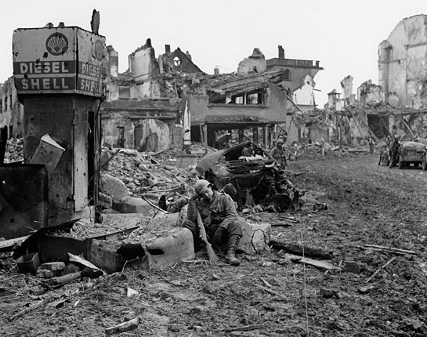
After America Enters the War
Battle of the Bulge
December 1944 – January 1945
Last major German counteroffensive of the war
At the beginning, the Germans were able to push through Belgium and surround Allied forces in France (making a distinct bulge in the front line that lent the battle its name).
But eventually the Allies regained the advantage and pushed the Germans into retreat.
Significance: This was the end of the war on the Western Front.

Slide 13
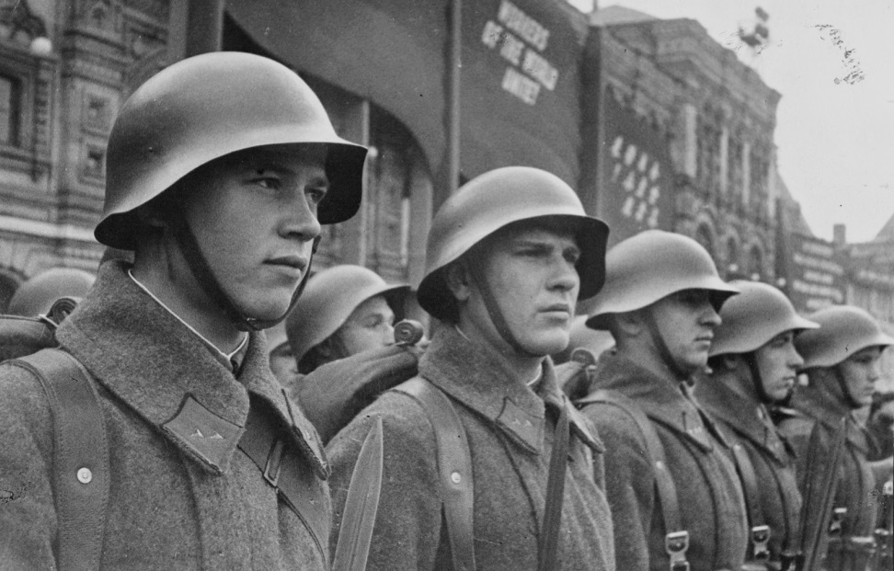
After America Enters the War
The End of Nazi Germany
In April 1945, the Soviets began their final offensive against the Third Reich.

Slide 14
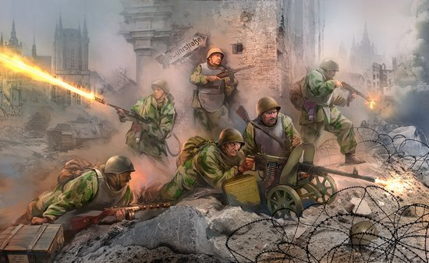
After America Enters the War
The End of Nazi Germany
In April 1945, the Soviets began their final offensive against the Third Reich.
The Soviets succeeded in pushing through to Berlin.

Slide 15
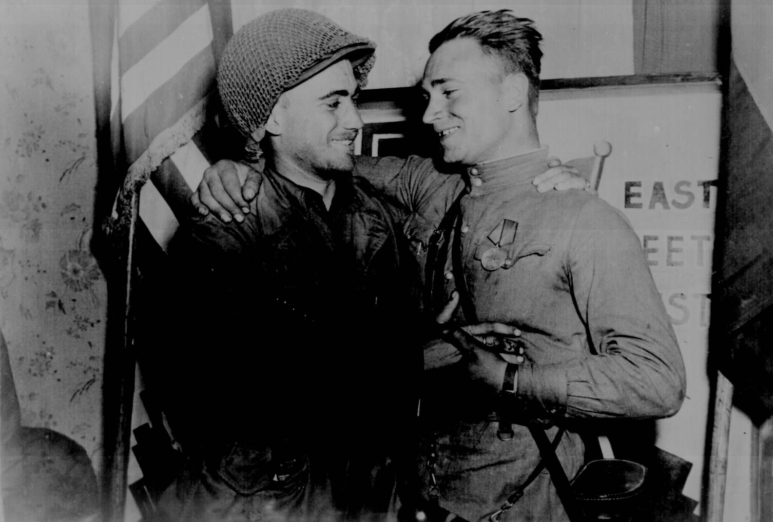
After America Enters the War
The End of Nazi Germany
In April 1945, the Soviets began their final offensive against the Third Reich.
The Soviets succeeded in pushing through to Berlin.
By April 25, the Allied armies advancing from the east and west met for the first time.

Slide 16
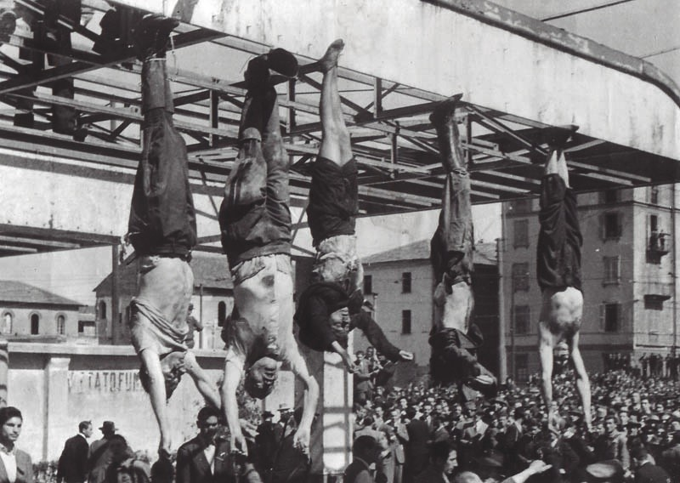
After America Enters the War
The End of Nazi Germany
In April 1945, the Soviets began their final offensive against the Third Reich.
The Soviets succeeded in pushing through to Berlin.
By April 25, the Allied armies advancing from the east and west met for the first time.
April 28, Mussolini was executed by Italian partisans and hung upside down in the center of Milan.

Slide 17
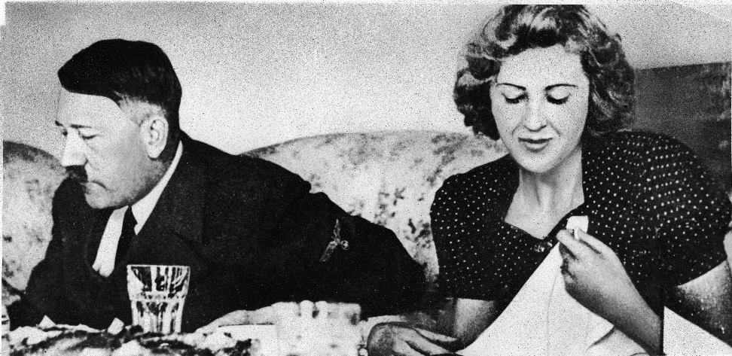
After America Enters the War
The End of Nazi Germany
In April 1945, the Soviets began their final offensive against the Third Reich.
The Soviets succeeded in pushing through to Berlin.
By April 25, the Allied armies advancing from the east and west met for the first time.
April 28, Mussolini was executed by Italian partisans and hung upside down in the center of Milan.
April 30, Hitler killed himself in his underground bunker.

Slide 18
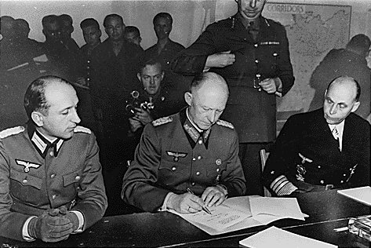
After America Enters the War
The End of Nazi Germany
In April 1945, the Soviets began their final offensive against the Third Reich.
The Soviets succeeded in pushing through to Berlin.
By April 25, the Allied armies advancing from the east and west met for the first time.
April 28, Mussolini was executed by Italian partisans and hung upside down in the center of Milan.
April 30, Hitler killed himself in his underground bunker.
May 7, 1945, Germany officially surrendered.

Slide 19
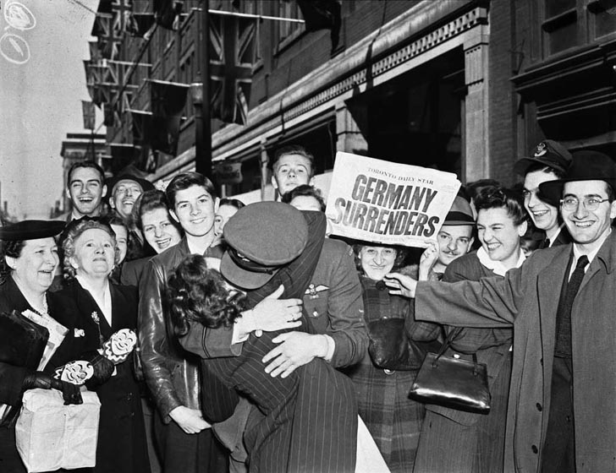
After America Enters the War
The End of Nazi Germany
In April 1945, the Soviets began their final offensive against the Third Reich.
The Soviets succeeded in pushing through to Berlin.
By April 25, the Allied armies advancing from the east and west met for the first time.
April 28, Mussolini was executed by Italian partisans and hung upside down in the center of Milan.
April 30, Hitler killed himself in his underground bunker.
May 7, 1945, Germany officially surrendered.
Significance: This was the end of the war in Europe; also known as V-E Day (Victory in Europe Day)

Slide 20
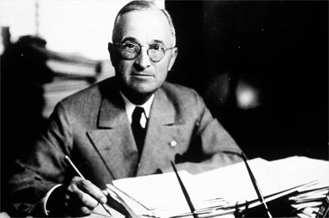
After America Enters the War
Atomic Bomb
Franklin Roosevelt died in April 1945. His vice president Harry Truman became President with a very important decision to make. The U.S. had two options regarding Japan:

Slide 21
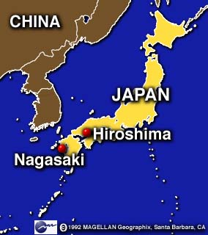
After America Enters the War
Atomic Bomb
Franklin Roosevelt died in April 1945. His vice president Harry Truman became President with a very important decision to make. The U.S. had two options regarding Japan:
  Land invasion
  Atomic Bomb

Slide 22
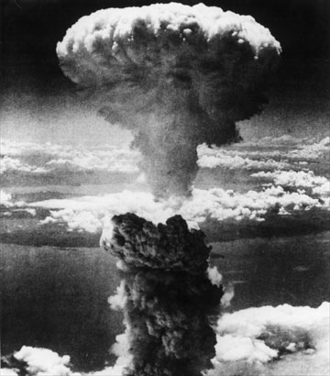
After America Enters the War
Atomic Bomb
Franklin Roosevelt died in April 1945. His vice president Harry Truman became President with a very important decision to make. The U.S. had two options regarding Japan:
  Land invasion
  Atomic Bomb
August 6, 1945 – “Little Boy” (name of bomb) was dropped on the city of Hiroshima.

Slide 23
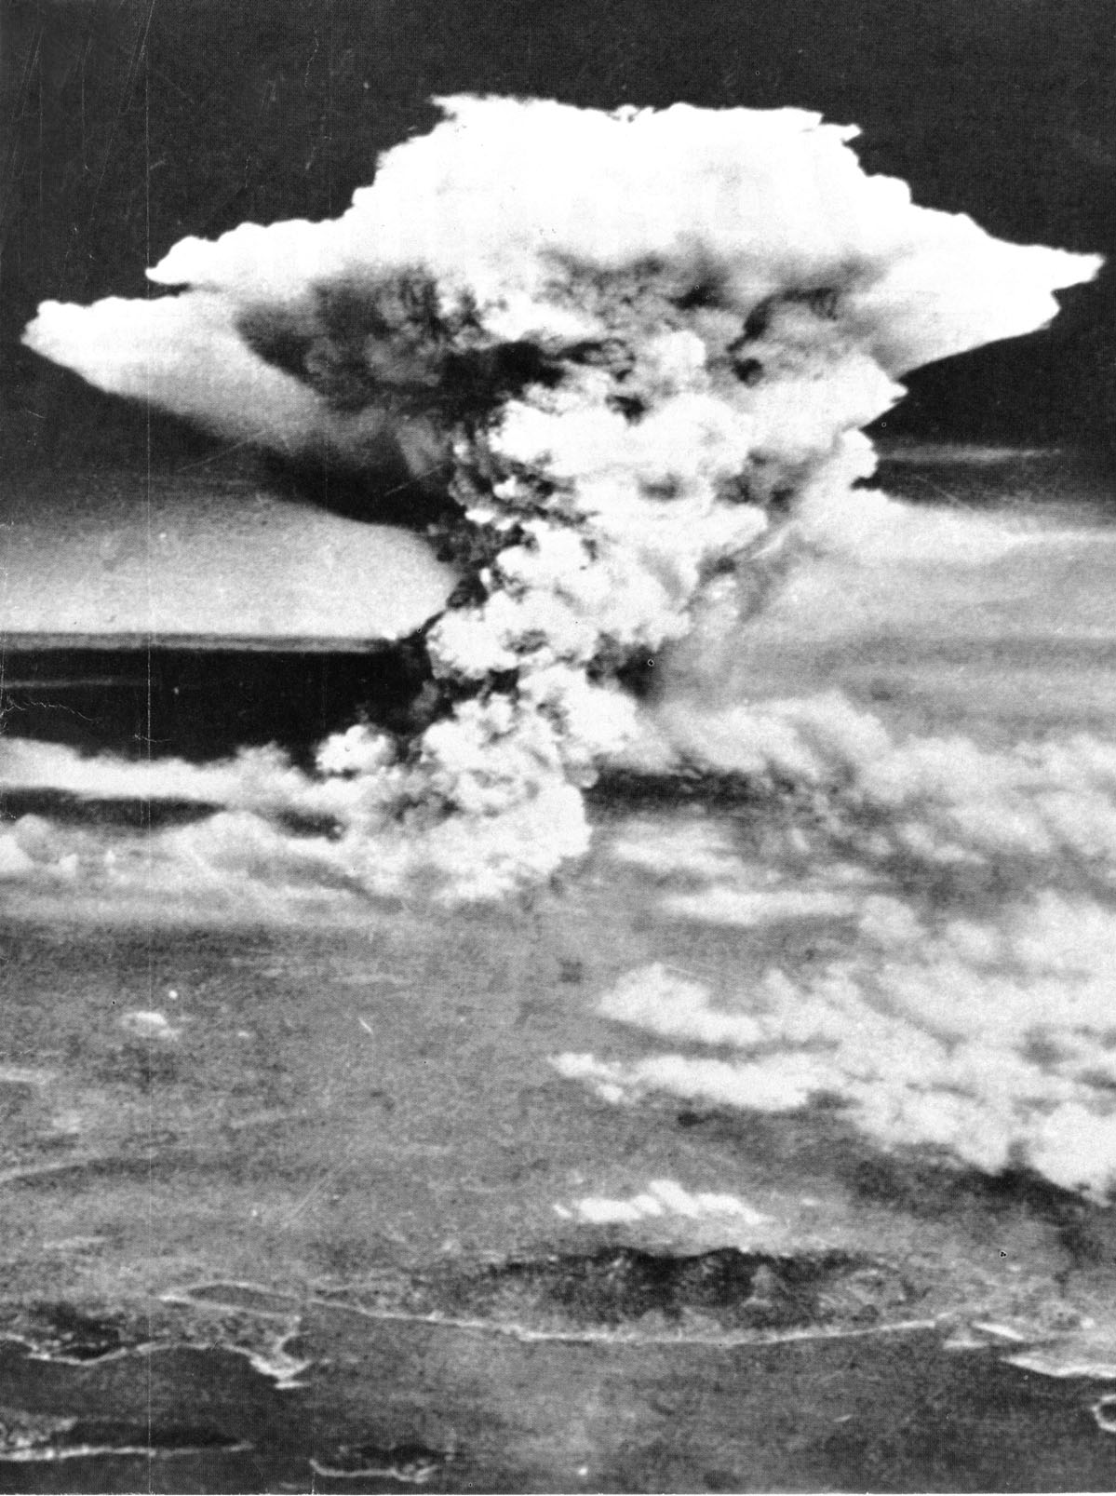
After America Enters the War
Atomic Bomb
Franklin Roosevelt died in April 1945. His vice president Harry Truman became President with a very important decision to make. The U.S. had two options regarding Japan:
  Land invasion
  Atomic Bomb
August 6, 1945 – “Little Boy” (name of bomb) was dropped on the city of Hiroshima.
August 9, 1945 – “Fat Man” (name of bomb) was dropped on the city of Nagasaki.

Slide 24
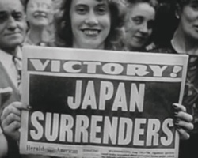
After America Enters the War
Atomic Bomb
Franklin Roosevelt died in April 1945. His vice president Harry Truman became President with a very important decision to make. The U.S. had two options regarding Japan:
  Land invasion
  Atomic Bomb
August 6, 1945 – “Little Boy” (name of bomb) was dropped on the city of Hiroshima.
August 9, 1945 – “Fat Man” (name of bomb) was dropped on the city of Nagasaki.
August 15, 1945 – Japan announces “unconditional” surrender (as demanded by the Allies)

Slide 25
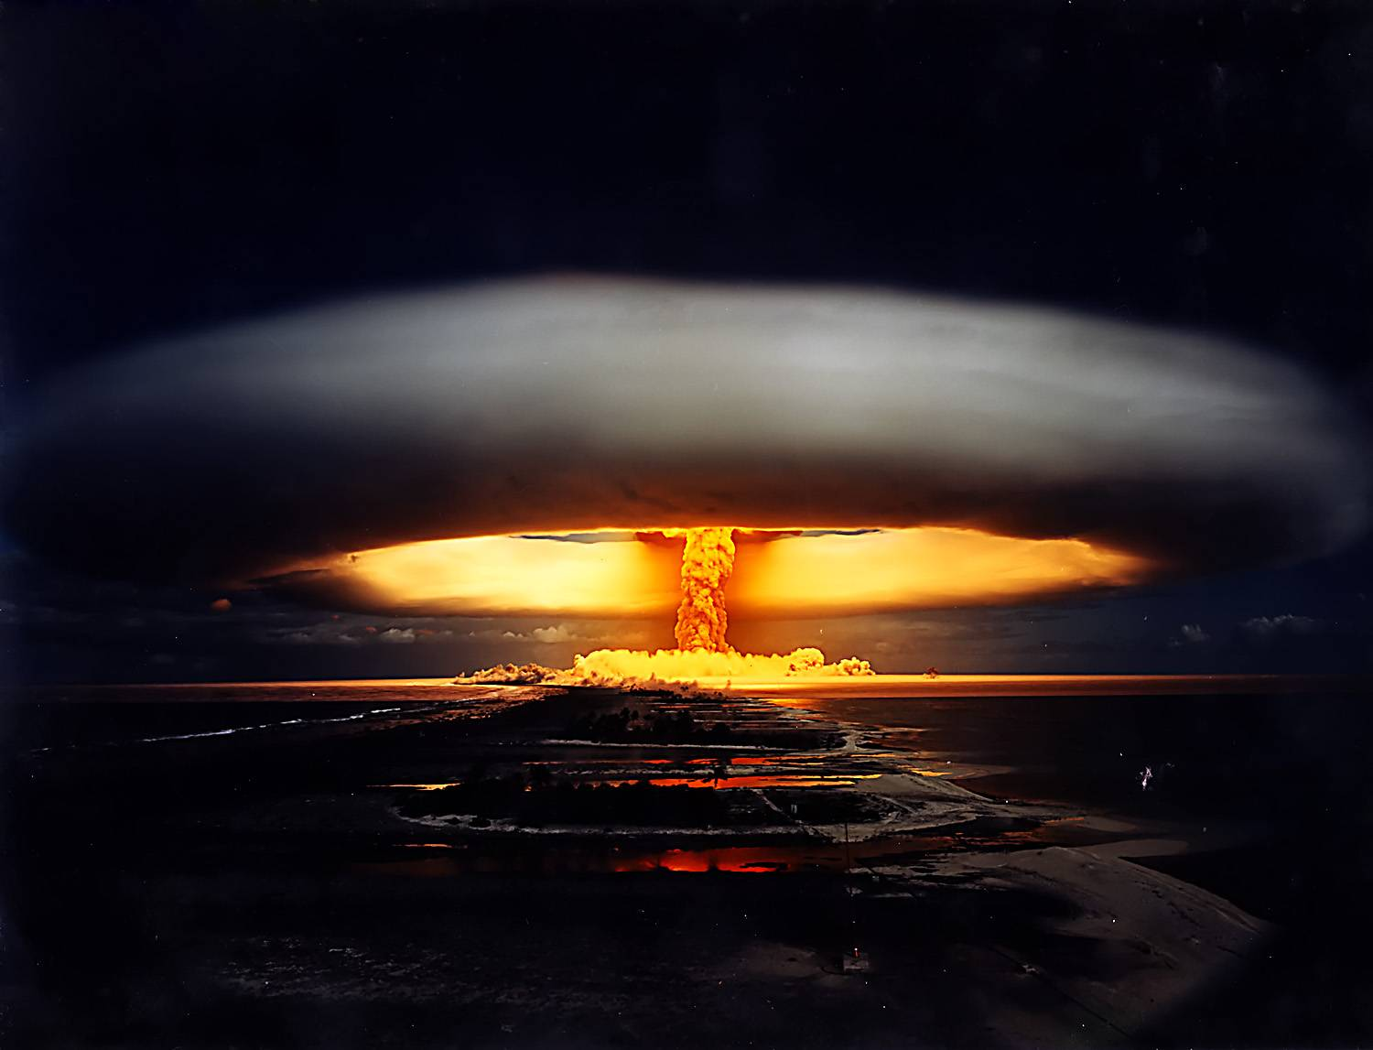
After America Enters the War
Atomic Bomb
Franklin Roosevelt died in April 1945. His vice president Harry Truman became President with a very important decision to make. The U.S. had two options regarding Japan:
  Land invasion
  Atomic Bomb
August 6, 1945 – “Little Boy” (name of bomb) was dropped on the city of Hiroshima.
August 9, 1945 – “Fat Man” (name of bomb) was dropped on the city of Nagasaki.
August 15, 1945 – Japan announces “unconditional” surrender (as demanded by the Allies)
Significance: First and only two uses of nuclear weapons against an enemy.

Slide 26
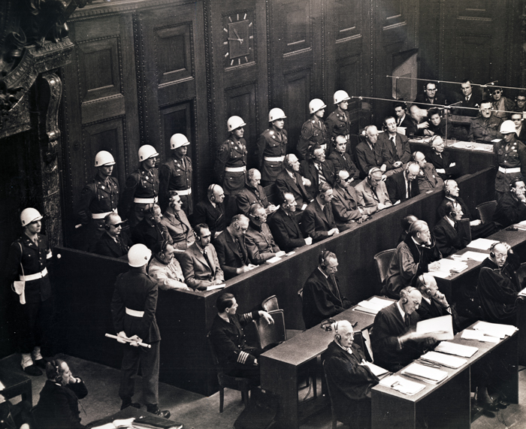
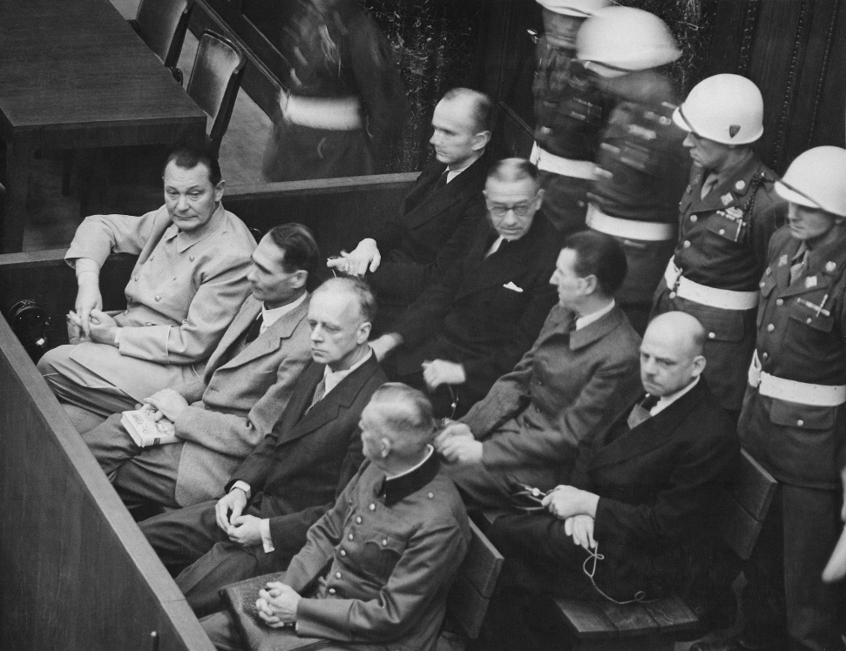
War Crimes Trials
Definitions
War Crimes
  Violations of the laws or customs of war
  Includes murder, ill-treatment of civilians in an occupied territory, murder or ill-treatment of prisoners of war, killing of hostages, plunder of public or private property, wanton destruction of cities, towns or villages, or devastation not justified by military necessity.
Crimes Against Humanity
  … murder, extermination, enslavement, deportation, and other inhumane acts committed against any civilian population, before or during the war…
  The plan to exterminate the Jewish race falls under the category of Crimes Against Humanity.
  Experiments conducted by the Nazis fall under both categories.

Slide 27
War Crimes Trials
Nuremberg Trials
Series of military courts held by the Allies for the prosecution of key leaders of Nazi Germany. Meant to be a judicial process whereby individuals responsible for war crimes would stand trial in public and given the opportunity to defend themselves.

Slide 28
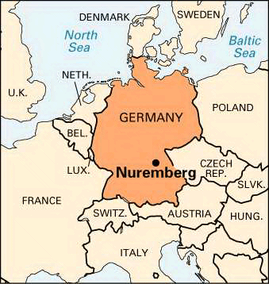
War Crimes Trials
Nuremberg Trials
Series of military courts held by the Allies for the prosecution of key leaders of Nazi Germany. Meant to be a judicial process whereby individuals responsible for war crimes would stand trial in public and given the opportunity to defend themselves.
Held in Nuremberg, Germany, 1945-46.

Slide 29
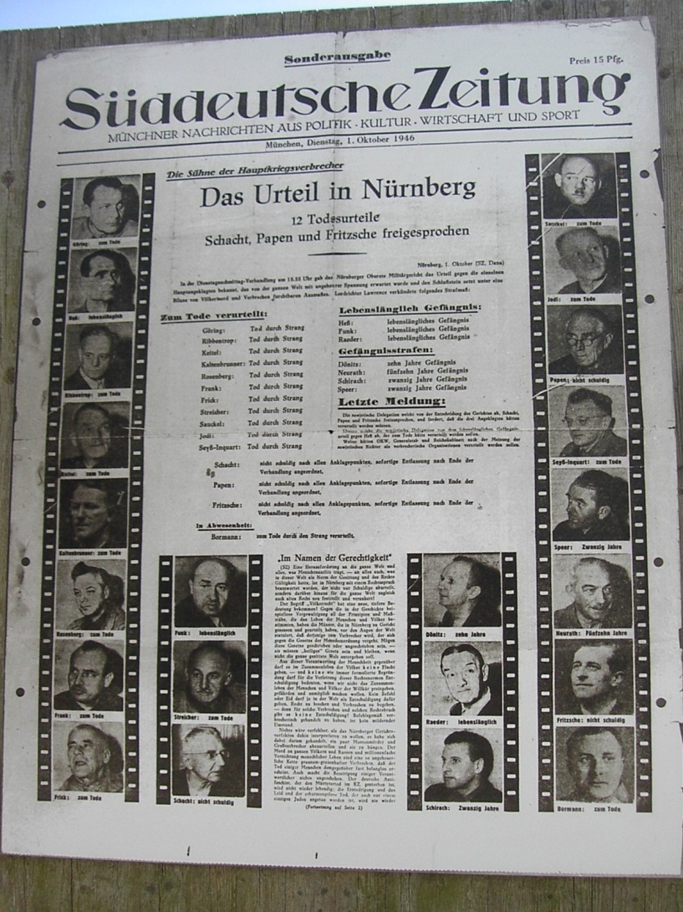
War Crimes Trials
Nuremberg Trials
Series of military courts held by the Allies for the prosecution of key leaders of Nazi Germany. Meant to be a judicial process whereby individuals responsible for war crimes would stand trial in public and given the opportunity to defend themselves.
Held in Nuremberg, Germany, 1945-46.
Tried 22 of the most important captured Nazi leaders.

Slide 30
War Crimes Trials
Nuremberg Trials
Series of military courts held by the Allies for the prosecution of key leaders of Nazi Germany. Meant to be a judicial process whereby individuals responsible for war crimes would stand trial in public and given the opportunity to defend themselves.
Held in Nuremberg, Germany, 1945-46.
Tried 22 of the most important captured Nazi leaders.
  Several key leaders of the war,

Slide 31
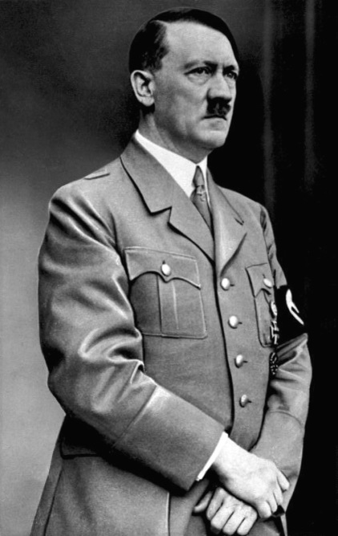
War Crimes Trials
Nuremberg Trials
Series of military courts held by the Allies for the prosecution of key leaders of Nazi Germany. Meant to be a judicial process whereby individuals responsible for war crimes would stand trial in public and given the opportunity to defend themselves.
Held in Nuremberg, Germany, 1945-46.
Tried 22 of the most important captured Nazi leaders.
  Several key leaders of the war, such as Hitler

Slide 32
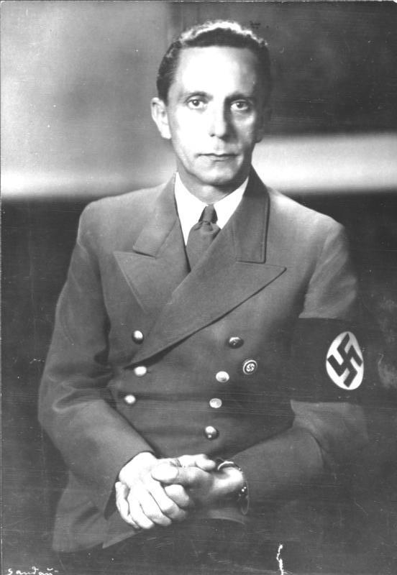
War Crimes Trials
Nuremberg Trials
Series of military courts held by the Allies for the prosecution of key leaders of Nazi Germany. Meant to be a judicial process whereby individuals responsible for war crimes would stand trial in public and given the opportunity to defend themselves.
Held in Nuremberg, Germany, 1945-46.
Tried 22 of the most important captured Nazi leaders.
  Several key leaders of the war, such as Hitler and Goebbels, had committed suicide before the trials began.

Slide 33
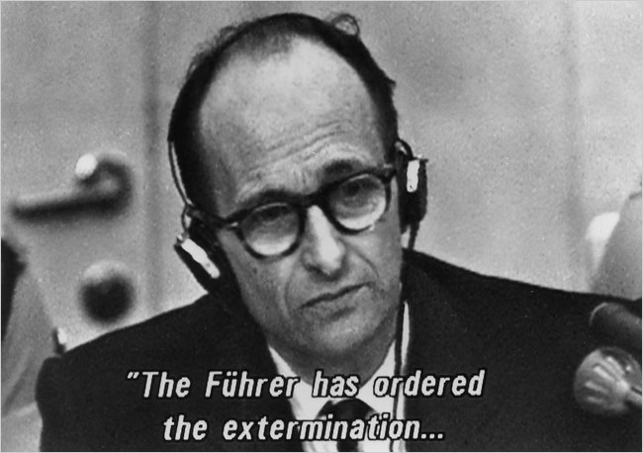
War Crimes Trials
Nuremberg Trials
Series of military courts held by the Allies for the prosecution of key leaders of Nazi Germany. Meant to be a judicial process whereby individuals responsible for war crimes would stand trial in public and given the opportunity to defend themselves.
Held in Nuremberg, Germany, 1945-46.
Tried 22 of the most important captured Nazi leaders.
  Several key leaders of the war, such as Hitler and Goebbels, had committed suicide before the trials began.
  Some escaped Europe… many were eventually caught and tried at later trials.

Slide 34
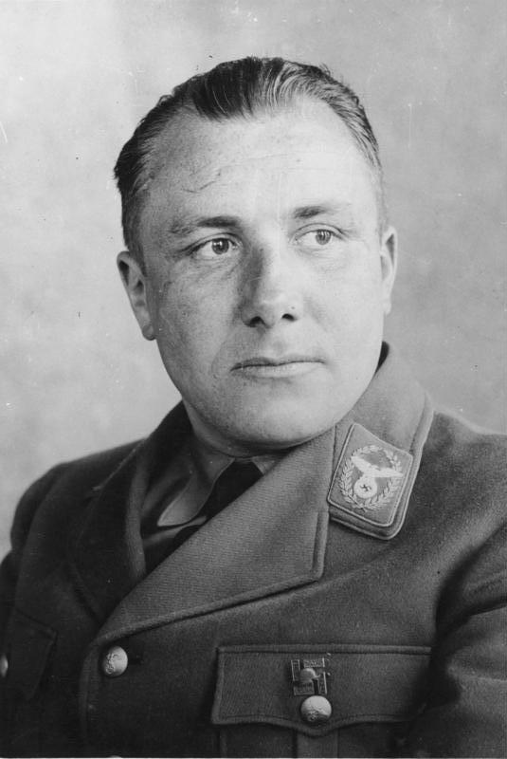
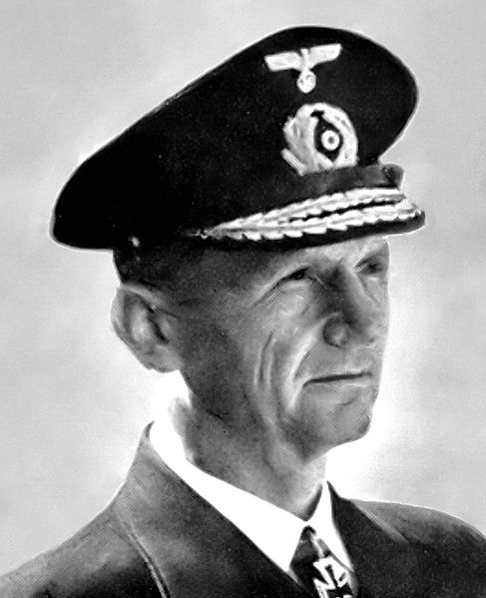
War Crimes Trials
Nuremberg Trials
Series of military courts held by the Allies for the prosecution of key leaders of Nazi Germany. Meant to be a judicial process whereby individuals responsible for war crimes would stand trial in public and given the opportunity to defend themselves.
Held in Nuremberg, Germany, 1945-46.
Tried 22 of the most important captured Nazi leaders.
  Several key leaders of the war, such as Hitler and Goebbels, had committed suicide before the trials began.
  Some escaped Europe… many were eventually caught and tried at later trials.
Outcome:
  12 were sentenced to death

Slide 35
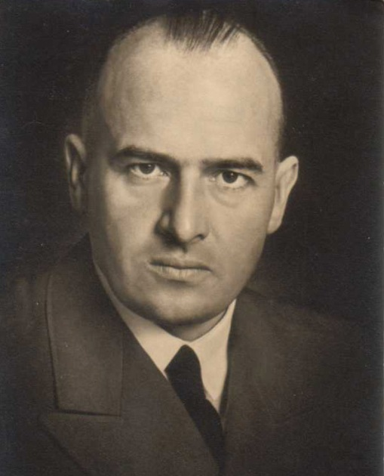
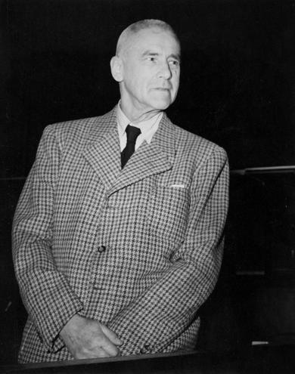
War Crimes Trials
Nuremberg Trials
Series of military courts held by the Allies for the prosecution of key leaders of Nazi Germany. Meant to be a judicial process whereby individuals responsible for war crimes would stand trial in public and given the opportunity to defend themselves.
Held in Nuremberg, Germany, 1945-46.
Tried 22 of the most important captured Nazi leaders.
  Several key leaders of the war, such as Hitler and Goebbels, had committed suicide before the trials began.
  Some escaped Europe… many were eventually caught and tried at later trials.
Outcome:
  12 were sentenced to death
  7 were sentenced to prison

Slide 36
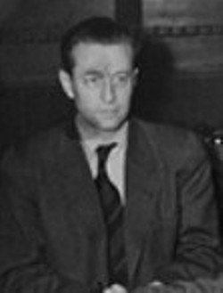
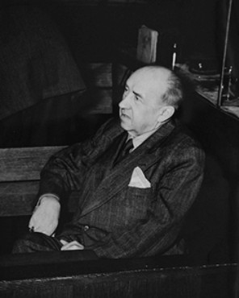
War Crimes Trials
Nuremberg Trials
Series of military courts held by the Allies for the prosecution of key leaders of Nazi Germany. Meant to be a judicial process whereby individuals responsible for war crimes would stand trial in public and given the opportunity to defend themselves.
Held in Nuremberg, Germany, 1945-46.
Tried 22 of the most important captured Nazi leaders.
  Several key leaders of the war, such as Hitler and Goebbels, had committed suicide before the trials began.
  Some escaped Europe… many were eventually caught and tried at later trials.
Outcome:
  12 were sentenced to death
  7 were sentenced to prison
  3 were acquitted

Slide 37
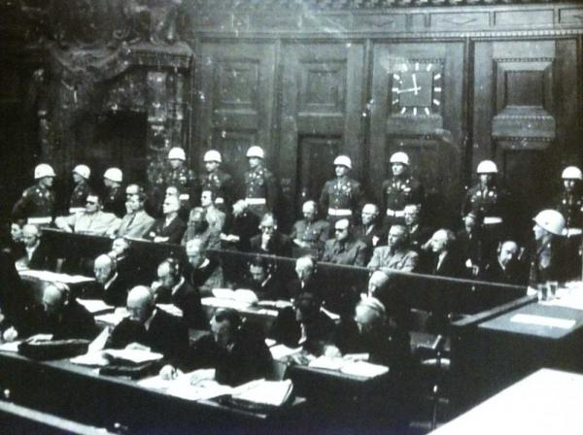
War Crimes Trials
Other Trials
Rest of Europe
  There were over 20 other trials for war crimes between 1945-1949.

Slide 38
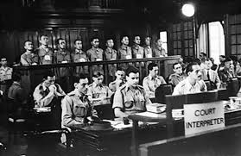
War Crimes Trials
Other Trials
Rest of Europe
  There were over 20 other trials for war crimes between 1945-1949.
  Thousands more were convicted to either death or prison.

Slide 39
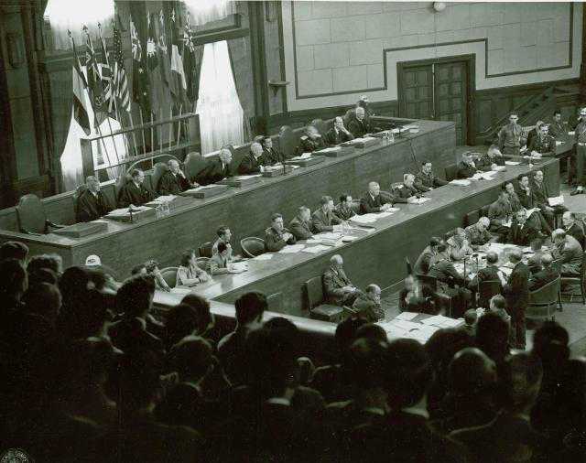
War Crimes Trials
Other Trials
Rest of Europe
  There were over 20 other trials for war crimes between 1945-1949.
  Thousands more were convicted to either death or prison.
Japan
  There was a separate set of trials for war crimes committed by the Japanese Empire.

Slide 40
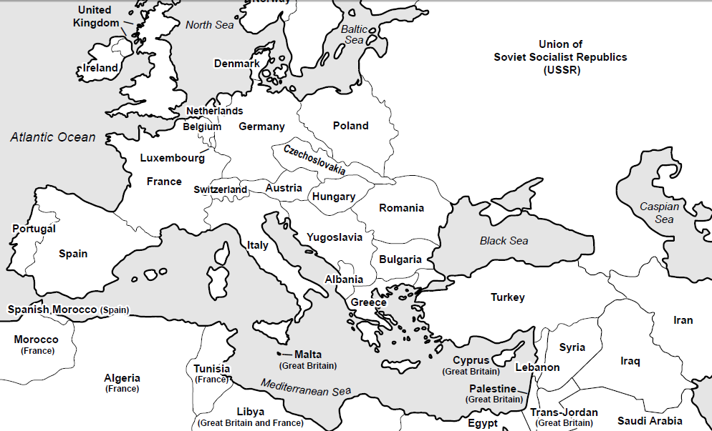
Ending the War
Conferences

Slide 41
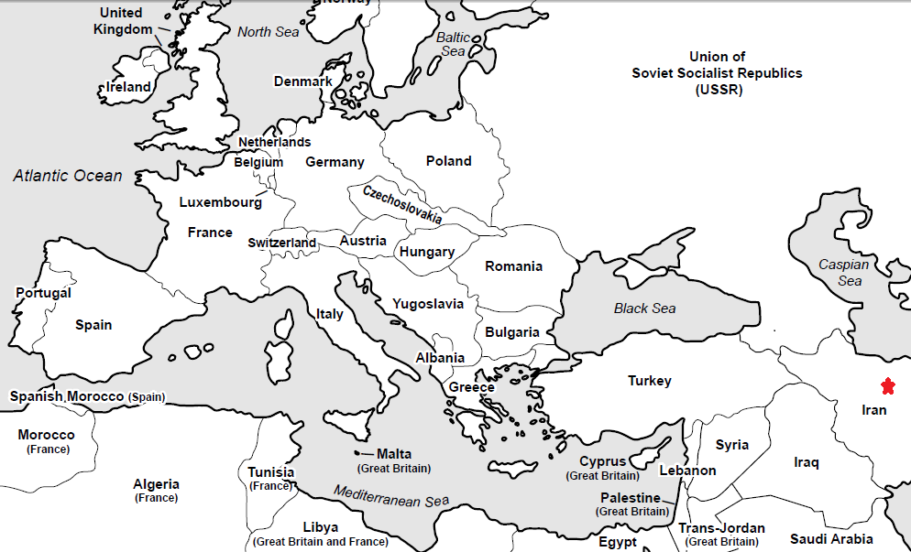
Ending the War
Conferences
Tehran, Iran – 1943

Slide 42
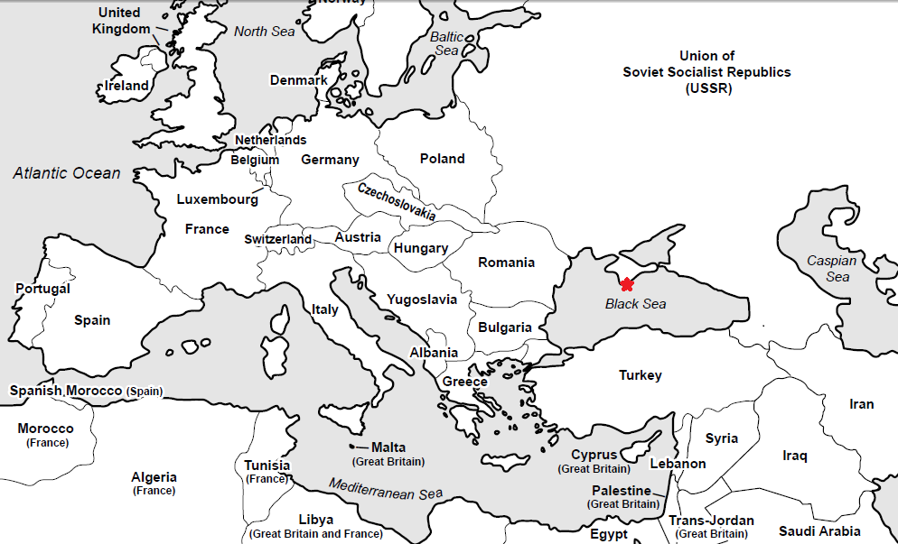
Ending the War
Conferences
Tehran, Iran – 1943
Yalta, Crimea – 1945

Slide 43
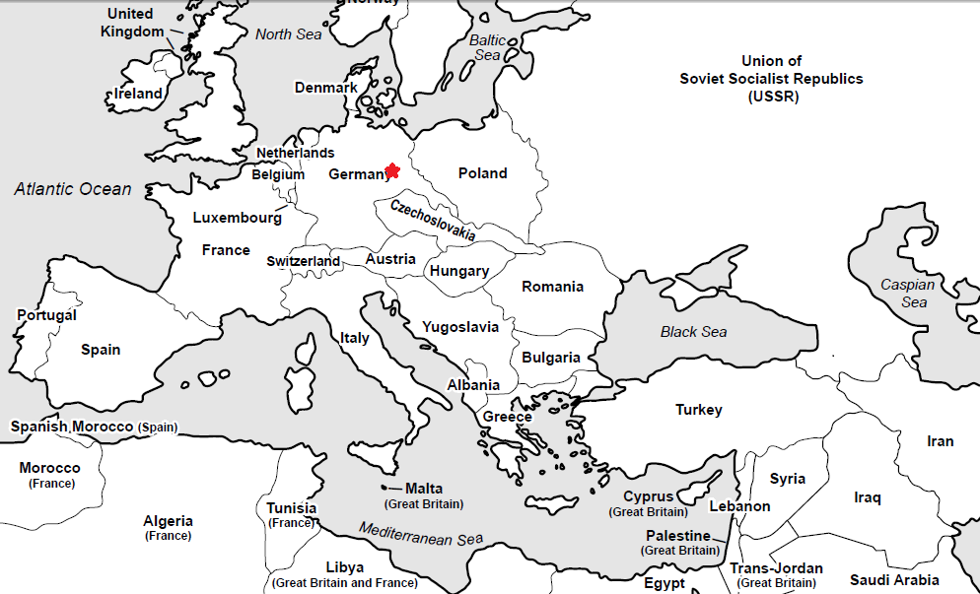
Ending the War
Conferences
Tehran, Iran – 1943
Yalta, Crimea – 1945
Potsdam, Germany – 1945

Slide 44
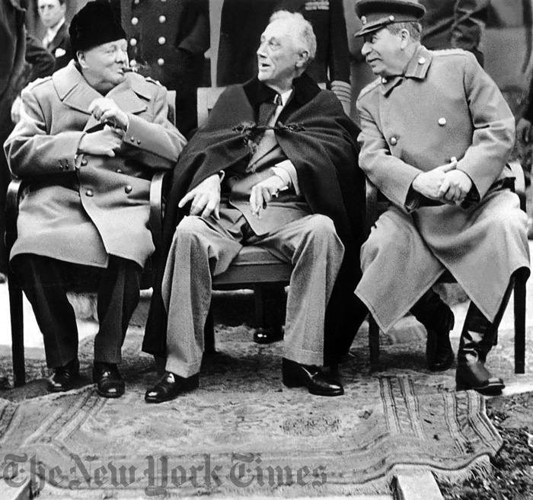
Ending the War
Conferences
Tehran, Iran – 1943
Yalta, Crimea – 1945
Potsdam, Germany – 1945
The “Big Three”
U.S. – Roosevelt/Truman

Slide 45
Ending the War
Conferences
Tehran, Iran – 1943
Yalta, Crimea – 1945
Potsdam, Germany – 1945
The “Big Three”
U.S. – Roosevelt/Truman
UK – Churchill

Slide 46
Ending the War
Conferences
Tehran, Iran – 1943
Yalta, Crimea – 1945
Potsdam, Germany – 1945
The “Big Three”
U.S. – Roosevelt/Truman
UK – Churchill
Soviet Union - Stalin

Slide 47
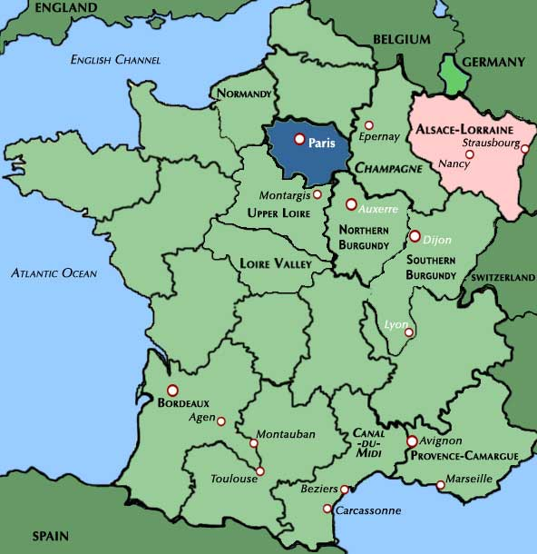
Ending the War
Loss of Empires
Germany
  Alsace-Lorraine returned to France

Slide 48
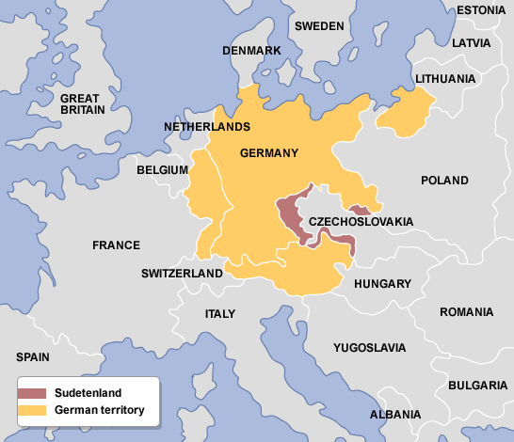
Ending the War
Loss of Empires
Germany
  Alsace-Lorraine returned to France
  Sudentenland returned to Czechoslovakia
Italy

Slide 49
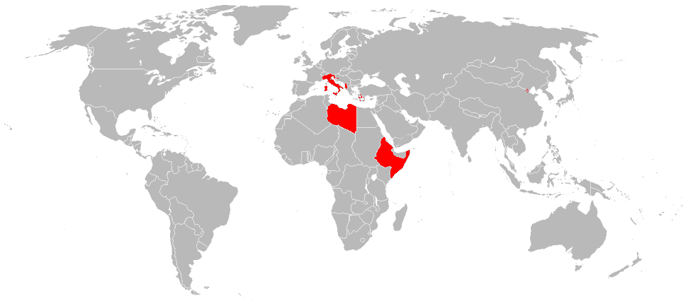
Ending the War
Loss of Empires
Germany
  Alsace-Lorraine returned to France
  Sudentenland returned to Czechoslovakia
Italy
  Lost Ethiopia, Egypt, and parts of the Middle East
Austria

Slide 50
Ending the War
Loss of Empires
Germany
  Alsace-Lorraine returned to France
  Sudentenland returned to Czechoslovakia
Italy
  Lost Ethiopia, Egypt, and parts of the Middle East
Austria
  Separated from Germany
Japan

Slide 51
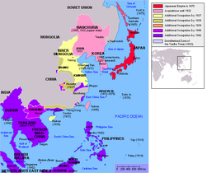
Ending the War
Loss of Empires
Germany
  Alsace-Lorraine returned to France
  Sudentenland returned to Czechoslovakia
Italy
  Lost Ethiopia, Egypt, and parts of the Middle East
Austria
  Separated from Germany
Japan
  Forced to return Manchuria to China
  Korea became independent

Slide 52
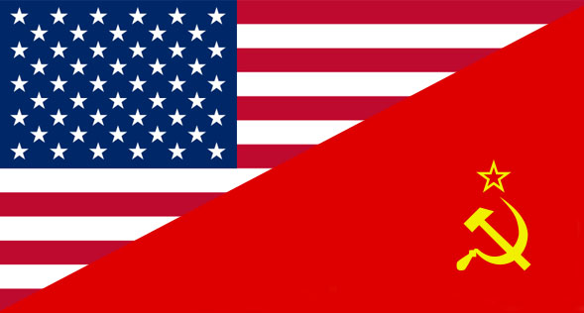
Ending the War
Major World Powers
United States
Soviet Union

Slide 53
Conclusion
Major theaters of war included Africa, Europe, Asia, and the Pacific Islands.
Leadership was essential to the Allied victory.
The outcomes of WWII include the war crimes trials.

