Slide 1
Do Now:
Grab today’s Agenda (10:7)
Go to Weebly → Unit 10 → Lesson 7 → UNDHR.
Read the Universal Declaration of Human Rights and answer the questions on your Agenda.

Slide 2
Do Now:
What are the goals of the UNDHR?
Why do you think the UN was tasked with carrying out the UNDHR?

Slide 3
Objective:
Maintaining Peace
WHII.12c
TSWDK of the worldwide impact of World War II by explaining the terms of peace… and the creation of international cooperative organizations and the Universal Declaration of Human Rights (1948).

Slide 4
Maintaining Peace
Reconstructing Germany
Reconstructing Japan
United Nations
Universal Declaration of Human Rights
NATO

Slide 5
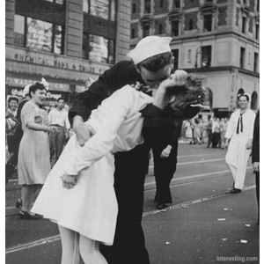
Reconstructing Germany
Potsdam Conference
All agreed:
  Germany should remain a single country, but to be divided (see below)
  Germany must be demilitarized
  Germany must pay reparations (again!)
  Nazi party outlawed
  German government should be democratic
  Individuals responsible for war crimes brought to trial (Nuremberg Trials)

Slide 6
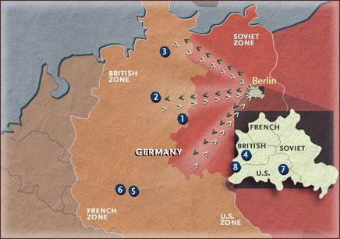
Reconstructing Germany
Division
Both Germany (and Berlin) and Austria (and Vienna) were divided into four zones of military occupation:
  Soviets control East Germany (and East Berlin)
  Western allies (U.S. Britain, French) control West Germany (and West Berlin)
Division was supposed to be temporary with a peace settlement to be arranged later.

Slide 7
Reconstructing Germany
Political Development
Democratic government installed in West Germany and West Berlin
  West German government dominated by the Christian Democrats and the Social Democrats
  Dedicated to fighting communism and the Soviets
East Germany and East Berlin fall under Soviet control (Iron Curtain)

Slide 8

Reconstructing Germany
Economic Development
Marshall Plan
  American program named for Secretary of State (and general during the war) George Marshall.
  Purpose was to help Europe rebuild in order to prevent the spread of communism.

Slide 9
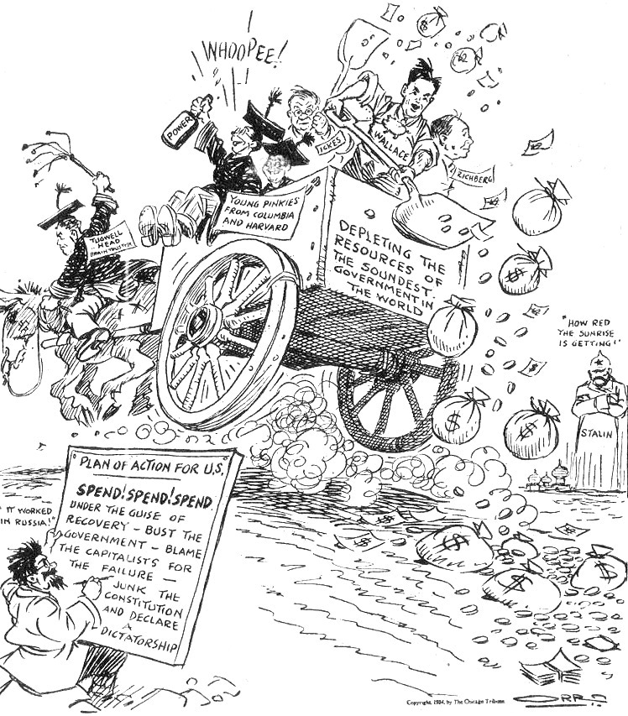
Reconstructing Germany
Economic Development
Marshall Plan
  American program named for Secretary of State (and general during the war) George Marshall.
  Purpose was to help Europe rebuild in order to prevent the spread of communism.
  European nations received nearly $13 billion in aid, which initially resulted in shipments of goods, staples, fuel, and machinery from the U.S. and later resulted in investment in industrial capacity in Europe.
With foreign aid, the West German government provided housing and jobs to many refugees from East Germany and other European nations.
The labor of these refugees contributed to West Germany’s rapidly growing economy.
German industry flourished, thanks to technological innovation, a commitment to quality, and few labor troubles.
By 1958, West Germany was the leading industrial nation in Western Europe.

Slide 10
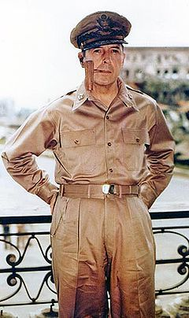
Reconstructing Japan
General Douglas MacArthur
Supreme Commander for the Allied Powers
Supervised the reconstruction of Japan through United States occupation of Japan

Slide 11
Reconstructing Japan
Political and Economic Development
Create new Japanese government – nonmilitary and democratic
  Parliamentary democracy
  Emperor no longer divine or with power. Just a symbol of state.
Elimination of Japanese offensive military capabilities; guarantee of Japan’s security by the United States.
Removed people who had been powerful in government and business during the war. (Some tried for war crimes)
Emergence of Japan as dominant economy in Asia.

Slide 12

United Nations
History
Founded in 1945
Founded by 51 countries committed to maintaining international peace and security.

Slide 13
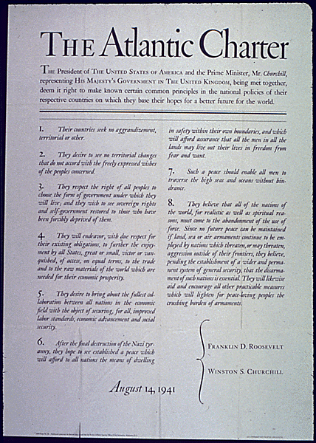
United Nations
History (continued)
Based on the Atlantic Charter

Slide 14
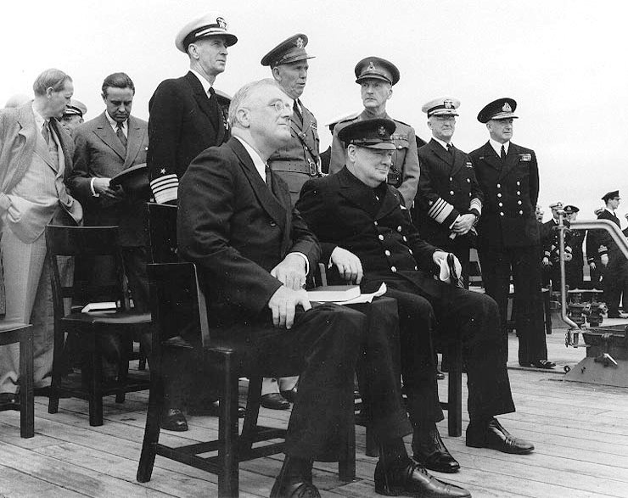
United Nations
History (continued)
Based on the Atlantic Charter
  Policy statement issued August 14, 1941 (drafted by leaders of Britain and U.S.)

Slide 15
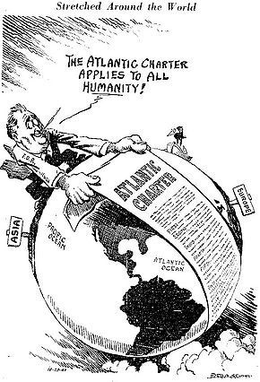
United Nations
History (continued)
Based on the Atlantic Charter
  Policy statement issued August 14, 1941 (drafted by leaders of Britain and U.S.)
  Defined Allied goals for the post-war world:
    No territorial aggrandizement (expansion)
    No territorial changes made against the wishes of the people
    Restoration of self-government to those deprived of it
    Reduction of trade restrictions
    Global cooperation to secure better economic and social conditions for all
    Freedom from fear and want
    Freedom of the seas
    Abandonment of the use of force, as well as disarmament of aggressor nations

Slide 16
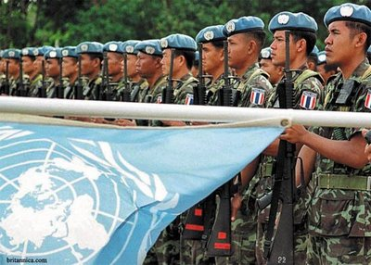
United Nations
Purpose
To keep peace throughout the world

Slide 17
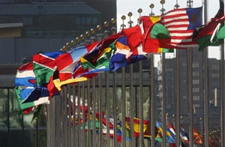
United Nations
Purpose
To keep peace throughout the world
To develop friendly relations among nations
To help nations work together to

Slide 18
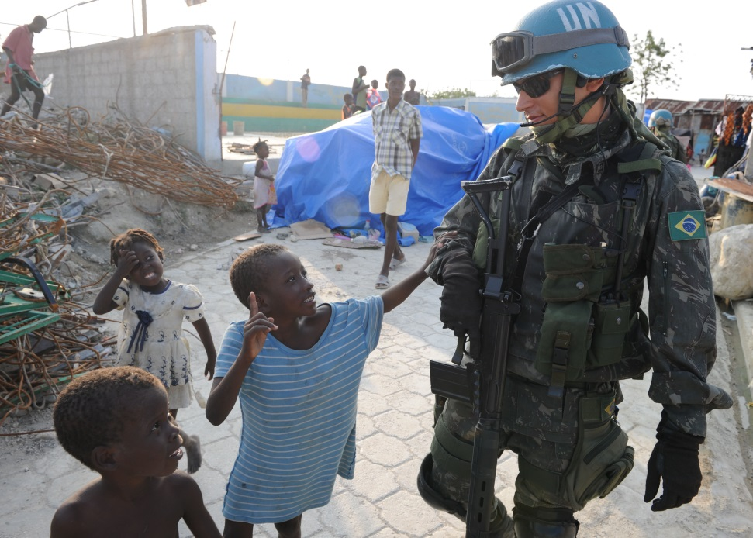
United Nations
Purpose
To keep peace throughout the world
To develop friendly relations among nations
To help nations work together to
  Improve the lives of poor people

Slide 19
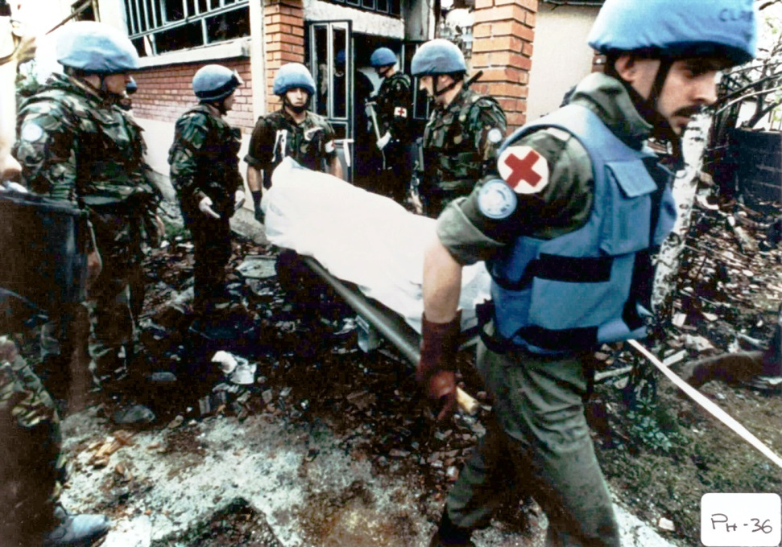
United Nations
Purpose
To keep peace throughout the world
To develop friendly relations among nations
To help nations work together to
  Improve the lives of poor people
  Conquer hunger, disease, and illiteracy

Slide 20
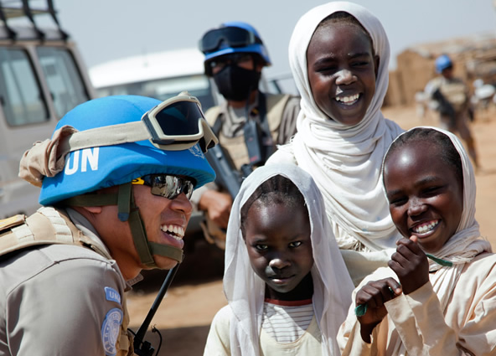
United Nations
Purpose
To keep peace throughout the world
To develop friendly relations among nations
To help nations work together to
  Improve the lives of poor people
  Conquer hunger, disease, and illiteracy
  Encourage respect for each other’s rights and freedom

Slide 21
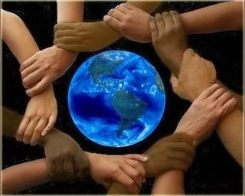
United Nations
Purpose
To keep peace throughout the world
To develop friendly relations among nations
To help nations work together to
  Improve the lives of poor people
  Conquer hunger, disease, and illiteracy
  Encourage respect for each other’s rights and freedom
To be a center for harmonizing the actions of nations to achieve these goals.

Slide 22
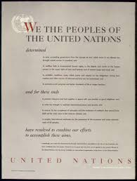
United Nations
Structure
United Nations Charter
  Foundational treaty of the UN
  Signed by 50 of the 51 original member countries
  Obligations to the UN prevail over all other treaty obligations

Slide 23
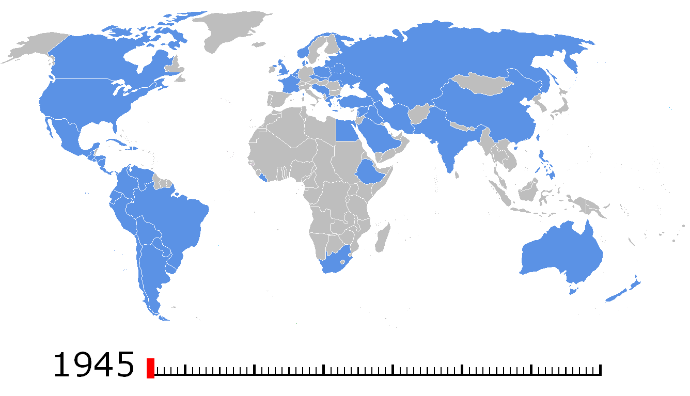
United Nations
Structure
United Nations Charter
  Foundational treaty of the UN
  Signed by 50 of the 51 original member countries
  Obligations to the UN prevail over all other treaty obligations
  UN currently has 193 member nations

Slide 24
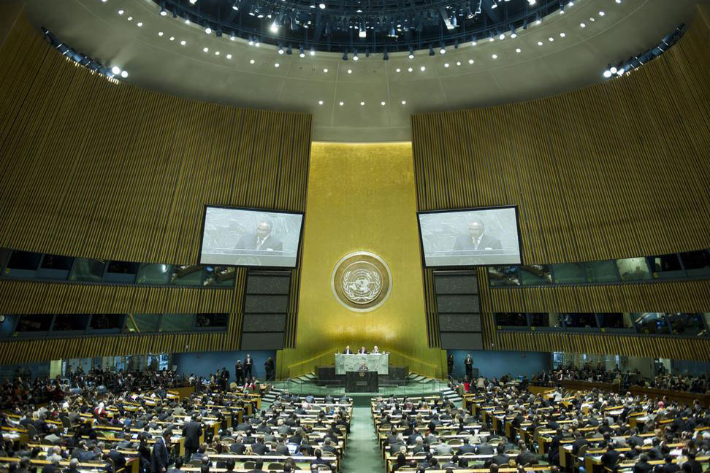
United Nations
Structure
Five Parts
  *General Assembly
    Deliberative assembly
    All member nations have equal representation
    Amongst other things, they make recommendations on matters of peace and security.

Slide 25
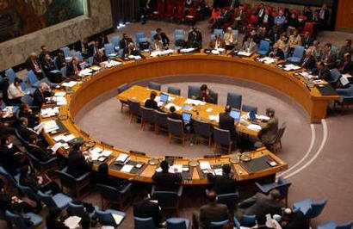
United Nations
Structure
Five Parts
  *General Assembly
    Deliberative assembly
    All member nations have equal representation
    Amongst other things, they make recommendations on matters of peace and security.
  *Security Council
    For international security issues – responsible for the maintenance of international peace and security
    May adopt emergency resolutions
    Has 15 members
      5 permanent (China, France, Russia, UK, US)
      10 elected (take turns)

Slide 26
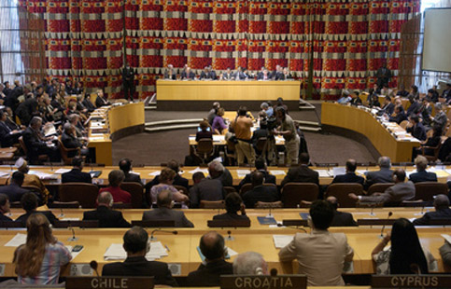
United Nations
Structure
Five Parts
  Economic and Social Council
    Responsible for cooperation between countries on economic and social issues
    Has 54 members, who are elected by the General Assembly

Slide 27
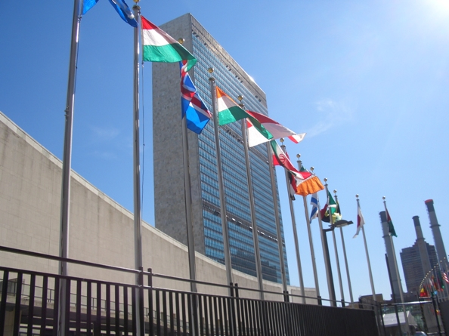
United Nations
Structure
Five Parts
  Economic and Social Council
    Responsible for cooperation between countries on economic and social issues
    Has 54 members, who are elected by the General Assembly
  Secretariat
    Administrative
    Prepares repots and studies, amongst other things

Slide 28
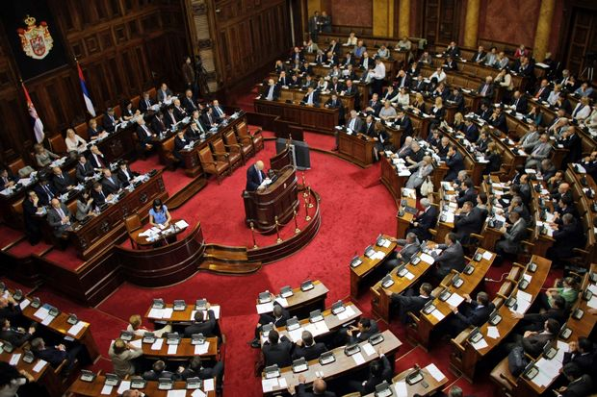
United Nations
Structure
Five Parts
  Economic and Social Council
    Responsible for cooperation between countries on economic and social issues
    Has 54 members, who are elected by the General Assembly
  Secretariat
    Administrative
    Prepares repots and studies, amongst other things
  International Court of Justice
    Universal court for international law
    Decides disputes between countries that recognize its jurisdiction and issues legal opinions
    Its 15 judges are elected by the General Assembly for 9-year terms

Slide 29
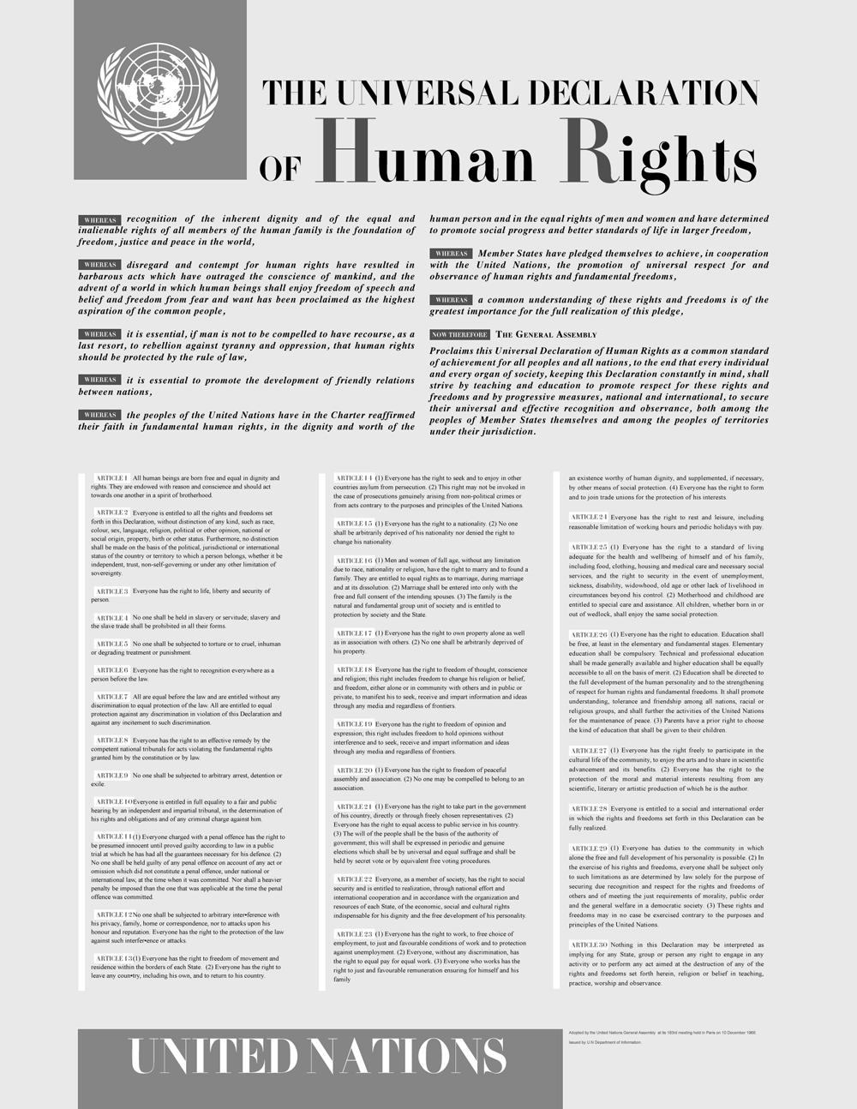
Universal Declaration of Human Rights
History
Adopted by the UN General Assembly December 1948

Slide 30
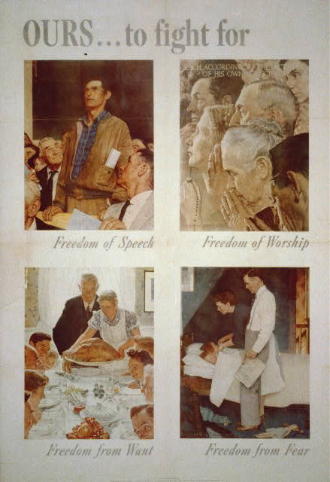
Universal Declaration of Human Rights
History
Adopted by the UN General Assembly December 1948
Based on the Four Freedoms, adopted by the Allies during WWII

Slide 31
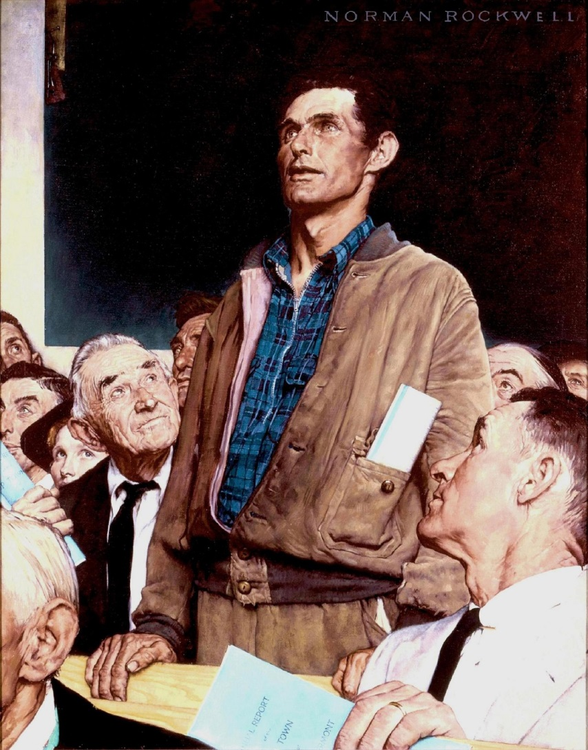
Universal Declaration of Human Rights
History
Adopted by the UN General Assembly December 1948
Based on the Four Freedoms, adopted by the Allies during WWII
  Freedom of Speech

Slide 32
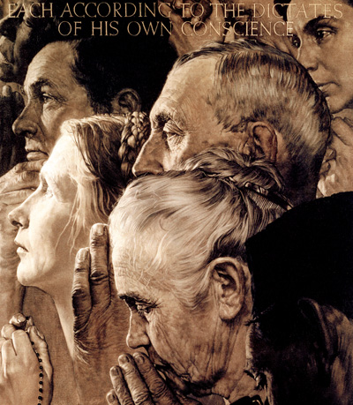
Universal Declaration of Human Rights
History
Adopted by the UN General Assembly December 1948
Based on the Four Freedoms, adopted by the Allies during WWII
  Freedom of Speech
  Freedom of Religion

Slide 33
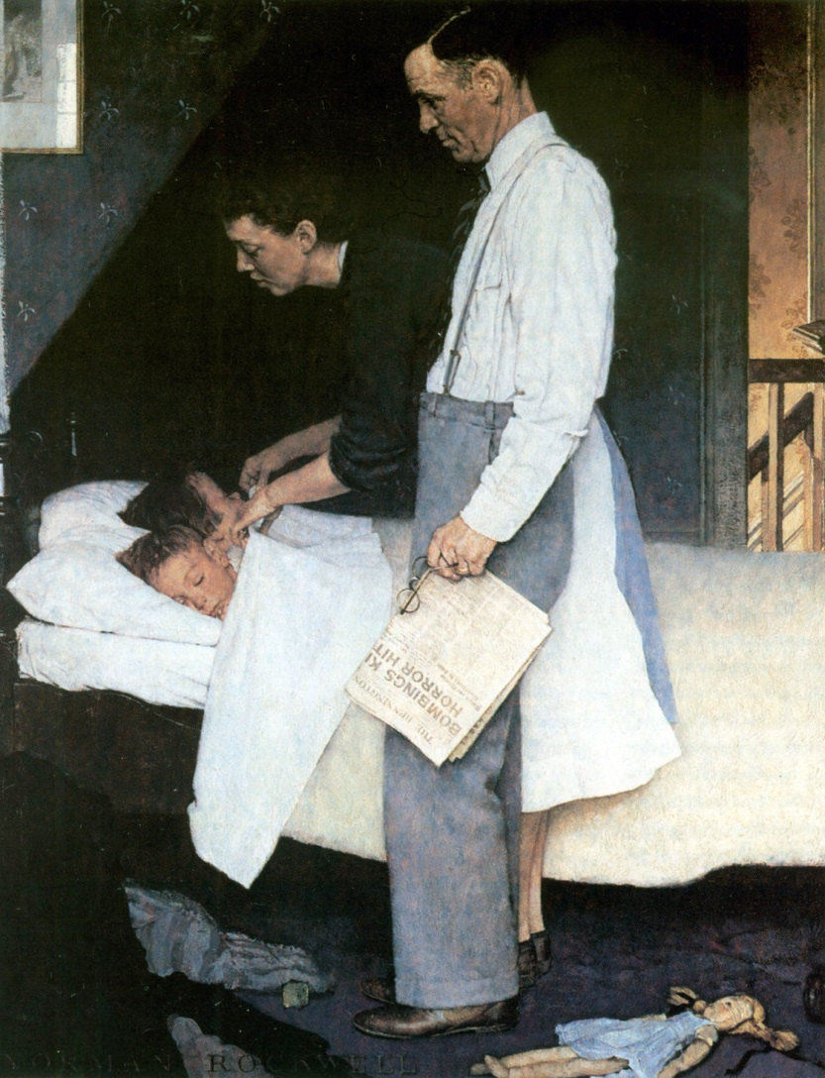
Universal Declaration of Human Rights
History
Adopted by the UN General Assembly December 1948
Based on the Four Freedoms, adopted by the Allies during WWII
  Freedom of Speech
  Freedom of Religion
  Freedom from Fear

Slide 34
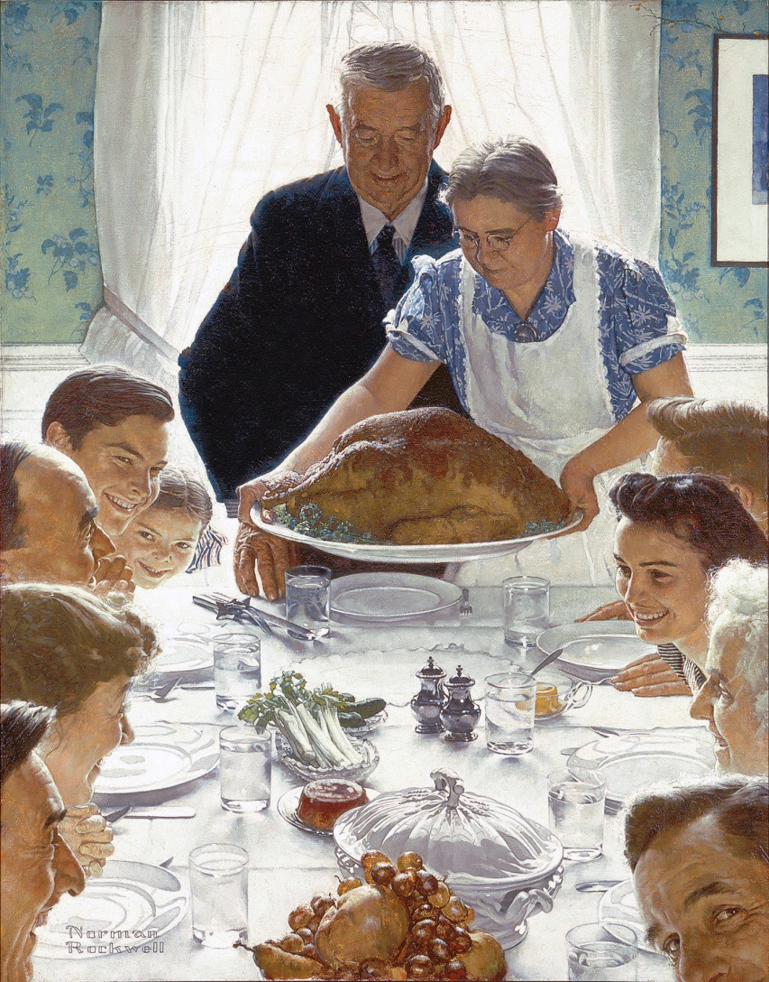
Universal Declaration of Human Rights
History
Adopted by the UN General Assembly December 1948
Based on the Four Freedoms, adopted by the Allies during WWII
  Freedom of Speech
  Freedom of Religion
  Freedom from Fear
  Freedom from Want

Slide 35
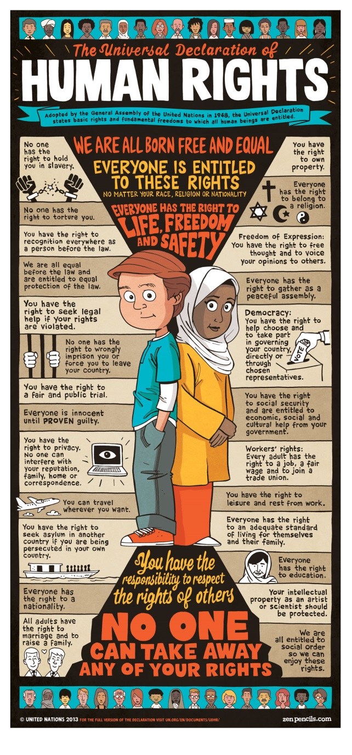
Universal Declaration of Human Rights
Content
Provided a code of conduct for the treatment of people under the protection of their government.

Slide 36
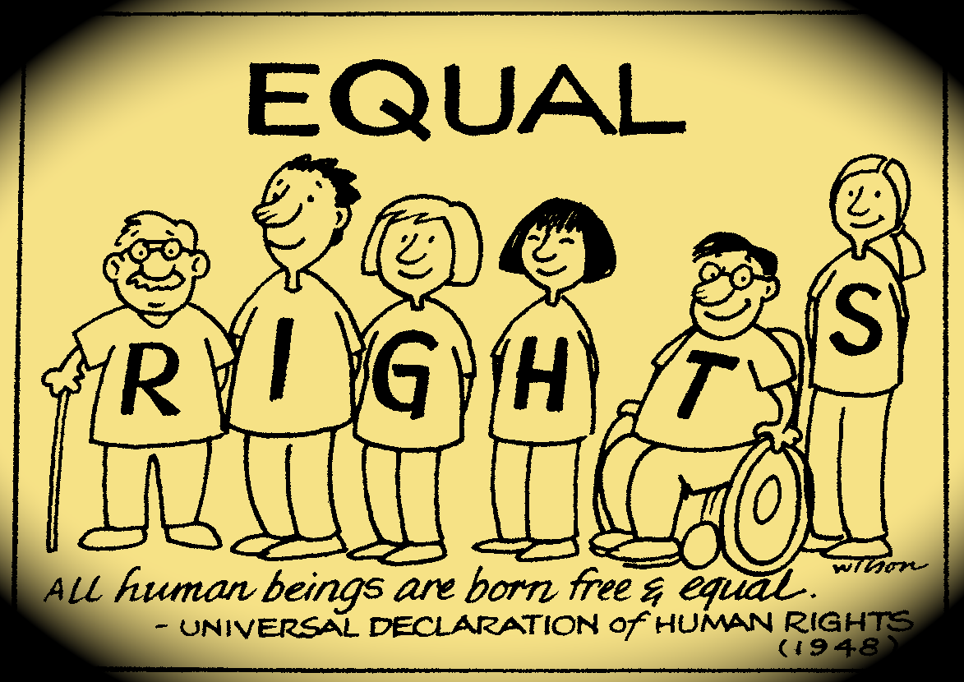
Universal Declaration of Human Rights
Content
Provided a code of conduct for the treatment of people under the protection of their government.
To protect the “inherent dignity and… the equal and inalienable rights of all members of the human family…”

Slide 37
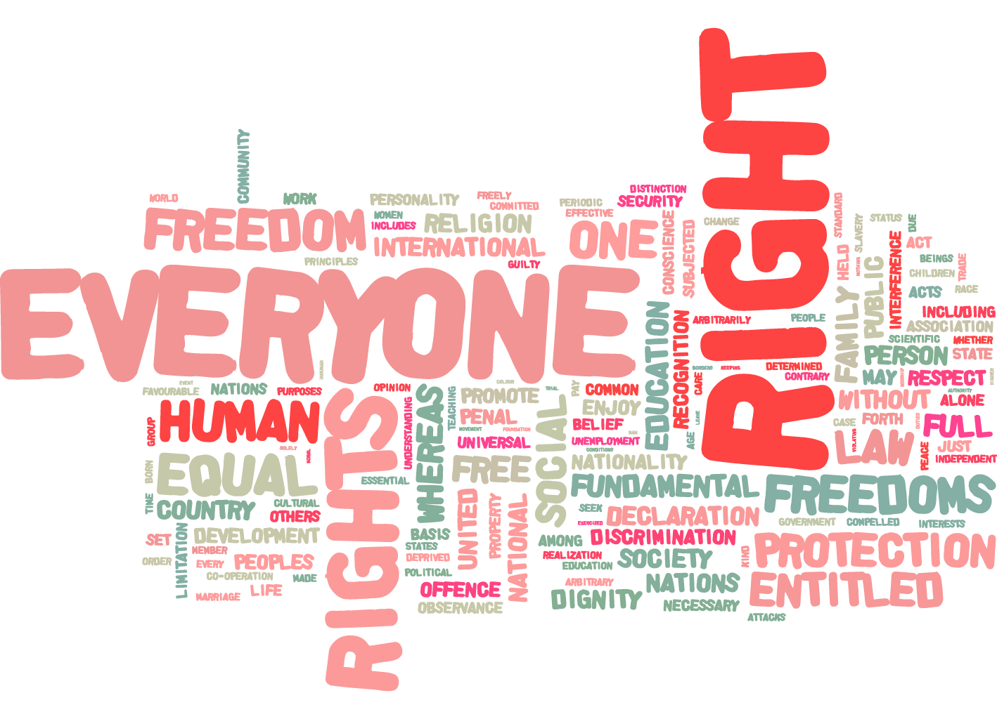
Universal Declaration of Human Rights
Content
Provided a code of conduct for the treatment of people under the protection of their government.
To protect the “inherent dignity and… the equal and inalienable rights of all members of the human family…”
Forms part of international law

Slide 38
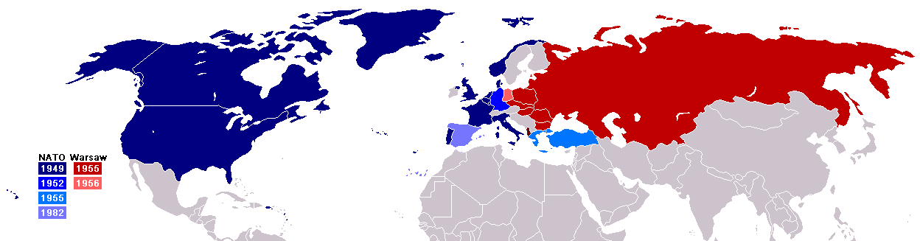
North Atlantic Treaty Organization
(NATO)
History
Established 1949
An alliance of Western powers to counter the military power of the USSR and to prevent the revival of nationalist militarism.
Relied heavily on US nuclear weapons to deter Soviet invasion of Western Europe.

Slide 39
North Atlantic Treaty Organization
(NATO)
Purpose
Political and Military Alliance: To safeguard the freedom and security of its members through political and military means.
Collective Defense: An attack against one or several members is considered an attack against all.
Transatlantic Link: An alliance of countries from Europe and North America. Provides a unique link between these two continents for consultation and cooperation in the field of defense and security and the conduct of multinational crisis-management operations.

Slide 40
North Atlantic Treaty Organization
(NATO)
Members
12 Original Members
  Belgium, Canada, Denmark, France, Iceland, Italy, Luxembourg, Netherlands, Norway, Portugal, UK, and US
28 members today

Slide 41
North Atlantic Treaty Organization
(NATO)
Warsaw Pact
Established 1955 in response to NATO
Purpose: Alliance of Soviet Union and Eastern bloc.
Members: Albania, Bulgaria, Czechoslovakia, East Germany, Hungary, Poland, Romania, Soviet Union

Slide 42
Conclusion
Western Europe and Japan were rebuilt to promote stable democratic governments and a healthy world economy… and to prevent the spread of communism!
The outcomes of WWII include the establishment of international cooperative organizations such as the United Nations, the North Atlantic Treaty Organization, and the Warsaw Pact.
The Universal Declaration of Human Rights arose directly from the experience of WWII and is the first global expression of rights to which all human beings are inherently entitled.

