Slide 1
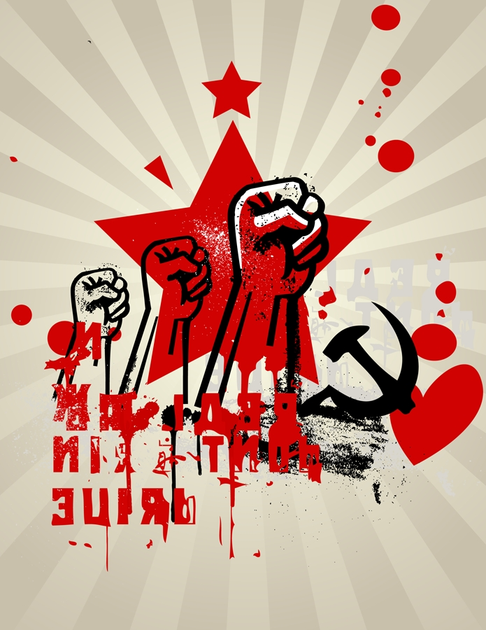
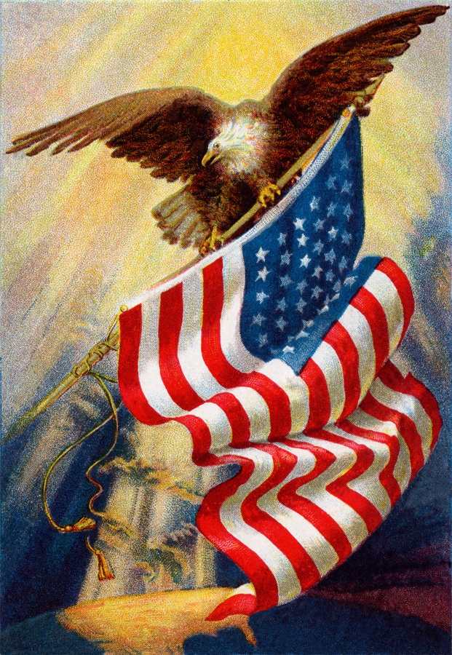
Do Now: Turn in Night Three question. Then grab today’s Agenda (11:1). Look at the following cartoon. Complete the speech bubbles!

Slide 2
Objective: The Cold War
WHII.13a-d
TSWDK of the second half of the 20th century by explaining key events of the Cold War, by describing conflicts and revolutionary movements in eastern Asia, and by describing major contributions of selected world leaders in the second half of the 20th century.

Slide 3
The Cold War Begins
USSR vs. US
Iron Curtain

Slide 4
USSR vs. US
Yalta Conference
1945
Attended by the “Big Three”

Slide 5
USSR vs. US
Yalta Conference
1945
Attended by the “Big Three”
Division of Germany
West Germany (and West Berlin): US, UK, and France
East Germany (and East Berlin): USSR

Slide 6
USSR vs. US (Rivalry)
USSR
US
Politics
Dictatorship
Economics
Communism
Politics
Democracy
Economics
Free enterprise system

Slide 7
USSR vs. US
Containment
Definition: A policy for preventing the expansion of communism.

Slide 8
USSR vs. US
Containment
Definition: A policy for preventing the expansion of communism.
Truman Doctrine
1947
By President Harry Truman
“…to support free people who are resisting attempted subjugation by armed minorities or by outside pressures.”
Since these totalitarian regimes (Soviets) forced “free peoples,” they represent a threat to international peace and the national security of the United States.
US would provide Greece and Turkey with economic and military aid to prevent them from falling under Soviet control.
Beginning of containment.

Slide 9
USSR vs. US
Cold War
1947-1991
Political and military tension between:
United States (and NATO allies)
USSR (and Eastern Bloc – Warsaw Pact)

Slide 10
USSR vs. US
Cold War
Eastern Bloc

Slide 11
Iron Curtain
Cold War
Eastern Bloc
Satellite nations under Soviet control
Poland, East Germany, Czechoslovakia, Hungary, Romania, Bulgaria, Albania
Soviet satellite nations

Slide 12
USSR vs. US
Cold War
Eastern Bloc
Satellite nations under Soviet control
Poland, East Germany, Czechoslovakia, Hungary, Romania, Bulgaria, Albania

Slide 13
USSR vs. US
Cold War
1947-1991
Political and military tension between:
United States (and NATO allies)
USSR (and Eastern Bloc – Warsaw Pact)
Called the “Cold War” because the tension never resulted in direct military action. Both sides had WMDs and knew that if there would be a war, both sides would lose. But it came close!

Slide 14
USSR vs. US
Nuclear Deterrence
For a time after WWII, America held nuclear superiority. They used this threat of “massive retaliation” as a means to deter Soviet aggression.
By late 1950s, the Soviet Union built up a nuclear arsenal that threatened the U.S. and its allies.
Unilateral (one-way) deterrence gave way to “mutual deterrence,” a stalemate.
The superpowers refrained from attacking each other because of the certainty of mutual assured destruction (MAD).

Slide 15
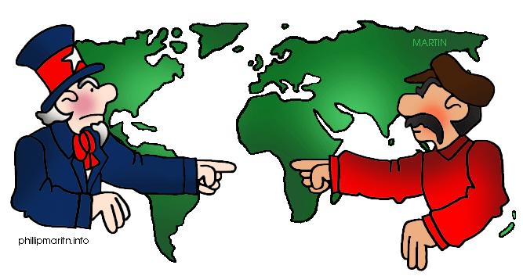
USSR vs US
Cuban Missile Crisis
October 14-28, 1962
Background
After the failed Bay of Pigs invasion,

Slide 16
USSR vs US
Cuban Missile Crisis
October 14-28, 1962
Background
After the failed Bay of Pigs invasion, Cuban President Fidel Castro feared further interference by the US.

Slide 17
USSR vs US
Cuban Missile Crisis
October 14-28, 1962
Background
After the failed Bay of Pigs invasion, Cuban President Fidel Castro feared further interference by the US. So he requested military support from Soviet President Nikita Khrushchev.

Slide 18
USSR vs US
Cuban Missile Crisis
October 14-28, 1962
Background
After the failed Bay of Pigs invasion, Cuban President Fidel Castro feared further interference by the US. So he requested military support from Soviet President Nikita Khrushchev.
Khrushchev set up missile sites in Cuba, which scared the Americans.

Slide 19
USSR vs US
Cuban Missile Crisis
Crisis
President Kennedy demanded sites be removed.

Slide 20
USSR vs US
Cuban Missile Crisis
Crisis
President Kennedy demanded sites be removed.
Set up blockade of Cuba.

Slide 21
USSR vs US
Cuban Missile Crisis
Crisis
President Kennedy demanded sites be removed.
Set up blockade of Cuba.
For 13 days the world was unsure of what would happen. Both NATO and the Warsaw Pact prepared for the worse – an all-out war, possibly nuclear.

Slide 22
USSR vs US
Cuban Missile Crisis
End
Khrushchev agreed to remove the missiles from Cuba.
Kennedy promised to leave Cuba alone.
Kennedy privately agreed to remove missile sites from Turkey.
Outcome
Khrushchev’s position as Soviet leader weakened; career never recovered.
Castro’s position as Cuban leader strengthened.
World saw how close we came to nuclear war.

Slide 23
Iron Curtain
Berlin Wall
What: Barrier constructed by the Soviets.

Slide 24
Iron Curtain
Berlin Wall
What: Barrier constructed by the Soviets.
When: Construction began August 31, 1961 (Initial was just barbed wire with armed guards; actual concrete wall built in 1965.)

Slide 25
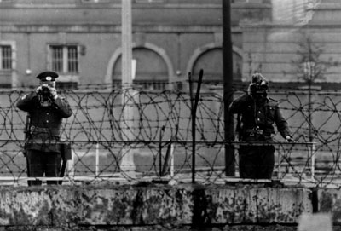
Iron Curtain
Berlin Wall (continued)
Why:
Stalin began to slowly take over and indoctrinate the Soviet satellite nations into Communism. As a result, starting in 1950, many people began to leave East Germany.
In 1952, Stalin placed a barbed-wire fence separating West Germany from East Germany. However, Berlin served as a loophole for escape. Those wishing to escape East Germany can leave by going into West Berlin.
So a wall was built.

Slide 26
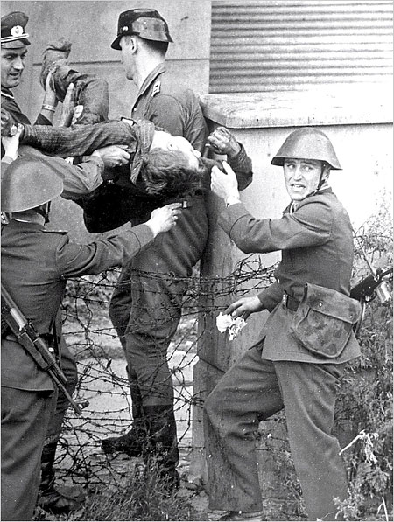
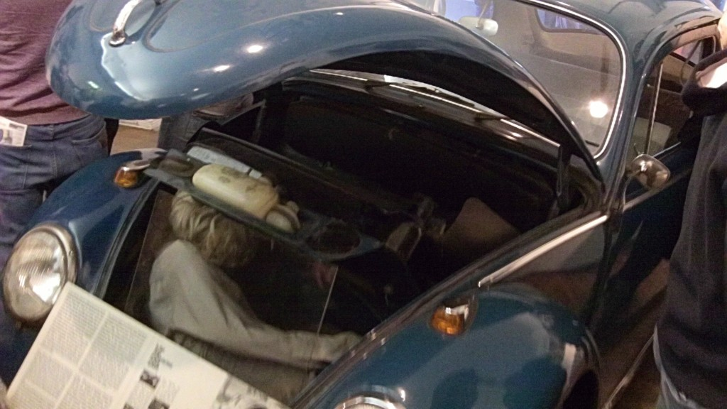
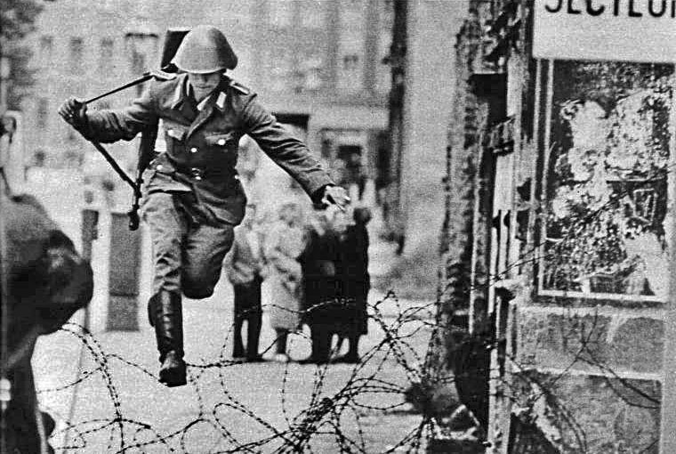
Iron Curtain
Berlin Wall (continued)
Purpose:
Keep Westerns out so they cannot “poison” the minds of the people.
Keep Soviet citizens from leaving and sharing secrets with the West (US)
Defection:
To leave without permission
Around 5,000 people successfully defected to West Berlin
100-200 people were killed trying to defect.

Slide 27
Iron Curtain
Three Worlds
First World
Countries aligned with the United States.
These countries were largely capitalistic and generally democracies.
Wealthy

Slide 28
Iron Curtain
Three Worlds
Second World
Countries aligned with the Soviet Union and China.
These countries were largely communist/socialist and generally ran under a dictator, or Stalin.
Not so wealthy

Slide 29
Iron Curtain
Three Worlds
Third World
Everyone else; countries not aligned with either NATO or the Communist Bloc (Warsaw Pact)
However, both the U.S. and the USSR tried to get these countries to pick a side. They did this by:
Overthrowing a communist or leftist government for a government friendlier to the U.S. (even if it meant a dictatorship)
Rigging elections so that the other side doesn’t win
Providing financial support (i.e., Marshall Plan)
These countries were largely former colonies.
Poor (However, this could also refer to newly industrialized countries that have not yet had the time to achieve a status higher than Third World.)

Slide 30
Iron Curtain
Three Worlds
Two-World Tension
The conflict of the Cold War was between the First World and the Second World.
The conflict was between the western capitalists and the eastern communists.

Slide 31
Conclusion
Competition between the United States and the USSR laid the foundation for the Cold War.
After WWII, the United States pursued a policy of containment against communism. This policy included the development of regional alliances against Soviet and Chinese aggression.
Homework – Crash Course!

