Slide 1
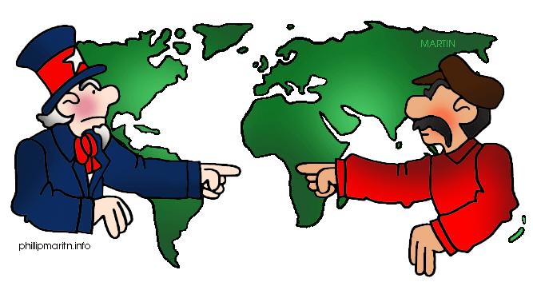
Do Now: Grab today’s Agenda (11:2). Turn in your Boxing Matches. What is the message of the following cartoon?

Slide 2
Objective: East Asia
WHII.13a-c
TSWDK of the second half of the 20th century by explaining key events of the Cold War and by describing conflicts and revolutionary movements in eastern Asia, including those in Vietnam, and their major leaders.

Slide 3
The Cold War Escalates
China
Korea
Vietnam

Slide 4
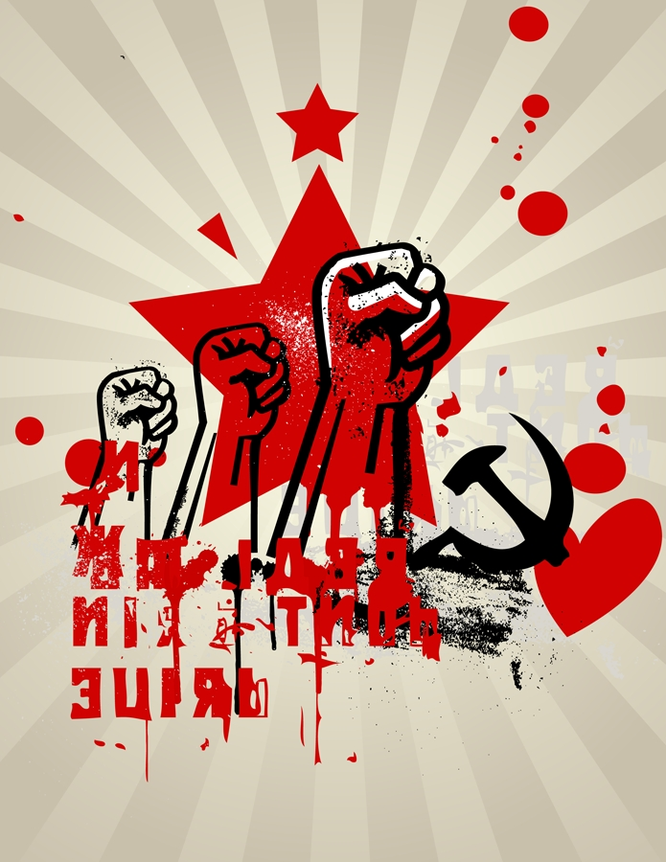
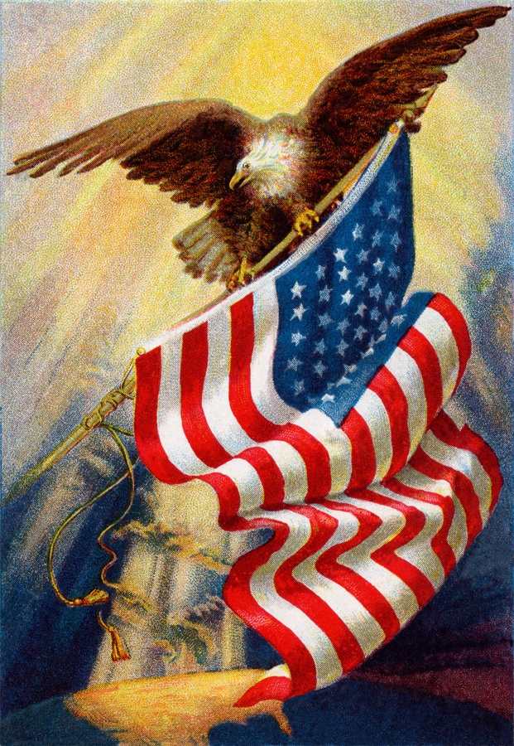
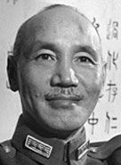
China
Civil War
After WWII, two groups formed in China:
Communist Party led by Mao Zedong
Nationalist Party led by Chiang Kai-Shek (Jiang Jieshi)

Slide 5
China
Civil War
After WWII, two groups formed in China:
Communist Party led by Mao Zedong
Nationalist Party led by Chiang Kai-Shek (Jiang Jieshi)
In 1949, after a brutal civil war (more than 1 million dead), Communist Party drove the Nationalist Party from power.

Slide 6
China
Civil War
After WWII, two groups formed in China:
Communist Party led by Mao Zedong
Nationalist Party led by Chiang Kai-Shek (Jiang Jieshi)
In 1949, after a brutal civil war (more than 1 million dead), Communist Party drove the Nationalist Party from power.
Kai-Shek fled to Taiwan where the Nationalists set up government.
Zedong formed the People’s Republic of China on mainland China.
There has been continuing conflict between the two Chinas.

Slide 7
China
Mao Zedong
1953 – First Five-Year Plan. Industrial development and collectivization. Success!

Slide 8
China
Mao Zedong
1953 – First Five-Year Plan. Industrial development and collectivization. Success!
1958 – Second Five-Year Plan. Compete with industrial West. Failure!

Slide 9
China
Mao Zedong
1953 – First Five-Year Plan. Industrial development and collectivization. Success!
1958 – Second Five-Year Plan. Compete with industrial West. Failure!
1966 – Cultural Revolution.
Replaced old Chinese culture with new socialist culture

Slide 10
China
Mao Zedong
1953 – First Five-Year Plan. Industrial development and collectivization. Success!
1958 – Second Five-Year Plan. Compete with industrial West. Failure!
1966 – Cultural Revolution.
Replaced old Chinese culture with new socialist culture – by force via the Red Guards.
They rampaged China, destroyed artwork, burned books… anything from the “old way.”
They also beat, tortured, and killed people who didn’t follow the “new way.”
Chaos ensued.
Failure.

Slide 11
China
Mao Zedong
1953 – First Five-Year Plan. Industrial development and collectivization. Success!
1958 – Second Five-Year Plan. Compete with industrial West. Failure!
1966 – Cultural Revolution.
Replaced old Chinese culture with new socialist culture – by force via the Red Guards.
They rampaged China, destroyed artwork, burned books… anything from the “old way.”
They also beat, tortured, and killed people who didn’t follow the “new way.”
Chaos ensued.
Failure.
Died 1976.

Slide 12
China
Deng Xiaoping
Modernization in
Agriculture
Industry
Science and technology
National defense
Reformed Communist China’s economy to a market economy, which opened Chinese society to cultural and scientific exchanges with the West.

Slide 13
China
Deng Xiaoping
Modernization in
Agriculture
Industry
Science and technology
National defense
Reformed Communist China’s economy to a market economy, which opened Chinese society to cultural and scientific exchanges with the West.
Led to rapid economic growth. In 1980s and 1990s, China had one of the world’s fastest growing economy.

Slide 14
China
Deng Xiaoping
Modernization in
Agriculture
Industry
Science and technology
National defense
Reformed Communist China’s economy to a market economy, which opened Chinese society to cultural and scientific exchanges with the West.
Led to rapid economic growth. In 1980s and 1990s, China had one of the world’s fastest growing economy.
Continued communist control of government. Considered a communist country today.

Slide 15
Korea
North vs. South
After WWII, Korea was divided on the 38th parallel
Soviets occupied North Korea.

Slide 16
Korea
North vs. South
After WWII, Korea was divided on the 38th parallel
Soviets occupied North Korea. Led by Kim Il Sung.
American troops occupied South Korea.

Slide 17
Korea
North vs. South
After WWII, Korea was divided on the 38th parallel
Soviets occupied North Korea. Led by Kim Il Sung.
American troops occupied South Korea. Led by Syngman Rhee.

Slide 18
Korea
North vs. South
After WWII, Korea was divided on the 38th parallel
Soviets occupied North Korea. Led by Kim Il Sung.
American troops occupied South Korea. Led by Syngman Rhee.
Both Sung and Rhee wanted to reunite Korea, by force if necessary, but on their terms (Soviets vs. US)

Slide 19
Korea
War
1950 – North Korea invades South Korea
UN condemned attack and called on member nations to send in troops… most of which came from US.
US and South Korea attacked North Korea and got pretty far into North Korea.
China felt threatened as US and South Korea approached North Korea’s border with China. So they sent in several hundred thousand soldiers to help North Korea fight off South Korea.

Slide 20
Korea
38th Parallel
1953 – war ends in a draw (tie)
38th parallel is where the two countries border each other.

Slide 21
Vietnam
Background
France colonized Indochina in the late 1850s, including Vietnam.

Slide 22
Vietnam
Background
France colonized Indochina in the late 1850s, including Vietnam.
There was opposition to French rule, particularly by the Viet Minh.
Viet Minh = nationalist party founded in 1941 and controlled by communist ideology.

Slide 23
Vietnam
Background
France colonized Indochina in the late 1850s, including Vietnam.
There was opposition to French rule, particularly by the Viet Minh.
Viet Minh = nationalist party founded in 1941 and controlled by communist ideology.
During WWII, Viet Minh was funded by both the US and China to fight off Japanese occupation.
When France fell to the Nazis in 1940, they lost control of Vietnam.

Slide 24
Vietnam
17th Parallel
Vietnam was divided at the 17th parallel.
Vietnam was divided into two parts:
Viet Minh’s Independent Republic of Vietnam, capital in Hanoi

Slide 25
Vietnam
17th Parallel
Vietnam was divided at the 17th parallel.
Vietnam was divided into two parts:
Viet Minh’s Independent Republic of Vietnam, capital in Hanoi, led by Ho Chi Minh and supported by the Soviets.

Slide 26
Vietnam
17th Parallel
Vietnam was divided at the 17th parallel.
Vietnam was divided into two parts:
Viet Minh’s Independent Republic of Vietnam, capital in Hanoi, led by Ho Chi Minh and supported by the Soviets.
State of Vietnam (French) in South Vietnam, capital in Saigon, and supported by the U.S.

Slide 27
Vietnam
War
Ho Chi Minh sent forces into South Vietnam in an attempt to destabilize the government there and reunite the Vietnams.

Slide 28
Vietnam
War
Ho Chi Minh sent forces into South Vietnam in an attempt to destabilize the government there and reunite the Vietnams.
The US sent a large number of troops and weapons to Saigon to fight off the Viet Minh.
By 1959, the government in Hanoi (North) created the National Liberation Front (NLF), or the Viet Cong, to begin open warfare in the South.

Slide 29
Vietnam
War
American Involvement
In 1960, the US had 800 troops in Vietnam. By 1964, that number grew to 23,000 troops.

Slide 30
Vietnam
War
American Involvement
In 1960, the US had 800 troops in Vietnam. By 1964, that number grew to 23,000 troops.
President Johnson used the Gulf of Tonkin Incident (“attack” of American destroyers in the Gulf of Tonkin by the Viet Cong) to get Congress to authorize the use of more troops.

Slide 31
Vietnam
War
American Involvement
In 1960, the US had 800 troops in Vietnam. By 1964, that number grew to 23,000 troops.
President Johnson used the Gulf of Tonkin Incident (“attack” of American destroyers in the Gulf of Tonkin by the Viet Cong) to get Congress to authorize the use of more troops.
By 1968, more than 500,000 US troops were in Vietnam.

Slide 32
Vietnam
War
American Involvement
In 1960, the US had 800 troops in Vietnam. By 1964, that number grew to 23,000 troops.
President Johnson used the Gulf of Tonkin Incident (“attack” of American destroyers in the Gulf of Tonkin by the Viet Cong) to get Congress to authorize the use of more troops.
By 1968, more than 500,000 US troops were in Vietnam.
Many Americans began to question the US role in Vietnam. The war was widely covered by television and print journalists. The American public was exposed to the images of death and destruction.

Slide 33
Vietnam
War
American Involvement
In 1960, the US had 800 troops in Vietnam. By 1964, that number grew to 23,000 troops.
President Johnson used the Gulf of Tonkin Incident (“attack” of American destroyers in the Gulf of Tonkin by the Viet Cong) to get Congress to authorize the use of more troops.
By 1968, more than 500,000 US troops were in Vietnam.
Many Americans began to question the US role in Vietnam. The war was widely covered by television and print journalists. The American public was exposed to the images of death and destruction.
By 1973, a cease-fire was negotiated. US troops would withdraw from Vietnam and all POWs would be released.

Slide 34
Vietnam
War
Fighting between Hanoi (North) and Saigon (South) continued after the Americans left in 1973 until 1975 when Hanoi forces finally captured Saigon.

Slide 35
Vietnam
War
Fighting between Hanoi (North) and Saigon (South) continued after the Americans left in 1973 until 1975 when Hanoi forces finally captured Saigon.
1975, Vietnam was finally unified… and a communist country.

Slide 36
Vietnam
War
Fighting between Hanoi (North) and Saigon (South) continued after the Americans left in 1973 until 1975 when Hanoi forces finally captured Saigon.
1975, Vietnam was finally unified… and a communist country.
Casualties:
1.3 million Vietnamese dead
58,000 American troops dead

Slide 37
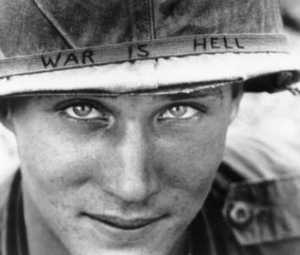

Slide 38
Conclusion
Competition between the United States and the USSR laid the foundation for the Cold War.
The Cold War influenced the policies of the United States and the USSR towards other nations around the world.
Japanese occupation of European colonies in Asia heightened demands for independence after WWII.
After WWII, the United States pursued a policy of containment against communism. This policy included the development of regional alliances against Soviet and Chinese aggression.
The Cold War led to armed conflict in Korea and Vietnam.

