Slide 1
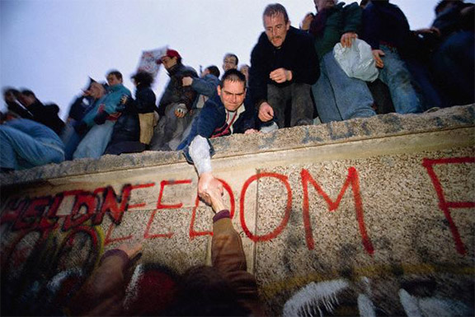
Do Now: Grab today’s Agenda (11:3). Complete the speech bubble.

Slide 2
Objective: The Cold War Ends
WHII.13a and d
TSWDK of the second half of the 20th century by explaining key events of the Cold War and by describing major contributions of selected world leaders in the second half of the 20th century.

Slide 3
The Cold War Ends
After Stalin
Mikhail Gorbachev
The End
England

Slide 4
After Stalin
Nikita Khrushchev
President of the Soviet Union after Stalin died in 1953.

Slide 5
After Stalin
Nikita Khrushchev
President of the Soviet Union after Stalin died in 1953.
“De-Stalinization” – ?

Slide 6
After Stalin
Nikita Khrushchev
President of the Soviet Union after Stalin died in 1953.
“De-Stalinization” – Khrushchev eased the repressive policies used by Stalin.

Slide 7
After Stalin
Nikita Khrushchev
President of the Soviet Union after Stalin died in 1953.
“De-Stalinization” – Khrushchev eased the repressive policies used by Stalin.
“The Thaw” – ?

Slide 8
After Stalin
Nikita Khrushchev
President of the Soviet Union after Stalin died in 1953.
“De-Stalinization” – Khrushchev eased the repressive policies used by Stalin.
“The Thaw” – Khrushchev shifted political, cultural, and economic life in the USSR. More interaction with other nations. Standard of living improved. Economic growth.

Slide 9
After Stalin
Nikita Khrushchev
President of the Soviet Union after Stalin died in 1953.
“De-Stalinization” – Khrushchev eased the repressive policies used by Stalin.
“The Thaw” – Khrushchev shifted political, cultural, and economic life in the USSR. More interaction with other nations. Standard of living improved. Economic growth.
Used the Soviet satellite states as a buffer zone for defense of its western borders. As a result, Soviet military force was used to keep them in line.

Slide 10
After Stalin
Nikita Khrushchev (continued)
Sino-Soviet Split – Mao did not approve of Khrushchev’s ease with the West. Split global communist movement.

Slide 11
After Stalin
Nikita Khrushchev (continued)
Sino-Soviet Split – Mao did not approve of Khrushchev’s ease with the West. Split global communist movement.
Sputnik – promoted scientific and technological advancements. Sent the first satellite in space (Sputnik). Began the space race!

Slide 12
After Stalin
Nikita Khrushchev (continued)
Sino-Soviet Split – Mao did not approve of Khrushchev’s ease with the West. Split global communist movement.
Sputnik – promoted scientific and technological advancements. Sent the first satellite in space (Sputnik). Began the space race!
Cuban Missile Crisis – never recovered from it. Removed from power in 1964,

Slide 13
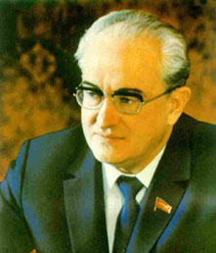
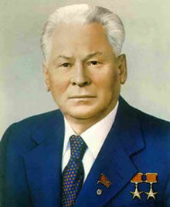
After Stalin
Brezhnev
Was not good for USSR
Andropov
Lasted only 15 months
Chernenko
Lasted less than a year

Slide 14
Mikhail Gorachev
Change
Perestroika
“Restructuring.”
Made government more “people-friendly.”
Returned many of the freedoms they had lost under previous leaders, such as speech and religion.
Turned economy toward market economy.

Slide 15
Mikhail Gorachev
Change
Perestroika
“Restructuring.”
Made government more “people-friendly.”
Returned many of the freedoms they had lost under previous leaders, such as speech and religion.
Turned economy toward market economy.
Glasnost
“Openness.”
Increased openness and transparency of government to reduce corruption and abuse of government power.
Lifted heavy government censorship.

Slide 16
Mikhail Gorbachev
Foreign Relations
Détente = an easing of tension in a strained relationship.
Improved with the United States. Signed several arms-reduction agreements with President Reagan.

Slide 17
Mikhail Gorbachev
Foreign Relations
Détente = an easing of tension in a strained relationship.
Improved with the United States. Signed several arms-reduction agreements with President Reagan.
Abandoned 9-year war in Afghanistan.

Slide 18
Mikhail Gorbachev
Foreign Relations
Détente = an easing of tension in a strained relationship.
Improved with the United States. Signed several arms-reduction agreements with President Reagan.
Abandoned 9-year war in Afghanistan.
Refused military support to satellite states.

Slide 19
The End
Economy
While Perestroika and Glasnost were popular with the international community, they were not popular at home. More goods were made available but basic goods were in short supply.
Soviet economy began to collapse.

Slide 20
The End
Economy
While Perestroika and Glasnost were popular with the international community, they were not popular at home. More goods were made available but basic goods were in short supply.
Soviet economy began to collapse.
Freedoms
Perestroika and Glasnost allowed citizens within the Soviet Union to speak and act more freely.
This led to a growing nationalist movement… especially as Soviet Satellite nations demanded an exit from the Soviet Union.

Slide 21
The End
The Fall of the Berlin Wall
Wall fell November 9, 1989; Germany was re-unified.

Slide 22
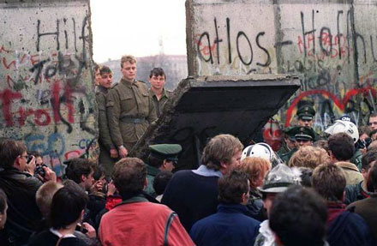
The End
The Fall of the Berlin Wall
Wall fell November 9, 1989; Germany was re-unified.
Actually tearing down began that night and lasted until November 1991.

Slide 23
The End
The Fall of the Berlin Wall
Wall fell November 9, 1989; Germany was re-unified.
Actually tearing down began that night and lasted until November 1991.
December 1991, Gorbachev resigned, becoming the last president of the Soviet Union.

Slide 24
The End
NATO
Without the Cold War, the Warsaw Pact dissolved.

Slide 25
The End
NATO
Without the Cold War, the Warsaw Pact dissolved.
Without the Warsaw Pact, NATO did not have to designate resources towards fighting communism.

Slide 26
The End
NATO
Without the Cold War, the Warsaw Pact dissolved.
Without the Warsaw Pact, NATO did not have to designate resources towards fighting communism.
They restructured and expanded with a focus on nuclear disarmament.

Slide 27
England
British Politics
Economic troubles during the Cold War
Political shift came in the 1970s when the Conservative Party won a majority and elected Margaret Thatcher to be Prime Minister. First woman prime minister in England.

Slide 28
England
Thatcherism
Promoted smaller government involvement; free trade and less government regulation of business.
Southern England benefited from policies; Northern England did not.
Developed close relationship with United States and US foreign policy.
Assertion of UK’s military; became the other world power after US.

Slide 29
Conclusion
Competition between the United States and the USSR laid the foundation for the Cold War.
The Cold War influenced the policies of the United States and the USSR towards other nations and conflicts around the world.
The presence of nuclear weapons has influenced patterns of conflict and cooperation since 1945.
Communism failed as an economic system in the Soviet Union and elsewhere.

