Slide 1
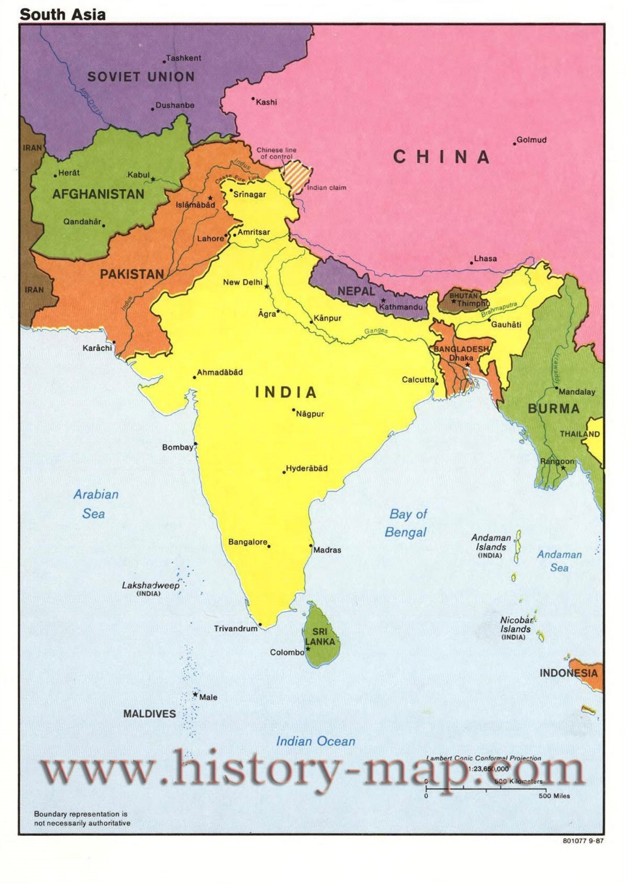
Do Now:
Grab today’s Agenda (12:1). Then complete the map using the map below.

Slide 2
Objective:
Indian Independence
WHII.14a
TSWDK of political, economic, social, and cultural aspects of independence movements and development efforts by describing the struggles for self-rule, including Gandhi’s leadership in India, and the development of India’s democracy.

Slide 3
Indian Independence
Independence for Indian Subcontinent
Indian Democracy

Slide 4
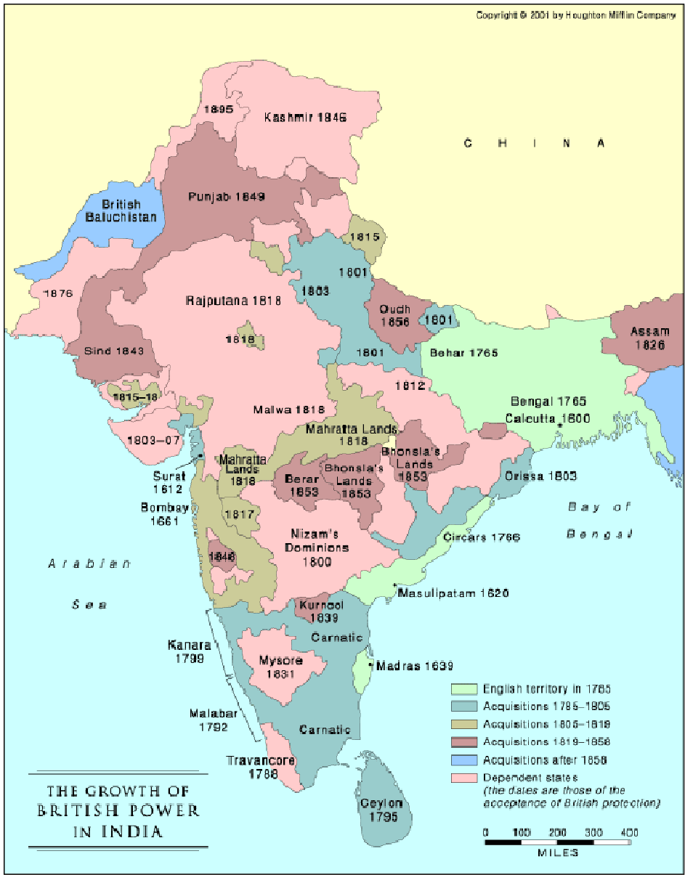
Independence for Indian Subcontinent
British Protectorate
Indian National Congress
  Founded in 1885.
  Took lead in negotiations for independence with British government.
Great Britain, while denying them independence, granted them more political freedoms.
Nationalism increased during WWII when Britain declared India at war with Germany without consulting India.

Slide 5
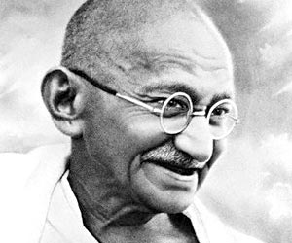
Independence for Indian Subcontinent
Mohandas Gandhi
AKA, Mahatma Gandhi

Slide 6
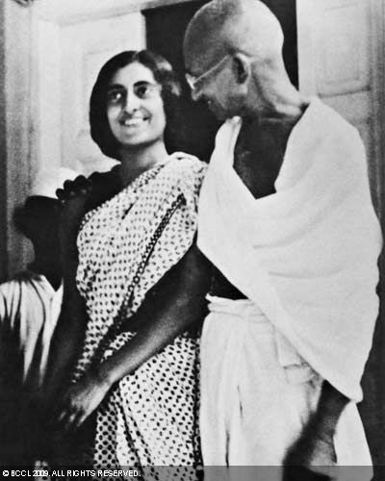
Independence for Indian Subcontinent
Mohandas Gandhi
AKA, Mahatma Gandhi
Led Indian National Congress in 1921

Slide 7
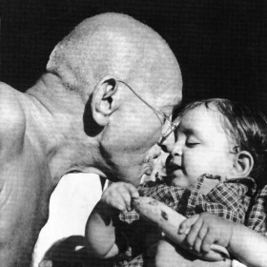
Independence for Indian Subcontinent
Mohandas Gandhi
AKA, Mahatma Gandhi
Led Indian National Congress in 1921
Led nationwide campaigns for easing poverty, expanding women’s rights, and many other social improvements.

Slide 8
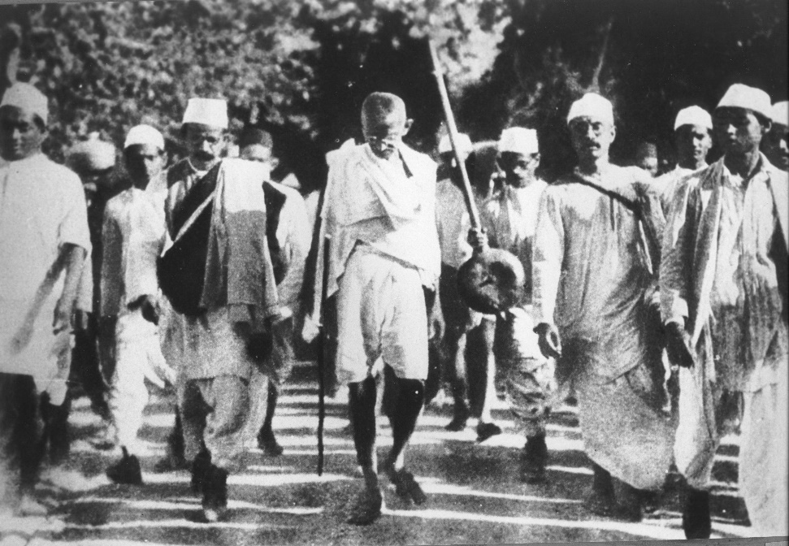
Independence for Indian Subcontinent
Mohandas Gandhi
AKA, Mahatma Gandhi
Led Indian National Congress in 1921
Led nationwide campaigns for easing poverty, expanding women’s rights, and many other social improvements.
Campaigned for the independence of India from foreign domination.

Slide 9
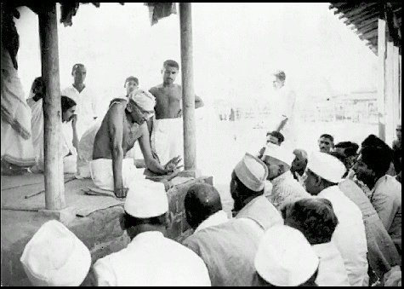
Independence for Indian Subcontinent
Mohandas Gandhi
AKA, Mahatma Gandhi
Led Indian National Congress in 1921
Led nationwide campaigns for easing poverty, expanding women’s rights, and many other social improvements.
Campaigned for the independence of India from foreign domination.
Role of Civil Disobedience
  The refusal to obey certain laws as a peaceful form of peaceful protest.

Slide 10
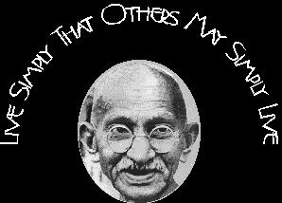
Independence for Indian Subcontinent
Mohandas Gandhi
AKA, Mahatma Gandhi
Led Indian National Congress in 1921
Led nationwide campaigns for easing poverty, expanding women’s rights, and many other social improvements.
Campaigned for the independence of India from foreign domination.
Role of Civil Disobedience
  The refusal to obey certain laws as a peaceful form of peaceful protest.
Passive resistance = Nonviolent opposition to authority.

Slide 11
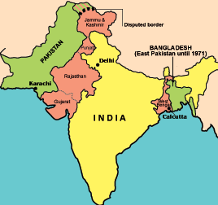
Independence for Indian Subcontinent
India and Pakistan
By 1942, Great Britain agreed to grant India independence after the war.
Tension between the Muslim and Hindu populations in India. So subcontinent was divided into two countries:
  India under Hindu rule
  Pakistan (West and East) under Muslim rule
Kashmir, in Northern India, was overwhelmingly Muslim but under Hindu rule… and remains so today. This has been a point of contention between India and Pakistan ever since.

Slide 12
Independence for Indian Subcontinent
Bangladesh and Sri Lanka
Fighting between West Pakistan and East Pakistan in 1971.
East Pakistan defeated West Pakistan and became Bangladesh.
Ceylon, an island south of India, was culturally different from mainland India. They also fought for independence. Became Sri Lanka.

Slide 13
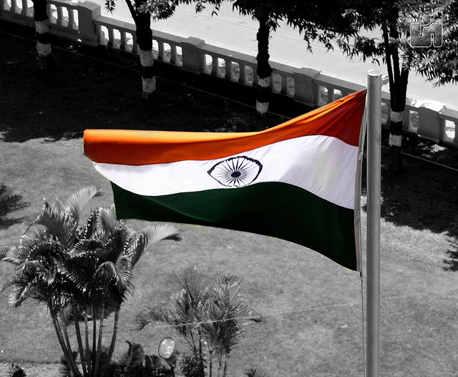
Indian Democracy
Republic of India
A democratic nation developed after the country gained independence.
World’s largest democratic nation.

Slide 14
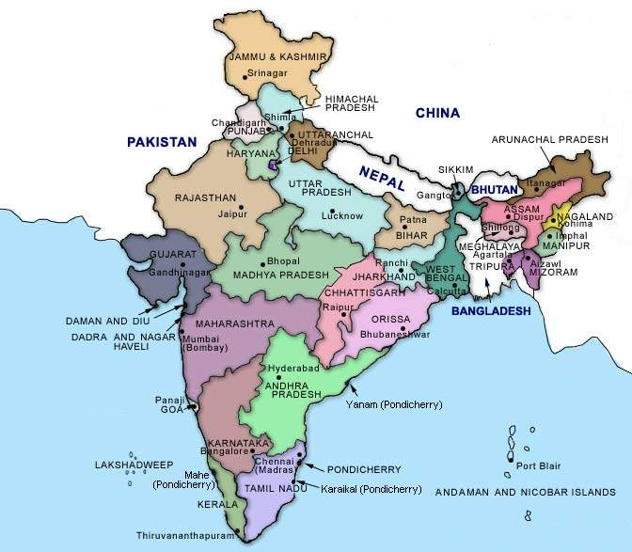
Indian Democracy
Republic of India
A democratic nation developed after the country gained independence.
World’s largest democratic nation.
Federal system – India divided into states; each state has its own powers.

Slide 15
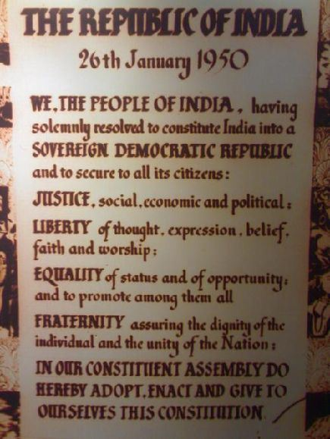
Indian Democracy
Republic of India
A democratic nation developed after the country gained independence.
World’s largest democratic nation.
Federal system – India divided into states; each state has its own powers.
1950 Constitution – declared India to be a sovereign, socialist, secular, democratic republic, assuring its citizens of justice, equality, and liberty. Sought to prohibit caste discrimination (class system).

Slide 16
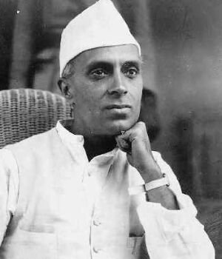
Indian Democracy
Jawaharlal Nehru
India’s first prime minister; close associate of Mohandas Gandhi.
Ethnic and religious differences caused problems in the development of India as a democratic nation.
Supported western-style industrialization.
New economic development has helped to ease financial problems of the nation.

Slide 17
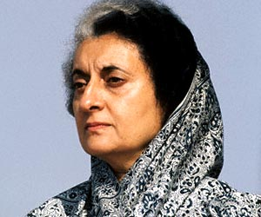
Indian Democracy
Indira Gandhi
Nehru’s daughter and prime minister of India (1966).
Turned Indian economy into a mixed economy – both private and government owned business. Did well for India.

Slide 18
Indian Democracy
Indira Gandhi
Nehru’s daughter and prime minister of India (1966).
Turned Indian economy into a mixed economy – both private and government owned business. Did well for India.
Major problems:

Slide 19
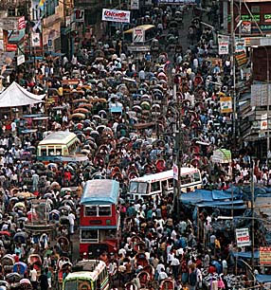
Indian Democracy
Indira Gandhi
Nehru’s daughter and prime minister of India (1966).
Turned Indian economy into a mixed economy – both private and government owned business. Did well for India.
Major problems:
  Population growing too quickly.

Slide 20
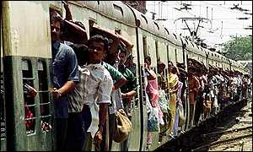
Indian Democracy
Indira Gandhi
Nehru’s daughter and prime minister of India (1966).
Turned Indian economy into a mixed economy – both private and government owned business. Did well for India.
Major problems:
  Population growing too quickly.
  Income level dropped.

Slide 21
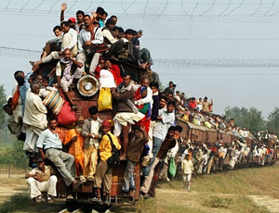
Indian Democracy
Indira Gandhi
Nehru’s daughter and prime minister of India (1966).
Turned Indian economy into a mixed economy – both private and government owned business. Did well for India.
Major problems:
  Population growing too quickly.
  Income level dropped.
  Not enough jobs.

Slide 22
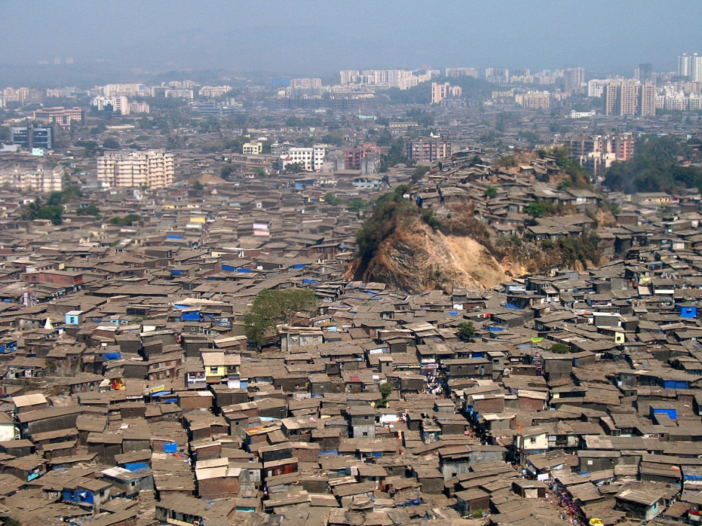
Indian Democracy
Indira Gandhi
Nehru’s daughter and prime minister of India (1966).
Turned Indian economy into a mixed economy – both private and government owned business. Did well for India.
Major problems:
  Population growing too quickly.
  Income level dropped.
  Not enough jobs.
  Crowded cities.

Slide 23
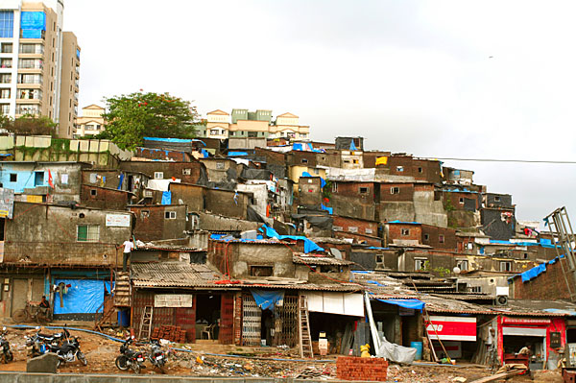
Indian Democracy
Indira Gandhi
Nehru’s daughter and prime minister of India (1966).
Turned Indian economy into a mixed economy – both private and government owned business. Did well for India.
Major problems:
  Population growing too quickly.
  Income level dropped.
  Not enough jobs.
  Crowded cities.
  Not enough housing.

Slide 24
Indian Democracy
Indira Gandhi
Nehru’s daughter and prime minister of India (1966).
Turned Indian economy into a mixed economy – both private and government owned business. Did well for India.
Major problems:
  Population growing too quickly.
  Income level dropped.
  Not enough jobs.
  Crowded cities.
  Not enough housing.
Did not take sides during the Cold War but had a closer relationship with the Soviet Union.
Developed nuclear programs.

Slide 25
Conclusion
British policies and India’s demand for self-rule led to the rise of the Indian independence movement, resulting in the creation of new states in the Indian subcontinent.
The Republic of India, a democratic nation, developed after the country gained independence.

