Slide 1
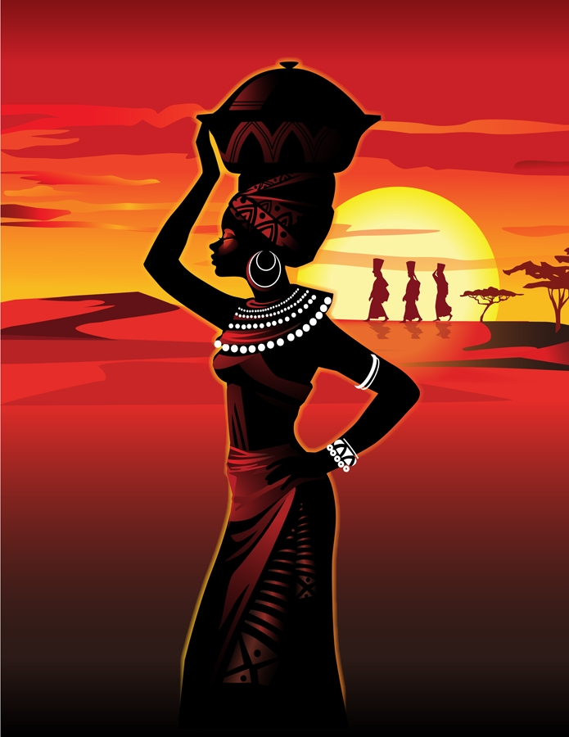
Do Now:
Grab today’s Agenda (12:2)
On the map, locate and label the following countries:
Algeria
Ivory Coast
Ghana
South Africa
Kenya

Slide 2
Objective: Independence in Africa
WHII.14b
TSWDK of political, economic, social, and cultural aspects of independence movements and development efforts by describing Africa’s achievement of independence.

Slide 3
Independence in Africa
Independence Movements
British Colonies
French Colonies

Slide 4
Independence Movements
Right to self-determination (UN Charter)
“All peoples have the right to self-determination. By virtue of that right they freely determine their political status and freely pursue their economic, social, and cultural development.”
Pan-Africanism
African nationalism
Pride in African cultures and heritage
After WWII
Resentment of imperial rule and economic exploitation
Peaceful and violent revolutions after WWII

Slide 5
British Colonies
Ghana (Gold Coast)

Slide 6
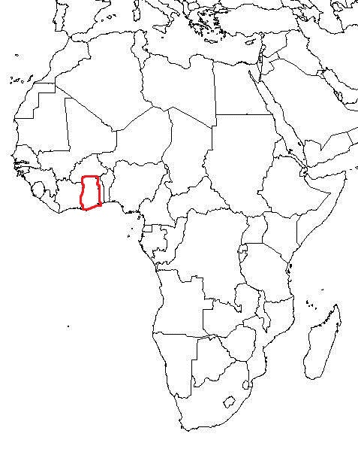
British Colonies
Ghana (Gold Coast)

Slide 7
British Colonies
Ghana (Gold Coast)
Kwame Nkrumah
Nationalist leader of the Gold Coast
Used civil disobedience to pressure the British into granting them independence in 1951

Slide 8
British Colonies
Kenya

Slide 9
British Colonies
Kenya

Slide 10
British Colonies
Kenya
Many white settlers feared that African self-government would threaten their power

Slide 11
British Colonies
Kenya
Many white settlers feared that African self-government would threaten their power
Kikuyu
Kenya’s largest ethnic group

Slide 12
British Colonies
Kenya
Many white settlers feared that African self-government would threaten their power
Kikuyu
Kenya’s largest ethnic group
Jomo Kenyatta, leader of the Kikuyu

Slide 13
British Colonies
Kenya
Many white settlers feared that African self-government would threaten their power
Kikuyu
Kenya’s largest ethnic group
Jomo Kenyatta, leader of the Kikuyu
Mau Mau
Kikuyu nationalist organization
Conducted a 4-year guerilla campaign for independence
Killed 100 Europeans and 2,000 Africans loyal to Britain
British fought back, killing 11,5000 Kikuyu. Thousands more jailed, including Kenyatta as a suspected Mau Mau leader.

Slide 14
British Colonies
Kenya
Many white settlers feared that African self-government would threaten their power
Kikuyu
Kenya’s largest ethnic group
Jomo Kenyatta, leader of the Kikuyu
Mau Mau
Kikuyu nationalist organization
Conducted a 4-year guerilla campaign for independence
Killed 100 Europeans and 2,000 Africans loyal to Britain
British fought back, killing 11,5000 Kikuyu. Thousands more jailed, including Kenyatta as a suspected Mau Mau leader.
Independence
Kenyatta was eventually freed and became a forceful leader.
Brought independence to Kenya in 1963.
Kenyatta was president of Kenya 1964-1978

Slide 15
British Colonies
South Africa

Slide 16
British Colonies
South Africa

Slide 17
British Colonies
South Africa
Only link to Britain was in foreign affairs; autonomous in all else

Slide 18
British Colonies
South Africa
Only link to Britain was in foreign affairs; autonomous in all else
Apartheid
Rigid policy of segregation. Whites and nonwhites were socially segregated. Nonwhites had fewer educational opportunities and could get only low-paying manual work.

Slide 19
British Colonies
South Africa
Only link to Britain was in foreign affairs; autonomous in all else
Apartheid
Rigid policy of segregation. Whites and nonwhites were socially segregated. Nonwhites had fewer educational opportunities and could get only low-paying manual work.
African National Congress (ANC)
Founded in 1912
Fought apartheid using civil disobedience

Slide 20
British Colonies
South Africa
Only link to Britain was in foreign affairs; autonomous in all else
Apartheid
Rigid policy of segregation. Whites and nonwhites were socially segregated. Nonwhites had fewer educational opportunities and could get only low-paying manual work.
African National Congress (ANC)
Founded in 1912
Fought apartheid using civil disobedience
South Africa responded with violence, killing 60 and wounding more than 180

Slide 21
British Colonies
South Africa
Only link to Britain was in foreign affairs; autonomous in all else
Apartheid
Rigid policy of segregation. Whites and nonwhites were socially segregated. Nonwhites had fewer educational opportunities and could get only low-paying manual work.
African National Congress (ANC)
Founded in 1912
Fought apartheid using civil disobedience
South Africa responded with violence, killing 60 and wounding more than 180
South Africa banned the ANC and jailed (some for life) its leaders, including…

Slide 22
British Colonies
South Africa (continued)
Nelson Mandela
Black lawyer and leader of the ANC; given life sentence in jail

Slide 23
British Colonies
South Africa (continued)
Nelson Mandela
Black lawyer and leader of the ANC; given life sentence in jail
ANC continued to work and many white South Africans joined anti-apartheid movement

Slide 24
British Colonies
South Africa (continued)
Nelson Mandela
Black lawyer and leader of the ANC; given life sentence in jail
ANC continued to work and many white South Africans joined anti-apartheid movement
Apartheid Ends
In the 1980s, after facing many protests, including many abroad, South Africa moved away from apartheid policies. Other countries imposed economic sanctions and real change began.

Slide 25
British Colonies
South Africa (continued)
Nelson Mandela
Black lawyer and leader of the ANC; given life sentence in jail
ANC continued to work and many white South Africans joined anti-apartheid movement
Apartheid Ends
In the 1980s, after facing many protests, including many abroad, South Africa moved away from apartheid policies. Other countries imposed economic sanctions and real change began.
September 1989, E.W. Klerk elected president of South Africa and he lifted the ban on anti-apartheid activities. Ordered release of Nelson Mandela.

Slide 26
British Colonies
South Africa (continued)
Nelson Mandela
Black lawyer and leader of the ANC; given life sentence in jail
ANC continued to work and many white South Africans joined anti-apartheid movement
Apartheid Ends
In the 1980s, after facing many protests, including many abroad, South Africa moved away from apartheid policies. Other countries imposed economic sanctions and real change began.
September 1989, E.W. Klerk elected president of South Africa and he lifted the ban on anti-apartheid activities. Ordered release of Nelson Mandela.
Violence continued.

Slide 27
British Colonies
South Africa (continued)
Nelson Mandela
Black lawyer and leader of the ANC; given life sentence in jail
ANC continued to work and many white South Africans joined anti-apartheid movement
Apartheid Ends
In the 1980s, after facing many protests, including many abroad, South Africa moved away from apartheid policies. Other countries imposed economic sanctions and real change began.
September 1989, E.W. Klerk elected president of South Africa and he lifted the ban on anti-apartheid activities. Ordered release of Nelson Mandela.
Violence continued.
1994, first all-races election. Mandela elected president of Republic of South Africa. (Retired in 1999; died in 2013)

Slide 28
French Colonies
Ivory Coast (West Africa)
France planned French African colonies to become a part of France itself… extending political opportunities to Africans. While not true independence, gave Africans experience needed to be politically independent.

Slide 29
French Colonies
Ivory Coast (West Africa)
France planned French African colonies to become a part of France itself… extending political opportunities to Africans. While not true independence, gave Africans experience needed to be politically independent.
In 1958, French President Charles de Gaulle gave colonies a choice: Become a member of French Community and accept French rule in foreign affairs, or become independent, giving up French aid.
Most states within West Africa chose to join the French Community. Only Guinea chose complete independence.

Slide 30
French Colonies
Ivory Coast (West Africa)
France planned French African colonies to become a part of France itself… extending political opportunities to Africans. While not true independence, gave Africans experience needed to be politically independent.
In 1958, French President Charles de Gaulle gave colonies a choice: Become a member of French Community and accept French rule in foreign affairs, or become independent, giving up French aid.
Most states within West Africa chose to join the French Community. Only Guinea chose complete independence.
However, independence without foreign aid opened the door to a communist takeover (Cold War) so France decided to grant aid.
By 1960, all French colonies were granted independence without losing their French connection. Peaceful transition.

Slide 31
French Colonies
Algeria

Slide 32
French Colonies
Algeria
Although a part of the French Community, resentment against foreign control grew among Muslim majority.

Slide 33
French Colonies
Algeria
Although a part of the French Community, resentment against foreign control grew among Muslim majority.
Following a mounting campaign of violence, revolution broke out in 1958.

Slide 34
French Colonies
Algeria
Although a part of the French Community, resentment against foreign control grew among Muslim majority.
Following a mounting campaign of violence, revolution broke out in 1958.
After 4 years of savage warfare, de Gaulle paved the way for Algeria’s independence. In 1963, Algerians won the War of Independence from France.

Slide 35
Conclusion
The charter of the United Nations guaranteed colonial populations the right to self-determination.
Independence movements in Africa challenged European imperialism.
Loss of colonies by Great Britain, France, Belgium, and Portugal; influence of superpower rivalry during the Cold War.

