Slide 1
Do Now:
Clear your desk and take out Part I of your SOL Review Guide. You may use it on the Review Quiz.
After you turn in the quiz, grab today’s Agenda (13:1)
What was the cause of the Palestinian-Israeli conflict?

Slide 2
Objective:
Conflict in the Middle East
WHII.16a
TSWDK of cultural, economic, and social conditions in developed and developing nations of the contemporary world by identifying contemporary political issues with emphasis on migrations of refugees, and other ethnic/religious conflicts and the impact of new technologies.

Slide 3
Conflict in the Middle East
Who Is Involved?
Conflict
An End?

Slide 4
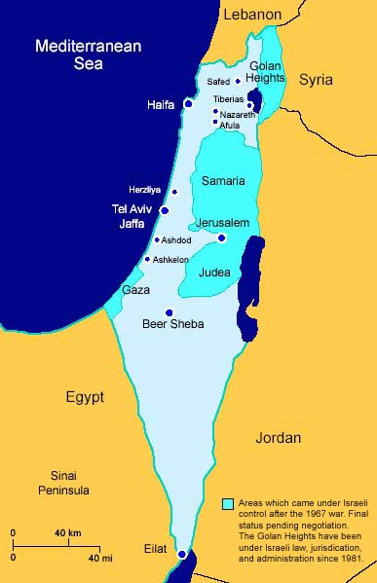
Who Is Involved?
Countries
Israel
Lebanon
Gaza

Slide 5

Who Is Involved?
Peoples
Israelis

Slide 6

Who Is Involved?
Peoples
Israelis
Palestinians
PLO
  Palestine (Palestinian) Liberation Front

Slide 7
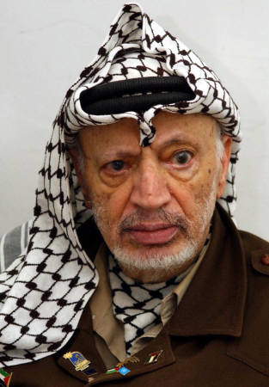
Who Is Involved?
Peoples
Israelis
Palestinians
PLO
  Palestine (Palestinian) Liberation Front
  Led by Yasser Arafat

Slide 8

Who Is Involved?
Peoples
Israelis
Palestinians
PLO
  Palestine (Palestinian) Liberation Front
  Led by Yasser Arafat
PA
  Palestinian Authority

Slide 9
Who Is Involved?
Peoples
Israelis
Palestinians
PLO
  Palestine (Palestinian) Liberation Front
  Led by Yasser Arafat
PA
  Palestinian Authority
  Led by Yasser Arafat

Slide 10
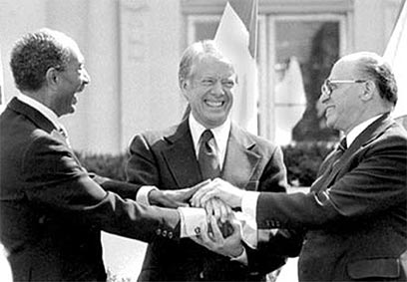
Conflict
Background
Egypt’s peace with Israel (Camp David Accords) meant that the Palestinians were on their own in their attempt to get rid of Israel.

Slide 11
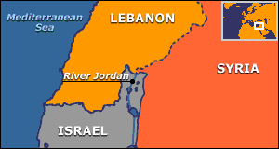
Conflict
Background
Egypt’s peace with Israel (Camp David Accords) meant that the Palestinians were on their own in their attempt to get rid of Israel.
As a result of the many wars in Israel, there were many Palestinians without a place to go (refugees). So in 1982, the PLO set up base in southern Lebanon and began to bomb northern Israel.

Slide 12
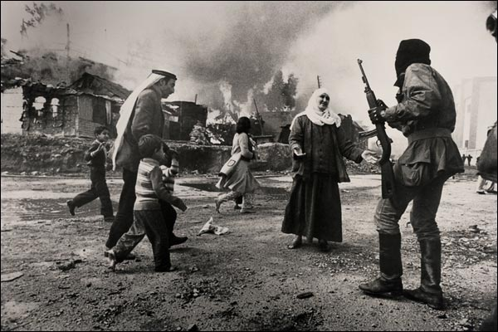
Conflict
Background
Egypt’s peace with Israel (Camp David Accords) meant that the Palestinians were on their own in their attempt to get rid of Israel.
As a result of the many wars in Israel, there were many Palestinians without a place to go (refugees). So in 1982, the PLO set up base in southern Lebanon and began to bomb northern Israel.
Israel attacks southern Lebanon to drive out the Palestinian guerillas. The Israelis succeed… for a few years.

Slide 13
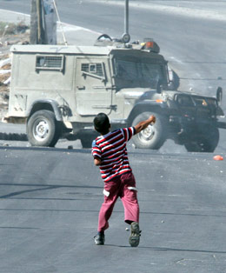
Conflict
First Intifada
1987
Began in West Bank and Gaza
A popular uprising of Palestinians living in Israel
No leader to be tracked down, no bases to be bombed, mostly young boys, usually throwing rocks
Very difficult for Israel, a professional military, to fight

Slide 14
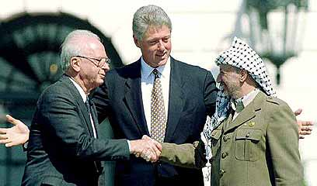
Conflict
Oslo Accords
1993
Cease-fire between Israel and the PA in order to start the peace process
Signed by
  Israel – Prime Minister Yitzchak Rabin
  PA – President Yasser Arafat
  U.S. – President Bill Clinton

Slide 15
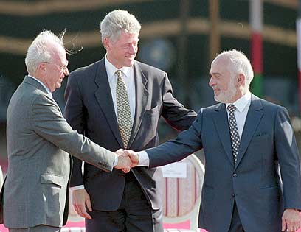
Conflict
Oslo Accords
1993
Cease-fire between Israel and the PA in order to start the peace process
Signed by
  Israel – Prime Minister Yitzchak Rabin
  PA – President Yasser Arafat
  U.S. – President Bill Clinton
  1994, Israel signs peace treaty with Jordan

Slide 16
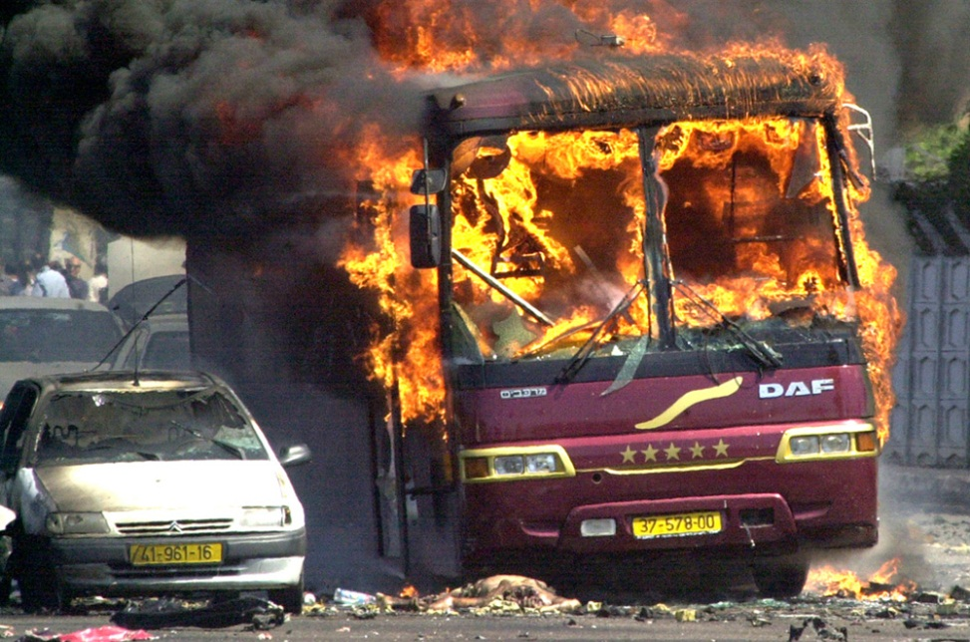
Conflict
Oslo Accords
1993
Cease-fire between Israel and the PA in order to start the peace process
Signed by
  Israel – Prime Minister Yitzchak Rabin
  PA – President Yasser Arafat
  U.S. – President Bill Clinton
  1994, Israel signs peace treaty with Jordan
  2000, after attempts at peace fail, the Second Intifada begins

Slide 17
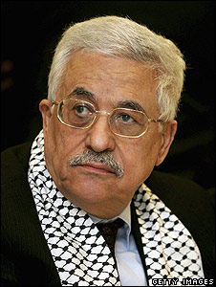
An End?
Resolution
2004, Arafat dies and Fatah’s (Palestinian nationalist movement) Mahmoud Abbas takes over as president of the PA.

Slide 18
An End?
Resolution
2004, Arafat dies and Fatah’s (Palestinian nationalist movement) Mahmoud Abbas takes over as president of the PA.
Attempts at peace continue; for a two-state solution rather than to get rid of Israel completely.

Slide 19
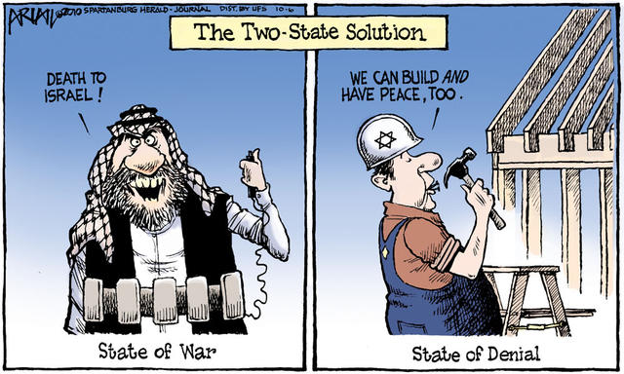
An End?
Resolution
2004, Arafat dies and Fatah’s (Palestinian nationalist movement) Mahmoud Abbas takes over as president of the PA.
Attempts at peace continue; for a two-state solution rather than to get rid of Israel completely.
Current Status

Slide 20
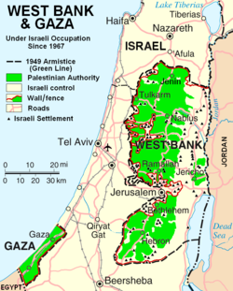
An End?
Resolution
2004, Arafat dies and Fatah’s (Palestinian nationalist movement) Mahmoud Abbas takes over as president of the PA.
Attempts at peace continue; for a two-state solution rather than to get rid of Israel completely.
Current Status
2005, Israel cedes Gaza to the PA. Hamas (terrorist organization) has since been elected to govern Gaza.

Slide 21
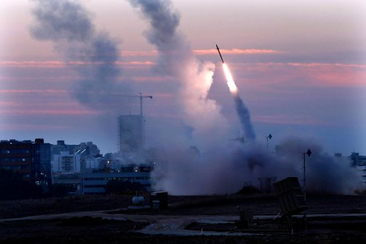
An End?
Resolution
2004, Arafat dies and Fatah’s (Palestinian nationalist movement) Mahmoud Abbas takes over as president of the PA.
Attempts at peace continue; for a two-state solution rather than to get rid of Israel completely.
Current Status
2005, Israel cedes Gaza to the PA. Hamas (terrorist organization) has since been elected to govern Gaza.
2008, after a 6-month cease-fire, Hamas steps up rocket attacks on Israel from Gaza.
2014, Fatah and Hamas join together; Israel ceases all peace talks

Slide 22
Conclusion
The contemporary world faces many challenges, including a conflict in the Middle East.

