Slide 1
Do Now:
Grab today’s Agenda (13:5)
Find the following countries on the map on your agenda:
Philippines
Burma (Myanmar)
Indonesia
Laos
Cambodia

Slide 2
Objective:
Conflict in South Asia
WHII.16a
TSWDK of cultural, economic, and social conditions in developed and developing nations of the contemporary world by identifying contemporary political issues with emphasis on migrations of refugees, and other ethnic/religious conflicts and the impact of new technologies.

Slide 3
World Conflicts
Philippines
Burma (Myanmar)
Indonesia
Laos and Cambodia

Slide 4
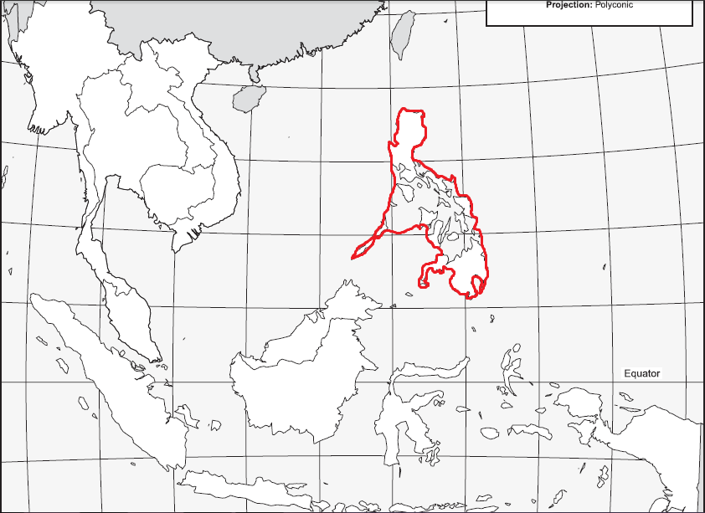
Philippines

Slide 5
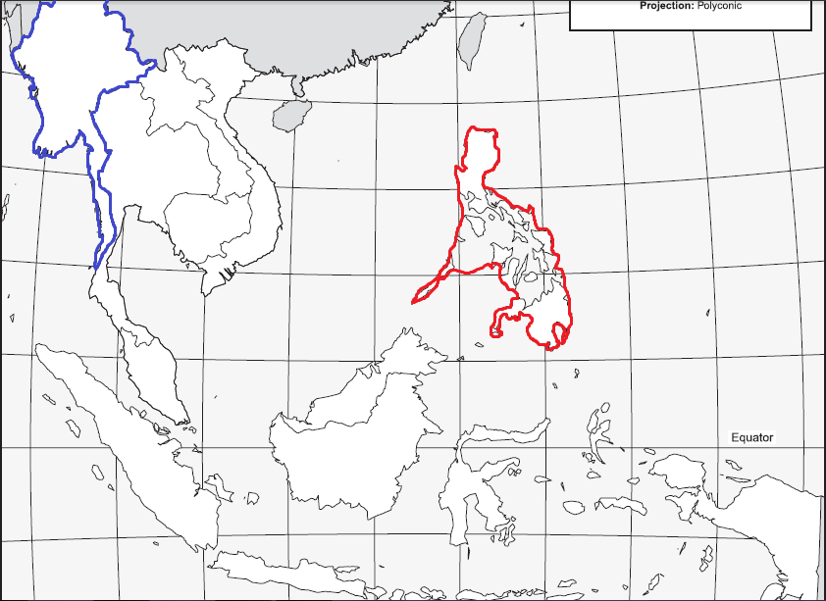
Burma (Myanmar)

Slide 6
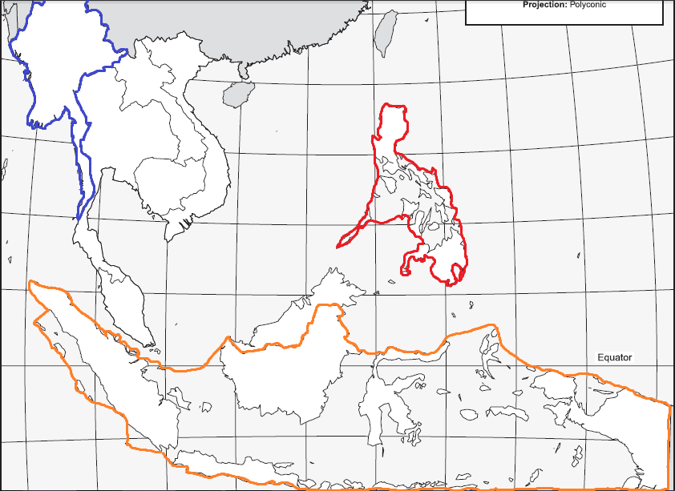
Indonesia

Slide 7
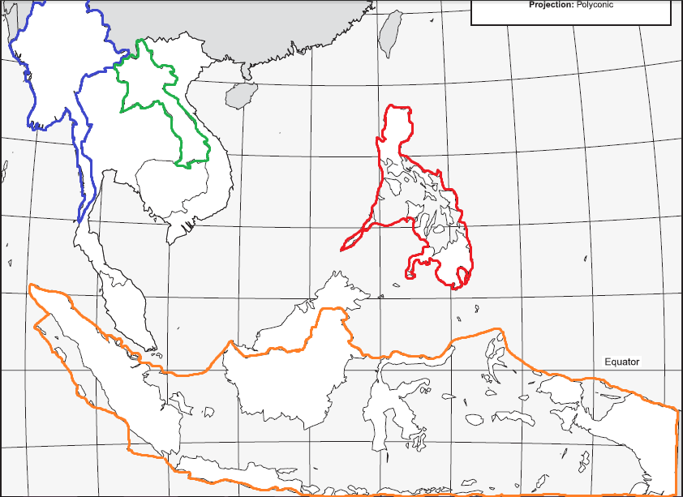
Laos

Slide 8

Cambodia

Slide 9
Philippines
Who Is Involved?
US
Philippines
Background
US controlled Philippines 1898-1946, when they declared independence

Slide 10
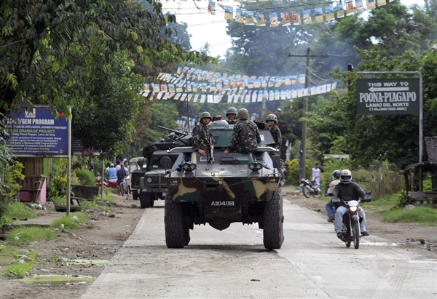
Philippines
Who Is Involved?
US
Philippines
Background
US controlled Philippines 1898-1946, when they declared independence
But there was much turmoil in the 1970s between rioting Communists and Muslims fighting for self-rule.

Slide 11
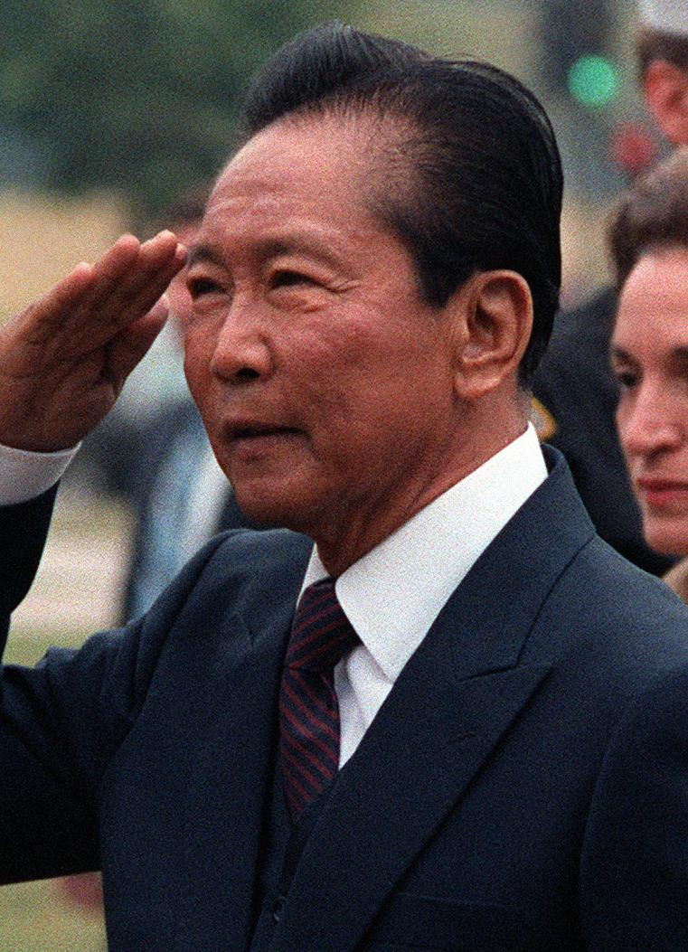
Philippines
Who Is Involved?
US
Philippines
Background
US controlled Philippines 1898-1946, when they declared independence
But there was much turmoil in the 1970s between rioting Communists and Muslims fighting for self-rule.
Conflict
1972, President Ferdinand Marcos placed country under martial law and had hundreds of enemies arrested.
US continued to support Marcos because he was anti-Communist and pro-West.
Economy weakened and protests against Marco’s rule grew.
Resolution
1986, Marcos forced out of country.
Rulers after him improved and then worsened economy.

Slide 12
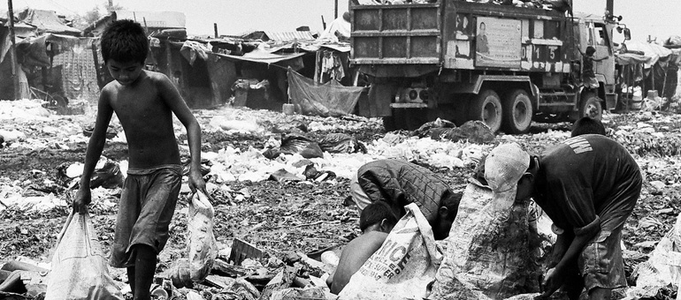
Philippines
Who Is Involved?
US
Philippines
Background
US controlled Philippines 1898-1946, when they declared independence
But there was much turmoil in the 1970s between rioting Communists and Muslims fighting for self-rule.
Conflict
1972, President Ferdinand Marcos placed country under martial law and had hundreds of enemies arrested.
US continued to support Marcos because he was anti-Communist and pro-West.
Economy weakened and protests against Marco’s rule grew.
Resolution
1986, Marcos forced out of country.
Rulers after him improved and then worsened economy.
Current Status
By 2000 Philippines torn by mass protests again.

Slide 13
Burma (Myanmar)
Who Is Involved?
UK
Burmese
Background
Britain colonized Burma until 1948, when it finally gained independence
Weak government led to dictatorship, which destroyed economy and agriculture.

Slide 14
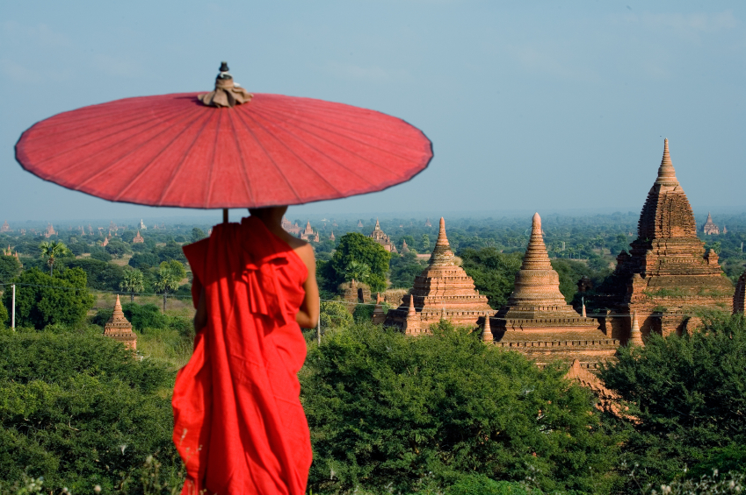
Burma (Myanmar)
Who Is Involved?
UK
Burmese
Background
Britain colonized Burma until 1948, when it finally gained independence
Weak government led to dictatorship, which destroyed economy and agriculture.
As dictators came and went, country renamed Myanmar to show fresh start.
Conflict
1990, first free elections in Myanmar

Slide 15
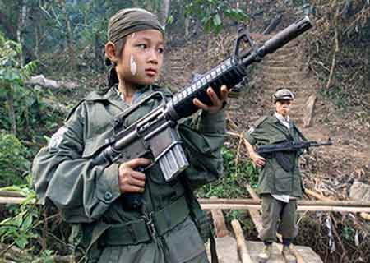
Burma (Myanmar)
Who Is Involved?
UK
Burmese
Background
Britain colonized Burma until 1948, when it finally gained independence
Weak government led to dictatorship, which destroyed economy and agriculture.
As dictators came and went, country renamed Myanmar to show fresh start.
Conflict
1990, first free elections in Myanmar
Opposing party won but military refused to give up power so cracked down on all opposition..
Resolution - None

Slide 16
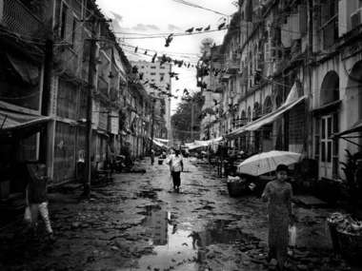
Burma (Myanmar)
Who Is Involved?
UK
Burmese
Background
Britain colonized Burma until 1948, when it finally gained independence
Weak government led to dictatorship, which destroyed economy and agriculture.
As dictators came and went, country renamed Myanmar to show fresh start.
Conflict
1990, first free elections in Myanmar
Opposing party won but military refused to give up power so cracked down on all opposition..
Resolution - None
Current Status – Little progress in Myanmar, but unrest continues.

Slide 17
Indonesia
Who Is Involved? Indonesians
Background
1949, East Indies gains independence from Dutch and renamed Republic of Indonesia
First president turns into dictator, which leads to economic problems

Slide 18
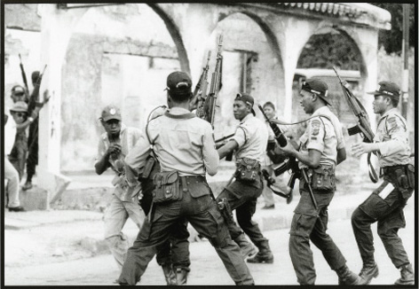
Indonesia
Who Is Involved? Indonesians
Background
1949, East Indies gains independence from Dutch and renamed Republic of Indonesia
First president turns into dictator, which leads to economic problems
Communists fight for control
Conflict
Indonesia allies with West for support and economy improves slightly.

Slide 19
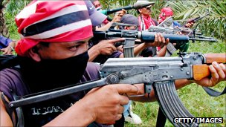
Indonesia
Who Is Involved? Indonesians
Background
1949, East Indies gains independence from Dutch and renamed Republic of Indonesia
First president turns into dictator, which leads to economic problems
Communists fight for control
Conflict
Indonesia allies with West for support and economy improves slightly.
Religious tension created by Islamic extremists
Resolution - None

Slide 20
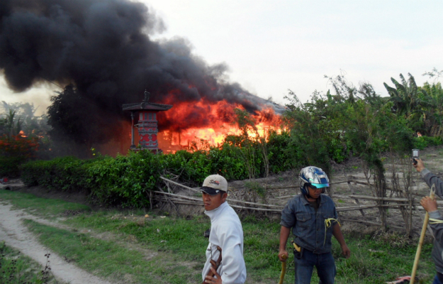
Indonesia
Who Is Involved? Indonesians
Background
1949, East Indies gains independence from Dutch and renamed Republic of Indonesia
First president turns into dictator, which leads to economic problems
Communists fight for control
Conflict
Indonesia allies with West for support and economy improves slightly.
Religious tension created by Islamic extremists
Resolution - None
Current Status – Indonesia still threatened by terrorist bombings by Islamic extremists

Slide 21
Laos and Cambodia
Who Is Involved?
France
Lao People
Cambodians
Background
France colonized Laos and Cambodia (Indochina) until 1954/53

Slide 22
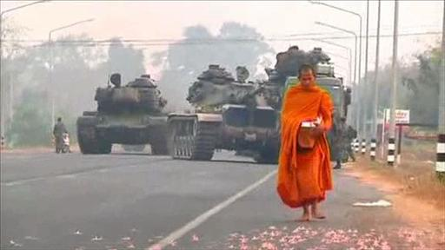
Laos and Cambodia
Who Is Involved?
France
Lao People
Cambodians
Background
France colonized Laos and Cambodia (Indochina) until 1954/53
But civil war immediately breaks out among factions over control of new government.
Conflict

Slide 23
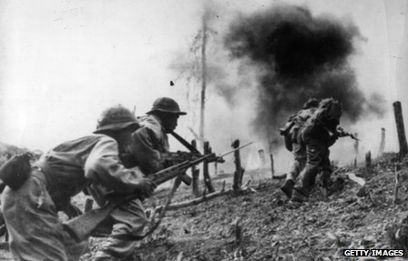
Laos and Cambodia
Who Is Involved?
France
Lao People
Cambodians
Background
France colonized Laos and Cambodia (Indochina) until 1954/53
But civil war immediately breaks out among factions over control of new government.
Conflict
Both Laos and Cambodia were affected by the Vietnam War. US bombed both countries to destroy the Viet Cong supply line.
Made civil war worse.
Resolution

Slide 24
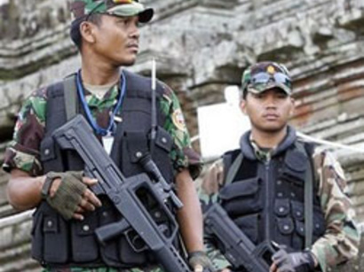
Laos and Cambodia
Who Is Involved?
France
Lao People
Cambodians
Background
France colonized Laos and Cambodia (Indochina) until 1954/53
But civil war immediately breaks out among factions over control of new government.
Conflict
Both Laos and Cambodia were affected by the Vietnam War. US bombed both countries to destroy the Viet Cong supply line.
Made civil war worse.
Resolution
1975, Communist government set up in Laos; became Lao People’s Democratic Republic

Slide 25
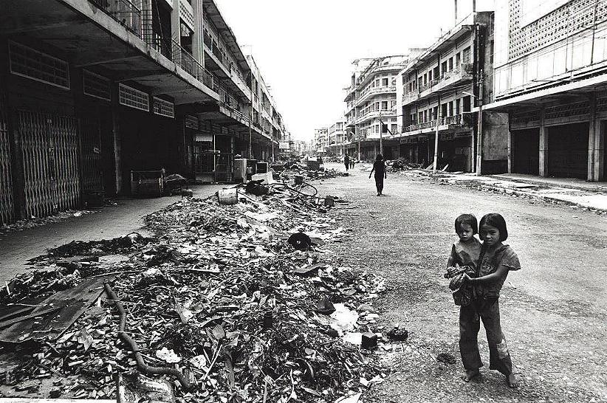
Laos and Cambodia
Who Is Involved?
France
Lao People
Cambodians
Background
France colonized Laos and Cambodia (Indochina) until 1954/53
But civil war immediately breaks out among factions over control of new government.
Conflict
Both Laos and Cambodia were affected by the Vietnam War. US bombed both countries to destroy the Viet Cong supply line.
Made civil war worse.
Resolution
1975, Communist government set up in Laos; became Lao People’s Democratic Republic
Cambodia suffered through Pol Pot and the Khmer Rouge

Slide 26
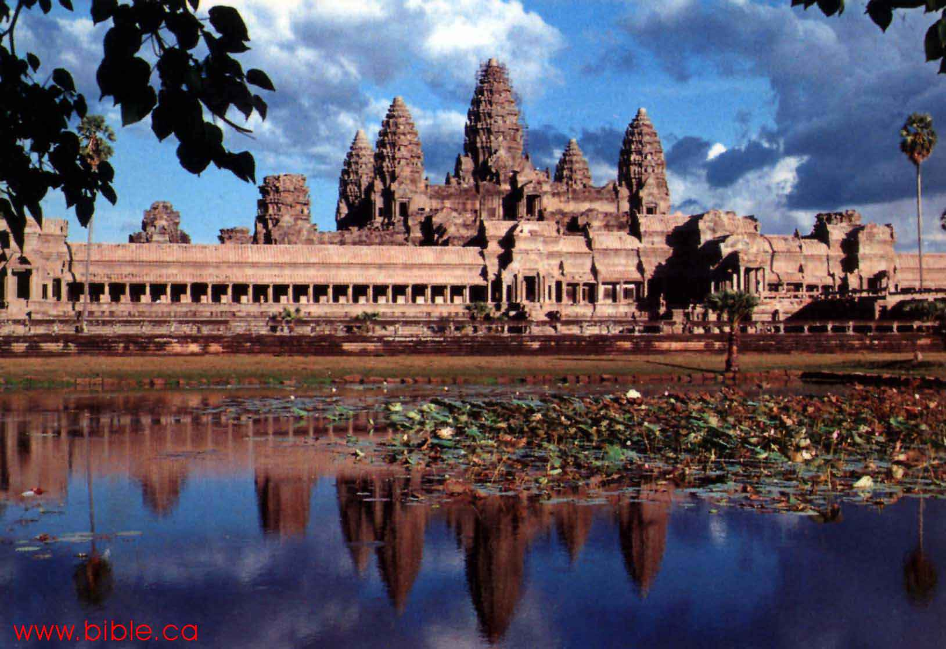
Laos and Cambodia
Who Is Involved?
France
Lao People
Cambodians
Background
France colonized Laos and Cambodia (Indochina) until 1954/53
But civil war immediately breaks out among factions over control of new government.
Conflict
Both Laos and Cambodia were affected by the Vietnam War. US bombed both countries to destroy the Viet Cong supply line.
Made civil war worse.
Resolution
1975, Communist government set up in Laos; became Lao People’s Democratic Republic
Cambodia suffered through Pol Pot and the Khmer Rouge
Current Status
Cambodia today is a constitutional monarchy

Slide 27
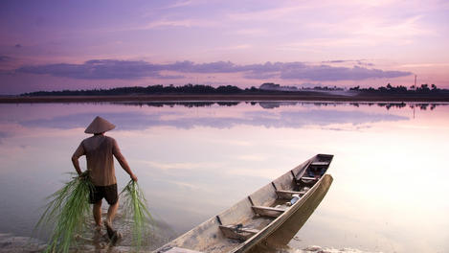
Laos and Cambodia
Who Is Involved?
France
Lao People
Cambodians
Background
France colonized Laos and Cambodia (Indochina) until 1954/53
But civil war immediately breaks out among factions over control of new government.
Conflict
Both Laos and Cambodia were affected by the Vietnam War. US bombed both countries to destroy the Viet Cong supply line.
Made civil war worse.
Resolution
1975, Communist government set up in Laos; became Lao People’s Democratic Republic
Cambodia suffered through Pol Pot and the Khmer Rouge
Current Status
Cambodia today is a constitutional monarchy
Laos is still a communist state

Slide 28
Conclusion
The contemporary world faces many challenges, which includes ethnic and religious conflicts.
The migration of refugees and others as a result of these conflicts has become an international conflict.
Homework!!!

