Slide 1
Do Now:
Grab today’s Agenda (13:6).
Take out your homework. Make sure you can locate your country on the map. Make sure the last two questions have been completed.

Slide 2
Objective: Globalization
WHII.16b and c
TSWDK of cultural, economic, and social conditions in developed and developing nations of the contemporary world by assessing the impact of economic development and global population growth on the environment and society, including an understanding of the links between economic and political freedoms, and by describing economic interdependence including the rise of multinational corporations, international organizations, and trade agreements.

Slide 3
Globalization
Economic Interdependence
Developed vs. Developing

Slide 4
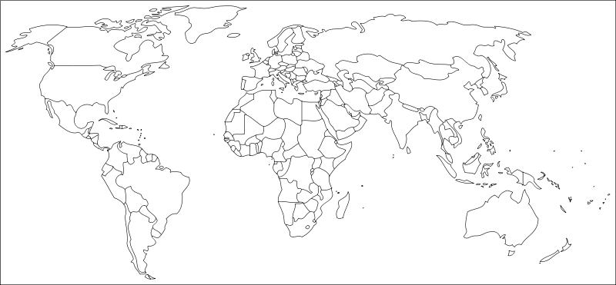

Slide 5
Economic Interdependence
Definitions
Interdependence = ?

Slide 6
Economic Interdependence
Definitions
Interdependence = a reciprocal relation between independent groups.
Economic interdependence = ?

Slide 7
Economic Interdependence
Definitions
Interdependence = a reciprocal relation between independent groups.
Economic interdependence = participants in an economic system are dependent on others for the products they cannot produce or produce efficiently themselves.

Slide 8
Economic Interdependence
New Technologies
New technologies such as rapid transportation, communication, and computer networks have made trade easier, faster, and cheaper.
Vast trading networks have led to the rise and influence of multinational corporations (corporations that move across international boundaries).
As a result of vast trading networks and multinational corporations, the role of international boundaries has changed.

Slide 9
Economic Interdependence
EU
European Union
Created in 1957
Purpose: regional integration; unite Europeans to escape from the extreme forms of nationalism.

Slide 10
Economic Interdependence
EU
European Union
Created in 1957
Purpose: regional integration; unite Europeans to escape from the extreme forms of nationalism.
1985, open borders
2002, Euro notes replace national currencies.
28 members (more coming)

Slide 11
Economic Interdependence
Trade Agreements
NAFTA
North Americans Free Trade Agreement
Created in 1954
Purpose: eliminates barriers to trade (tariffs)
Includes Canada, Mexico, and the United States

Slide 12
Economic Interdependence
Trade Agreements
NAFTA
North Americans Free Trade Agreement
Created in 1954
Purpose: eliminates barriers to trade (tariffs)
Includes Canada, Mexico, and the United States
WTO
World Trade Organization
Created in 1995
Purpose: to help producers of goods and services, exporters, importers conduct their business. Global international organization deals with rules of trade between nations.
154 member countries

Slide 13
Economic Interdependence
International Organizations
UN
(You know this!)

Slide 14
Economic Interdependence
International Organizations
UN
(You know this!)
IMF
International Monetary Fund
Created in 1945
Purpose: to stabilize world economy by fostering global monetary cooperation, secure financial stability, facilitate international trade, promote high employment and sustainable economic growth, and reduce poverty.
188 member nations

Slide 15
Developed vs. Developing
Define “Globalization”
Worldwide integration and development

Slide 16
Developed vs. Developing
Environmental Changes
The growth of economic interdependence has led to an increase in developing countries around the world.

Slide 17
Developed vs. Developing
Environmental Changes
The growth of economic interdependence has led to an increase in developing countries around the world.
This has created challenges on the environment:
Pollution

Slide 18
Developed vs. Developing
Environmental Changes
The growth of economic interdependence has led to an increase in developing countries around the world.
This has created challenges on the environment:
Pollution
Loss of habitat

Slide 19
Developed vs. Developing
Environmental Changes
The growth of economic interdependence has led to an increase in developing countries around the world.
This has created challenges on the environment:
Pollution
Loss of habitat
Global climate change

Slide 20
Developed vs. Developing
Social Changes
The development of economies around the world has led to rapid population growth.

Slide 21
Developed vs. Developing
Social Changes
The development of economies around the world has led to rapid population growth.
This has created challenges on society:
Poverty

Slide 22
Developed vs. Developing
Social Changes
The development of economies around the world has led to rapid population growth.
This has created challenges on society:
Poverty
Poor health

Slide 23
Developed vs. Developing
Social Changes
The development of economies around the world has led to rapid population growth.
This has created challenges on society:
Poverty
Poor health
Illiteracy

Slide 24
Developed vs. Developing
Social Changes
The development of economies around the world has led to rapid population growth.
This has created challenges on society:
Poverty
Poor health
Illiteracy
Famine

Slide 25
Developed vs. Developing
Social Changes
The development of economies around the world has led to rapid population growth.
This has created challenges on society:
Poverty
Poor health
Illiteracy
Famine
Migration

Slide 26
Developed vs. Developing
Stages of Development
Definitions:
Developed Country = a sovereign state that has a highly developed economy and advanced technological infrastructure relative to other less developed nations.
Developing Country = a nation with a low living standard, underdeveloped industrial base, and low human development relative to other countries.

Slide 27
Developed vs. Developing
Stages of Development
Geography matters. Where a country is geographically located determines its success in development.
Economic conditions
GDP – Gross Domestic Product = ?

Slide 28
Developed vs. Developing
Stages of Development
Geography matters. Where a country is geographically located determines its success in development.
Economic conditions
GDP – Gross Domestic Product = the value of what a country can produce in both goods and services.
Determined by per capita income, how much the average citizen earns in a year.
What types of industries would earn the most money?

Slide 29
Developed vs. Developing
Stages of Development
Geography matters. Where a country is geographically located determines its success in development.
Economic conditions
GDP – Gross Domestic Product = the value of what a country can produce in both goods and services.
Determined by per capita income, how much the average citizen earns in a year.
What types of industries would earn the most money? The least money?

Slide 30
Developed vs. Developing
Stages of Development
Social conditions
Literacy rate – the percentage of a country that can read above a certain age.
What level of literacy would a developed country need?
What does a literacy rate tell us about the country?
Access to health care – what indicators would tell us about a country’s access to health care?
Life expectancy
Death rate
Maternal death rate
Infant mortality rate

Slide 31
Developed vs. Developing
Stages of Development
Population and rate of growth
Populations are supposed to grow but the rate of growth determines how a country’s resources should be divided among its citizens.
A country that grows too fast will not have enough resources for its people, thus producing many challenges for the country.

Slide 32
Developed vs. Developing
Freedoms
Free market economies allow for a rising standard of living and an expanding middle class.
An expanding middle class produces growing demands on a government, particularly for political freedoms and individual rights.
Recent examples include Taiwan and South Korea.

Slide 33
Conclusion
The countries of the world are increasingly dependent one each other for raw materials, markets, and financial resources, although there is still a difference between the developed and developing nations.
Developed and developing nations are characterized by different levels of economic development, population characteristics, and social conditions.
Economic development and the rapid growth of population are having an impact on the environment.
Sound economic conditions contribute to a stable democracy, and political freedom helps foster economic development.

Slide 34
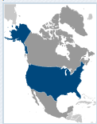
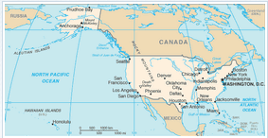
United States of America
Birthrate: 13.68 (per 1,000)
Deathrate: 8.39 (per 1,000)
Life expectancy: 78.49
Infant mortality rate: 5.98 (per 1,000)
Children under the age of 5 underweight: 1.3%
Literacy (age 15 and over): 99%
Government type: Republic
GDP – per capita: $48,100
Population below poverty line: 15.1%

Slide 35
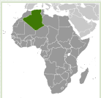
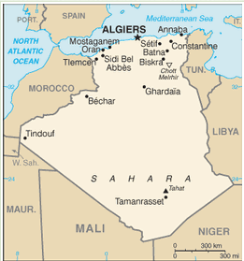
Algeria
Birthrate: 16.64 (per 1,000)
Deathrate: 4.72 (per 1,000)
Life expectancy: 74.73
Infant mortality rate: 24.9 (per 1,000)
Children under the age of 5 underweight: 3.7%
Literacy (age 15 and over): 69.9%
Government type: Republic
GDP – per capita: $7,200
Population below poverty line: 23%

Slide 36
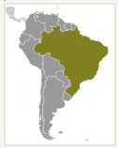
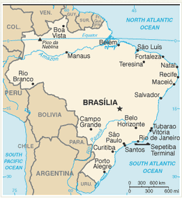
Brazil
Birthrate: 17.48 (per 1,000)
Deathrate: 6.38 (per 1,000)
Life expectancy: 72.79
Infant mortality rate: 20.5 (per 1,000)
Children under the age of 5 underweight: 2.2%
Literacy (age 15 and over): 88.6%
Government type: Republic
GDP – per capita: $11,600
Population below poverty line: 26%

Slide 37
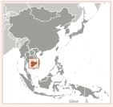
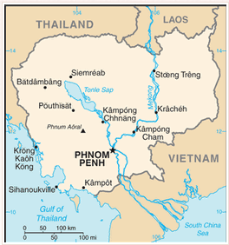
Cambodia
Birthrate: 25.7 (per 1,000)
Deathrate: 7.97 (per 1,000)
Life expectancy: 63.04
Infant mortality rate: 54.08 (per 1,000)
Children under the age of 5 underweight: 28.8%
Literacy (age 15 and over): 73.6%
Government type: Constitutional Monarchy
GDP – per capita: $2,300
Population below poverty line: 31%

Slide 38
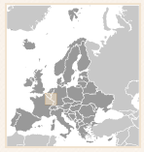
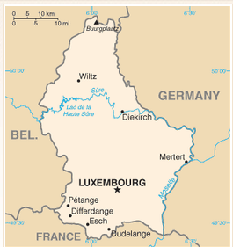
Luxembourg
Birthrate: 11.7 (per 1,000)
Deathrate: 8.5 (per 1,000)
Life expectancy: 79.75
Infant mortality rate: 4.39 (per 1,000)
Children under the age of 5 underweight: NA
Literacy (age 15 and over): 100%
Government type: Constitutional Monarchy
GDP – per capita: $84,700
Population below poverty line: NA

Slide 39
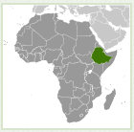
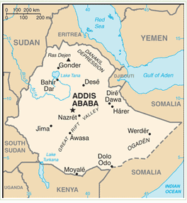
Ethiopia
Birthrate: 42.59 (per 1,000)
Deathrate: 10.79 (per 1,000)
Life expectancy: 56.56
Infant mortality rate: 75.29 (per 1,000)
Children under the age of 5 underweight: 34.6%
Literacy (age 15 and over): 42.7%
Government type: Republic
GDP – per capita: $1,100
Population below poverty line: 29.2%

