Slide 1
Do Now:
Please take a map from the table below.
Then go to Weebly → Assignments → Unit 1 → Lesson 2. Grab “Know Your Map!” (Hard copies are available.)
Locate and label the places on the list.

Slide 2
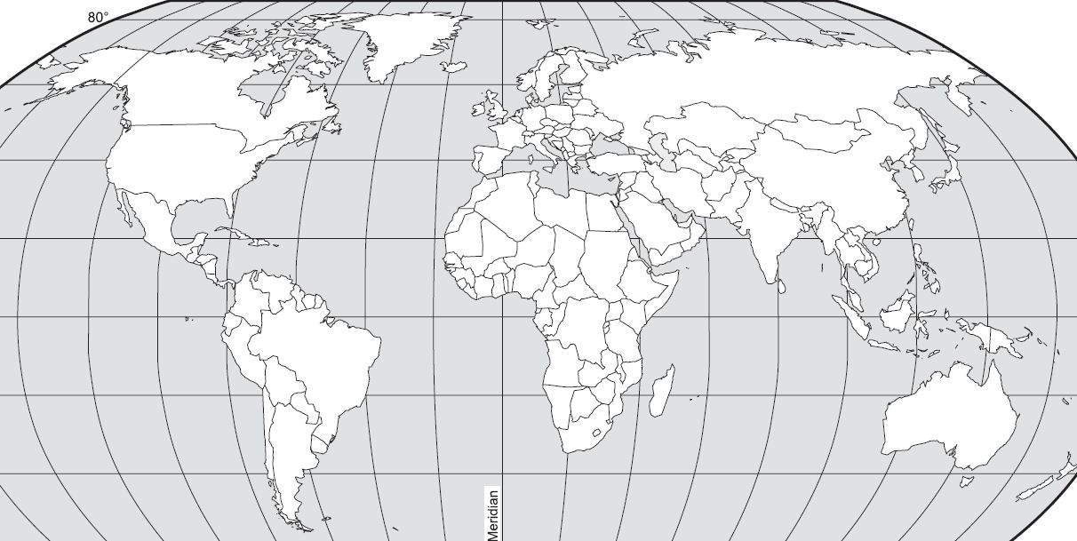

Slide 3
Questions to Consider…
Why is it important to know the world map?
Why do you think it is important to know these places? (Especially if borders change!)

