Slide 1
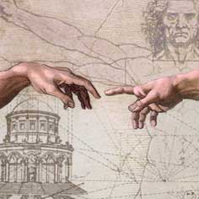
Do Now:
Grab today’s Agenda from the Out Box.
Take out an index card. At the top of the lined side, write your name, today’s date, and class period.
Then answer the Do Now question on your Agenda (not on the index card).

Slide 2
Exit Question
(Your Name)
Today’s Date
Class Period
Come up with at least one question…
a. On something you are still confused about today’s lesson
or
b. On something else you would like to know about today’s lesson
Place it in the orange bucket at the end of class.
Participation Grade!

Slide 3
What was the Renaissance?
Why did it begin?

Slide 4
Objective: Road to the Renaissance
SOL WHII.2d and e
TSWDK of the political, cultural, geographic, and economic conditions in the world about 1500 AD (CE) by analyzing major trade patterns and by citing major technological and scientific exchanges in the Eastern Hemisphere.

Slide 5
Road to the Renaissance
The Middle Ages
The Crusades
Trade
The Black Plague

Slide 6
The Middle Ages
Began ?

Slide 7
The Middle Ages
Began when the Roman Empire fell in 476 CE.
“Medieval” = Middle Ages (in Latin)

Slide 8
The Middle Ages
Began when the Roman Empire fell in 476 CE.
“Medieval” = Middle Ages (in Latin)
Aka The Dark Ages
Very few could read
Nobody expected life to improve…

Slide 9
The Middle Ages
Began when the Roman Empire fell in 476 CE.
“Medieval” = Middle Ages (in Latin)
Aka The Dark Ages
Very few could read
Nobody expected life to improve… at least in this life.
Only hope was strong belief in Christianity and that life in heaven would be better than life on earth.

Slide 10
The Middle Ages
Feudalism = ?

Slide 11
The Middle Ages
Feudalism = system of loyalties and protections.
Careers other than lords:

Slide 12
The Middle Ages
Feudalism = system of loyalties and protections.
Careers other than lords:
Knighthood (the military)

Slide 13
The Middle Ages
Feudalism = system of loyalties and protections.
Careers other than lords:
Knighthood (the military)
Learn a trade

Slide 14
The Middle Ages
Feudalism = system of loyalties and protections.
Careers other than lords:
Knighthood (the military)
Learn a trade
The Church (option for everybody)

Slide 15
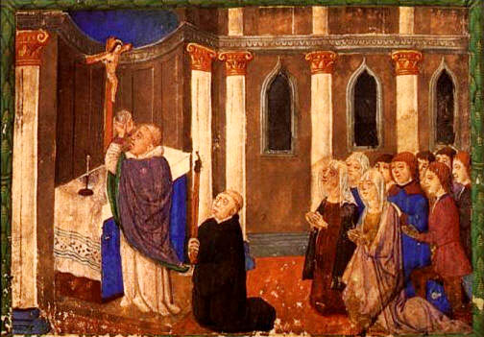
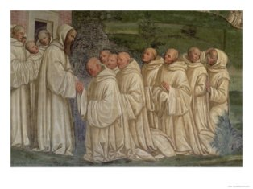
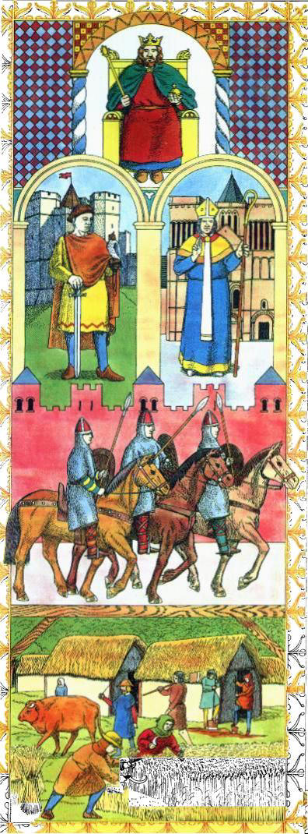
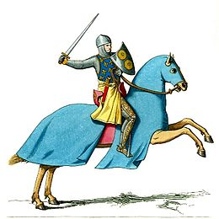
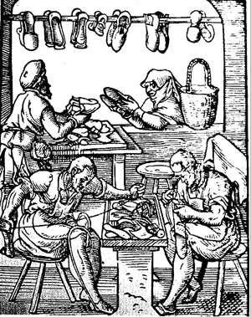
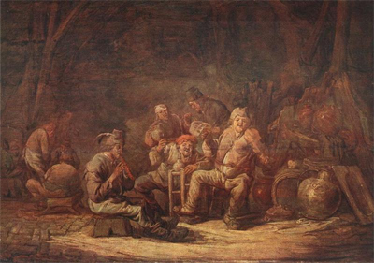
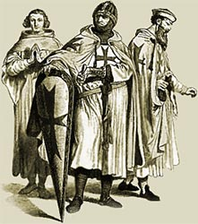
This was life in the Middle Ages!

Slide 16
The Crusades
1095
1095, Pope Urban II launched the First Crusade (13 Total) to stop the expanding Ottoman (Muslim) Empire.

Slide 17
The Crusades
1095
1095, Pope Urban II launched the First Crusade (13 Total) to stop the expanding Ottoman (Muslim) Empire.
“War of the Cross”

Slide 18
The Crusades
1095
1095, Pope Urban II launched the First Crusade (13 Total) to stop the expanding Ottoman (Muslim) Empire.
“War of the Cross”
Also to reclaim the holy city of Jerusalem from Muslim control.

Slide 19
The Crusades
1095
1095, Pope Urban II launched the First Crusade (13 Total) to stop the expanding Ottoman (Muslim) Empire.
“War of the Cross”
Also to reclaim the holy city of Jerusalem from Muslim control.
First time many Europeans left their homes!
Crusades were unsuccessful.

Slide 20
The Crusades
The End
But the Crusades opened up the world to the Europeans.
The Crusades changed European perspective from inward to outward.

Slide 21
Trade
During Crusades
Traveling armies

Slide 22
Trade
During Crusades
Traveling armies
Following merchants
Reacquainted with Middle East → More and new products!

Slide 23
Trade
During Crusades
Traveling armies
Following merchants
Reacquainted with Middle East → More and new products!
After Crusades
Military career to merchant

Slide 24
Trade
During Crusades
Traveling armies
Following merchants
Reacquainted with Middle East → More and new products!
After Crusades
Military career to merchant
Trade with East for spices, ivory, jade, diamonds, glass, gun powder…

Slide 25
Trade
Trade Patterns
By 1500, regional trade patterns had developed that linked Africa, the Middle East, Asia, and Europe.
Traditional trade patterns linking Europe with Asia and Africa:

Slide 26
Trade
Trade Patterns
By 1500, regional trade patterns had developed that linked Africa, the Middle East, Asia, and Europe.
Traditional trade patterns linking Europe with Asia and Africa:
Silk routes across Asia to the Mediterranean basin

Slide 27
Trade
Trade Patterns
By 1500, regional trade patterns had developed that linked Africa, the Middle East, Asia, and Europe.
Traditional trade patterns linking Europe with Asia and Africa:
Silk routes across Asia to the Mediterranean basin
Maritime routes across the Indian Ocean

Slide 28
Trade
Trade Patterns
By 1500, regional trade patterns had developed that linked Africa, the Middle East, Asia, and Europe.
Traditional trade patterns linking Europe with Asia and Africa:
Silk routes across Asia to the Mediterranean basin
Maritime routes across the Indian Ocean
Trans-Saharan routes across North Africa

Slide 29
Trade
Trade Patterns
By 1500, regional trade patterns had developed that linked Africa, the Middle East, Asia, and Europe.
Traditional trade patterns linking Europe with Asia and Africa:
Silk routes across Asia to the Mediterranean basin
Maritime routes across the Indian Ocean
Trans-Saharan routes across North Africa
Northern Europe links with the Black Sea

Slide 30
Trade
Trade Patterns
By 1500, regional trade patterns had developed that linked Africa, the Middle East, Asia, and Europe.
Traditional trade patterns linking Europe with Asia and Africa:
Silk routes across Asia to the Mediterranean basin
Maritime routes across the Indian Ocean
Trans-Saharan routes across North Africa
Northern Europe links with the Black Sea
Western Europe sea and river trade

Slide 31
Trade
Trade Patterns
By 1500, regional trade patterns had developed that linked Africa, the Middle East, Asia, and Europe.
Traditional trade patterns linking Europe with Asia and Africa:
Silk routes across Asia to the Mediterranean basin
Maritime routes across the Indian Ocean
Trans-Saharan routes across North Africa
Northern Europe links with the Black Sea
Western Europe sea and river trade
South China Sea and lands of Southeast Asia

Slide 32
Trade
Knowledge
These trade patterns were important because it established an exchange of products and ideas.
By 1500, technological and scientific advancements had been exchanged among cultures of the world.

Slide 33
Trade
Knowledge
Advancements exchanged along trade routes include:

Slide 34
Trade
Knowledge
Advancements exchanged along trade routes include:
Paper,

Slide 35
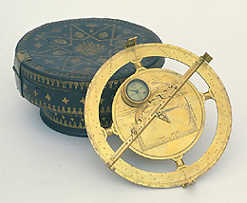
Trade
Knowledge
Advancements exchanged along trade routes include:
Paper, compass,

Slide 36
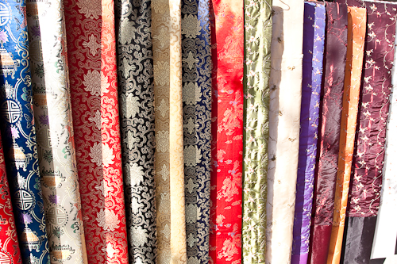
Trade
Knowledge
Advancements exchanged along trade routes include:
Paper, compass, silk,

Slide 37
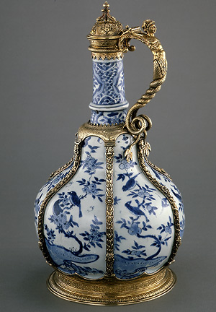
Trade
Knowledge
Advancements exchanged along trade routes include:
Paper, compass, silk, porcelain (China)

Slide 38
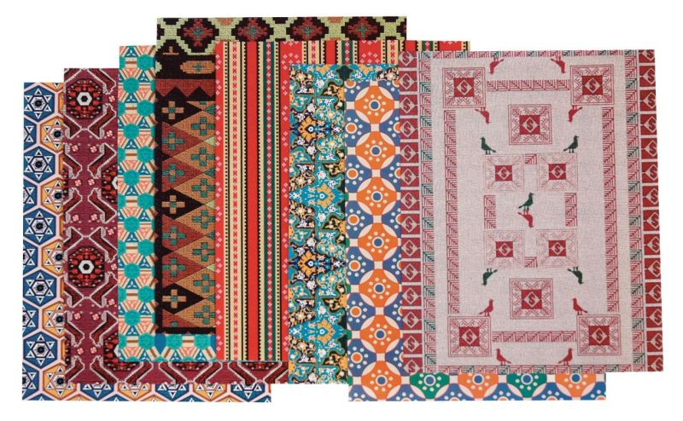
Trade
Knowledge
Advancements exchanged along trade routes include:
Paper, compass, silk, porcelain (China)
Textiles,

Slide 39
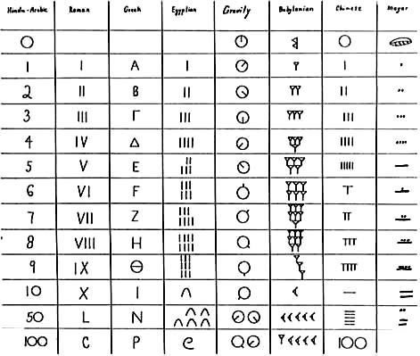
Trade
Knowledge
Advancements exchanged along trade routes include:
Paper, compass, silk, porcelain (China)
Textiles, numeral system (India and Middle East)

Slide 40
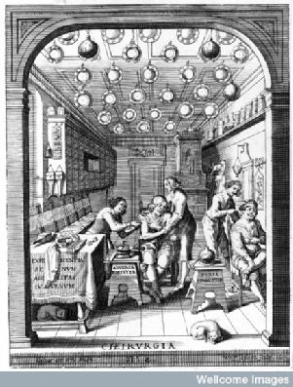
Trade
Knowledge
Advancements exchanged along trade routes include:
Paper, compass, silk, porcelain (China)
Textiles, numeral system (India and Middle East)
Scientific knowledge – medicine,

Slide 41
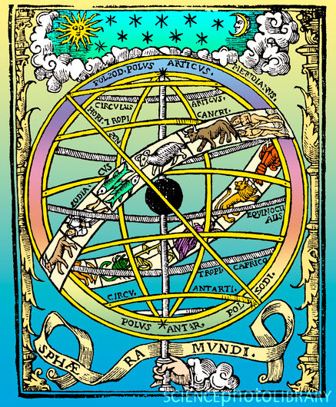
Trade
Knowledge
Advancements exchanged along trade routes include:
Paper, compass, silk, porcelain (China)
Textiles, numeral system (India and Middle East)
Scientific knowledge – medicine, astronomy,

Slide 42
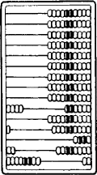
Trade
Knowledge
Advancements exchanged along trade routes include:
Paper, compass, silk, porcelain (China)
Textiles, numeral system (India and Middle East)
Scientific knowledge – medicine, astronomy, mathematics

Slide 43
The Black Plague
Plague
Originated in the East

Slide 44
The Black Plague
Plague
Originated in the East
Carried by flea-infested rats, the epidemic came in the caravans that traveled the trade routes.

Slide 45
The Black Plague
Spread
The economic boom and population increase of the High Middle Ages prepared Europe for such a devastating event.

Slide 46
The Black Plague
Spread
The economic boom and population increase of the High Middle Ages prepared Europe for such a devastating event.
Towns grew too large too fast; they were overpopulated and lacked proper sanitation, and the Black Death found good breeding ground.

Slide 47
The Black Plague
Spread
The economic boom and population increase of the High Middle Ages prepared Europe for such a devastating event.
Towns grew too large too fast; they were overpopulated and lacked proper sanitation, and the Black Death found good breeding ground.
The increase of trade allowed the disease to spread along all of the land and sea trade routes.

Slide 48
The Black Plague
Spread
The economic boom and population increase of the High Middle Ages prepared Europe for such a devastating event.
Towns grew too large too fast; they were overpopulated and lacked proper sanitation, and the Black Death found good breeding ground.
The increase of trade allowed the disease to spread along all of the land and sea trade routes.
The military conflicts of the Crusades left people already weakened. Food and energy had been devoted to war, and when the plague hit, resources were too low to fight the disease.

Slide 49
The Black Plague
Spread
The disease spread so fast that by 1348, France, England, and Spain were devastated.

Slide 50
The Black Plague
Spread
The disease spread so fast that by 1348, France, England, and Spain were devastated.
A year later, Russia, Scandinavia, and Germany were infected.

Slide 51
The Black Plague
Spread
The disease spread so fast that by 1348, France, England, and Spain were devastated.
A year later, Russia, Scandinavia, and Germany were infected.
By 1350, when the Black Death disappeared from the continent, over one-third of the population, approximately 25 million people, succumbed to its horrific affects.

Slide 52
The Black Plague
“Ring Around the Rosie”
Refers to bubonic plague.
Plague showed as a ring shaped sore – “ring around the rosie.”
Bodies that succumbed to plague had to be burned – “ashes, ashes”
Result of the plague was always death; no cure – “we all fall down.”

Slide 53
The Black Plague
Life After the Plague
Those who survived were left looking for answers.
Survivors were also grateful to be alive, resulting in a renewal of trade and cultural achievements in Europe.
The Black Death decimated Europe, bringing the institutions of the Middle Ages into question.

Slide 54
Conclusion
The Renaissance was a response to:

Slide 55
Conclusion
The Renaissance was a response to:
Dark Middle Ages

Slide 56
Conclusion
The Renaissance was a response to:
Dark Middle Ages
Re-introduction to East from Crusades

Slide 57
Conclusion
The Renaissance was a response to:
Dark Middle Ages
Re-introduction to East from Crusades
Trade of new products and ideas

Slide 58
Conclusion
The Renaissance was a response to:
Dark Middle Ages
Reintroduction to East from Crusades
Trade of new products and ideas
Devastation from Black Plague

Slide 59
Exit Question
(Your Name)
Today’s Date
Class Period
Come up with at least one question…
a. On something you are still confused about today’s lesson
or
b. On something else you would like to know about today’s lesson
Place it in the orange bucket at the end of class.
Participation Grade!

Slide 60
Your Test
This Friday!
On this test only, you may use a cheat sheet:
Size of regular paper – 8 ½ x 11
Must be handwritten
Can use both sides

Slide 61
Your Project
Next Tuesday (9-16)!

