Slide 1
Do Now: Grab today’s Agenda from your Out Box and answer the following questions: Compare and contrast these two paintings. How are they similar? How are they different?

Slide 2
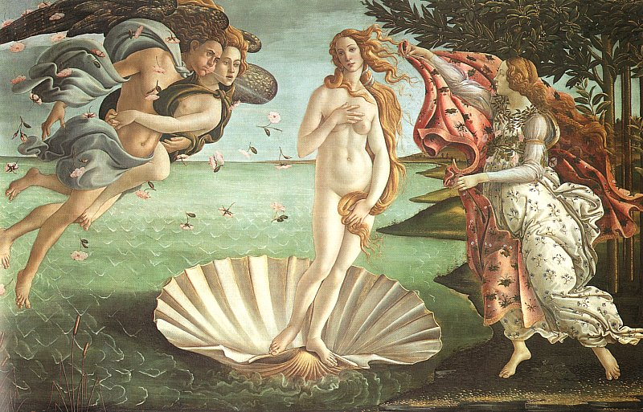
Objective: The Renaissance
SOL WHII.2b
TSWDK of the political, cultural, geographic, and economic conditions in the world about 1500 AD (CE) by describing artistic, literary, and intellectual ideas of the Renaissance.

Slide 3
The Renaissance
Italy
Humanism
Art
Literature

Slide 4
Italy
Beginning
The Renaissance began in Italy. Why?

Slide 5
Italy
Beginning
The Renaissance began in Italy. Why?
Trade was centered in Italy because of its many ports. Both products and ideas were traded so it all came to Italy first.

Slide 6
Italy
Beginning
The Renaissance began in Italy. Why?
Trade was centered in Italy because of its many ports. Both products and ideas were traded so it all came to Italy first.
Center of Trade
Naples,

Slide 7
Italy
Beginning
The Renaissance began in Italy. Why?
Trade was centered in Italy because of its many ports. Both products and ideas were traded so it all came to Italy first.
Center of Trade
Naples, Genoa,

Slide 8
Italy
Beginning
The Renaissance began in Italy. Why?
Trade was centered in Italy because of its many ports. Both products and ideas were traded so it all came to Italy first.
Center of Trade
Naples, Genoa, and Venice became the centers of trade between Europe and the Middle East… and those are major cities of the Renaissance!

Slide 9
Italy
Beginning
The Renaissance began in Italy. Why?
Trade was centered in Italy because of its many ports. Both products and ideas were traded so it all came to Italy first.
Center of Trade
Naples, Genoa, and Venice became the centers of trade between Europe and the Middle East… and those are major cities of the Renaissance!
And from Italy, the Renaissance spread North.

Slide 10
Humanism
Renaissance
Renaissance means ‘Rebirth.” It was a rebirth of classical knowledge and the birth of the modern world.

Slide 11
Humanism
Renaissance
Renaissance means ‘Rebirth.” It was a rebirth of classical knowledge and the birth of the modern world.
Arabs had kept ancient and Roman works. The Europeans were reintroduced to it and so the Renaissance was marked by a renewed interest in ancient Greek and Roman literature and life.

Slide 12
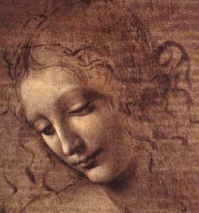
Humanism
Defined
Renaissance scholars studied the ancient world to explore its great achievements.
Focus on human innovation instead of spiritualism.
Humanism = a system of thought with humanity at the center, the sum of all things.

Slide 13
Humanism
Characteristics
Focused on the classics.

Slide 14
Humanism
Characteristics
Focused on the classics
Believed in reason

Slide 15
Humanism
Characteristics
Focused on the classics
Believed in reason
Emphasized education

Slide 16
Humanism
Characteristics
Focused on the classics
Believed in reason
Emphasized education
Meaningful life

Slide 17
Humanism
Characteristics
Focused on the classics
Believed in reason
Emphasized education
Meaningful life
Human values instead of religious beliefs

Slide 18
Humanism
Secularism
As a result of these new ideas and the horrors of war and disease, people became less interested in thinking about God, heaven, and the saints, and more interested in thinking about themselves, their surroundings, and their everyday lives.
People now studied math, engineering, architecture, art, literature, music… works outside the church.
Secular = outside the church
But humanists did not throw off religion; they still embraced it. They were just sometimes at odds with the Church.

Slide 19
Art
Middle Ages
Renaissance
Not realistic
No depth
Hieratic scale – Gods and saints larger than life
Landscape was heaven or inside
Stressed world beyond everyday life; used formal figures to express religious concern.
Lifelike, more natural
Perspective
Realistic – Gods and saints same size as humans
Landscape was nature, what they saw around them
Created realistic scenes and images; depicted lifelike human figures in paintings.

Slide 20
Art
Leonardo da Vinci
1452-1519

Slide 21
Art
Leonardo da Vinci
1452-1519
“Renaissance Man”

Slide 22
Art
Leonardo da Vinci
1452-1519
“Renaissance Man”
Mona Lisa

Slide 23
Art
Leonardo da Vinci
1452-1519
“Renaissance Man”
Mona Lisa
Last Supper

Slide 24
Art
Michelangelo
1475-1564

Slide 25
Art
Michelangelo
1475-1564
“Renaissance Man”

Slide 26
Art
Michelangelo
1475-1564
“Renaissance Man”
Sistine Chapel

Slide 27
Art
Michelangelo
1475-1564
“Renaissance Man”
Sistine Chapel

Slide 28
Art
Michelangelo
1475-1564
“Renaissance Man”
Sistine Chapel
David

Slide 29
Art
Michelangelo
1475-1564
“Renaissance Man”
Sistine Chapel
David
St. Peter’s Church

Slide 30
Literature
Erasmus
1466-1536

Slide 31
Literature
Erasmus
1466-1536
Dutch scholar

Slide 32
Literature
Erasmus
1466-1536
Dutch scholar
Believed ideas of Christianity and of classical civilization could be harmonized.

Slide 33
Literature
Erasmus
1466-1536
Dutch scholar
Believed ideas of Christianity and of classical civilization could be harmonized.
Erasmus (and other northern humanists) criticized Church’s lack of spirituality. Argued for return to the original, simple message of Jesus.

Slide 34
Literature
Erasmus
1466-1536
Dutch scholar
Believed ideas of Christianity and of classical civilization could be harmonized.
Erasmus (and other northern humanists) criticized Church’s lack of spirituality. Argued for return to the original, simple message of Jesus.
Wrote the Praise of Folly, criticizing the Catholic Church.

Slide 35
Literature
Erasmus
1466-1536
Dutch scholar
Believed ideas of Christianity and of classical civilization could be harmonized.
Erasmus (and other northern humanists) criticized Church’s lack of spirituality. Argued for return to the original, simple message of Jesus.
Wrote the Praise of Folly, criticizing the Catholic Church. Through satire,

Slide 36
Literature
Erasmus
1466-1536
Dutch scholar
Believed ideas of Christianity and of classical civilization could be harmonized.
Erasmus (and other northern humanists) criticized Church’s lack of spirituality. Argued for return to the original, simple message of Jesus.
Wrote the Praise of Folly, criticizing the Catholic Church. Through satire, he ridiculed ignorance, superstitious, and vice among Christians.

Slide 37
Literature
Thomas More
1478-1535

Slide 38
Literature
Thomas More
1478-1535
English humanist

Slide 39
Literature
Thomas More
1478-1535
English humanist
Wrote Utopia. Contrasted life in Europe with an imaginary, ideal society.
Utopia = ?

Slide 40
Literature
Thomas More
1478-1535
English humanist
Wrote Utopia. Contrasted life in Europe with an imaginary, ideal society.
Utopia = an ideal place or society.
In Utopia, all males citizens were equal and everyone worked to support the society.

Slide 41
Literature
Williams Shakespeare
1564-1616
English writer

Slide 42
Literature
Williams Shakespeare
1564-1616
English writer; wrote sonnets,

Slide 43
Literature
Williams Shakespeare
1564-1616
English writer; wrote sonnets, plays,

Slide 44
Literature
Williams Shakespeare
1564-1616
English writer; wrote sonnets, plays, and essays

Slide 45
Literature
Williams Shakespeare
1564-1616
English writer; wrote sonnets, plays, and essays
Hamlet,

Slide 46
Literature
Williams Shakespeare
1564-1616
English writer; wrote sonnets, plays, and essays
Hamlet, Romeo and Juliet,

Slide 47
Literature
Williams Shakespeare
1564-1616
English writer; wrote sonnets, plays, and essays
Hamlet, Romeo and Juliet, Macbeth,

Slide 48
Literature
Williams Shakespeare
1564-1616
English writer; wrote sonnets, plays, and essays
Hamlet, Romeo and Juliet, Macbeth, Midsummer Night’s Dream,

Slide 49
Literature
Williams Shakespeare
1564-1616
English writer; wrote sonnets, plays, and essays
Hamlet, Romeo and Juliet, Macbeth, Midsummer Night’s Dream, Julius Caesar…

Slide 50
Conclusion
New intellectual and artistic ideas that developed during the Renaissance marked the beginning of the modern world.

Slide 51
Conclusion
New intellectual and artistic ideas that developed during the Renaissance marked the beginning of the modern world.
The Renaissance began in Italy and spread North; it focused on the works of ancient Greece and Rome.

Slide 52
Conclusion
New intellectual and artistic ideas that developed during the Renaissance marked the beginning of the modern world.
The Renaissance began in Italy and spread North; it focused on the works of ancient Greece and Rome.
Humanism, the main drive of the Renaissance, was a focus on human achievement rather than spirituality.

Slide 53
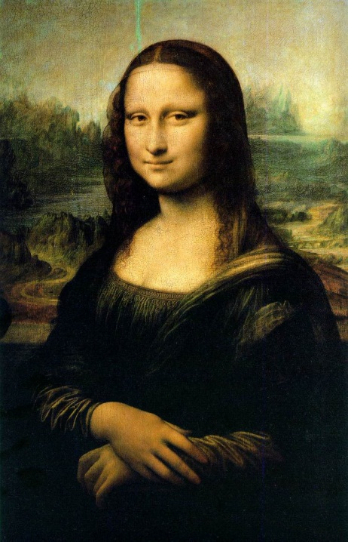
Conclusion
New intellectual and artistic ideas that developed during the Renaissance marked the beginning of the modern world.
The Renaissance began in Italy and spread North; it focused on the works of ancient Greece and Rome.
Humanism, the main drive of the Renaissance, was a focus on human achievement rather than spirituality.
Renaissance epitomized in works of Da Vinci,

Slide 54
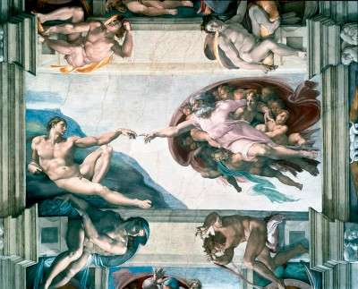
Conclusion
New intellectual and artistic ideas that developed during the Renaissance marked the beginning of the modern world.
The Renaissance began in Italy and spread North; it focused on the works of ancient Greece and Rome.
Humanism, the main drive of the Renaissance, was a focus on human achievement rather than spirituality.
Renaissance epitomized in works of Da Vinci, Michelangelo,

Slide 55
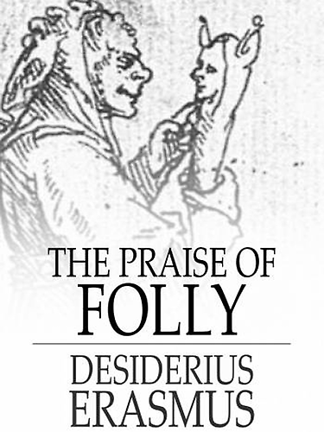
Conclusion
New intellectual and artistic ideas that developed during the Renaissance marked the beginning of the modern world.
The Renaissance began in Italy and spread North; it focused on the works of ancient Greece and Rome.
Humanism, the main drive of the Renaissance, was a focus on human achievement rather than spirituality.
Renaissance epitomized in works of Da Vinci, Michelangelo, Erasmus,

Slide 56
Conclusion
New intellectual and artistic ideas that developed during the Renaissance marked the beginning of the modern world.
The Renaissance began in Italy and spread North; it focused on the works of ancient Greece and Rome.
Humanism, the main drive of the Renaissance, was a focus on human achievement rather than spirituality.
Renaissance epitomized in works of Da Vinci, Michelangelo, Erasmus, More,

Slide 57
Conclusion
New intellectual and artistic ideas that developed during the Renaissance marked the beginning of the modern world.
The Renaissance began in Italy and spread North; it focused on the works of ancient Greece and Rome.
Humanism, the main drive of the Renaissance, was a focus on human achievement rather than spirituality.
Renaissance epitomized in works of Da Vinci, Michelangelo, Erasmus, More, and Shakespeare

Slide 58
Exit Question
(Your Name)
Today’s Date
Class Period
Come up with at least one question…
a. On something you are still confused about today’s lesson
or
b. On something else you would like to know about today’s lesson
Place it in the orange bucket at the end of class.
Participation Grade!

