Slide 1
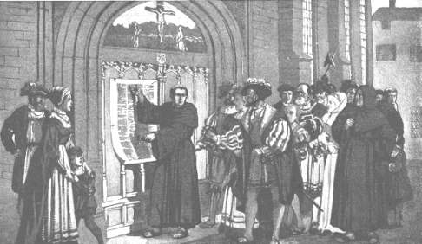
Do Now
Grab today’s Agenda (2:2) from your Out Box.
Based on your homework from last night, what is the author’s problem with the Catholic Church? What is his solution?

Slide 2
Objective: Protest
WHII.3a and b
TSWDK of the Reformation in terms of its impact on Western civilization by explaining the effects of the theological, political, and economic differences that emerged, including the views and actions of Martin Luther, John Calvin, Henry VIII, and Elizabeth I, and by describing the impact of religious conflicts, the Inquisition, and Catholic Reformation on society and government actions.

Slide 3
Protest
Before Luther
Luther
Calvin

Slide 4
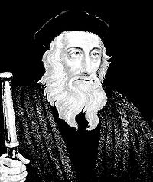
Before Luther
John Wycliffe
English priest from the late 14th century
Humanist; believed the Bible was the center of religious life, and not the church
Teachings did not go beyond own small congregation
Declared by Church to be a heretic but died of a stroke before the Church could punish him. Body was still burned – after death.

Slide 5
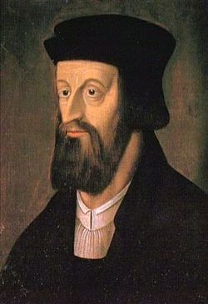
Before Luther
Jan Hus
Late 14th century Czech priest
Believed Bible as the center of Christianity
Teachings did not go beyond own small congregation
Declared heretic by the Church and burned at the stake

Slide 6
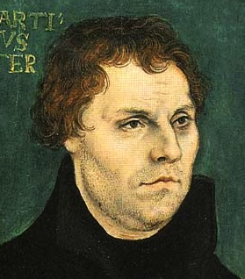
Luther
His Beginnings
Martin Luther was born 1483 into wealthy German family
Spiritual and unhappy man. Believed he was full of sin and wracked with despair.
Became a monk.
Eventually figured out it was all about faith!
Indulgences were ludicrous!

Slide 7
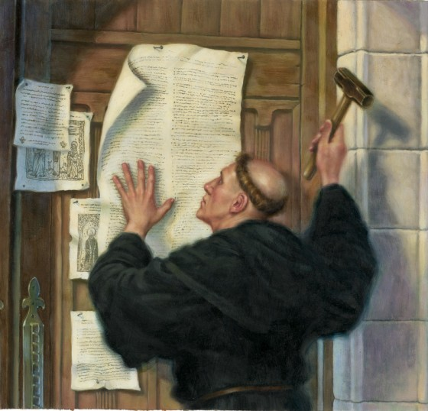
Luther
A Conversation
Luther wanted to start a conversation with his educated congregants on how to reform the catholic Church.
1517, he wrote a list of things he would like to discuss in conversation, mainly problems with the church and his belief of faith alone.
Posted list on the door of Wittenberg Church.
Luther’s 95 Theses was a list of problems he had with the Church.
Meant to be a local conversation.
Reprinted via printing press and spread.

Slide 8
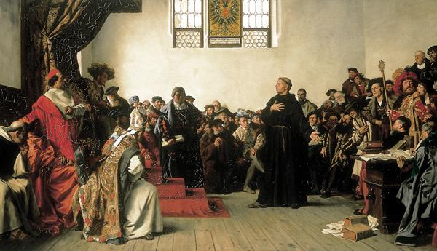
Luther
Protestant Church
Luther never wanted to leave Roman Catholic Church… just reform it.

Slide 9
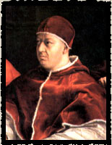
Luther
Protestant Church
Luther never wanted to leave Roman Catholic Church… just reform it.
1521, Luther was excommunicated by Pope Leo X.

Slide 10
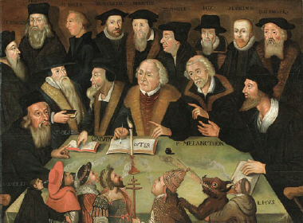
Luther
Protestant Church
Luther never wanted to leave Roman Catholic Church… just reform it.
1521, Luther was excommunicated by Pope Leo X.
Ideas popular in Germany.

Slide 11
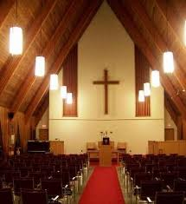
Luther
Protestant Church
Luther never wanted to leave Roman Catholic Church… just reform it.
1521, Luther was excommunicated by Pope Leo X.
Ideas popular in Germany.
Became the Protestant Church (Lutheranism).

Slide 12
Luther
Luther’s Beliefs
Salvation is obtained by faith alone, not works.
Religious truth and authority can only be found in the Bible.
The worship service should be in the language of the people for them to understand.
To further help Protestantism along, the Bible was printed in vernacular (language of the people) – English, German, and French.
The Catholic Church still had its Bible in Latin.

Slide 13
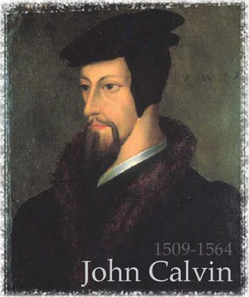
Calvin
John Calvin
16th century French priest who wanted to reform the Catholic Church.
But France was heavily Catholic and very close to the Pope, so he wasn’t going to get done what he wanted.
Moved to Geneva (Switzerland) to teach own doctrine (similar to Luther’s).

Slide 14
Calvin
Calvinism
Predestination = the belief that God determines beforehand whether souls will be saved and left to damnation.
Calvin helped to expand the Protestant Church (through Calvinism and not Lutheranism).

Slide 15
Conclusion
The Reformation had its roots in disagreements about theology.
The resistance of the Church to change led to the Protestant Reformation, which resulted in the birth of new political and economic institutions.
Before Martin Luther, there was Wycliffe and Hus. But their teachings did not go beyond their congregation.
Martin Luther began the Lutheran tradition of Protestantism:
Views: Salvation by faith alone; Bible as the ultimate authority; all humans equal before God.
Actions: 95 Theses, birth of the Protestant Movement
John Calvin began the Calvinist tradition of Protestantism:
Views: Predestination, faith revealed by living a righteous life, work ethic
Action: Expansion of the Protestant Movement
So why did Luther succeed where many before him failed?
The printing press!

