Slide 1
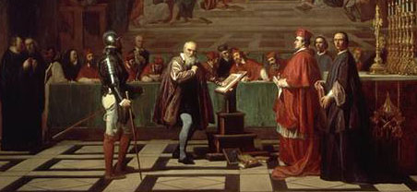
Do Now:
Grab today’s Agenda (2:3) from your Out Box.
Was
Martin Luther
a threat to the Catholic Church?
Why or why not?

Slide 2
Objective: Catholic Reformation
SOL WHII.3b
TSWDK of the Reformation in terms of its impact on Western civilization by describing the impact of religious conflicts, the Inquisition, and Catholic Reformation on society and government actions.

Slide 3
Catholic Reformation
Because of Martin Luther…
Council of Trent
The Society of Jesus
The Inquisition

Slide 4
Because of Martin Luther…
Church Reaction Before Luther
It took time for the Church to recognize Protestantism as a serious threat. They’d been dealing with heretics for centuries, so why should Luther be any different.
What was so different about Luther? Why was his quest for reform so successful while reformers before him were not?
Printing Press!
At first the pope dismissed Luther’s criticisms. But the printing press spread Luther’s ideas further and faster. As a result, more and more people joined the bandwagon of reform.

Slide 5
Because of Martin Luther…
Church Reaction After Luther
In the 1530s, the Catholic Church started a major reform effort known as the Counter-Reformation, or the Catholic Reformation.
It was an attempt to return the Church to an emphasis on spiritual matters. It was an increase in religious devotion.
This led to a new art and musical style called Baroque, that emerged in Catholic Europe.
It was also a campaign to stop the spread of Protestantism.

Slide 6
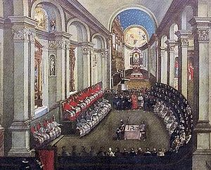
Council of Trent
Purpose
Pope Paul III called a meeting in 1545 in the city of Trent.
Defined the official position of the church on matters of doctrine – what to believe.
Worked to revive a spiritual outlook in the Catholic Church.

Slide 7
Council of Trent
Points of Discussion
First and foremost, the sale of indulgences was forbidden.
Salvation is achieved by a combination of good works and faith.
Religious authority is found in the Bible, the traditions of the Church, and the writings of Church leaders.
The Latin Bible is to be used.
People cannot interpret the message of the Bible without the guidance of the Church.

Slide 8
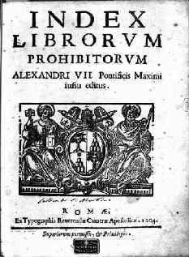
Council of Trent
Index of Forbidden Books
Council of Trent banned Catholics from reading certain books; books considered harmful to faith and morals (i.e. Luther’s 95 Theses)
Anyone with the books on this list was deemed a heretic.
By the way, the Index further shows the importance of the printing press!

Slide 9
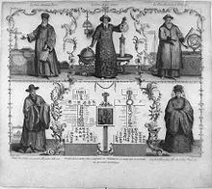
The Society of Jesus
Purpose
The Jesuits

Slide 10
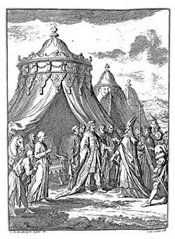
The Society of Jesus
Purpose
The Jesuits
Religious order worked to preserve and spread Catholicism.

Slide 11
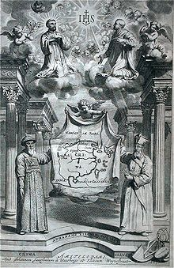
The Society of Jesus
Purpose
The Jesuits
Religious order worked to preserve and spread Catholicism.
Engaged in missionary activities around the world. Some schools were established to strengthen religious faith.

Slide 12
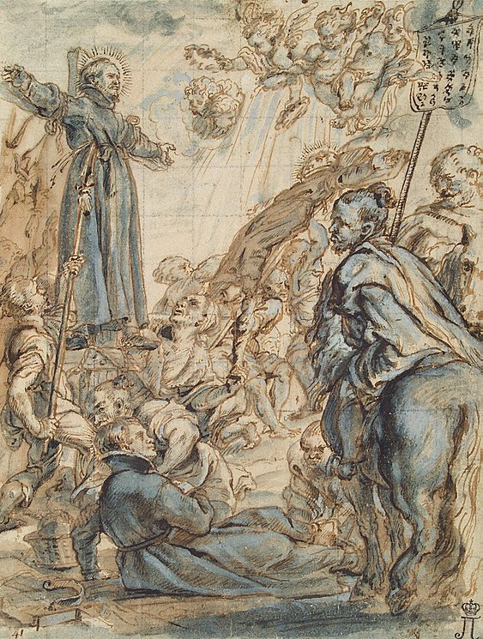
The Society of Jesus
Purpose
The Jesuits
Religious order worked to preserve and spread Catholicism.
Engaged in missionary activities around the world. Some schools were established to strengthen religious faith.
Established schools in Catholic nations to help perpetuate the Catholic faith.

Slide 13
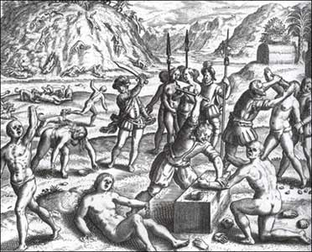
The Society of Jesus
Purpose
The Jesuits
Religious order worked to preserve and spread Catholicism.
Engaged in missionary activities around the world. Some schools were established to strengthen religious faith.
Established schools in Catholic nations to help perpetuate the Catholic faith.
Rooted out heresy through the Inquisition.

Slide 14
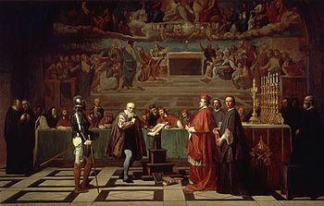
The Inquisition
Purpose
A general tribunal used to discover and root out heresy in the Roman Catholic Church.

Slide 15
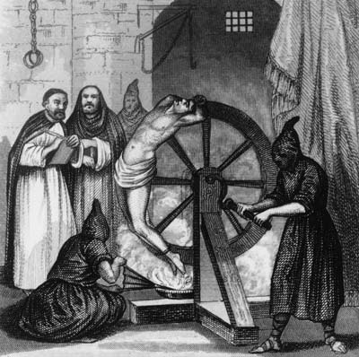
The Inquisition
Purpose
A general tribunal used to discover and root out heresy in the Roman Catholic Church.
Punishments included extreme cruelties such as burning at the stake.
Effects

Slide 16
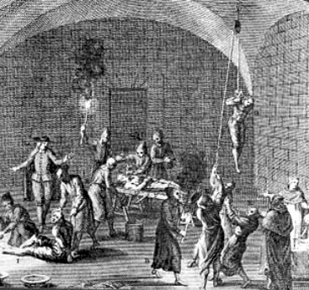
The Inquisition
Purpose
A general tribunal used to discover and root out heresy in the Roman Catholic Church.
Punishments included extreme cruelties such as burning at the stake.
Effects
Didn’t target Protestants, although they were victims.

Slide 17
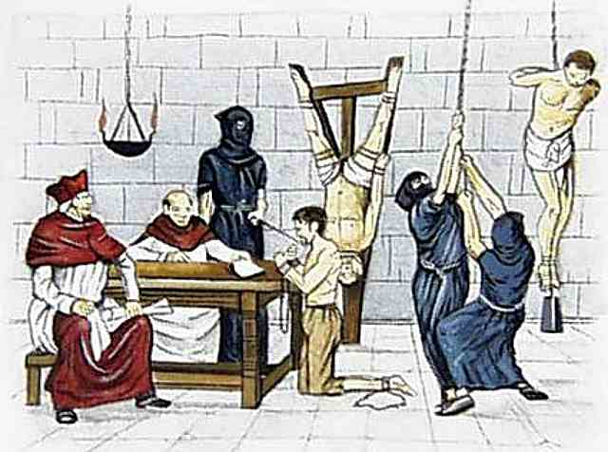
The Inquisition
Purpose
A general tribunal used to discover and root out heresy in the Roman Catholic Church.
Punishments included extreme cruelties such as burning at the stake.
Effects
Didn’t target Protestants, although they were victims.
Focused on anyone they regarded as a threat to the Church… this meant Muslims and Jews too.

Slide 18
Conclusion
The Reformation had its roots in disagreements about theology, but it led to important changes.
The Catholic Reformation succeeded in curing some abuses and prevented Protestantism from spreading across Europe (remained in North).

