Slide 1
Do Now
Grab today’s Agenda (2:4) from your Out Box.
Find the most interesting fact about Henry VIII.
Then go to Weebly → Unit 2 → Lesson 4 → “Henry VIII is Interesting!”
Most interesting fact gets extra credit!

Slide 2
Objective: The Reformation in England
WHII.3a
TSWDK of the Reformation in terms of its impact on Western civilization by explaining the effects of the theological, political, and economic differences that emerged, including the views and actions of Martin Luther, John Calvin, Henry VIII, and Elizabeth I.

Slide 3
Reformation in England
Henry VIII
Edward and Mary
Elizabeth I

Slide 4
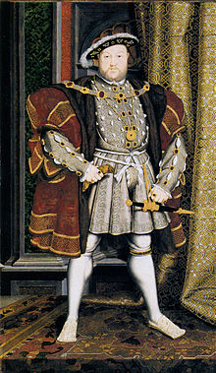
Henry
Life
1509-1547
Tudor
“Defender of the Faith”
Proclaimed by pope to keep Protestantism out of England.
Failed.

Slide 5
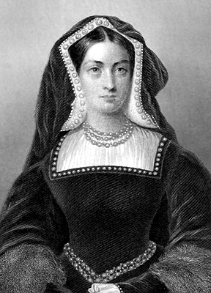
Henry VIII
Divorce!
Catherine of Aragon
Could not give Henry VIII a male heir. Only a daughter – Mary.
Wanted to divorce Catherine so he could marry Anne Boleyn.
Pope denied the divorce.
So in 1534, Henry VIII broke from the Catholic Church and declared himself Supreme Head of the Church of England.
Granted himself a divorce.
As head of new Church of England, Henry VIII took control of all Church lands and funds.

Slide 6
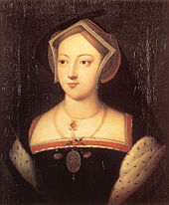
Henry VIII
Divorce (continued)
Anne Boleyn
Was a Protestant and a very strong woman.
Worked hard to push forth Protestant reforms within Church of England.
Church of England became Protestant church.
Also could not give Henry VIII a son; only a daughter – Elizabeth.
Henry claimed she was a witch so he had her beheaded.

Slide 7
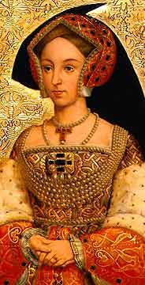
Henry
Divorce! (continued)
Jane Seymour
Favorite wife!
Finally gave Henry a son – Edward!
She died while giving birth to Edward.

Slide 8
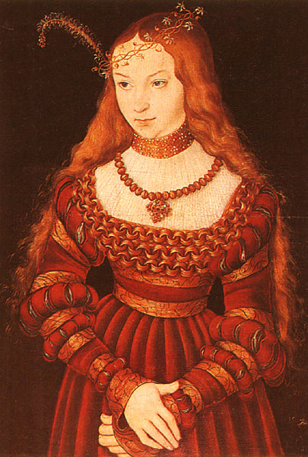
Henry VIII
Divorce! (continued)
Anne of Cleves
Marriage was a political move
Henry VIII didn’t like the way she looked; claimed to have never consummated the marriage.
Divorce!

Slide 9
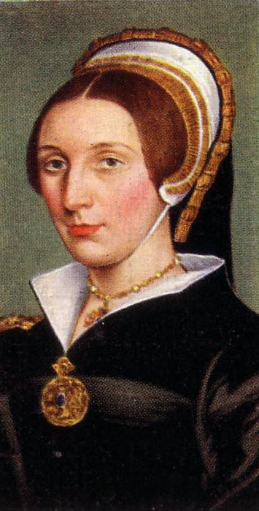
Henry VIII
Divorce!
Catherine Howard
Committed adultery
Beheaded

Slide 10
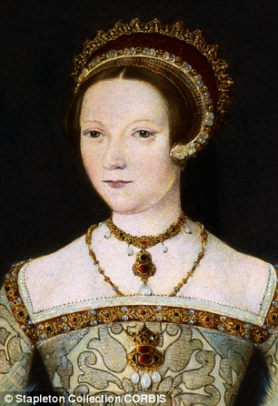
Henry VIII
Divorce! (continued)
Catherine Parr
Outlived Henry VIII
Song

Slide 11
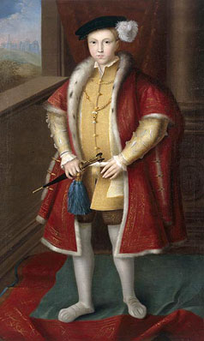
Edward and Mary
Edward
Henry’s only son (from favorite wife Jane Seymour)
Became king at age 9.
Continued to lead Church of England down the path of Protestant Reform.
Died at the age of 15 from a lung disease (tuberculosis?)

Slide 12
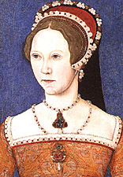
Edward and Mary
“Bloody Mary”
Henry’s first daughter (from his first wife Catherine of Aragon)
1553 – became Queen of England
Mary was a Catholic. Imprisoned leading reforming churchmen.
1554 – she had numerous Protestants executed – burned at the stake. 283 Protestants were executed… “Bloody Mary.”
Died in 1558 (influenza?). No heir.
Song

Slide 13
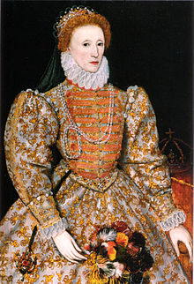
Elizabeth I
Life
1533-1603
Henry’s second daughter (from Anne Boleyn)

Slide 14
Elizabeth I
Anglican Church
Reinstituted the Church of England (after Mary’s mess), finally getting rid of the supremacy of the Catholic Church.
Established the Anglican Church.
Tolerance for Dissenters
Established religious tolerance, particularly for dissenters.
Expansion and Colonialism
Saw success of the Spanish from exploration so engaged England in it too.

Slide 15
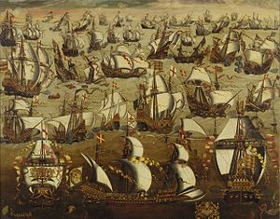
Elizabeth I
Spanish Armada
Spanish Armada (navy) in the 16th century was very powerful and invincible.
1588 – Spain planned to attack England using Spanish Armada.

Slide 16
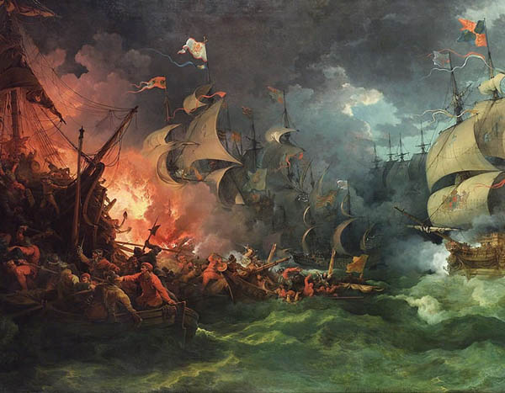
Elizabeth I
Spanish Armada
Spanish Armada (navy) in the 16th century was very powerful and invincible.
1588 – Spain planned to attack England using Spanish Armada.
England won!

Slide 17
Conclusion
King Henry VIII introduced the Protestant Reformation into England.
Views: Dismissed the authority of the Pope in Rome.
Actions: Divorced; broke with Rome; headed the national church in England; appropriated lands and wealth of the Roman Catholic Church in England
Queen Elizabeth I established Protestantism (Anglicanism) in England and expanded the glory of the British Empire through tolerance for dissenters, expansion and colonialism, and victory over the Spanish Armada in 1588.
Review

