Slide 1
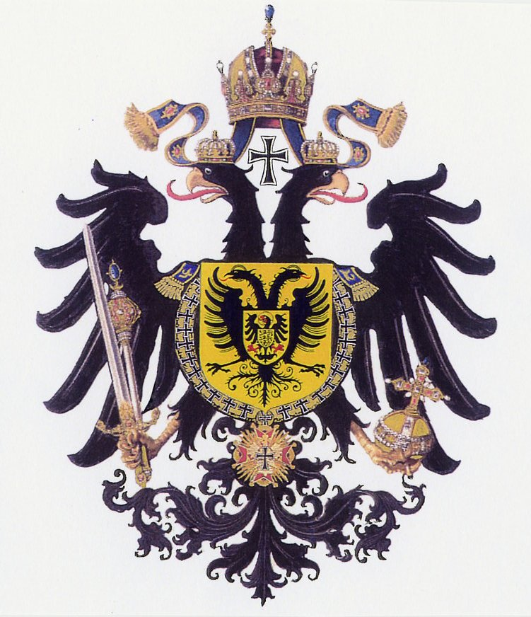
Do Now:
Grab today’s Agenda (2:5) from your Out Box.
Based on the essay that you’ve already started (due next Friday!!), what do you think is the greatest consequence of the printing press? Write your answer on the board! Then record what is on the board onto your Agenda.

Slide 2
Objective: The Reformation in Germany
WHII.3b and c
TSWDK of the Reformation in terms of its impact on Western civilization by describing the impact of religious conflicts, the Inquisition, and the Catholic Reformation on society and government actions, and by describing changing cultural values, traditions, and philosophies, and assessing the role of the printing press.

Slide 3
The Reformation in Germany
The Holy Roman Empire
Lutheranism
The Thirty Years’ War

Slide 4
The Holy Roman Empire
Brief
Originally part of the Roman Empire

Slide 5
The Holy Roman Empire
Brief
Originally part of the Roman Empire
Took on a different character during the 10th century
Two parts: Northern Germany and Southern Germany.

Slide 6
The Holy Roman Empire
Brief (continued)
Northern Germany
Fragmented collection of largely independent states.
Each state has own prince.

Slide 7
The Holy Roman Empire
Brief (continued)
Southern German
Ruled by the Hapsburg Family
Also ruling family of the Spanish Empire

Slide 8
Lutheranism
Martin Luther
Started Protestant Reformation in Germany

Slide 9
Lutheranism
Martin Luther
Started Protestant Reformation in Germany
Lutheranism
Attractive to German princes because:

Slide 10
Lutheranism
Martin Luther
Started Protestant Reformation in Germany
Lutheranism
Attractive to German princes because:
No longer answered to the Church in Rome
All money in German states stayed in German states
All Church land returned to German states
Many German princes, and thus their states, converted to Lutheranism.

Slide 11
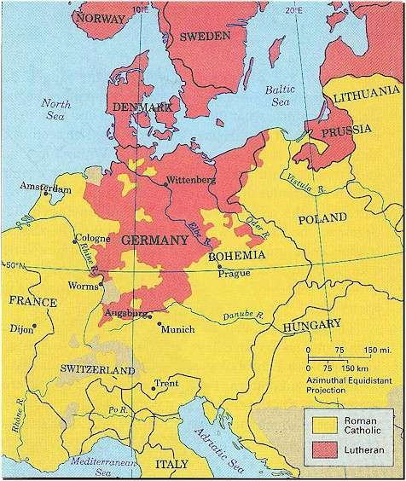
Lutheranism
1555
Fighting
Agreement: German princes can follow Lutheranism if they chose.
North German states became Protestant, specifically Lutheran.

Slide 12
Lutheranism
1555
Fighting
Agreement: German princes can follow Lutheranism if they chose.
North German states became Protestant, specifically Lutheran.
South Germany remained Catholic under the Hapsburg Empire.

Slide 13
Thirty Years’ War
1618 - 1648
This war spanned thirty years…
Religious Motive
Started as a religious war between the Protestant German princes and the Catholic Hapsburg Empire.

Slide 14
Thirty Years’ War
Political Motive
Hapsburg Family ruled both the southern portion of the Holy Roman Empire and the Spanish Empire.
Some nations didn’t want to be a part of the Spanish Empire anymore. Saw this war as an opportunity to break away.
Enemies of Spain, such as the French, saw this same opportunity to diminish the size of the Spanish Empire.

Slide 15
Thirty Years’ War
Political Motive
Hapsburg Family ruled both the southern portion of the Holy Roman Empire and the Spanish Empire.
Some nations didn’t want to be a part of the Spanish Empire anymore. Saw this war as an opportunity to break away.
Enemies of Spain, such as the French, saw this same opportunity to diminish the size of the Spanish Empire.
Cardinal Richelieu of France turned the Thirty Years’ War from a religious war to a political war.

Slide 16
Thirty Years’ War
Peace of Westphalia
War ended in 1648
Terms of the peace:
The princes in each German state would determine the religion of his own state: Catholic, Lutheran, or Calvin.

Slide 17
Thirty Years’ War
Peace of Westphalia
War ended in 1648
Terms of the peace:
The princes in each German state would determine the religion of his own state: Catholic, Lutheran, or Calvin. (religious)
Christians living in a state of a different denomination were allowed to practice their faith.

Slide 18
Thirty Years’ War
Peace of Westphalia
War ended in 1648
Terms of the peace:
The princes in each German state would determine the religion of his own state: Catholic, Lutheran, or Calvin. (religious)
Christians living in a state of a different denomination were allowed to practice their faith. (religious)
Netherlands and Switzerland independent.

Slide 19
Thirty Years’ War
Peace of Westphalia
War ended in 1648
Terms of the peace:
The princes in each German state would determine the religion of his own state: Catholic, Lutheran, or Calvin. (religious)
Christians living in a state of a different denomination were allowed to practice their faith. (religious)
Netherlands and Switzerland independent. (political)
Many country borders were expanded and defined.

Slide 20
Thirty Years’ War
Peace of Westphalia
War ended in 1648
Terms of the peace:
The princes in each German state would determine the religion of his own state: Catholic, Lutheran, or Calvin. (religious)
Christians living in a state of a different denomination were allowed to practice their faith. (religious)
Netherlands and Switzerland independent. (political)
Many country borders were expanded and defined. (political)
Each country had sovereign over itself.

Slide 21
Thirty Years’ War
Peace of Westphalia
War ended in 1648
Terms of the peace:
The princes in each German state would determine the religion of his own state: Catholic, Lutheran, or Calvin. (religious)
Christians living in a state of a different denomination were allowed to practice their faith. (religious)
Netherlands and Switzerland independent. (political)
Many country borders were expanded and defined. (political)
Each country had sovereign over itself. (political)

Slide 22
Conclusion
Religious tolerance was slow, but happening.
Individualism grew and strengthened:
The Reformation in Germany was focused on the faith of the individual.
As long as Christian, allowed to practice faith.
Secularism grew and strengthened:
A doctrine that rejects religion and religious considerations (not atheism).
As the religious focus shifted from the community to the individual, secularism shifted to the forefront of society.

