Slide 1
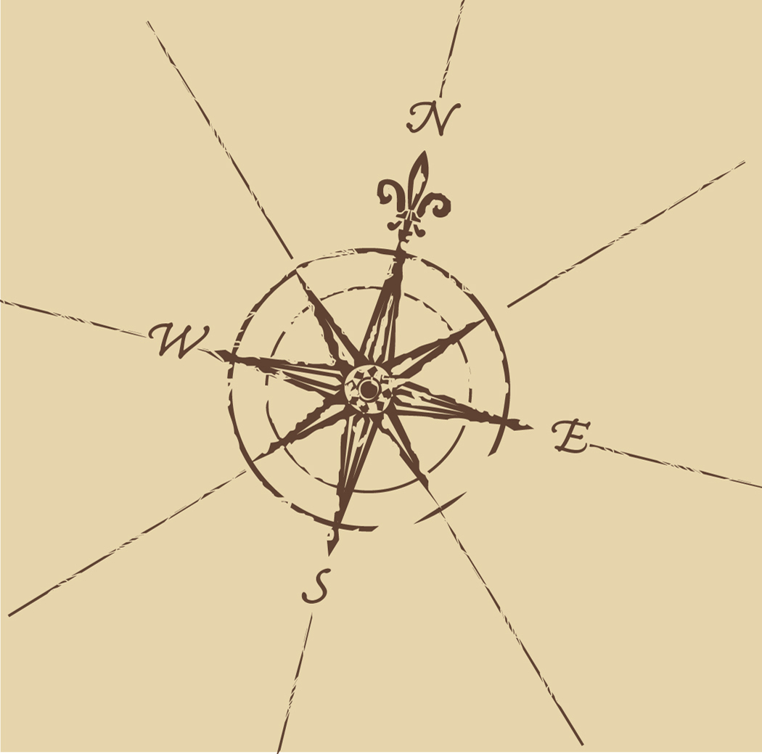
Do Now: Grab today’s Agenda (3:1) from your Out Box. Go to Nearpod.com and join a session with pin: WCPIQ Then explain what you see below onto your Agenda. You must write your answer!
Notes:
Students should recognize it as an old map, possible of Europe, Asia, and Africa.
Why are the shapes of the continents different?
Notice that the Indian Ocean seems to be a landlocked sea.

Slide 2
Objective: Introduction to Exploration
WHII.4a-b
TSWDK of the impact of the European Age of Discovery and expansion into the Americas, Africa, and Asia by explaining the roles and economic motivations of explorers and conquistadores and by describing the influence of religion.

Slide 3
Introduction to Exploration
Before the Age of Discovery
Why Explore?
Prince Henry the Navigator

Slide 4
Before the Age of Discovery
Medieval Geography
Knowledge of Asia (beyond Byzantine Empire) was limited. Silk Route added little info
Knowledge of northern Africa only. There were reports of great African kingdoms beyond the Sahara but there were no factual reports – the Arab traders blocked the Europeans from exploring inland.
Knowledge of Atlantic coast fragmented and derived mainly from old Greek and Roman maps.
Knowledge of Red Sea and Indian Ocean limited – Arab traders controlled maritime routes.
In fact, many Europeans believed the Indian Ocean to be landlocked!
Cartography = the making of maps.
Notes:
Cartography = the making of maps

Slide 5
Before the Age of Discovery
Medieval Travel
Little travel beyond Europe. Maritime routes controlled by Arab traders.
Travel was difficult after Black Plague.
Notes:
There was little travel beyond Europe by Europeans. Of course there was the overland Silk Route, which was mostly trekked by Italian traders. The maritime routes were mainly controlled by Arab traders.
Travel was made increasingly difficult after the Black Plague. Towns were wary of travelers for fear of spreading the disease which made it difficult for traders to travel. And then, of course, people were dying so there were fewer traders traveling.

Slide 6
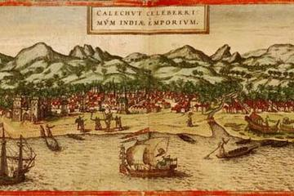
Why Explore?
Gold! (and other things…)
Muslim nations offered spices and fine linens from the Far East…
… and gold from Africa!
This was the main impetus (motivation) for trade.
Notes:
And don’t forget about the gold in Africa!
This was the main impetus for trade.

Slide 7
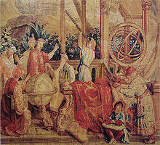
Why Explore?
God
Religious Diffusion – European states and various churches saw it as their duty to spread Christianity, and it was time to find some new prospects. Think Jesuits!
Religious Freedom – to find a place to practice their religion freely. This did not mean that they were tolerant of other religions… because they were not. Think Pilgrims.
Notes:
European states and the various churches saw it as their duty to spread Christianity, and it was time to find some new prospects. Think Jesuits!

Slide 8
Why Explore?
Glory
For their Families!
The population in Europe increased tremendously, despite the devastating loses from the Black Plague.
First born sons inherited the family land but what about the other sons?
The glory that comes with discovery was too tempting to them.
Notes:
The population in Europe increased tremendously, despite the devastating losses from the Black Plague. First born sons inherited the family land but what about the other sons? The glory that comes with discovery was too tempting to them.

Slide 9
Why Explore?
Glory
For the Monarch!
There was political and economic competition between European empires. When one country discovers and becomes rich, the other countries have to do it too.
However, after many years of fighting with Christians, the Muslims did not care to do business with the Europeans. So to acquire exotic goods from the Far East, European monarchs and merchants started to look for ways around the Muslim traders.
Notes:
When once country discovers and becomes rich, the other countries have to do it too.
So there was political and economic competition between European empires.
However, after many years of fighting with Christians, the Muslims did not care to do business with the Europeans. So, to acquire exotic goods from the Far East, European monarchs and merchants started to look for ways around the Middle East.

Slide 10
Why Explore?
Constantinople
While not a reason for exploration, the events at Constantinople played in role in exploration.
A significant portion of trade ran through the Black Sea, making Constantinople a very important city.
Constantinople was controlled by the Byzantine Empire (Christians)…
…until 1453! The Ottoman Turks captured the Byzantine Empire, including Constantinople, which they renamed Istanbul.
The Turks closed off the port city to the West, making traveling east just about impossible.
European countries had no choice but to find another way.
Istanbul, Not Constantinople
Notes:
But the most important date was 1453.
Up until this date, a significant portion of trade ran through the Black Sea, making the city of Constantinople a very important city.
And up until this date, Constantinople was controlled by the Byzantine Empire.
But Muslims and Christians were not friends and have been fighting for a very long time; think Crusades!
In 1453, the Ottoman Turks captured Constantinople.
They renamed it Istanbul and closed off the port city to the West. This made traveling east just about impossible! So they had to find another way!

Slide 11
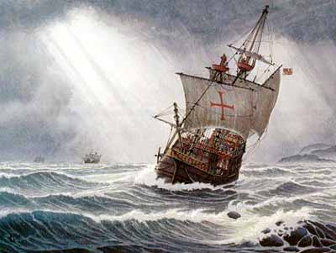
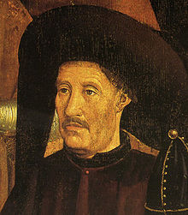
Prince Henry the Navigator
Monarch of Portugal
While fighting in Morocco, discovered profitable trade with gold countries to the south.
But controlled by Muslims so Prince Henry had to find a way around the Muslims in North Africa.

Slide 12
Prince Henry the Navigator
Obsessed with Navigation
Remember that while Europe was going through the Dark Ages, the rest of the world was progressing forward.
However, just like the ideas that promoted the Renaissance, many new inventions in navigational arts of Islamic origin made their way into Europe. And Europeans made some new inventions.
Promoted and invested in the study of navigation and cartography.
As a result, many technological advancements were invented such as
Magnetic Compass – magnetic needle that points to the north.
Astrolabe – used the position of stars to navigate in the oceans.
Caravel – light sailing ship that was developed by the Portuguese to help them explore the African coast.
Prince Henry started sending out ships southward along the West African coast.

Slide 13
Conclusion
The expanding economies of European states stimulated increased trade with markets in Asia.
Factors contributing to the European discovery of lands in the Western Hemisphere:
Demand for gold, spices, and natural resources in Europe
Support for the diffusion of Christianity
Political and economic competition between European empires
Innovations of European and Islamic origins in navigational arts
Pioneering role of Prince Henry the Navigator

