Slide 1
Do Now:
Grab today’s Agenda (3:4) from your Out Box. Then read the excerpt below and then answer the questions that follow onto your Agenda.
“It appears to me that the people are ingenious, and would be good servants and I am of the opinion that they would very readily become Christians as they have no religion. They very quickly learn such words as they are spoken to them.”
Who do you think wrote this excerpt?
Who do you think he is writing about?

Slide 2
Objective:
Exploration
SOL WHII.4a and b
TSWDK of the impact of the European Age of Discovery and expansion into the Americas, Africa, and Asia by explaining the roles and economic motivations of explorers and conquistadores and by describing the influence of religion.

Slide 3
Exploration
Notable Explorers
Why?

Slide 4
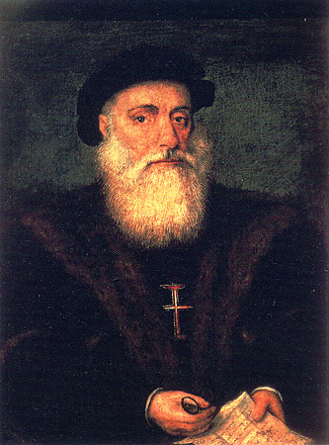
Notable Explorers
Vasco da Gama

Slide 5
Notable Explorers
Vasco da Gama
Portugal

Slide 6
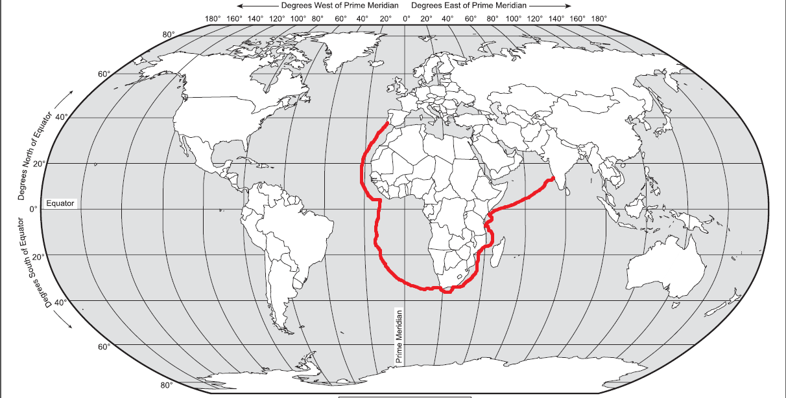
Notable Explorers
Vasco da Gama
Portugal
1498, first Portuguese voyage to India.

Slide 7
Notable Explorers
Vasco da Gama
Portugal
1498, first Portuguese voyage to India.
Rounded the southern tip of Africa – named it Cape of Good Hope.

Slide 8
Notable Explorers
Vasco da Gama
Portugal
1498, first Portuguese voyage to India.
Rounded the southern tip of Africa – named it Cape of Good Hope.
Came back from his first voyage with ships full of valuable goods.

Slide 9
Notable Explorers
Vasco da Gama
Portugal
1498, first Portuguese voyage to India.
Rounded the southern tip of Africa – named it Cape of Good Hope.
Came back from his first voyage with ships full of valuable goods.
Cruel.

Slide 10
Notable Explorers
Vasco da Gama
Portugal
1498, first Portuguese voyage to India.
Rounded the southern tip of Africa – named it Cape of Good Hope.
Came back from his first voyage with ships full of valuable goods.
Cruel.
  Took second voyage in 1502. Plundered a number of East African cities on the way to India.

Slide 11
Notable Explorers
Vasco da Gama
Portugal
1498, first Portuguese voyage to India.
Rounded the southern tip of Africa – named it Cape of Good Hope.
Came back from his first voyage with ships full of valuable goods.
Cruel.
  Took second voyage in 1502. Plundered a number of East African cities on the way to India.
  Most notorious is his taking of an Arab ship, having taken all its valuables, he deliberately caused the ship to sink with all 300 passengers on board, most of them pilgrims going to Mecca.

Slide 12
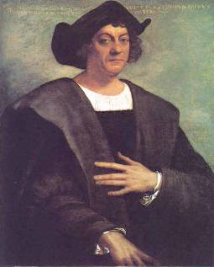
Notable Explorers
Christopher Columbus

Slide 13
Notable Explorers
Christopher Columbus
Sailed for Spain (but Italian)

Slide 14
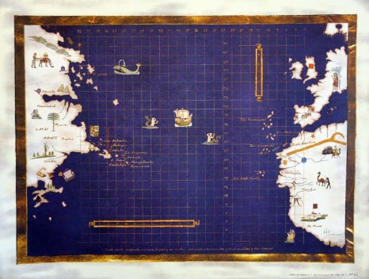
Notable Explorers
Christopher Columbus
Sailed for Spain (but Italian)
Believed there was a shorter route to the Indies than having to sail around Africa and across the Indian Ocean. Based on ancient knowledge, he calculated the size of the Earth and figured out how much water there must be between Europe and Asia. Columbus’ Earth was too small.

Slide 15
Notable Explorers
Christopher Columbus
Sailed for Spain (but Italian)
Believed there was a shorter route to the Indies than having to sail around Africa and across the Indian Ocean. Based on ancient knowledge, he calculated the size of the Earth and figured out how much water there must be between Europe and Asia. Columbus’ Earth was too small.
King Ferdinand and Queen Isabella agreed to finance Columbus’ voyage.

Slide 16
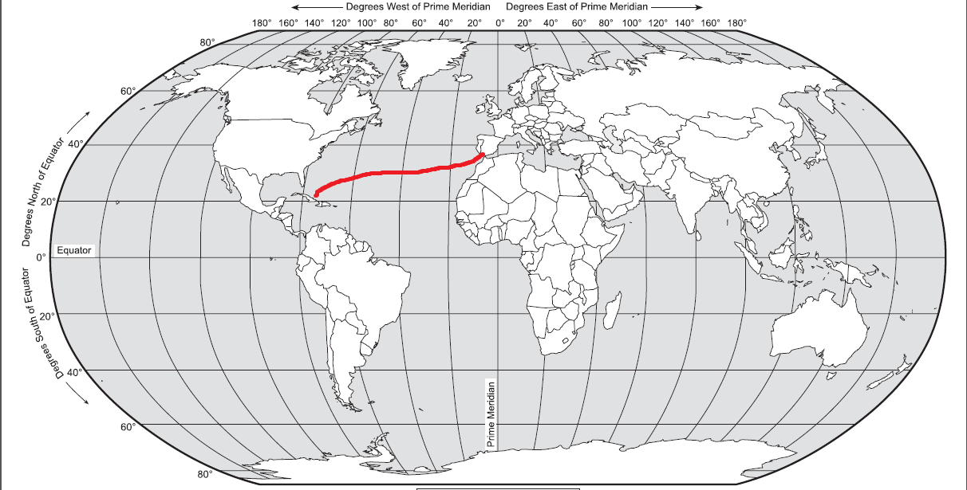
Notable Explorers
Christopher Columbus
Sailed for Spain (but Italian)
Believed there was a shorter route to the Indies than having to sail around Africa and across the Indian Ocean. Based on ancient knowledge, he calculated the size of the Earth and figured out how much water there must be between Europe and Asia. Columbus’ Earth was too small.
King Ferdinand and Queen Isabella agreed to finance Columbus’ voyage.
In August 1492, Columbus set sail from Spain on three small ships. Crew almost mutinied!

Slide 17
Notable Explorers
Christopher Columbus
Sailed for Spain (but Italian)
Believed there was a shorter route to the Indies than having to sail around Africa and across the Indian Ocean. Based on ancient knowledge, he calculated the size of the Earth and figured out how much water there must be between Europe and Asia. Columbus’ Earth was too small.
King Ferdinand and Queen Isabella agreed to finance Columbus’ voyage.
In August 1492, Columbus set sail from Spain on three small ships. Crew almost mutinied!
October 12, 1492, Columbus landed on tiny island that Columbus named San Salvador

Slide 18
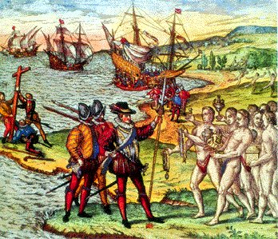
Notable Explorers
Christopher Columbus
Sailed for Spain (but Italian)
Believed there was a shorter route to the Indies than having to sail around Africa and across the Indian Ocean. Based on ancient knowledge, he calculated the size of the Earth and figured out how much water there must be between Europe and Asia. Columbus’ Earth was too small.
King Ferdinand and Queen Isabella agreed to finance Columbus’ voyage.
In August 1492, Columbus set sail from Spain on three small ships. Crew almost mutinied!
October 12, 1492, Columbus landed on tiny island that Columbus named San Salvador. (Today one of the islands in the Bahamas.) Claimed it for Spain. He thought he reached the Indies and so he called the natives “Indians.”

Slide 19
Notable Explorers
Christopher Columbus
Sailed for Spain (but Italian)
Believed there was a shorter route to the Indies than having to sail around Africa and across the Indian Ocean. Based on ancient knowledge, he calculated the size of the Earth and figured out how much water there must be between Europe and Asia. Columbus’ Earth was too small.
King Ferdinand and Queen Isabella agreed to finance Columbus’ voyage.
In August 1492, Columbus set sail from Spain on three small ships. Crew almost mutinied!
October 12, 1492, Columbus landed on tiny island that Columbus named San Salvador. (Today one of the islands in the Bahamas.) Claimed it for Spain. He thought he reached the Indies and so he called the natives “Indians.”
Later, in reporting his discovery, Columbus wrote the excerpt above.

Slide 20
Notable Explorers
Christopher Columbus
Sailed for Spain (but Italian)
Believed there was a shorter route to the Indies than having to sail around Africa and across the Indian Ocean. Based on ancient knowledge, he calculated the size of the Earth and figured out how much water there must be between Europe and Asia. Columbus’ Earth was too small.
King Ferdinand and Queen Isabella agreed to finance Columbus’ voyage.
In August 1492, Columbus set sail from Spain on three small ships. Crew almost mutinied!
October 12, 1492, Columbus landed on tiny island that Columbus named San Salvador. (Today one of the islands in the Bahamas.) Claimed it for Spain. He thought he reached the Indies and so he called the natives “Indians.”
Later, in reporting his discovery, Columbus wrote the excerpt above.
So why is it called “America” and not “Columbia”?

Slide 21
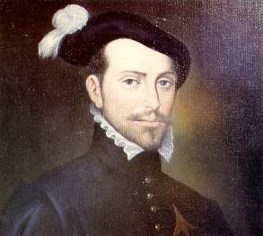
Notable Explorers
Hernan Cortez

Slide 22
Notable Explorers
Hernan Cortez
Not really an explorer… a conqueror. Difference?

Slide 23
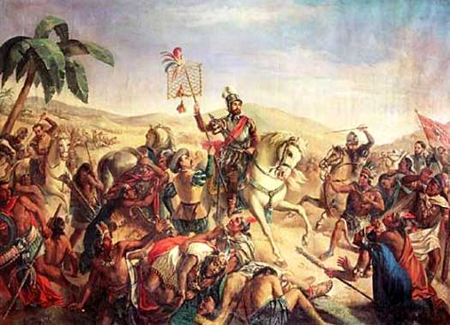
Notable Explorers
Hernan Cortez
Not really an explorer… a conqueror. Difference?
Cortez was the first man to make it to the New World with conquest as his objective and not exploration.

Slide 24
Notable Explorers
Hernan Cortez
Not really an explorer… a conqueror. Difference?
Cortez was the first man to make it to the New World with conquest as his objective and not exploration.
Hence the title… Conquistadores.

Slide 25
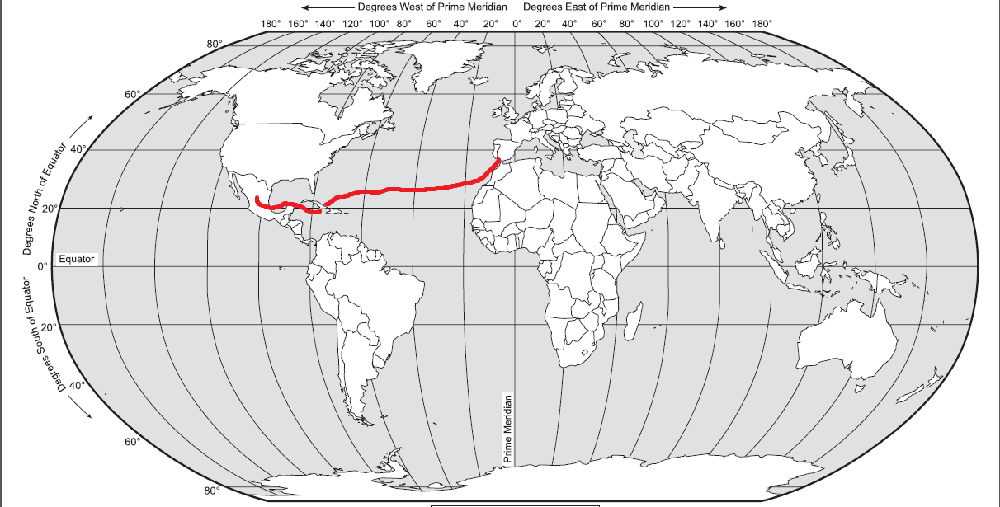
Notable Explorers
Hernan Cortez
Not really an explorer… a conqueror. Difference?
Cortez was the first man to make it to the New World with conquest as his objective and not exploration.
Hence the title… Conquistadores.
1518, landed in Central America. Invaded Mexico in 1519. Conquered the Aztec Empire.

Slide 26
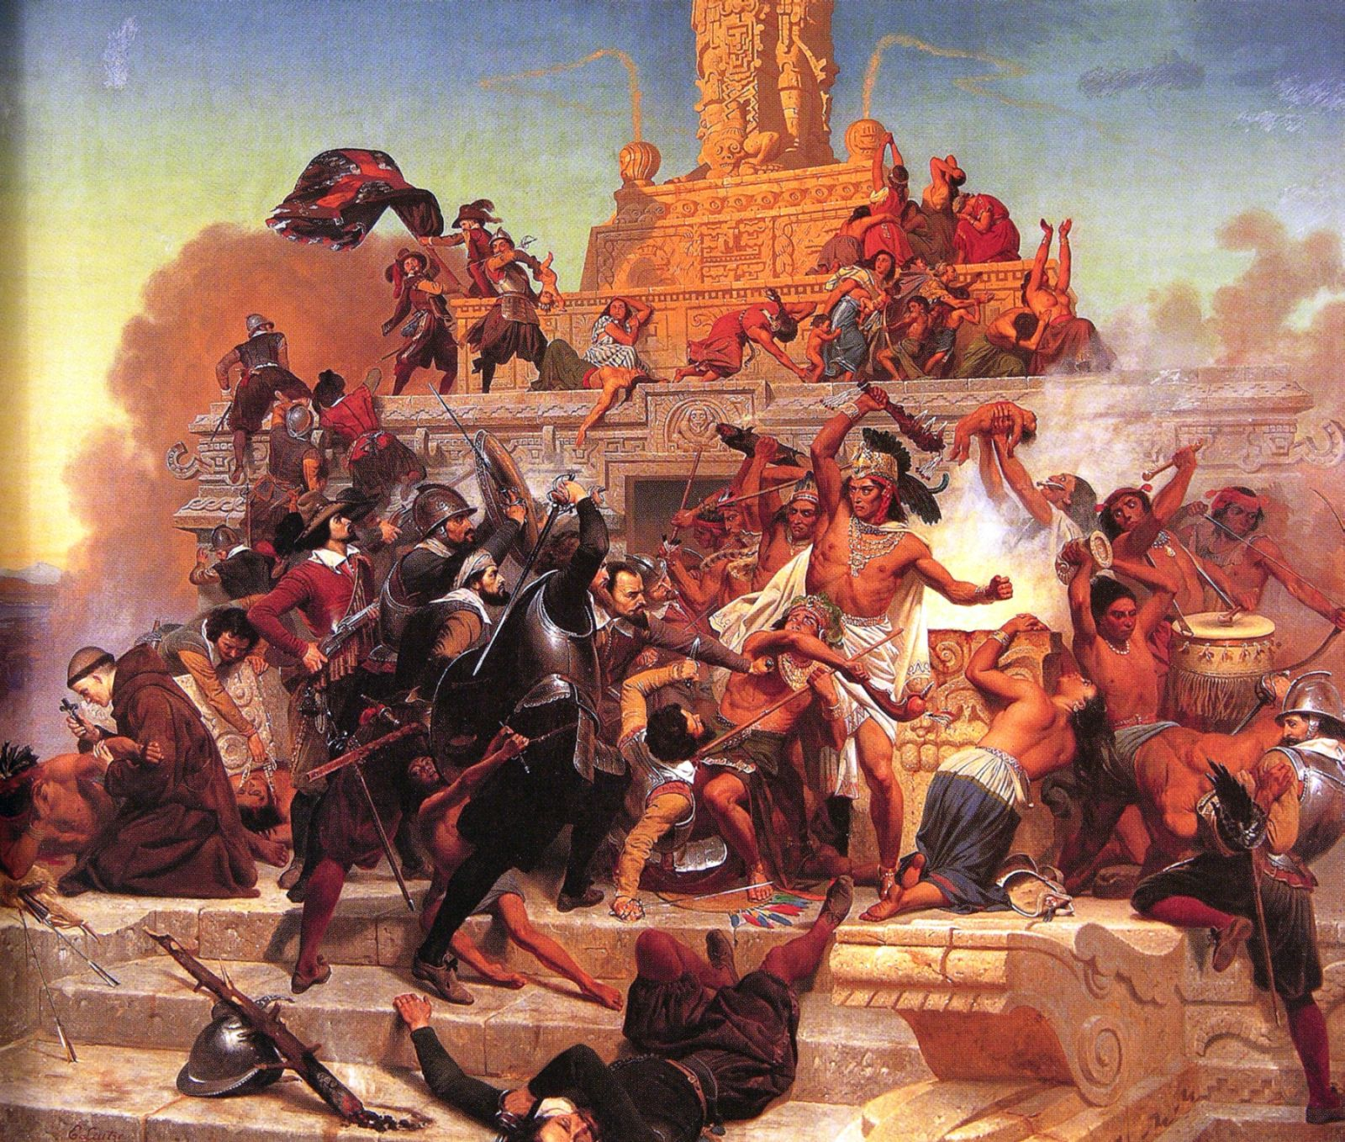
Notable Explorers
Hernan Cortez
Not really an explorer… a conqueror. Difference?
Cortez was the first man to make it to the New World with conquest as his objective and not exploration.
Hence the title… Conquistadores.
1518, landed in Central America. Invaded Mexico in 1519. Conquered the Aztec Empire.
How is it that a few hundred Spanish soldiers were able to subjugate an entire nation?

Slide 27
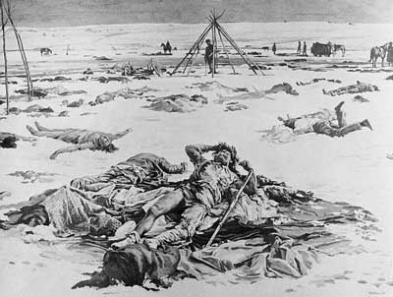
Notable Explorers
Hernan Cortez
Not really an explorer… a conqueror. Difference?
Cortez was the first man to make it to the New World with conquest as his objective and not exploration.
Hence the title… Conquistadores.
1518, landed in Central America. Invaded Mexico in 1519. Conquered the Aztec Empire.
How is it that a few hundred Spanish soldiers were able to subjugate an entire nation? Muskets and horses… and disease!

Slide 28
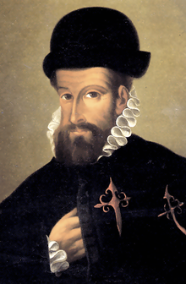
Notable Explorers
Francisco Pizarro

Slide 29
Notable Explorers
Francisco Pizarro
Sailed for Spain.

Slide 30
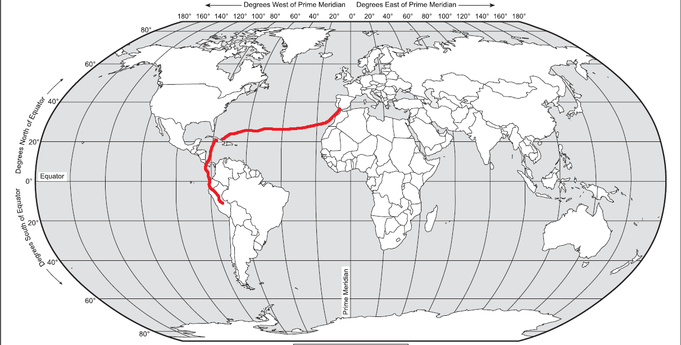
Notable Explorers
Francisco Pizarro
Sailed for Spain.
In 1530 led 180 men on an expedition, following Cortez’s footsteps. Set out from Panama in 1531 and crossed the mountains into the Incan Empire – now Peru.

Slide 31
Notable Explorers
Francisco Pizarro
Sailed for Spain.
In 1530 led 180 men on an expedition, following Cortez’s footsteps. Set out from Panama in 1531 and crossed the mountains into the Incan Empire – now Peru.
1533, conquered the Incan Empire.

Slide 32
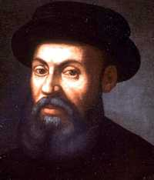
Notable Explorers
Ferdinand Magellan

Slide 33
Notable Explorers
Ferdinand Magellan
Sailed for Spain.

Slide 34
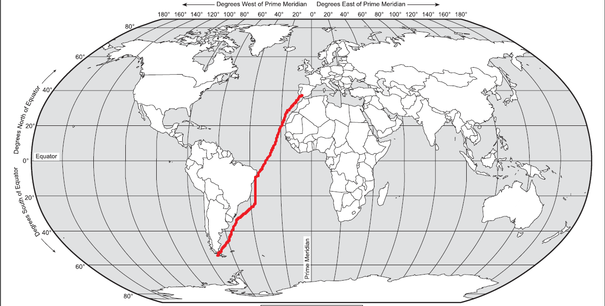
Notable Explorers
Ferdinand Magellan
Sailed for Spain.
In 1519, set out from Spain with 5 ships to cross the Atlantic to South America.

Slide 35
Notable Explorers
Ferdinand Magellan
Sailed for Spain.
In 1519, set out from Spain with 5 ships to cross the Atlantic to South America.
The ships sailed along its eastern shore until they reached the southernmost tip.

Slide 36
Notable Explorers
Ferdinand Magellan
Sailed for Spain.
In 1519, set out from Spain with 5 ships to cross the Atlantic to South America.
The ships sailed along its eastern shore until they reached the southernmost tip.
After passing through the strait now named after him, Magellan found himself in a great ocean. Named it the Pacific Ocean.

Slide 37
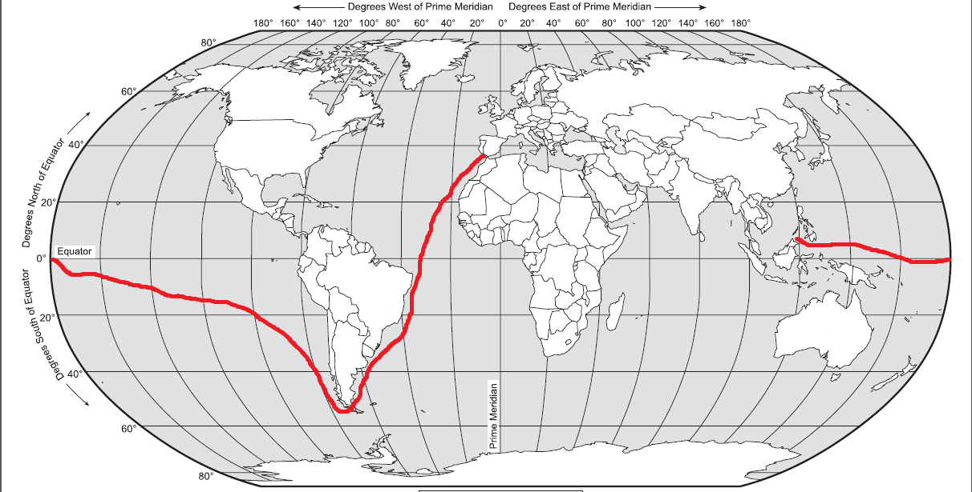
Notable Explorers
Ferdinand Magellan
Sailed for Spain.
In 1519, set out from Spain with 5 ships to cross the Atlantic to South America.
The ships sailed along its eastern shore until they reached the southernmost tip.
After passing through the strait now named after him, Magellan found himself in a great ocean. Named it the Pacific Ocean.
Sailed westward across the Pacific.

Slide 38
Notable Explorers
Ferdinand Magellan
Sailed for Spain.
In 1519, set out from Spain with 5 ships to cross the Atlantic to South America.
The ships sailed along its eastern shore until they reached the southernmost tip.
After passing through the strait now named after him, Magellan found himself in a great ocean. Named it the Pacific Ocean.
Sailed westward across the Pacific.
Reached the Philippine Islands in 1521

Slide 39
Notable Explorers
Ferdinand Magellan
Sailed for Spain.
In 1519, set out from Spain with 5 ships to cross the Atlantic to South America.
The ships sailed along its eastern shore until they reached the southernmost tip.
After passing through the strait now named after him, Magellan found himself in a great ocean. Named it the Pacific Ocean.
Sailed westward across the Pacific.
Reached the Philippine Islands in 1521 and died there. Killed in a fight with islanders. Spear went through his leg, which slowed him down enough to take a spear in the face.

Slide 40
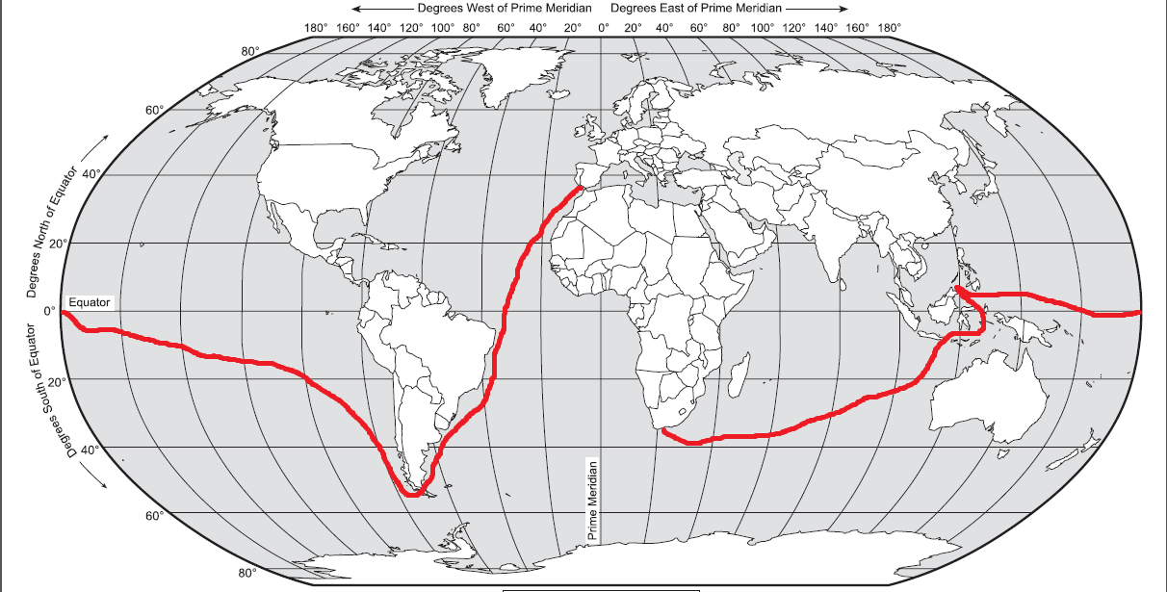
Notable Explorers
Ferdinand Magellan
Sailed for Spain.
In 1519, set out from Spain with 5 ships to cross the Atlantic to South America.
The ships sailed along its eastern shore until they reached the southernmost tip.
After passing through the strait now named after him, Magellan found himself in a great ocean. Named it the Pacific Ocean.
Sailed westward across the Pacific.
Reached the Philippine Islands in 1521 and died there. Killed in a fight with islanders. Spear went through his leg, which slowed him down enough to take a spear in the face.
But his crew sailed on. In 1522, one ship and 18 crew members returned to Spain.

Slide 41
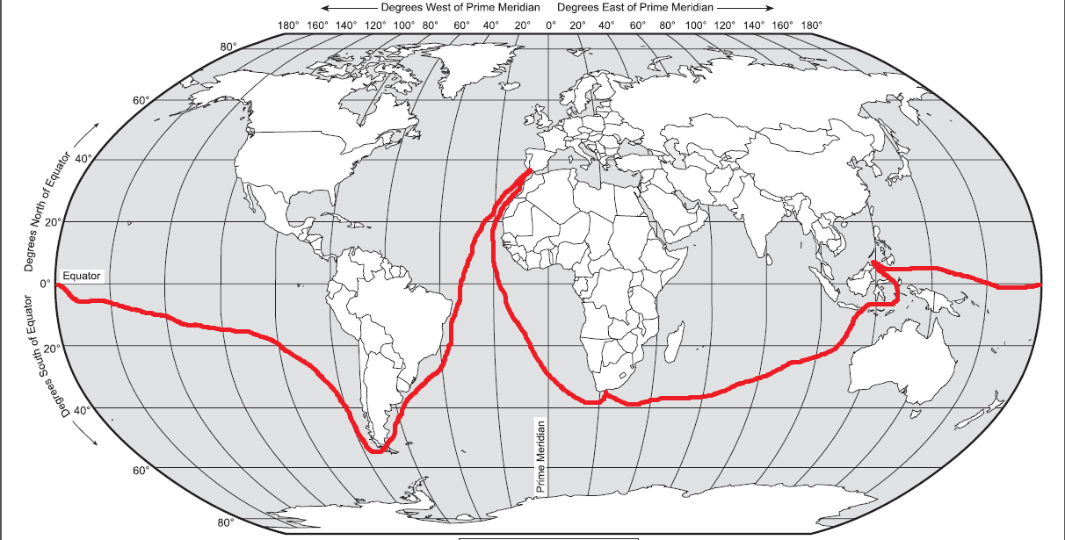
Notable Explorers
Ferdinand Magellan
Sailed for Spain.
In 1519, set out from Spain with 5 ships to cross the Atlantic to South America.
The ships sailed along its eastern shore until they reached the southernmost tip.
After passing through the strait now named after him, Magellan found himself in a great ocean. Named it the Pacific Ocean.
Sailed westward across the Pacific.
Reached the Philippine Islands in 1521 and died there. Killed in a fight with islanders. Spear went through his leg, which slowed him down enough to take a spear in the face.
But his crew sailed on. In 1522, one ship and 18 crew members returned to Spain.
First circumnavigation of the Earth.

Slide 42
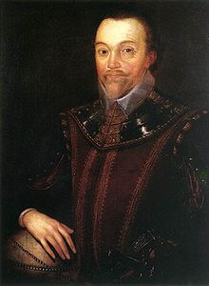
Notable Explorers
Francis Drake

Slide 43
Notable Explorers
Francis Drake
Sailed for England

Slide 44
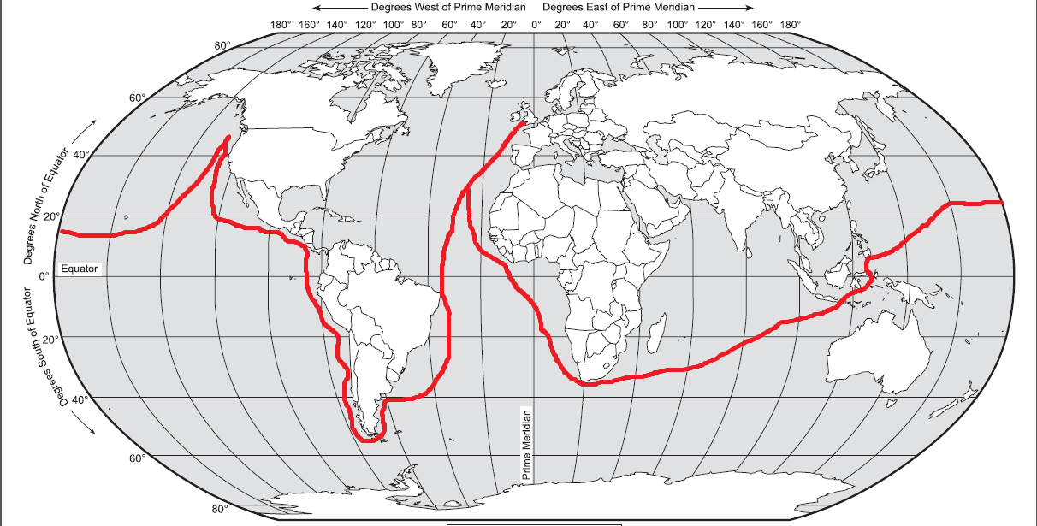
Notable Explorers
Francis Drake
Sailed for England to explore the Pacific coast of the Americas.

Slide 45
Notable Explorers
Francis Drake
Sailed for England to explore the Pacific coast of the Americas.
In 1579, second to circumnavigate the Earth.

Slide 46
Notable Explorers
Francis Drake
Sailed for England to explore the Pacific coast of the Americas.
In 1579, second to circumnavigate the Earth.
Claimed land for England, never mind that it was already claimed by Spain.

Slide 47
Notable Explorers
Francis Drake
Sailed for England to explore the Pacific coast of the Americas.
In 1579, second to circumnavigate the Earth.
Claimed land for England, never mind that it was already claimed by Spain.
Known by the Spanish as a pirate.

Slide 48
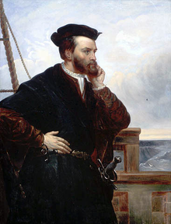
Notable Explorers
Jacques Cartier

Slide 49
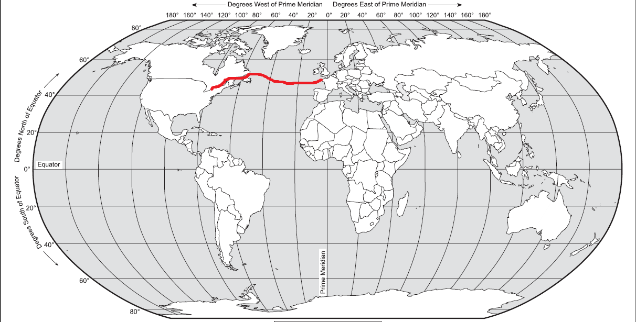
Notable Explorers
Jacques Cartier
From 1534 to 1536, French explorer Cartier was the first European to travel inland in North America.

Slide 50
Notable Explorers
Jacques Cartier
From 1534 to 1536, French explorer Cartier was the first European to travel inland in North America.
Explored and mapped the St. Lawrence River and claimed Canada for France.

Slide 51
Why?

Slide 52
Why?
Glory

Slide 53
Why?
Glory
Fame obviously came from exploration and discovery.

Slide 54
Why?
Glory
Fame obviously came from exploration and discovery.
As explorers claimed land for countries, empires expanded.

Slide 55
Why?
Glory
Fame obviously came from exploration and discovery.
As explorers claimed land for countries, empires expanded.
The empire with the most colonies is the most powerful.

Slide 56
Why?

Slide 57
Why?
Gold

Slide 58
Why?
Gold
This was the main impetus for trade and exploration.

Slide 59
Why?
Gold
This was the main impetus for trade and exploration.
Other precious metals were exported from the Americas to Europe and Asia.

Slide 60
Why?

Slide 61
Why?
God

Slide 62
Why?
God
One motive for exploration was to spread the Christian religion.

Slide 63
Why?
God
One motive for exploration was to spread the Christian religion.
Means of diffusion of Christianity:

Slide 64
Why?
God
One motive for exploration was to spread the Christian religion.
Means of diffusion of Christianity:
  Migration of colonies to new lands – European presence in the Americas paved the way for their influence.

Slide 65
Why?
God
One motive for exploration was to spread the Christian religion.
Means of diffusion of Christianity:
  Migration of colonies to new lands – European presence in the Americas paved the way for their influence.
  Influence of Catholic and Protestant colonists, who carried their faith, language, and cultures to new lands.

Slide 66
Why?
God
One motive for exploration was to spread the Christian religion.
Means of diffusion of Christianity:
  Migration of colonies to new lands – European presence in the Americas paved the way for their influence.
  Influence of Catholic and Protestant colonists, who carried their faith, language, and cultures to new lands.
  Conversion of indigenous peoples – through missionaries (such as the Jesuits)

Slide 67
Conclusion
The expanding economies of European states stimulated increased trade with markets in Asia.

Slide 68
Conclusion
The expanding economies of European states stimulated increased trade with markets in Asia.
In 1453, European nations fronting the Atlantic sought new maritime routes for trade.

Slide 69
Conclusion
The expanding economies of European states stimulated increased trade with markets in Asia.
In 1453, European nations fronting the Atlantic sought new maritime routes for trade.
Factors contributing to the European discovery of lands in the Western Hemisphere include:

Slide 70
Conclusion
The expanding economies of European states stimulated increased trade with markets in Asia.
In 1453, European nations fronting the Atlantic sought new maritime routes for trade.
Factors contributing to the European discovery of lands in the Western Hemisphere include:
  Demand for gold, spices, and natural resources in Europe

Slide 71
Conclusion
The expanding economies of European states stimulated increased trade with markets in Asia.
In 1453, European nations fronting the Atlantic sought new maritime routes for trade.
Factors contributing to the European discovery of lands in the Western Hemisphere include:
  Demand for gold, spices, and natural resources in Europe
  Support for the diffusion of Christianity

Slide 72
Conclusion
The expanding economies of European states stimulated increased trade with markets in Asia.
In 1453, European nations fronting the Atlantic sought new maritime routes for trade.
Factors contributing to the European discovery of lands in the Western Hemisphere include:
  Demand for gold, spices, and natural resources in Europe
  Support for the diffusion of Christianity
  Political and economic competition between European empires.

Slide 73
Conclusion
The expanding economies of European states stimulated increased trade with markets in Asia.
In 1453, European nations fronting the Atlantic sought new maritime routes for trade.
Factors contributing to the European discovery of lands in the Western Hemisphere include:
  Demand for gold, spices, and natural resources in Europe
  Support for the diffusion of Christianity
  Political and economic competition between European empires.
  (Innovations of European and Islamic origin in navigational arts)

Slide 74
Conclusion
The expanding economies of European states stimulated increased trade with markets in Asia.
In 1453, European nations fronting the Atlantic sought new maritime routes for trade.
Factors contributing to the European discovery of lands in the Western Hemisphere include:
  Demand for gold, spices, and natural resources in Europe
  Support for the diffusion of Christianity
  Political and economic competition between European empires.
  (Innovations of European and Islamic origin in navigational arts)
  (Pioneering role of Prince Henry the Navigator)

Slide 75
Conclusion
The expanding economies of European states stimulated increased trade with markets in Asia.
In 1453, European nations fronting the Atlantic sought new maritime routes for trade.
Factors contributing to the European discovery of lands in the Western Hemisphere include:
  Demand for gold, spices, and natural resources in Europe
  Support for the diffusion of Christianity
  Political and economic competition between European empires.
  (Innovations of European and Islamic origin in navigational arts)
  (Pioneering role of Prince Henry the Navigator)
The establishment of these overseas empires began the decimation of indigenous populations.

Slide 76
Conclusion
The expanding economies of European states stimulated increased trade with markets in Asia.
In 1453, European nations fronting the Atlantic sought new maritime routes for trade.
Factors contributing to the European discovery of lands in the Western Hemisphere include:
  Demand for gold, spices, and natural resources in Europe
  Support for the diffusion of Christianity
  Political and economic competition between European empires.
  (Innovations of European and Islamic origin in navigational arts)
  (Pioneering role of Prince Henry the Navigator)
The establishment of these overseas empires began the decimation of indigenous populations.
  Portugal: Vasco da Gama

Slide 77
Conclusion
The expanding economies of European states stimulated increased trade with markets in Asia.
In 1453, European nations fronting the Atlantic sought new maritime routes for trade.
Factors contributing to the European discovery of lands in the Western Hemisphere include:
  Demand for gold, spices, and natural resources in Europe
  Support for the diffusion of Christianity
  Political and economic competition between European empires.
  (Innovations of European and Islamic origin in navigational arts)
  (Pioneering role of Prince Henry the Navigator)
The establishment of these overseas empires began the decimation of indigenous populations.
  Portugal: Vasco da Gama
  Spain: Christopher Columbus, Hernando Cortez, Francisco Pizarro, Ferdinand Magellan

Slide 78
Conclusion
The expanding economies of European states stimulated increased trade with markets in Asia.
In 1453, European nations fronting the Atlantic sought new maritime routes for trade.
Factors contributing to the European discovery of lands in the Western Hemisphere include:
  Demand for gold, spices, and natural resources in Europe
  Support for the diffusion of Christianity
  Political and economic competition between European empires.
  (Innovations of European and Islamic origin in navigational arts)
  (Pioneering role of Prince Henry the Navigator)
The establishment of these overseas empires began the decimation of indigenous populations.
  Portugal: Vasco da Gama
  Spain: Christopher Columbus, Hernando Cortez, Francisco Pizarro, Ferdinand Magellan
  England : Francis Drake

Slide 79
Conclusion
The expanding economies of European states stimulated increased trade with markets in Asia.
In 1453, European nations fronting the Atlantic sought new maritime routes for trade.
Factors contributing to the European discovery of lands in the Western Hemisphere include:
  Demand for gold, spices, and natural resources in Europe
  Support for the diffusion of Christianity
  Political and economic competition between European empires.
  (Innovations of European and Islamic origin in navigational arts)
  (Pioneering role of Prince Henry the Navigator)
The establishment of these overseas empires began the decimation of indigenous populations.
  Portugal: Vasco da Gama
  Spain: Christopher Columbus, Hernando Cortez, Francisco Pizarro, Ferdinand Magellan
  England : Francis Drake
  France: Jacques Cartier

