Slide 1
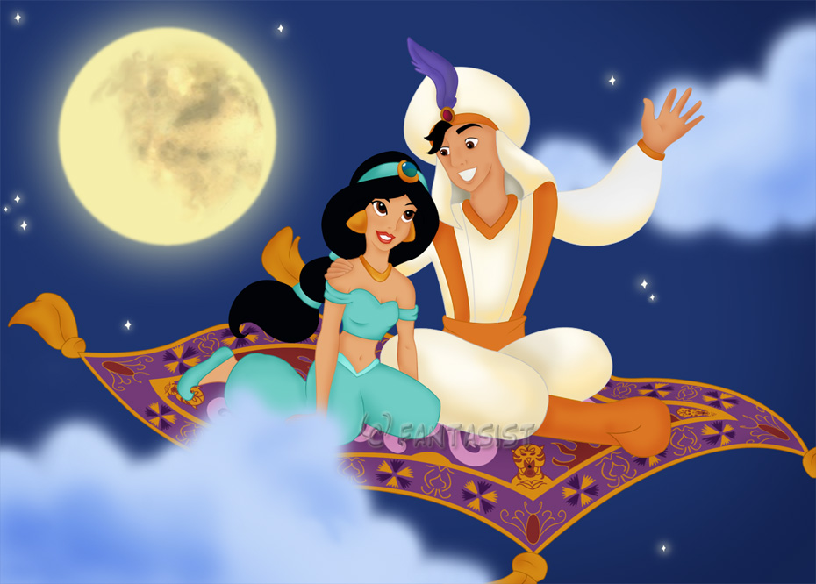
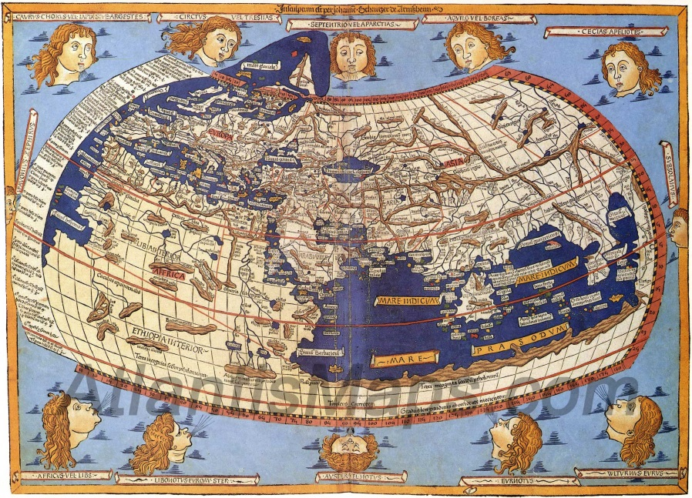
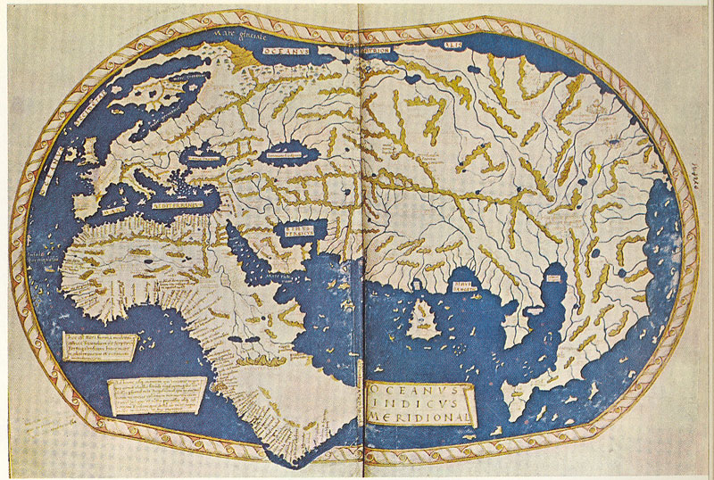
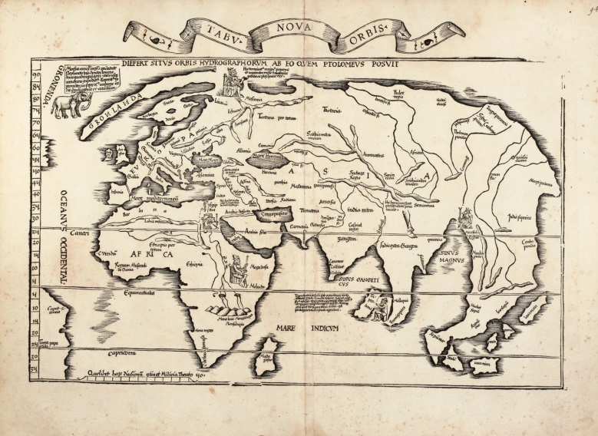
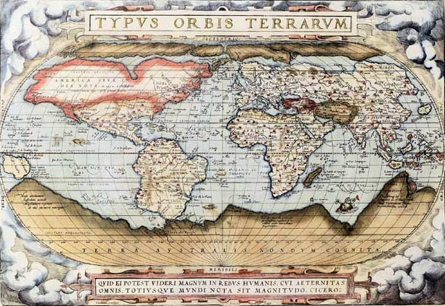
Do Now: Grab today’s Agenda (3:5) from your Out Box. Then, look at the maps below. Compare and contrast. Why do you think they are different? Write your answer on your Agenda.

Slide 2
Objective: A Whole New World
WHII.4c,f
TSWDK of the impact of the European Age of Discovery and expansion into the Americas, Africa, and Asia by explaining migration, settlement patterns, cultural diffusion, and social classes in the colonized areas and by describing the impact of precious metal exports from the Americas.

Slide 3
A Whole New World
Effects on Europe
Effects on Everyone Else

Slide 4
Effects on Europe
Portugal
The Portuguese established an overseas trade route from Europe to India (via the Indian Ocean) to the East Indies, without having to deal with the Muslim traders. This lowered the cost of goods.
Portuguese also set up colonies in Brazil, where they built huge agricultural estates.
But Portugal did not have the financial wealth to support so large an empire.
1580, Spain annexed Portugal. Under Spanish control, Portugal’s trade was greatly restricted and its overseas colonies were neglected. Only Brazil and Angola survived as major Portuguese colonies.

Slide 5
Effects on Europe
Spain
What made the Aztec and Incan Empire so desirable to Cortez and Pizarro was the amount of gold and silver these two empires had. It was an insane amount! And, of course, this made the Spanish very wealthy.
The success of Cortez and Pizarro only prompted more conquistadores to come to the New World in search of wealth.
The Spanish created a complex colonial administration system to control their empire. Spain directed the colonial government.
The system of encomienda, allowed Spanish settlers to use Native Americans as forced labor. Eventually this policy of forced labor, combined with disease and starvation, took a heavy toll on the native population.

Slide 6
Effects on Europe
Spain (continued)
But the amount of gold and silver flowing into Spain from the colonies drove down the price of gold and silver, which meant the price of goods, such as food and clothes, increased. Inflation.
The Spanish economy was already weakening – many reasons. (Among them the Spanish expulsion of the Jews in 1492.)
The Spanish Empire declined.

Slide 7
Effects on Everyone Else
Americas
Religion
There was a concerted effort by Catholic missionaries to convert the Native Americans in hopes of protecting them.
Hundreds of thousands were converted to Christianity, which only hastened the destruction of Native American social and political structure.

Slide 8
Effects on Everyone Else
Americas
Social
The expansion of overseas territorial claims led to European emigration to North and South America.
Europeans migrated to new colonies in the Americas, creating new cultural and social patterns – Colonies’ imitation of the culture and social patterns of their parent countries.
Legacy of rigid class system and dictatorial rule in Latin America – left over from the encomienda.
European plantation system in the Caribbean and the Americas destroyed indigenous economies and damaged the environment.
Slavery – both Native American and African (see below)

Slide 9
Effects on Everyone Else
Americas
Disease
European diseases such as smallpox, typhus, and measles weakened the Native American societies conquered by Cortez and Pizarro.
Millions of Native Americans died. Whole cultures that had lived and thrived for centuries were wiped out or broken up in a matter of relatively a few years.
Exact losses cannot be accurately determined, but many historians believe that the numbers were enormous.

Slide 10
Effects on Everyone Else
Africa
Trading posts and colonies – Europeans established trading posts and colonies along the African coast. Trade in slaves, gold, and other resources.
Slavery
Slavery existed for centuries in Africa prior to European contact.
Portuguese and Spanish were first to purchase these slaves in small numbers of coastal trading ports.
As demand increased on plantations, European acquired more slaves.
Africans in the interior helped to capture and move slaves. In return, they received European-made goods.
During slave trade, native populations in some parts of Africa were greatly reduced. These population losses had disastrous effects on Africa’s development and progress.

Slide 11
Effects on Everyone Else
Asia
Europeans established trading posts and colonies in Asia.
Colonization by small groups of merchants (India, the Indies, China)
Influence of trading companies (Portuguese, Dutch, British)

Slide 12
Conclusion
The European nations exported precious metals from the Americas.
Gold and silver exported to Europe and Asia
Impact on indigenous empires of the Americas
Impact on Spain and international trade
Europeans migrated to new colonies in the Americas, creating new cultural and social patterns.
Europeans established trading posts and colonies in Africa and Asia.
The effect exploration and colonization had on Europe is evident through the expansion and decline of empires.
The effect exploration and colonization had on the Americas is evident through
The loss of indigenous religions and growth of Christianity
The demise of the Aztec and Incan Empires
The changes in society from European immigration and forced migration of slaves
Crash Course: Spanish Empire

