Slide 1
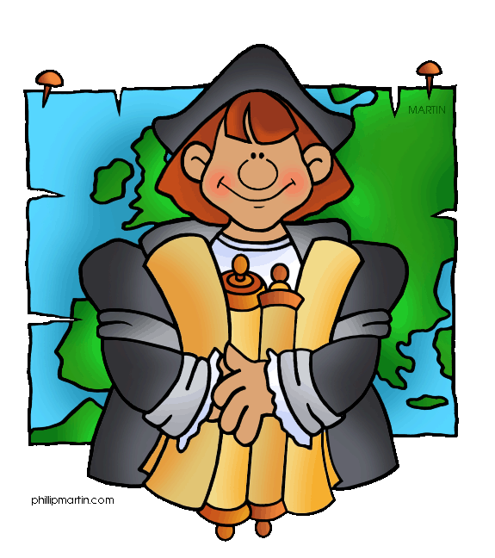
Do Now:
Turn in your Sugar, Potato, or Horse ad.
Grab today’s Agenda (3:8) from your Out Box.
Get onto Nearpod.

Slide 2
Objective: The Columbian Exchange
WHII.4d and f
TSWDK of the impact of the European Age of Discovery and expansion into the Americas, Africa, and Asia by describing the Columbian Exchange, including its impact on native populations and by mapping and explaining the Triangular Trade.

Slide 3
The Columbian Exchange
Triangular Trade
Columbian Exchange

Slide 4
Triangular Trade
Definition

Slide 5
Triangular Trade
Definition
The European nations established a trade pattern known as the Triangular Trade.

Slide 6
Triangular Trade
Definition
The European nations established a trade pattern known as the Triangular Trade.
It linked Europe, Africa, and the Americas.

Slide 7
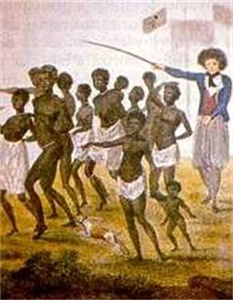
Triangular Trade
Definition
The European nations established a trade pattern known as the Triangular Trade.
It linked Europe, Africa, and the Americas.
Slaves,

Slide 8
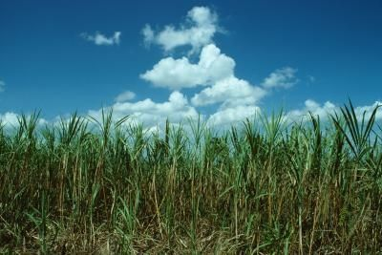
Triangular Trade
Definition
The European nations established a trade pattern known as the Triangular Trade.
It linked Europe, Africa, and the Americas.
Slaves, sugar,

Slide 9
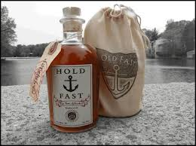
Triangular Trade
Definition
The European nations established a trade pattern known as the Triangular Trade.
It linked Europe, Africa, and the Americas.
Slaves, sugar, and rum were traded.

Slide 10
Triangular Trade
Pattern

Slide 11
Triangular Trade
Pattern
1st: Merchants shipped cotton goods, weapons, and liquor to Africa in exchange for slaves and gold.

Slide 12
Triangular Trade
Pattern
1st: Merchants shipped cotton goods, weapons, and liquor to Africa in exchange for slaves and gold.
2nd: The shipment of slaves across the Atlantic to the Americas. Slaves sold for goods produced on plantations, such as sugar, tobacco, and raw cotton.

Slide 13
Triangular Trade
Pattern
1st: Merchants shipped cotton goods, weapons, and liquor to Africa in exchange for slaves and gold.
2nd: The shipment of slaves across the Atlantic to the Americas. Slaves sold for goods produced on plantations, such as sugar, tobacco, and raw cotton.
3rd: Merchants sent the products produced by the plantations to Europe. Raw materials shipped to Europe were manufactured into finished goods to be sold in the colonies and Africa.

Slide 14
Triangular Trade
Middle Passage

Slide 15
Triangular Trade
Middle Passage
The slave journey across the Atlantic from Africa to the Americas was known as the Middle Passage.

Slide 16
Triangular Trade
Middle Passage
The slave journey across the Atlantic from Africa to the Americas was known as the Middle Passage.
The Middle Passage was brutal and degrading.

Slide 17
Triangular Trade
Middle Passage
The slave journey across the Atlantic from Africa to the Americas was known as the Middle Passage.
The Middle Passage was brutal and degrading.
Traders chained the slaves in the crowded hold of the ship. This stopped slaves from jumping overboard or causing trouble aboard the ship.

Slide 18
Triangular Trade
Middle Passage
The slave journey across the Atlantic from Africa to the Americas was known as the Middle Passage.
The Middle Passage was brutal and degrading.
Traders chained the slaves in the crowded hold of the ship. This stopped slaves from jumping overboard or causing trouble aboard the ship.
Slaves had little food or water and no sanitary facilities.

Slide 19
Triangular Trade
Middle Passage
The slave journey across the Atlantic from Africa to the Americas was known as the Middle Passage.
The Middle Passage was brutal and degrading.
Traders chained the slaves in the crowded hold of the ship. This stopped slaves from jumping overboard or causing trouble aboard the ship.
Slaves had little food or water and no sanitary facilities.
Many died before reaching their destination.

Slide 20
The Columbian Exchange
Definition

Slide 21
The Columbian Exchange
Definition
An exchange of goods, plants, animals, and diseases that followed Columbus’ initial connection between Europe and the Americas.

Slide 22
The Columbian Exchange
Definition
An exchange of goods, plants, animals, and diseases that followed Columbus’ initial connection between Europe and the Americas.
The discovery of the Americas by Europeans resulted in the exchange of products and resources between the Eastern and Western Hemisphere.

Slide 23
Columbian Exchange Pattern

Slide 24
Columbian Exchange Pattern
From Western Hemisphere (Americas) to Eastern Hemisphere (Europe)

Slide 25
Columbian Exchange Pattern
From Western Hemisphere (Americas) to Eastern Hemisphere (Europe)
From Eastern Hemisphere (Europe) to Western Hemisphere (Americas)

Slide 26
Columbian Exchange Pattern
From Western Hemisphere (Americas) to Eastern Hemisphere (Europe)
Agricultural products, such as corn, potatoes, and tobacco.
From Eastern Hemisphere (Europe) to Western Hemisphere (Americas)

Slide 27
Columbian Exchange Pattern
From Western Hemisphere (Americas) to Eastern Hemisphere (Europe)
Agricultural products, such as corn, potatoes, and tobacco.
Changed European lifestyle.
From Eastern Hemisphere (Europe) to Western Hemisphere (Americas)

Slide 28
Columbian Exchange Pattern
From Western Hemisphere (Americas) to Eastern Hemisphere (Europe)
Agricultural products, such as corn, potatoes, and tobacco.
Changed European lifestyle.
From Eastern Hemisphere (Europe) to Western Hemisphere (Americas)
Horses, cattle, and diseases (smallpox)

Slide 29
Columbian Exchange Pattern
From Western Hemisphere (Americas) to Eastern Hemisphere (Europe)
Agricultural products, such as corn, potatoes, and tobacco.
Changed European lifestyle.
From Eastern Hemisphere (Europe) to Western Hemisphere (Americas)
Horses, cattle, and diseases (smallpox)
Changed the lifestyle of American Indians

Slide 30
Columbian Exchange
Impact

Slide 31
Columbian Exchange
Impact
Shortage of labor to grow cash crops led to the use of African slaves.

Slide 32
Columbian Exchange
Impact
Shortage of labor to grow cash crops led to the use of African slaves.
Slavery was based on race.

Slide 33
Columbian Exchange
Impact
Shortage of labor to grow cash crops led to the use of African slaves.
Slavery was based on race.
European plantation system in the Caribbean and the Americas destroyed indigenous economies and damaged the environment.

Slide 34
Conclusion
The European nations established a trade pattern known as the Triangular Trade which connected Europe, Africa, and the Americas.

Slide 35
Conclusion
The European nations established a trade pattern known as the Triangular Trade which connected Europe, Africa, and the Americas.
The discovery of the Americas by Europeans resulted in an exchange of products and resources between the Eastern and Western Hemisphere.

Slide 36
Conclusion
The European nations established a trade pattern known as the Triangular Trade which connected Europe, Africa, and the Americas.
The discovery of the Americas by Europeans resulted in an exchange of products and resources between the Eastern and Western Hemisphere.
Crash Course: The Columbian Exchange

