Slide 1
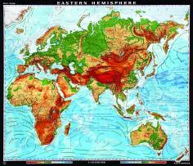
Do Now:
Grab today’s Agenda (4:3) and a worksheet. Complete Parts 1 and 2 of the worksheet.

Slide 2
Objective: Commercial Revolution
WHII.5d-e
TDWDK of the status and impact of global trade on regional civilizations of the world after 1500 AD (CE) by describing Africa and its increasing involvement in global trade and by describing the growth of European nations including the Commercial Revolution and mercantilism.

Slide 3
How Did the Commercial Revolution Create Rich European Nations?
“The voyages of exploration and discovery to Africa and the Americas shifted European trade routes from the Mediterranean Sea to the Atlantic Ocean. This change in trading patterns led to important new economic developments in Europe. These economic changes were so great that they have been called the Commercial Revolution.”
Based on this document, what started the Commercial Revolution?

Slide 4
Commercial Revolution
The Eastern Hemisphere
Commercial Revolution

Slide 5
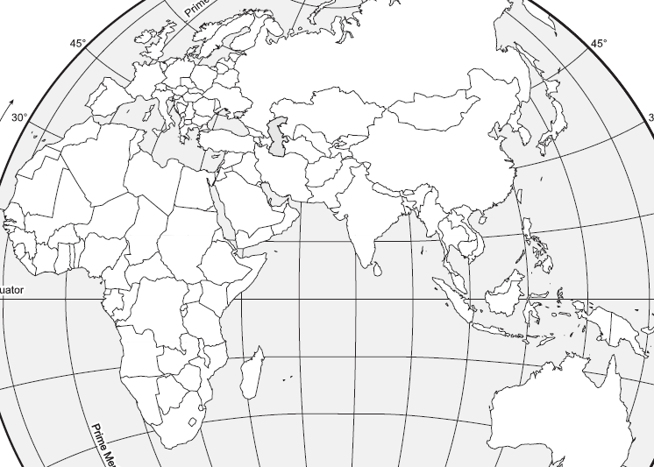
The Eastern Hemisphere

Slide 6
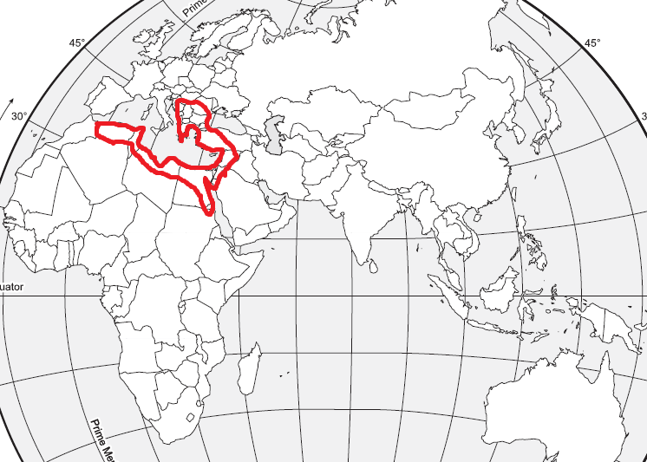
The Eastern Hemisphere
Ottoman Empire
Islamic
Coffee and Ceramics

Slide 7
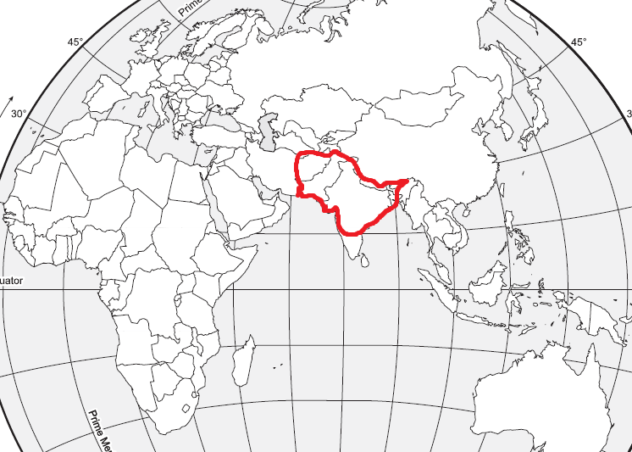
The Eastern Hemisphere
Ottoman Empire
Islamic
Coffee and Ceramics
Mughal Empire
Islamic
Silks, spices, and gems

Slide 8
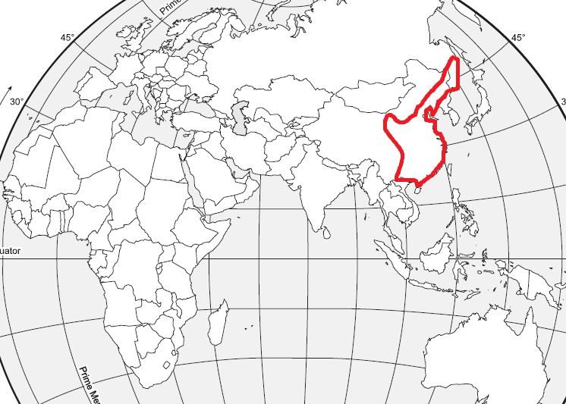
The Eastern Hemisphere
Ottoman Empire
Islamic
Coffee and Ceramics
Mughal Empire
Islamic
Silks, spices, and gems
China
Foreign enclaves
Tea and porcelain

Slide 9
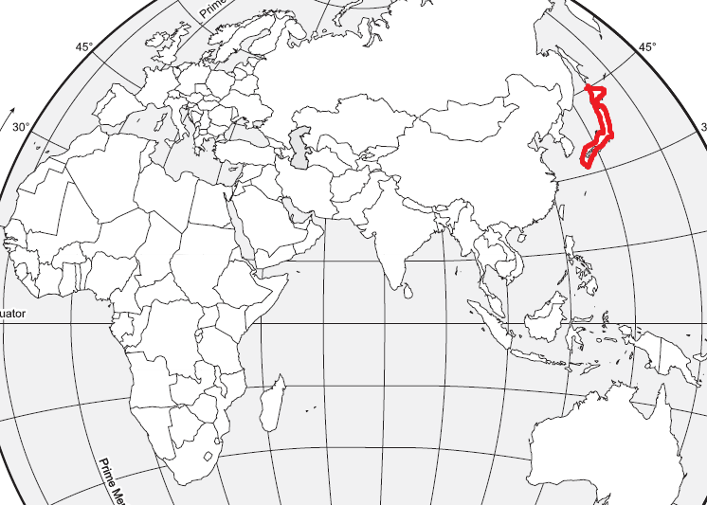
The Eastern Hemisphere
Ottoman Empire
Islamic
Coffee and Ceramics
Mughal Empire
Islamic
Silks, spices, and gems
China
Foreign enclaves
Tea and porcelain
Japan
Limited foreign influence

Slide 10
The Eastern Hemisphere
African Exports (leaving Africa)
Slaves (triangular trade)
Raw materials (ivory, gold)
African Imports (coming into Africa)
Manufactured goods from Europe, Asia, and the Americas
New food products (corn, peanuts)
Impact
The exportation of slaves and demand for imported goods began to alter traditional economic patterns in Africa.

Slide 11
How Did the Commercial Revolution Create Rich European Nations?
Capitalism is an economic system that is based upon two principles:
Private citizens own and operate businesses; they may own as much property (houses, clothes, horses, etc.) as they can buy.
The goal of capitalism is to make the maximum profit possible.
Wealthy capitalists often financed the voyages of European explorers. In exchange for lending money to the voyagers, they expected to receive a share of the profits that the voyagers returned with.
So… let’s check out your thoughts!

Slide 12
Commercial Revolution
Mercantilism
An economic practice adopted by European colonial powers in an effort to become self-sufficient, based on the theory that colonies existed for the benefit of the mother country.
Mother countries were conquerors.
The conquered land was a colony.
Mercantilism was the belief that a nation’s power depended on the ownership of gold and silver.
In order to acquire gold and silver, European countries established overseas colonies. However, gold and silver were in abundance in parts of South America. The rest of the colonies provided raw materials for the mother country to produce finished products.
Example: cotton was produced in the colonies and exported to the mother country, where it was processed to produce clothes, which were then exported back to the colonies (and other places).

Slide 13
How Did the Commercial Revolution Create Rich European Nations?
Complete Parts 3 and 4 now!
Based on the rest of the worksheet, what effects do you think mercantilism had on…
Europe?
Americas?
Africa?

Slide 14
Commercial Revolution
Commercial Revolution
European maritime nations competed for overseas markets, colonies, and resources.
However, while European kings and capitalists increased their wealth, Native American Indians and Africans were terribly exploited.
A new economic system emerged:
New money and banking systems were created
Economic practices such as mercantilism evolved
Colonial economies were limited by the economic needs of the mother country
The Commercial Revolution marked an important step in Europe’s transformation from local economies to a global economy.

Slide 15
Conclusion
The Ottoman Empire emerged as a political and economic power following the conquest of Constantinople.
Descendants of the Mongols, the Muslim Mughal (Mogul) rulers, established an empire in northern India.; The Mughal Empire traded with European nations; Much of southern India remained independent and continued international trade.
China and Japan sought to limit the influence and activities of European merchants.
The exportation of slaves and demand for imported goods began to alter traditional economic patterns in Africa.
European maritime nations competed for overseas markets, colonies, and resources, creating new economic practices, such as mercantilism, linking European nations with their colonies.

