Slide 1
Do Now:
Grab today’s Agenda (5:2) and complete Do Now.
When done, sign onto Nearpod.

Slide 2
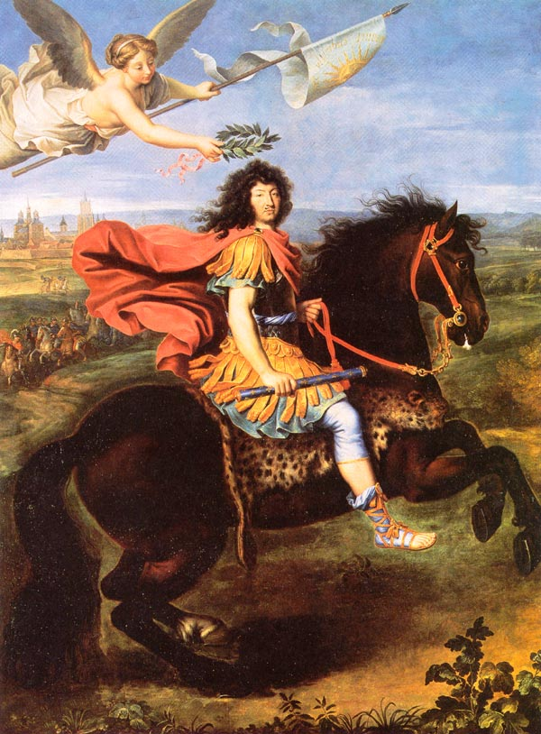
Objective: Absolutism
SOL WHII.6b
TSWDK of scientific, political, economic, and religious changes during the 16th, 17th, and 18th centuries by describing the Age of Absolutism, including the monarchs of Louis XIV and Peter the Great.

Slide 3
Absolutism
Absolutism
Louis XIV of France
Frederick the Great of Prussia
House of Hapsburg
Peter the Great of Russia

Slide 4
Absolutism
“Monarchs”
Who rules the country?
King/Tsar/Monarch
What powers do they have?
Tax when they want
Go to war when they want
Controls the making and repealing of laws
Where does their power come from?
God – “Divine Right of Kings”
Are there any checks and balances?
No. King does what he wants

Slide 5
Absolutism
Define
A form of government in which the ruler is an absolute dictator (not restricted by a constitution, laws, or opposition)
The Age of Absolutism takes its name from a series of European monarchs who increased the power of their central government.
Westernization
Modernization
The act of being like Western Europe

Slide 6
Louis XIV of France
1638-1715
Received crown at the age of 4 and ruled for 72 years – the longest reign of any European monarch.
Began his reign of absolute monarchy in 1661. (He was 23 years old; 19 years into his reign.)

Slide 7
Louis XIV of France
1638-1715
Received crown at the age of 4 and ruled for 72 years – the longest reign of any European monarch.
Began his reign of absolute monarchy in 1661. (He was 23 years old; 19 years into his reign.)
“Sun King”
Believed in the “Divine Right” kings – king’s authority to rule is derived from God.
Maintained control over nobles by keeping them at his Palace at Versailles – if they are taken care of and constantly entertained, they can’t complain!

Slide 8
Louis XIV of France
Palace of Versailles

Slide 9
Louis XIV of France
Palace of Versailles
Symbol of Absolutism

Slide 10
Louis XIV of France
Palace of Versailles
Symbol of Absolutism

Slide 11
Louis XIV of France
Palace of Versailles
Symbol of Absolutism
Every monarch wanted one!

Slide 12
Louis XIV of France
Palace of Versailles
Symbol of Absolutism
Every monarch wanted one!
Some stats…
2,300 rooms

Slide 13
Louis XIV of France
Palace of Versailles
Symbol of Absolutism
Every monarch wanted one!
Some stats…
2,300 rooms (350 living units)

Slide 14
Louis XIV of France
Palace of Versailles
Symbol of Absolutism
Every monarch wanted one!
Some stats…
2,300 rooms (350 living units)
2,153 windows

Slide 15
Louis XIV of France
Palace of Versailles
Symbol of Absolutism
Every monarch wanted one!
Some stats…
2,300 rooms (350 living units)
2,153 windows
67 staircases

Slide 16
Louis XIV of France
Palace of Versailles
Symbol of Absolutism
Every monarch wanted one!
Some stats…
2,300 rooms (350 living units)
2,153 windows
67 staircases
5, 210 pieces of furniture

Slide 17
Louis XIV of France
Centralized Power
Turned France into a great European power, but at the expense of the poor.
Got into many successful, yet costly, wars… but for a greater France (which was Louis XIV)
“L’etat, c’est moi!” – “I am the State”
Revoked the Edict of Nantes (1598 document which had awarded Huguenots political and religious freedom). Religious freedom is now gone! (If you can choose your own religion, then could you choose your own ruler?! Gasp!!)

Slide 18
Frederick the Great of Prussia
1712-1786
Enlightened absolutism = a form of absolute monarchy in which the rulers were influenced by the Enlightenment
Fostered the arts, sciences, and education

Slide 19
Frederick the Great of Prussia
1712-1786
Enlightened absolutism = a form of absolute monarchy in which the rulers were influenced by the Enlightenment
Fostered the arts, sciences, and education
Modernized Prussia through…
Industrialization
Building canals
Reorganizing tax system
Improving education (one of the best in Europe)
Construction of monumental buildings (like a palace similar to Versailles)
Religious tolerance

Slide 20
House of Hapsburg
1278-1780
Included the (South) Holy Roman Empire, Austria, Hungary

Slide 21
House of Hapsburg
1278-1780
Included the (South) Holy Roman Empire, Austria, Hungary
Joseph II
Ruled with enlightened absolutism
Modernized empire by
Freeing peasantry
Spreading education
Secularizing church lands
Granting religious tolerance
Ruling for the good of all

Slide 22
Peter the Great of Russia
1672-1725
About Peter
Enlightened Absolutism
Modernized Russia by
Reorganizing army and navy
Enforcing European styles of dress
Improving education
Building modern structures (like a palace similar to Versailles)
Built the city of St. Petersburg

Slide 23
Conclusion
The Age of Absolutism takes its name from a series of European monarchs who increased the power of their central government.
Characteristics of absolute monarchies include
Centralization of power
Concept of rule by divine right
Some absolute monarchs…
Louis XIV of France: Palace of Versailles as a symbol of royal power
Peter the Great of Russia; Westernization of Russia

