Slide 1
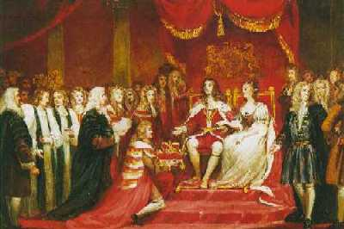
Do Now:
Grab today’s Agenda (5:4) from your Out Box.
Then answer the “Do Now” question.

Slide 2
Objective: The English Civil War
SOL WHII.6c
TSWDK of scientific, political, and economic, and religious changes during the 16th, 17th, and 18th centuries by assessing the impacts of the English Civil War and the Glorious Revolution on democracy.

Slide 3
The English Civil War
Parliament vs. King
Charles I

Slide 4
Parliament vs. King
William the Conqueror
William I, who was French, conquered England in 1066.
Uniting all of England under his rule was difficult. He established feudalism to do just that.
He also created a group to advise him on behalf of the people – so as not to upset them and keep them happy.
This group would eventually be called “parliament” from the French word parle, which means “to speak.”

Slide 5
Parliament vs. King
Common Law
And as long as they’ve had a king, the British have also had common law, which is based on traditional ideas rather than written law.
Common law was based on the idea that government ruled for the protection of people and property.
It was understood that since taxation deprived citizens of their property, it could only be done with their consent – or the consent of Parliament.
This was the beginning of the “rights of Englishmen.”

Slide 6
Parliament vs. King
Magna Carta
King John
1199-1216
Abused his position as king:
Taxing when he wanted
Throwing who he wanted in jail without proof of wrongdoing or even a trial.

Slide 7
Parliament vs. King
Magna Carta
A Document
The nobles fought back with the Magna Carta, a document that affirmed due process
Government cannot take our property or put us in jail without proper process.
This includes warrants and trial by jury.
This is due process.
King was also not allowed to tax the people without the consent of Parliament. King could not do whatever he wanted to do. He was subject to Parliament’s approval.

Slide 8
Parliament vs. King
Magna Carta
Significance: The power of the king was limited for the first time.
Testing Limits
After the passage of the Magna Carta, king after king would test the limits of their boundaries.
Kings, of course, would need permission from Parliament to tax the people (for the many wars they engaged in).
Parliament would usually consent but only in exchange for something.
Kings understood that they needed the support of Parliament to keep the people happy.

Slide 9
Parliament vs. King
The Tudors
Included Henry VIII, Mary I, and Elizabeth I.
Each of the Tudors ruled with near absolute power, but usually worked with Parliament.
This was especially true of Elizabeth who often consulted Parliament.
As a result, Parliament gained power and influence, which made it even more challenging for future monarchs.

Slide 10
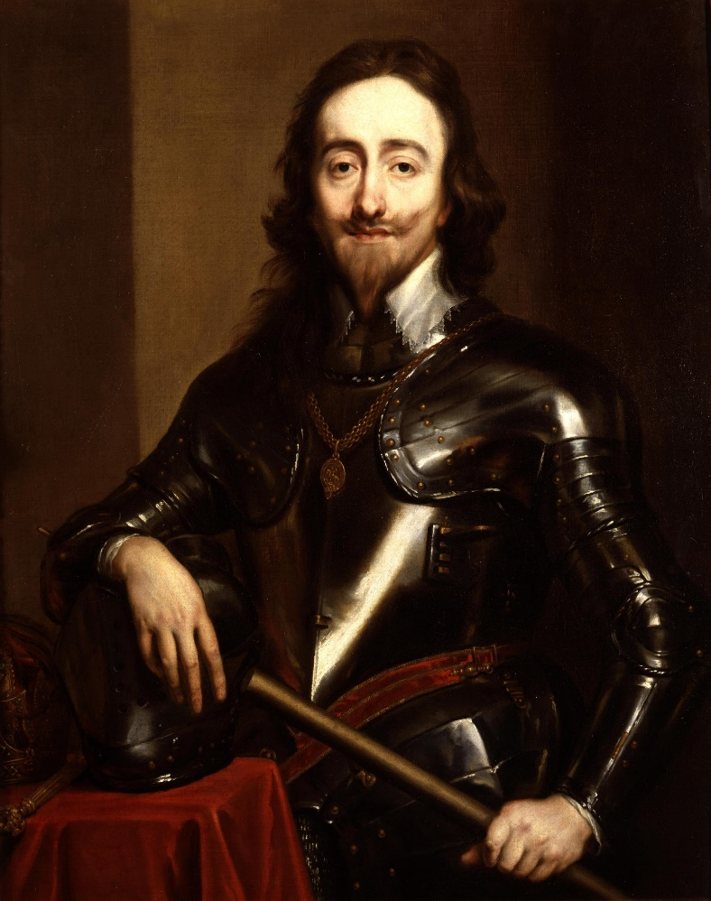
Parliament vs. King
The Stuarts
James I
First of the Stuart kings after Elizabeth I.
Reigned 1603-1625.
Strong supporter of Divine Right, and therefore, clashed often with Parliament.
Charles I
Son of James I
Reigned 1625-1649
Believed in Divine Right of Kings
(Homework Video)

Slide 11
Charles I
British Petition of Rights
Charles wanted to go to war with France but Parliament refused to finance it.
So Charles found another way to get money:
Forced nobles to loan him money. Those who did not pay were thrown in jail.
Ordered maritime ports to pay for any improvements required in the navy.
Forced the public to support the troops (quartering).
Placed several counties under martial law in order to further enforce his authority.

Slide 12
Charles I
British Petition of Rights
In 1628, Parliament decided it was time to limit the power of the king (again… since the Magna Carta)
The British Petition of Rights guaranteed the basic rights of Englishmen:
Trial by jury
Protection against quartering troops
Protection of private property

Slide 13
Charles I
British Petition of Rights
Charles signed the document, promising to uphold the Petition.
Keeping the terms of the Petition of Rights was easy under peace time, of which Charles had over a decade.
However, the peace had to come to an end, and, like any other time a British monarch wants money, Charles requested funds from Parliament.
Parliament refused. This time they had some demands for the king… demands that would limit his power even more.
Charles, a firm believer of Divine Right was outraged. This meant war!

Slide 14
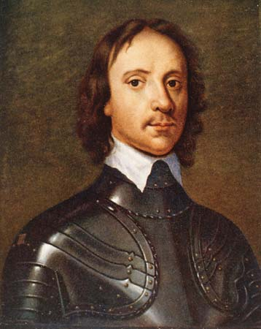
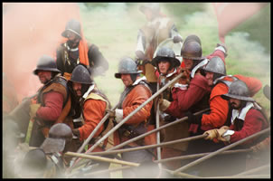
Charles I
Civil War
Players
Royalists
Those supporting King Charles I
AKA the Cavaliers, from the Spanish word, cavaleiros, meaning mounted horsemen, suggesting they were foreigners and bullies. This was a name given to them by the opposing side.
Parliamentarians
Those supporting Parliament.
AKA the Roundheads, referring to the apprentices’ shaved heads, implying they were lowbred, rough, and uncouth.
Oliver Cromwell
Leader of the Parliamentarians who built an army to fight the King Charles and his Cavaliers.

Slide 15
Charles I
Trial and Execution
Charles I was tried for acts of tyranny, which he was accused of committing against the people of Britain.
Charles I and his followers believed that Parliament had no authority to try the king of England. He refused to recognize the court and did not plead his case.
Charles was found guilty and then executed – beheaded.
Video Clip

Slide 16
Charles I
Trial and Execution
The English Civil War was significant because:
The end of any attempt at absolutism
Parliament did not start out wanting to execute the king. They were fine with compromise.
However, it was Charles’ stubborn unyielding nature that forced them to act so drastically...
And the will of Oliver Cromwell to see Charles gone.

Slide 17
Conclusion
Political democracy rests on the principle that government derives power from the consent of the governed.
The foundations of English rights include the jury trial, the Magana Carta, and common law.
Parliament was created to ensure the protection of English rights. However, kings often ruled with the notion of divine right. As a result, Parliament and King often clashed.
Charles I was raised to be king based on Divine Right. The British Petition of Rights attempted to limit the power of the king.
The Petition of Rights was easy to follow during times of peace but war time strained its purpose and once again, king and Parliament clashed.
Parliament took advantage of this opportunity to limit the power of the king. This time, it meant war.
The English Civil War pitted the Cavaliers (royalists) against the Roundheads (parliamentarians). It ended with the trial and execution of Charles I and the end of any attempt at absolutism in England.

