Slide 1
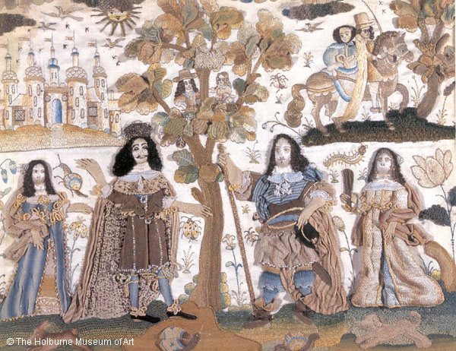
Do Now:
Grab today’s Agenda (5:5).

Slide 2
Objective: The Glorious Revolution
SOL WHII.6c
TSWDK of scientific, political, economic, and religious changes during the 16th, 17th, and 18th centuries by assessing the impacts of the English Civil War and the Glorious Revolution on democracy.

Slide 3
The Glorious Revolution
The British Commonwealth
The Restoration
James II
1688 Revolution

Slide 4
The British Commonwealth
Oliver Cromwell
Leader of Parliament before and during the English Civil War.
He led the Roundheads to victory.
He also pushed to convict Charles I of treason.
After the execution of Charles I, Parliament replaced the monarchy with the British Commonwealth.
Cromwell was appointed Lord Protector of the Commonwealth.
Unfortunately, like so many monarchs before him, he quarreled with Parliament. He finally dissolved Parliament in 1653 (4 years in).
Cromwell ruled alone until his death in 1658.

Slide 5
The British Commonwealth
Life in the Commonwealth
1653-1660

Slide 6
The British Commonwealth
Life in the Commonwealth
1653-1660
Cromwell was a Puritan and very religious.

Slide 7
The British Commonwealth
Life in the Commonwealth
1653-1660
Cromwell was a Puritan and very religious.
He believed in living life according to the Bible and that everyone should follow his example.

Slide 8
The British Commonwealth
Life in the Commonwealth
1653-1660
Cromwell was a Puritan and very religious.
He believed in living life according to the Bible and that everyone should follow his example.
Pointless enjoyment was frowned upon.

Slide 9
The British Commonwealth
Life in the Commonwealth
1653-1660
Cromwell was a Puritan and very religious.
He believed in living life according to the Bible and that everyone should follow his example.
Pointless enjoyment was frowned upon.
Sunday became an absolute day of rest.

Slide 10
The British Commonwealth
Life in the Commonwealth
1653-1660
Cromwell was a Puritan and very religious.
He believed in living life according to the Bible and that everyone should follow his example.
Pointless enjoyment was frowned upon.
Sunday became an absolute day of rest.
Conservative dress was enforced.

Slide 11
The British Commonwealth
Life in the Commonwealth
1653-1660
Cromwell was a Puritan and very religious.
He believed in living life according to the Bible and that everyone should follow his example.
Pointless enjoyment was frowned upon.
Sunday became an absolute day of rest.
Conservative dress was enforced.
Christmas was banned.
“Cousin Ollie”

Slide 12
The British Commonwealth
The End
By the end of his life, Cromwell had become hated by the people.
The population was tired of this strict rules.
More importantly, Cromwell failed to settle the nation’s problems.
Oliver Cromwell died in 1658 and was buried in Westminster Abbey, where kings and queens are buried.
Cromwell’s son Richard took over the leadership of the country.
However, Richard was clearly not up to the task and in 1660, he left the job.
The people wanted their king back.

Slide 13
The Restoration
Charles II
Son of Charles I.
In 1660, Parliament offered to Charles II the throne in exchange for some concessions. The most important of these was the undisputable power of Parliament.
And so, in 1660, the British monarchy, particularly the Stuart Family, was restored.
Hence the name… The Restoration.

Slide 14
The Restoration
Charles II
Charles II worked with Parliament.
He wanted an alliance with France, but Parliament objected so he stopped.
Tried to increase religious tolerance for Catholics. Parliament protested so he stopped.

Slide 15
The Restoration
Charles II
Charles II worked with Parliament.
He wanted an alliance with France, but Parliament objected so he stopped.
Tried to increase religious tolerance for Catholics. Parliament protested so he stopped.
During his reign, Britain faced a plague that killed 60,000-70,000 people. Charles did the best he could. All attempts by London public health officials to contain the disease failed and the plague spread quickly.

Slide 16
The Restoration
Charles II
Charles II worked with Parliament.
He wanted an alliance with France, but Parliament objected so he stopped.
Tried to increase religious tolerance for Catholics. Parliament protested so he stopped.
During his reign, Britain faced a plague that killed 60,000-70,000 people. Charles did the best he could. All attempts by London public health officials to contain the disease failed and the plague spread quickly.
Charles II also had to deal with a massive fire in central London (1666) that destroyed 70,000 of the city’s 80,000 homes. He encouraged the evacuation of London and the resettlement elsewhere, which greatly decreased the number of deaths.

Slide 17
The Restoration
The “Merry Monarch”
Charles II was not at all like his father. He was casual and easy-going. He was cheerful, witty, and fond of a good time.
Theaters reopened after having been closed under Cromwell. In fact, theater licenses granted by Charles II were the first in England to permit women to play female roles on stage.
After so many years of Puritan rule, the people welcomed a king who loved the theater, horse riding, and spectacular mistresses (including one named Hortense Mancini).
Charles II was married to Catherine of Braganza but was unable to have children live past infancy. He has, however, had at least twelve illegitimate children by various mistresses.
King of Bling

Slide 18
James II
King
Charles II died in 1685 without an heir. So next in line was his brother, James II.
During the reign of Oliver Cromwell, James II was exiled to France.
His time there exposed him to the beliefs and ceremonies of Catholicism.
He even married a French woman (Catholic).
Despite his conversion, James continued to associate primarily with Anglicans and even continued to attend Anglican services.

Slide 19
James II
Heir
In 1688, James II had a son – an heir to the throne. His name was James Edward.
Since James Edwards’ parents were Catholic, he would be raised Catholic.
And now we have a problem…

Slide 20
1688 Revolution
Political Parties
Defined: A group wanting to control government via organized electoral process.
Purpose: To win the support of the people to gain power in government.
Impact: Power of government comes from the people.
Faction = a group within a larger group, usually in conflict with the group. This usually manifests when ideological purists are unhappy with the moderation of the larger group (which is necessary to accomplish anything).

Slide 21
1688 Revolution
Whigs vs. Tories
Whigs
Pro-Parliament. Even at the expense of a weaker monarch.
They believed that the consent of the people was the source of political power and authority.
Monarchs were in power only as a result of a “contract” with the people. If the monarch fails them, the people have a right to resist him.
The people of England are Protestant. Their king should be Protestant as well.
Whigs vs. Tories
Tories
Pro-Monarch. Even at the expense of having a Catholic king.
They believed in Divine Right and hereditary succession.
James II was the king because he was next in line of hereditary succession, even though he is Catholic.

Slide 22
1688 Revolution
William and Mary
The Problem
Having another Catholic monarch was problematic for the Whigs.
Getting rid of the king because of his religion was problematic for the Tories.
There was another option: Mary – eldest daughter of James II, who was raised a Protestant.
In one of their rare moments of working together, both the Whigs and the Tories asked James II to step down.
They sent an ‘invitation” to William of Orange and his wife Mary to rule England.
They reigned 1688-1702.

Slide 23
1688 Revolution
English Bill of Rights
But their reign came on the condition of an English Bill of Rights.
Signed in 1689, it was another document guaranteeing rights of the people.
The English Bill of Rights
Reaffirmed due process (MC 1215)
Reaffirmed the only Parliament can levy taxes (PR 1628)
Reaffirmed protection against quartering troops (PR 1628)
Freedom of petition
Right to bear arms
No cruel and unusual punishment
Significance: severely limited the power of the monarch to the point of eventually turning them into just figureheads – monarchs without power.

Slide 24
Glorious Revolution
“Glorious Revolution”
Bloodless transfer of power from James II to William and Mary
Thus ends the struggle between monarch and Parliament.
Who won? Parliament.
This was a huge increase of parliamentary power and decrease in royal power.

Slide 25
Conclusion
While the English Civil War further developed the rights of Englishmen, the rule of Oliver Cromwell under the British Commonwealth restricted the lives of Englishmen.
The Restoration of the British monarch with the return of Charles II brought back the glory of the British kingdom.
Political democracy rests on the principle that government derives power from the consent of the governed.
The foundations of English rights include the jury trial, the Magna Carta, and common law.
The English Civil War and the Glorious Revolution prompted further development of the rights of Englishmen.

