Slide 1
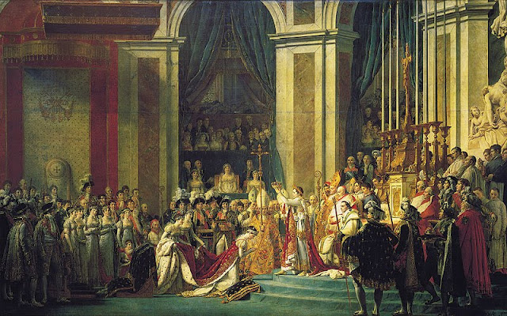
Do Now:
Grab an today’s Agenda (5:10)
What is the painting about?

Slide 2
Objective:
The Rise of Napoleon
WHII.6e
TSWDK of scientific, political, economic, and religious changes during the 16th, 17th, and 18th centuries by describing the French Revolution.

Slide 3
The Rise of Napoleon
Military Life
Political Life
French Revolution Review

Slide 4
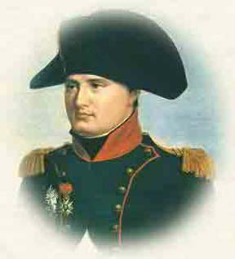
Military Life
Early Life
Born 1769
Studied military history

Slide 5
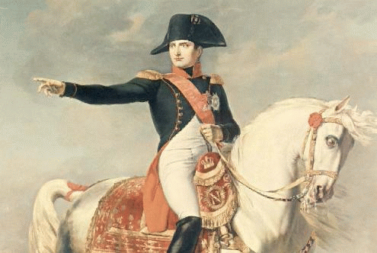
Military Life
Military
Joined army at 16… moved quickly up the ranks

Slide 6
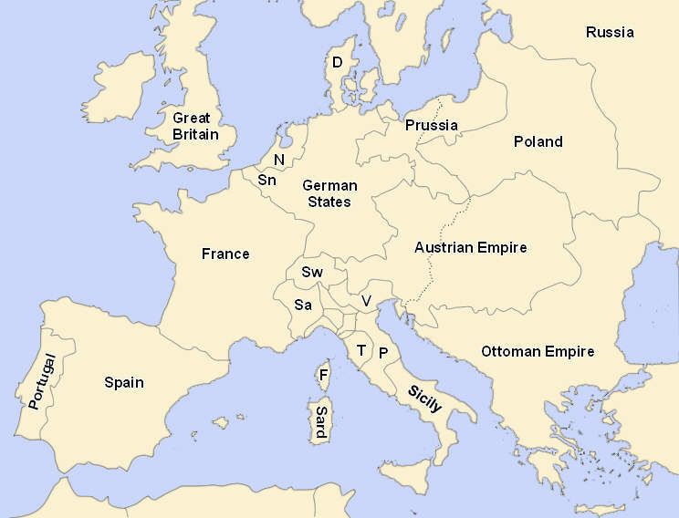
Military Life
Military
Joined army at 16… moved quickly up the ranks
Given first command in 1796

Slide 7
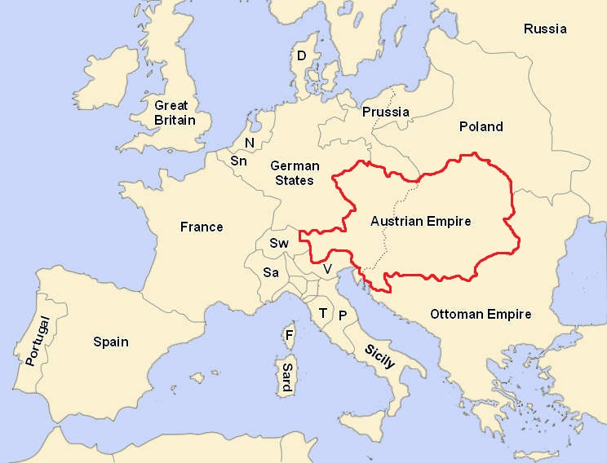
Military Life
Military
Joined army at 16… moved quickly up the ranks
Given first command in 1796
  Austria tried to end the revolution in France because Marie Antoinette was Austrian. So they sent troops to France. (This ended badly for the French monarchs.)

Slide 8
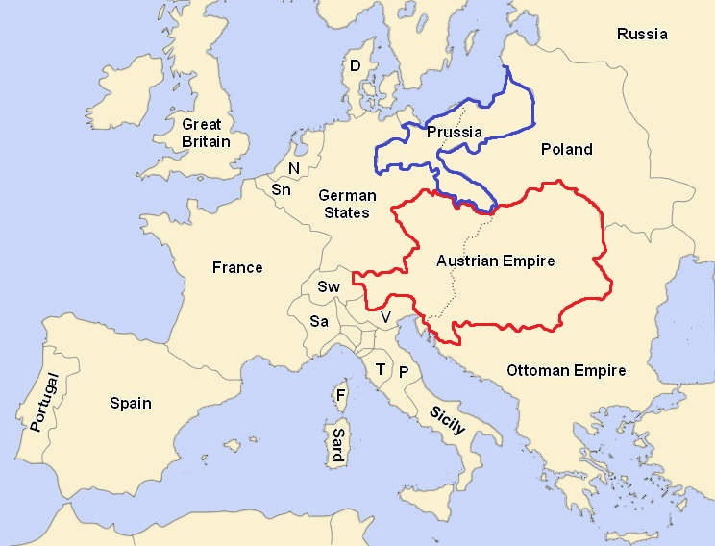
Military Life
Military
Joined army at 16… moved quickly up the ranks
Given first command in 1796
  Austria tried to end the revolution in France because Marie Antoinette was Austrian. So they sent troops to France. (This ended badly for the French monarchs.)
  Prussia

Slide 9
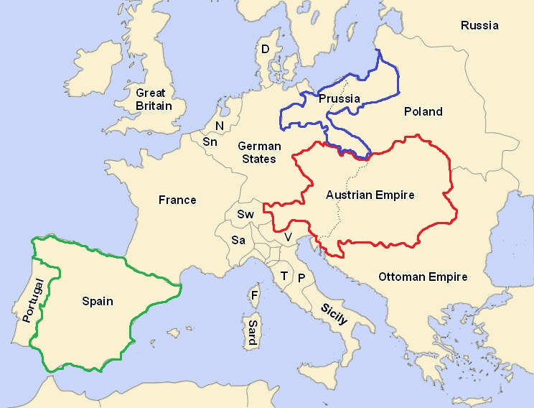
Military Life
Military
Joined army at 16… moved quickly up the ranks
Given first command in 1796
  Austria tried to end the revolution in France because Marie Antoinette was Austrian. So they sent troops to France. (This ended badly for the French monarchs.)
  Prussia and Spain feared the spread of these revolutionary ideas if France succeeds so they also sent troops to France.

Slide 10
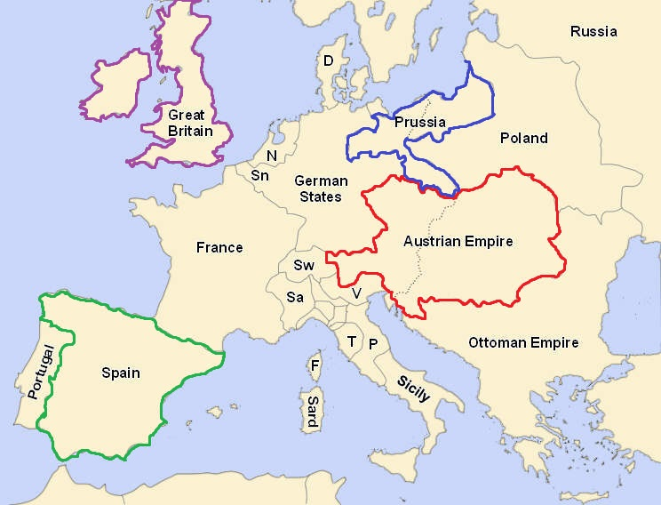
Military Life
Military
Joined army at 16… moved quickly up the ranks
Given first command in 1796
  Austria tried to end the revolution in France because Marie Antoinette was Austrian. So they sent troops to France. (This ended badly for the French monarchs.)
  Prussia and Spain feared the spread of these revolutionary ideas if France succeeds so they also sent troops to France.
  Great Britain didn’t really fear these revolutionary ideas (although the Reign of Terror was a bit much for them). They just wanted to get back at their enemy for helping the 13 win their independence.

Slide 11
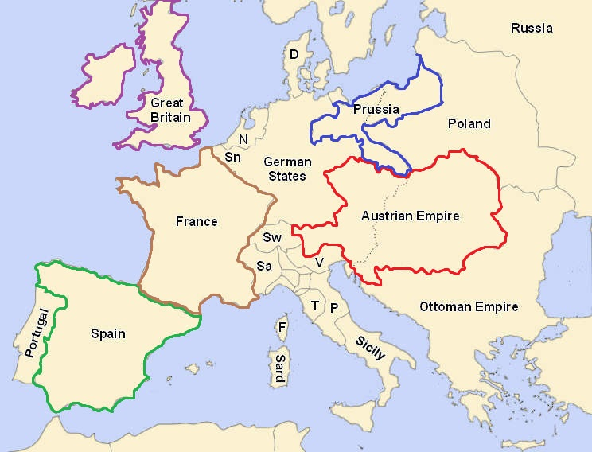
Military Life
Napoleonic Wars
Series of wars between Napoleon’s French Empire and a series of opposing coalitions.
They were a continuation of the wars sparked by the French Revolution.
French power rose quickly as Napoleon’s armies conquered much of Europe.

Slide 12
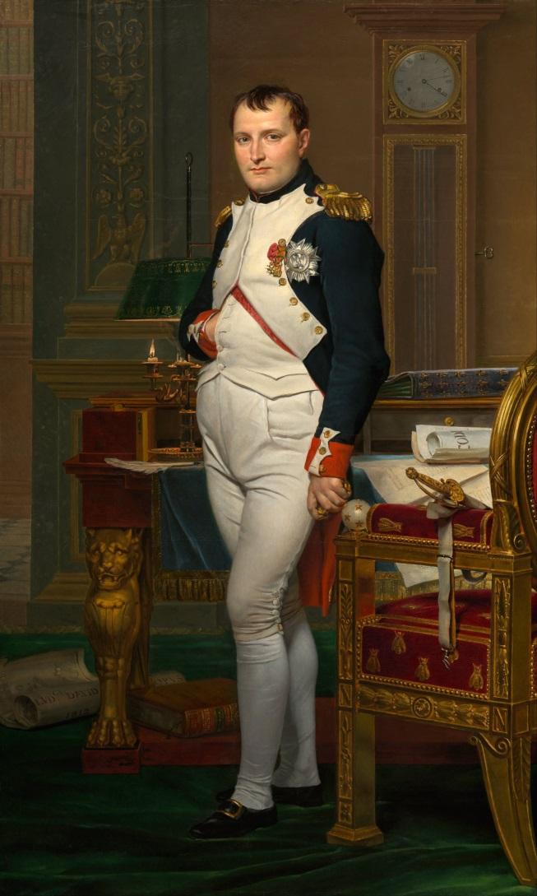
Political Life
After Revolution
After successfully defeating the other European powers, he returns to France; some urged him to take power.

Slide 13
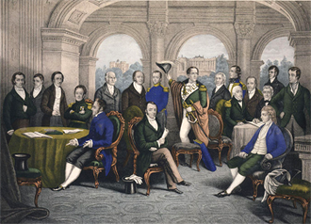
Political Life
After Revolution
After successfully defeating the other European powers, he returns to France; some urged him to take power.
In 1799, he convinces the newly established French government (The Directory – 5 members)

Slide 14
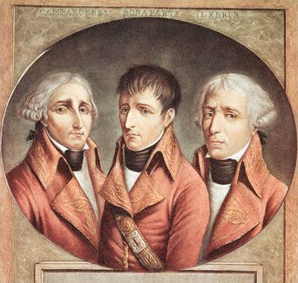
Political Life
After Revolution
After successfully defeating the other European powers, he returns to France; some urged him to take power.
In 1799, he convinces the newly established French government (The Directory – 5 members) to become a 3 man Counsel. Napoleon becomes First Consul.

Slide 15
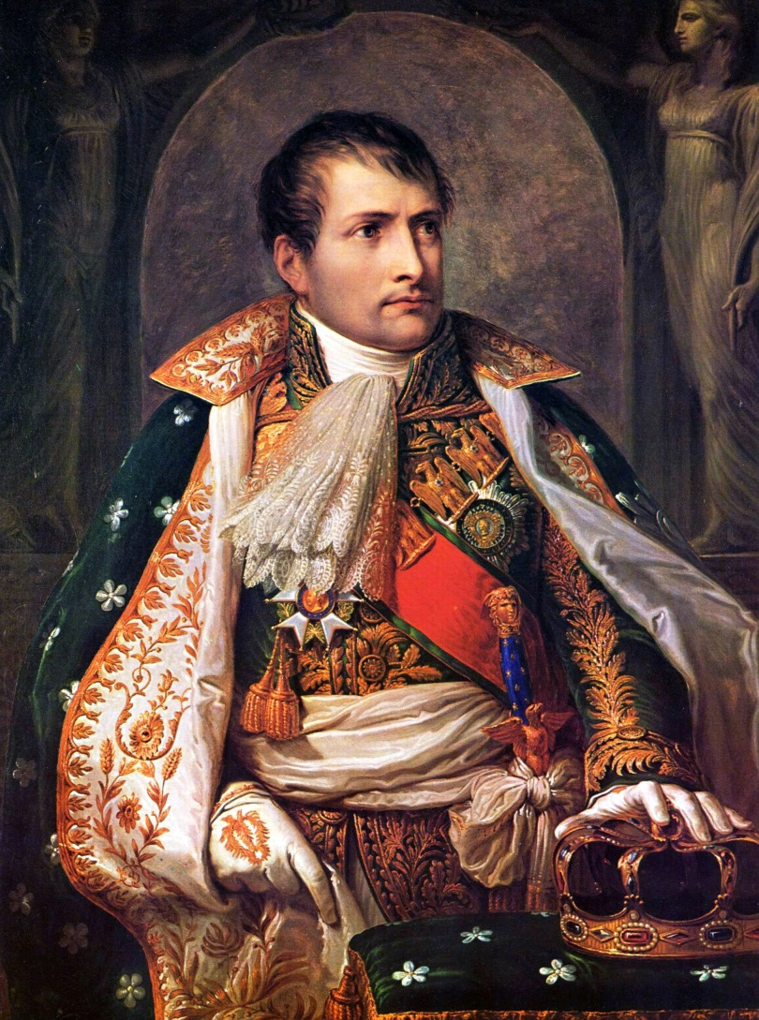
Political Life
After Democracy
Despite the French government being controlled by more than one person, the military was loyal to Napoleon. He controlled the entire French military.

Slide 16
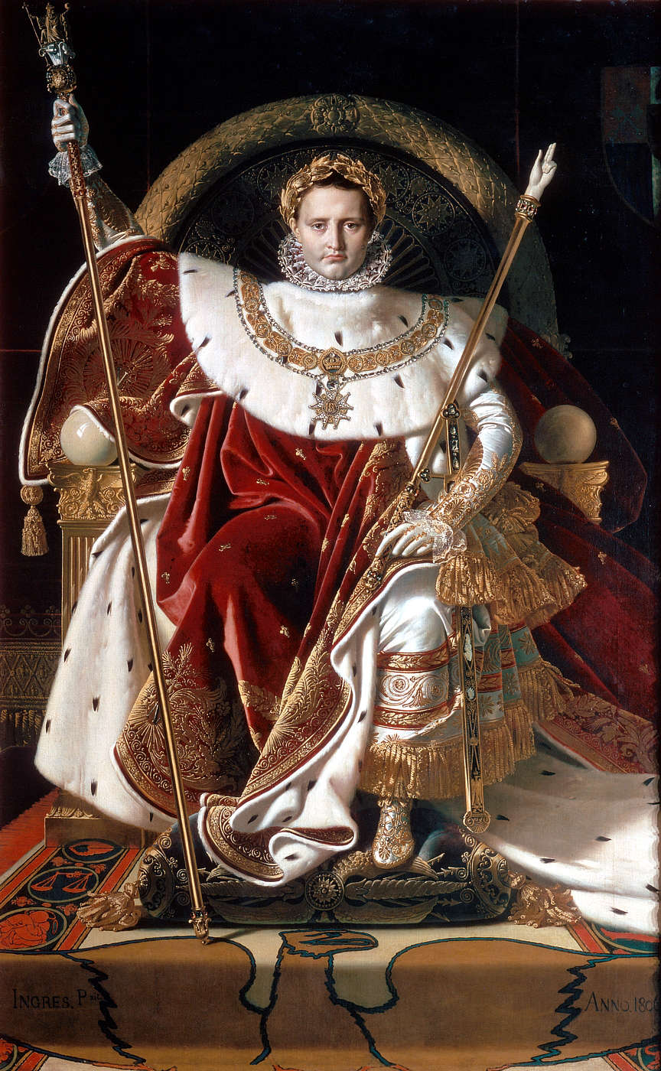
Political Life
After Democracy
Despite the French government being controlled by more than one person, the military was loyal to Napoleon. He controlled the entire French military.
In 1804, he assumes a dictatorship and crowns himself emperor.

Slide 17
Conclusion
One of the important outcomes of the French Revolution was the rise of Napoleon Bonaparte.
Napoleon’s military success allowed him to gain control of France in 1799. By 1805, he declares himself Emperor of France!

