Slide 1
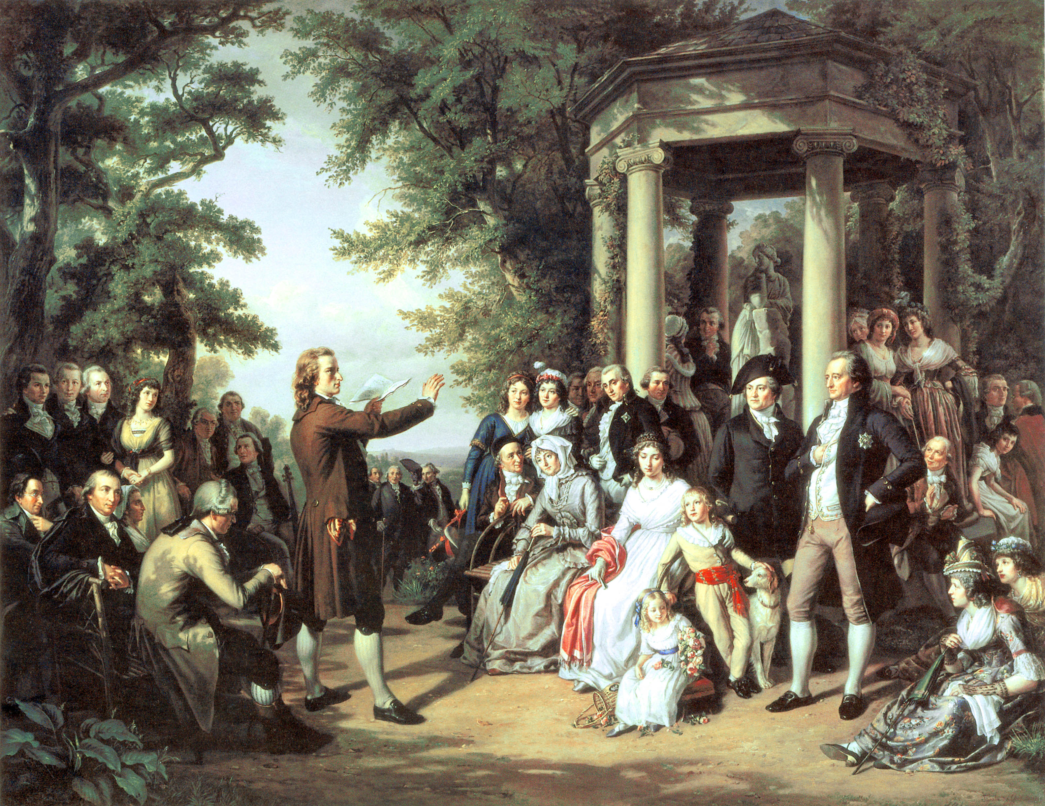
Do Now:
Grab today’s Agenda (5:8).
While you listen to this music, consider the following questions:
What is culture?
Why is it important?

Slide 2
Objective: The Age of Reason
WHII.6f
TSWDK of scientific, political, economic, and religious changes during the 16th, 17th, and 18th centuries by describing the expansion of the arts, philosophy, literature, and new technology.

Slide 3
The Age of Reason
Some Background Info
Culture

Slide 4
Some Background Info
Define
17th century that succeeded the Renaissance and preceded the Age of Enlightenment.
The Age of Reason saw a continuation of the move away from theology and faith-based arguments, and marks the shaking off of medieval approaches to philosophy.
Dominated by mathematics and rationalism to philosophy.
Along with the Age of Enlightenment, which the Age of Reason gave rise to, it is also known as the Early Modern period.

Slide 5
Some Background Info
Stages
The Scientific Revolution was stage one. Brought to the forefront the ideas of mathematical calculation and natural law.
The Enlightenment was stage two. Was all about applying the same scientific theories to the issues of day; specifically law and government.

Slide 6
Some Background Info
Society
Absolutism was at its most extreme in France due to the policies and influences of Louis XIV.
King’s power was not questioned; nobles had been reduced to being a class without power.

Slide 7
The Culture
Music
This new aristocracy lived in opulent surroundings with the quest for entertainment as a central part of their lives.
Music became a passion for this class as chamber music and operas became popular.

Slide 8
The Culture
Music
Johann Sebastian Bach
1685-1750
German
Baroque composer
The Baroque is often thought of as a period of artistic style that used exaggerated motion and clear, easily interpreted detail to produce drama, tension, and grandeur in sculpture, painting, architecture, literature, dance, and music.
The Baroque style was encouraged by the Catholic Church in response to the Protestant Reformation, that the arts should communicate religious themes in direct and emotional involvement.
The aristocracy also saw the dramatic style of Baroque as a means of impressing visitors and expressing triumph, power, and control.
Fantasia's Bach

Slide 9
Culture
Music
Wolfgang Amadeus Mozart
1756-1791
Austrian
Classical composer
The Baroque period transitioned into the Classical period.
Classical music was similar to Baroque but freer and simpler.
Mozart

Slide 10
Culture
Literature
New forms of literature evolved, such as the novel.
Novel = a fictitious narrative of book length, typically representing character and action with some degree of realism.

Slide 11
Culture
Literature
Miguel de Cervantes
1547-1616
Spanish
Novelist, poet, and playwright

Slide 12
Culture
Literature
Miguel de Cervantes
1547-1616
Spanish
Novelist, poet, and playwright
Don Quixote

Slide 13
Culture
Art
Paintings depicted classical subjects

Slide 14
Culture
Art
Paintings depicted classical subjects, public events

Slide 15
Culture
Art
Paintings depicted classical subjects, public events, natural scenes

Slide 16
Culture
Art
Paintings depicted classical subjects, public events, natural scenes, and living people (portraits).

Slide 17
Culture
Art
Eugene Delacroix
1798-1863
French

Slide 18
Culture
Art
Eugene Delacroix
1798-1863
French
Artist – Romantic painter

Slide 19
Conclusion
The 16th, 17th, and 18th centuries brought many changes in the arts, literature, and political philosophy.
The culture of these centuries depicted the changing values of an evolving society.
'Cuz Disney likes this culture...
... and Warner Bros. too!

