Slide 1
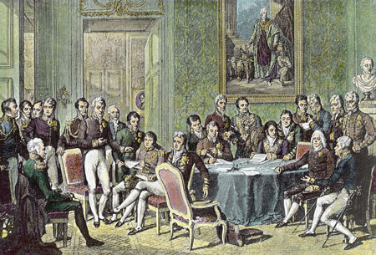
Do Now:
Grab today’s Agenda (6:2) and a map.
Explain what it means to be patriotic. Why do you think people are patriotic?

Slide 2
Objective: The Congress of Vienna
WHII.8a-b
TSWDK of political and philosophical developments in Europe during the 19th century by assessing the impact of Napoleon and the Congress of Vienna, including changes in political boundaries in Europe after 1815, and by describing unsuccessful revolutions on the continent and political reform in the United Kingdom.

Slide 3
The Congress of Vienna
New Politics
The Congress
Plan of Action
1848

Slide 4
New Politics
Nationalism
A people embracing a common land, language, folklore, history, enemies, and religion.
These elements are the ingredients of the nation’s and the individual’s identity and it pulls the members into an indivisible unity.
National pride, economic competition, and democratic ideals stimulated the growth of nationalism.

Slide 5
New Politics
Conservatism
Conservatives advocated keeping and/or restoring the “old regimes” of Europe.
The conservatives were backward-looking, finding their standards and values in the proven events of the past, not in the untried reforms of the present.
Liberalism
This was the philosophy of the middle class – and therefore had less political influence.
It is an ideology which supported the concept of freedom of the individual holding the perspective that less government was better government in that authority was corruptible.
Liberals saw the sole end of government as promoting individual freedom.
Liberals also believed that individuals should use their power to ensure that each person would be given the maximum amount of freedom from the state or any other external authority. Fight for your rights!

Slide 6
The Congress
Purpose
The purpose of the Congress was to build a new political and diplomatic structure for Europe after a quarter century of wars and revolution.
Time
The Congress met over the course of 10 months, 1814-1815
During that time was Napoleon’s Hundred Days
Diplomats:
Austria – Prince Klemens von Metternich **(led the Congress)
France – Prince Charles-Maurice de Talleyrand
Great Britain – Lord Castlereagh (Duke of Wellington)
Prussia – Count von Hardenberg
Russia – Tsar Alexander I

Slide 7
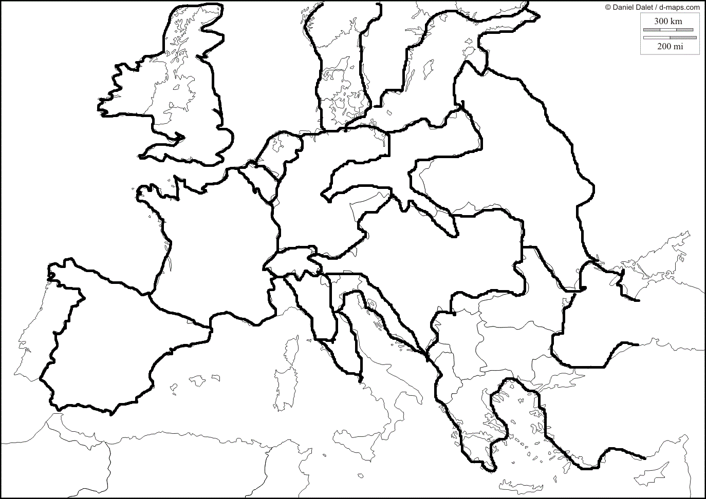
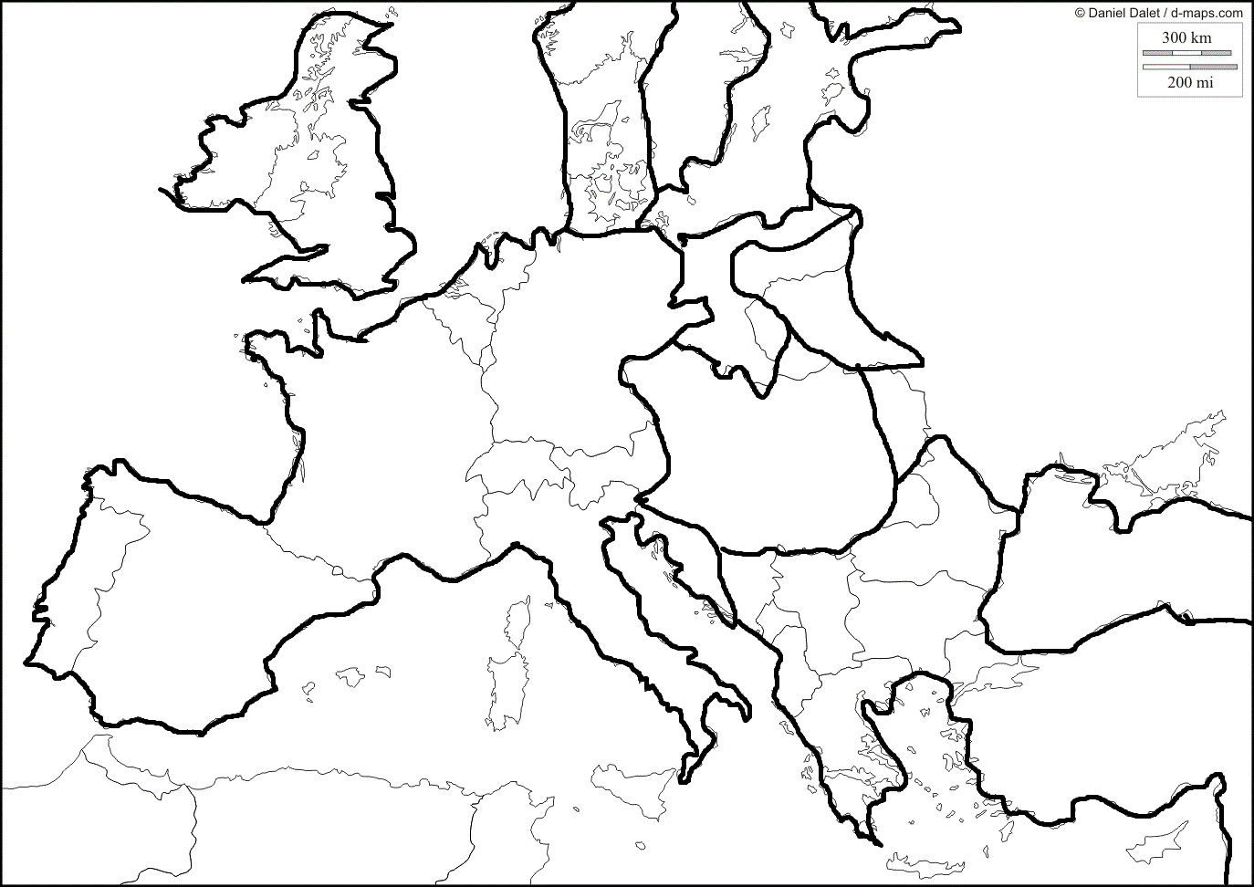
Europe
Pre-Napoleon
Napoleon

Slide 8
Plan of Action
The status of France
What should the status of France be? Should they be punished? If so, how? If not, why not?
At the beginning of the Congress, France was allowed to return to 1792 boundaries…
… However, after Napoleon’s Hundred Days, France’s borders were cut back and penalties were imposed
Future of dispossessed dynasties
What about all those thrones that Napoleon took over during his conquest? Should they be returned?
The Holy Roman Empire disappeared. They were just now a group of German states.
The royal houses that had been expelled would be placed back on the their thrones
Response to liberal and national attitudes sweeping the continent
Ignored the democratic, liberal, and nationalistic forces in favor of a more traditional solution to the upheavals of the precious 25 years

Slide 9
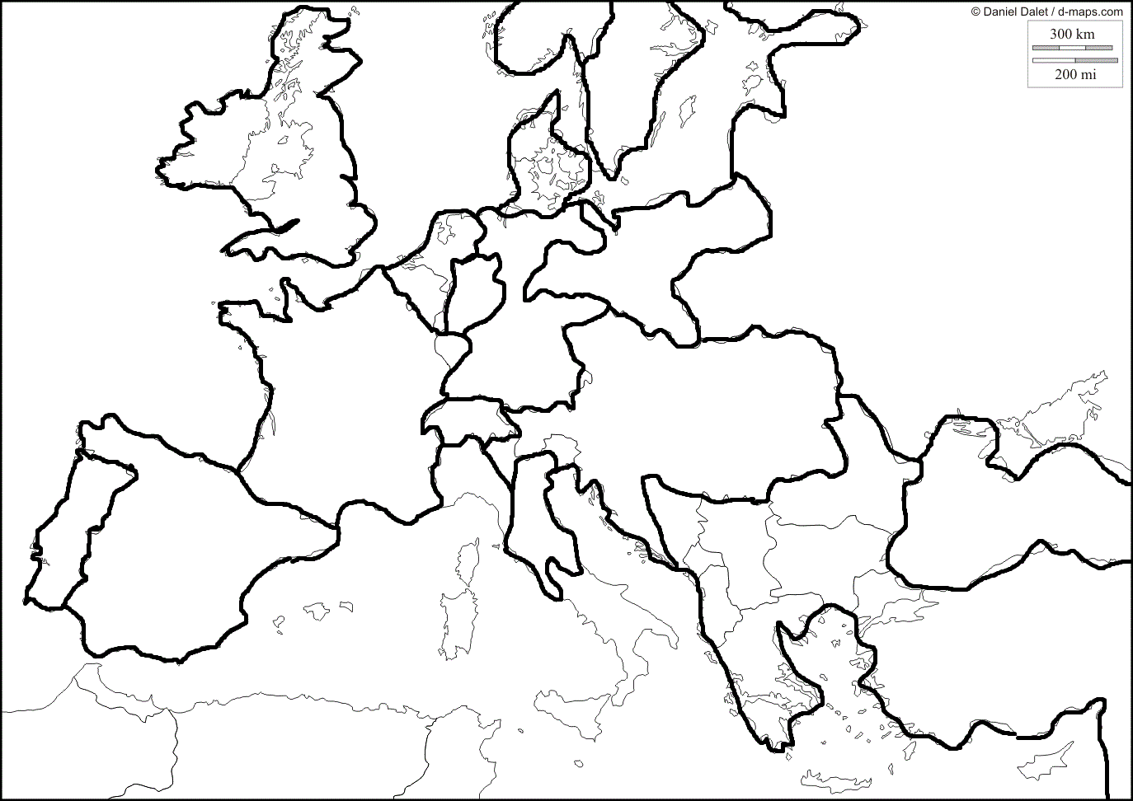
Plan of Action
New political boundaries
The redrawn map of Europe resembled the 1789 configuration, except without the Holy Roman Empire.
In its place were the 39 states of the German confederation, dominated by Austria.
The redrawing of boundaries created a protective belt of states around France to make future aggression more difficult. (Look at Prussia!)

Slide 10
Plan of Action
Compensation
No important power should suffer a loss as the result of the Congress’ work.
All nations will be compensated in some way for the devastation they were put through by France

Slide 11
Plan of Action
Balance of Power
The Congress attempted to restructure Europe in a way that no nation would ever be in the position to dominate and threaten the others – the Balance of Power Doctrine.
Therefore, it was decided that no nation should get territory without giving up territory and vice versa.
Each nation had its own idea of what constituted a proper balance… and soon the British and the Austrians found themselves arrayed against the Russians and the Prussians.
Eventually a balance of power was achieved… without war.

Slide 12
1848
Effects of the Congress
The terms of the Congress of Vienna led to widespread discontent in Europe.
Most of the discontent were motivated by liberalism.

Slide 13
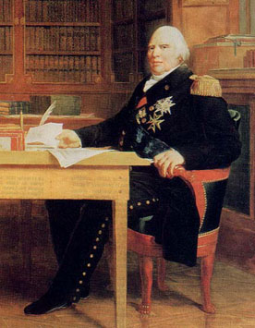
1848
France
Louis XVIII tried to hold the country together after Napoleon. He accepted the Napoleonic Code, as well as other reforms made under Napoleon.
But he was still attacked by both sides:
By the conservatives for giving too much to the middle class
By the liberals for not going far enough

Slide 14
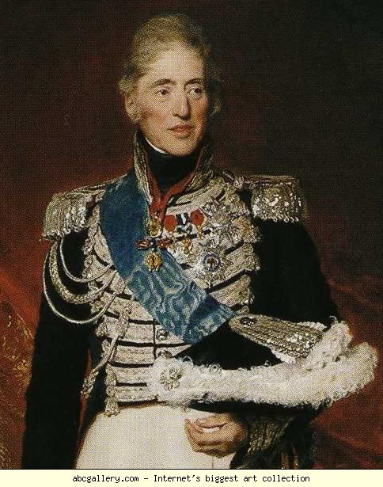
1848
France (continued)
Louis XVIII was succeeded by his brother Charles X, who did not accept any of the changes made since 1789:
He issued laws censoring the press
He further limited the right to vote
These repressive acts drove liberals to revolt – in 1848.

Slide 15
1848
France (continued)
The people, mostly students, barricaded the narrow streets of Paris with overturned carts, boxes, tables, and paving stones. Charles was forced to flee to Great Britain.

Slide 16
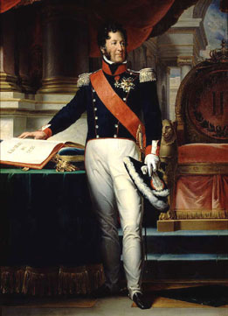
1848
France (continued)
The people, mostly students, barricaded the narrow streets of Paris with overturned carts, boxes, tables, and paving stones. Charles was forced to flee to Great Britain.
A new government was established under King Louis Philippe.
Unfortunately for him, he consistently favored the upper bourgeoisie and gentry, shutting out the workers and middle class. Workers protested… Louis Philippe fled to England.
Many reforms were not instituted.

Slide 17
1848
Italy and Germany
They went through some revolutions as well.
They were also unsuccessful.
But that is for another lesson.

Slide 18
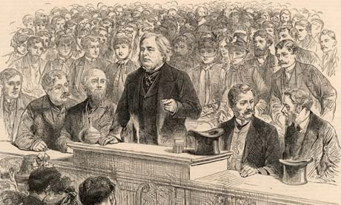
1848
Great Britain
In contrast to continental Europe, the United Kingdom did not go through the same revolutions.
In fact, they expanded political rights through legislative means (rather than through fighting):
Ended capital punishment for more than 100 offenses
Created a modern police force for London
Allowed non-Anglicans the right to participate in government (such as Parliament)
Ended slavery in the Empire

Slide 19
Conclusion
The rise of nationalism was a powerful force behind European politics during the 19th century.
The Congress of Vienna attempted to restore Europe as it had been before the French Revolution and the Napoleonic conquests.
Legacy of the Congress of Vienna:
“Balance of power” doctrine
Restoration of monarchs
New political map of Europe
Widespread demands for political rights led to revolutions (1848) and legislative actions in Europe.
Unsuccessful revolutions of 1848 increased nationalistic tensions. (They weren’t going to stop fighting!)

