Slide 1
Do Now:
Grab today’s Agenda (7:1) and do your best to figure out the following problem:
You are trapped in a room with a scale, a five gallon container, a three gallon container, and a tub of water. You are told that the only way out is to measure out four gallons of water and place it on the scale. However, you may use the scale only once. If you get it wrong, you will be trapped in the room forever. How do you get four gallons?

Slide 2
Answer
Fill 5 gallon container and pour into 3 gallon container, which will leave 2 gallons in the 5 gallon container. Pour out the water from the 3 gallon container and pour the 2 gallons from the 5 gallon container into the 3 gallon container. Refill the 5 gallon container with water and pour what you can into the almost full 3 gallon container – which is 1 gallon, leaving 4 gallons in the 5 gallon container.

Slide 3
Objective:
Introduction to Industrialization
WHII.6f, 9a
TSWDK of scientific, political, economic, and religious changes during the 16th, 17th, and 18th centuries by describing the expansion of… new technology. TSWDK of the effects of the Industrial Revolution during the 19th century by citing scientific, technological, and industrial developments and explaining how they brought about urbanization and social environmental change.

Slide 4
Introduction to Industrialization
Cotton
Iron Ore
Capitalism
Why England?

Slide 5
Cotton
Agricultural Revolution
Many different agricultural revolutions throughout history. (Crash Course: Agricultural Revolution)
Most recent one in our timeline began during the Age of Reason (right before the French Revolution)
New technologies emerged:
  New design in farm tools increased productivity (plow)
  All-weather roads improved year-round transport and trade
  Improvements in ship design lowered the cost of transportation

Slide 6
Cotton
Agricultural Revolution
When there is more of an item, the price of the item drops. So…
  More food

Slide 7
Cotton
Agricultural Revolution
When there is more of an item, the price of the item drops. So…
  More food → Cheaper food

Slide 8
Cotton
Agricultural Revolution
When there is more of an item, the price of the item drops. So…
  More food → Cheaper food → More people eat
  Population started growing at a much faster rate.
More people → More clothes

Slide 9
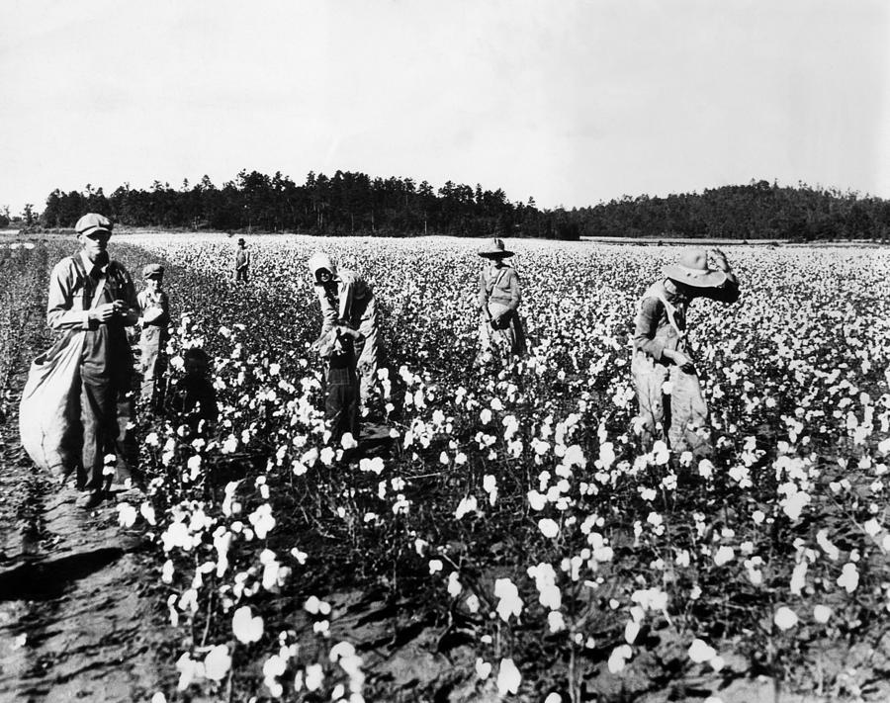
Cotton
How to make cloth:
Process
a. Pick Cotton

Slide 10
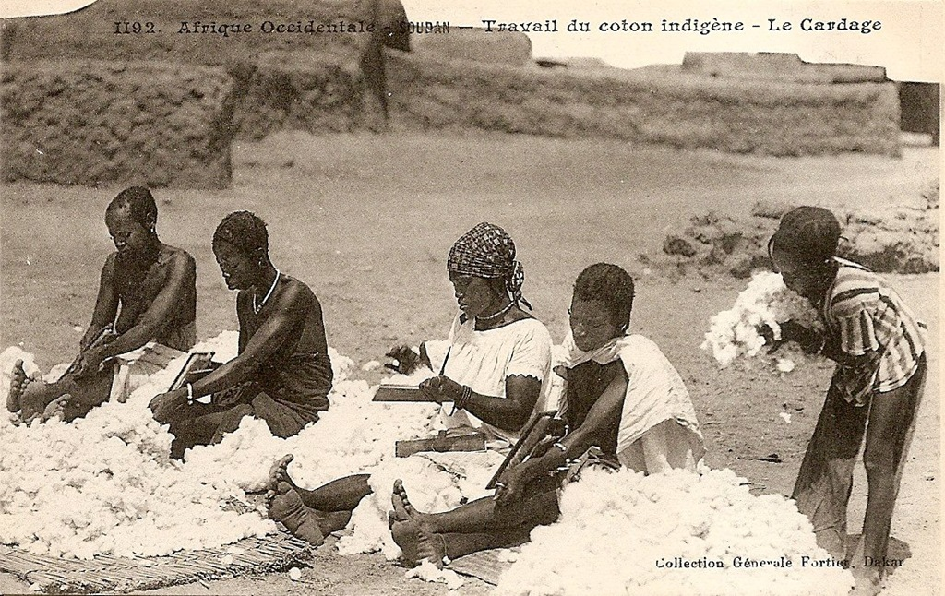
Cotton
How to make cloth:
Process
b. Remove the Seeds

Slide 11
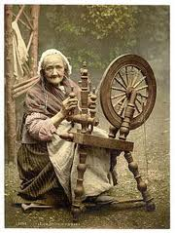
Cotton
How to make cloth:
Process
c. Spin it into Thread

Slide 12
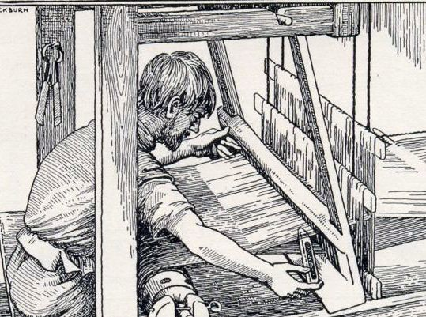
Cotton
How to make cloth:
Process
d. Weave it into Cloth

Slide 13
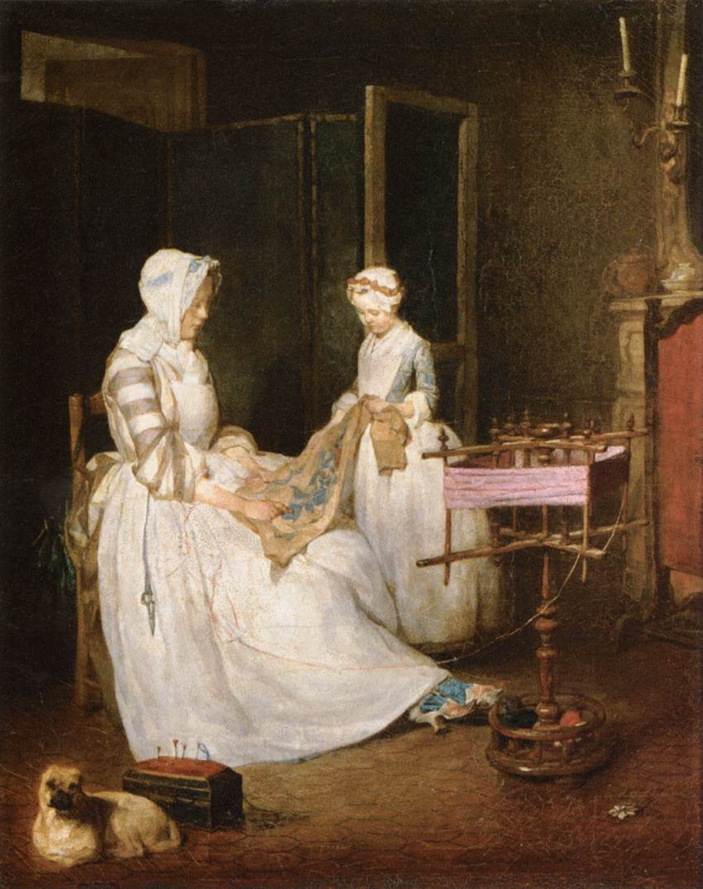
Cotton
How to make clothes:
Process
e. Sew it into Clothes

Slide 14
Cotton
How to make cloth (continued):
Cottage-Industry = home business; family business
England was the center for making cloth.

Slide 15
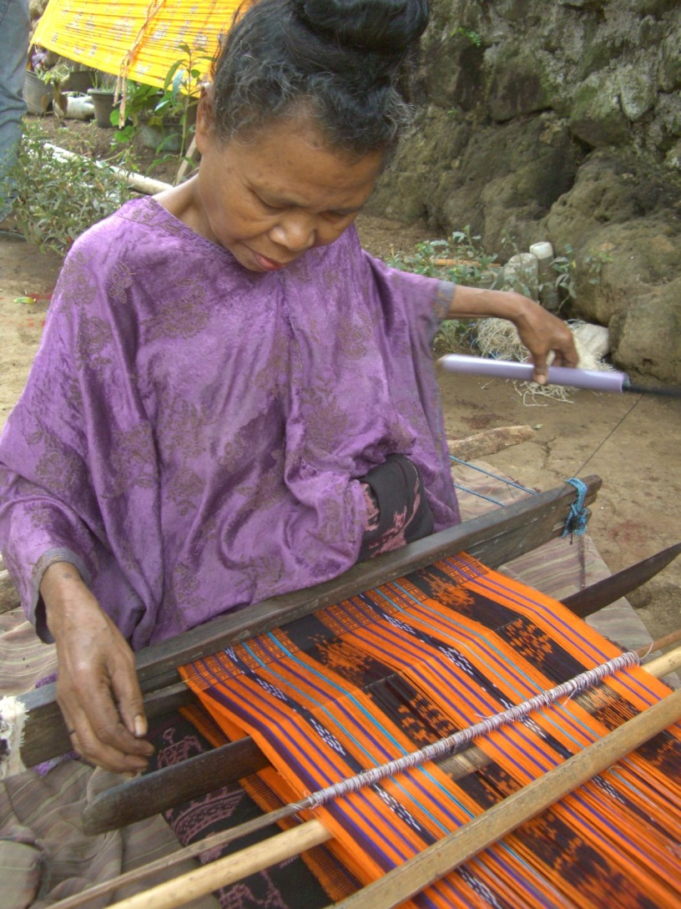
Cotton
Problems and Solutions
At first…
  Problem: Weavers could not weave fast enough to keep up with the spinners.

Slide 16
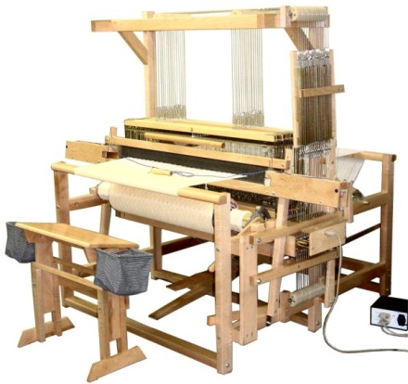
Cotton
Problems and Solutions
At first…
  Problem: Weavers could not weave fast enough to keep up with the spinners.
  Solution: In 1733, John Kay, a spinner and mechanic, invented the “flying shuttle” which made it possible to weave cloth faster.

Slide 17
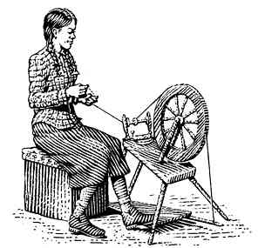
Cotton
Problems and Solutions
Then…
  Problem: Spinners could not keep up with the weavers and their new machine.

Slide 18
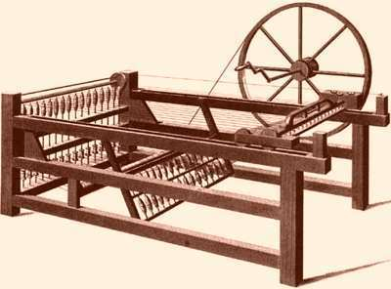
Cotton
Problems and Solutions
Then…
  Problem: Spinners could not keep up with the weavers and their new machine.
  Solution: In 1764, James Hargreaves, a weaver and carpenter, invented the “spinning jenny” that allowed spinners to keep up with the weavers.

Slide 19
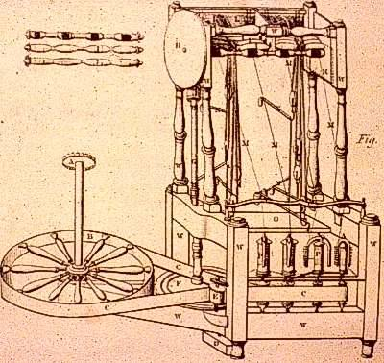
Cotton
Problems and Solutions
To be more efficient…
  In 1769, Richard Arkwright built the “water frame” that made it possible to spin many threads at the same time.

Slide 20
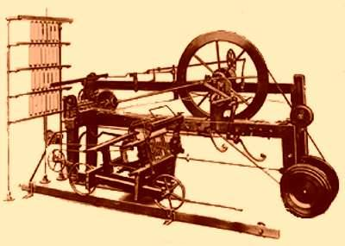
Cotton
Problems and Solutions
To be more efficient…
  In 1769, Richard Arkwright built the “water frame” that made it possible to spin many threads at the same time.
  In 1779, Samuel Crompton combined the spinning jenny with the water frame to create the “water mule.” This allowed even more thread to be spun.

Slide 21
Cotton
Problems and Solutions
So…
  Problem: Spinners were outpacing weavers.

Slide 22
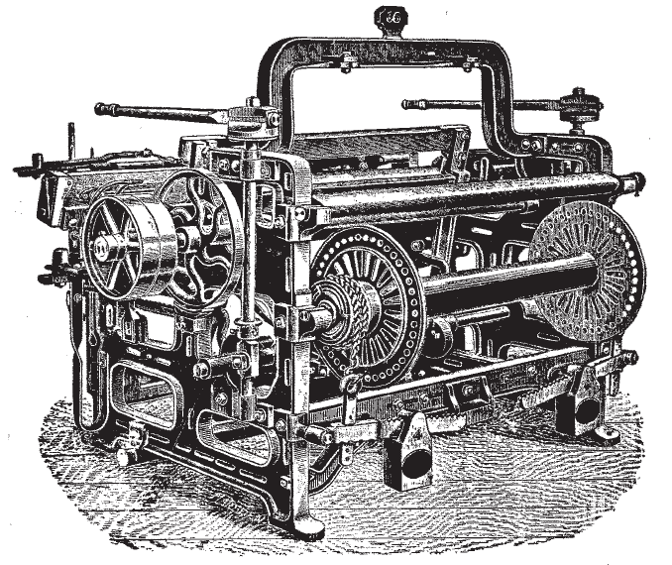
Cotton
Problems and Solutions
So…
  Problem: Spinners were outpacing weavers.
  Solution: In 1785, Edmund Cartwright invented the “power loom” which mechanized the weaving process. What had once been a home-based craft became an industry.

Slide 23
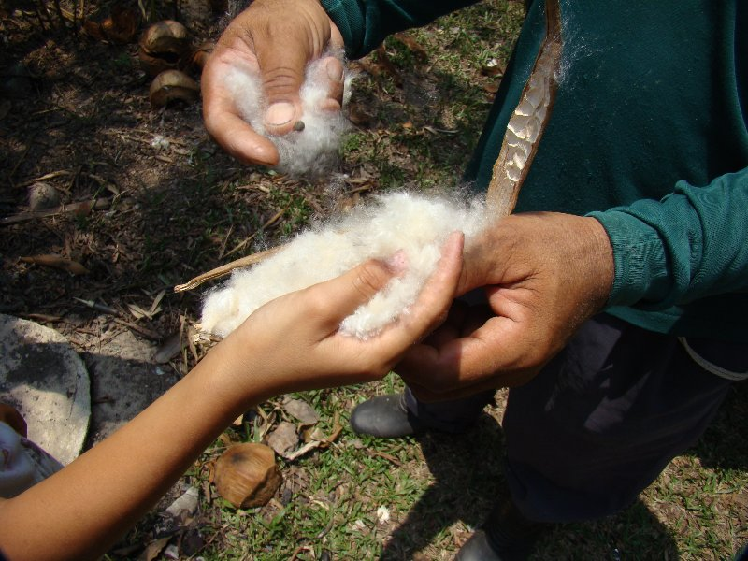
Cotton
Problems and Solutions
Then…
  Problem: Spinners could not get cotton fast enough to keep up with the demand for cloth. Cotton came from the United States but the demand for cotton exceeded the capability of the slave-based southern economy to create the supply. The best worker could not prepare more than 5 or 6 pounds of cotton per day because of the problems of removing the seeds.

Slide 24
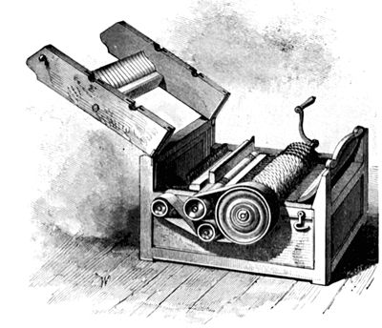
Cotton
Problems and Solutions
Then…
  Problem: Spinners could not get cotton fast enough to keep up with the demand for cloth. Cotton came from the United States but the demand for cotton exceeded the capability of the slave-based southern economy to create the supply. The best worker could not prepare more than 5 or 6 pounds of cotton per day because of the problems of removing the seeds.
  Solution: In 1793, Eli Whitney invented the “cotton gin,” a machine that enabled workers to clean more than 50 times more cotton a day.

Slide 25
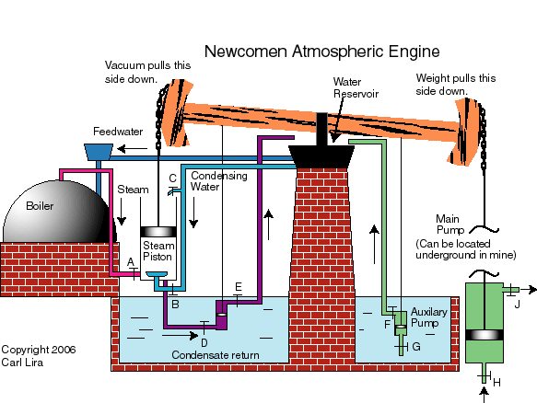
Cotton
Problems and Solutions
Also…
  Problem: The textile industry became so large that it outgrew the possibilities of its power source; water power. The “atmospheric engine” (invented by Thomas Newcomen) was originally used in creating water power but it was inefficient.

Slide 26
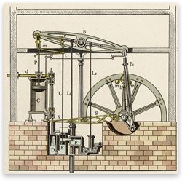
Cotton
Problems and Solutions
Also…
  Problem: The textile industry became so large that it outgrew the possibilities of its power source; water power. The “atmospheric engine” (invented by Thomas Newcomen) was originally used in creating water power but it was inefficient.
  Solution: In 1784, James Watt invented a better steam engine which created enough power for the clothing industry. The application of steam to weaving made it possible to expand to new areas – didn’t need to be near water anymore. This further industrialized the clothing industry.

Slide 27
Cotton
Industrialization
Period of social and economic change that transformed people from an agrarian (farming) society into an industrial one.
It is the extensive reorganization of an economy for the purpose of manufacturing.
Industrialization is illustrated with factories and cities.
Due to industrialization, goods were mass produced (on a larger scale), which made them cheaper to buy. Cheap goods made them available to more people.

Slide 28
Iron Ore
Mining
Mining metals was (and still is) very dangerous.
There have been many innovations to improve mining to make it safer and more efficient.
Until the 1780s, mining used the atmospheric engine. It brought the water needed into the mine while also expelling the water from the mine. However, it was just as inefficient as it was in creating power for the clothing industry.

Slide 29
Iron Ore
Productivity
When Watt invented the steam engine, this was used in mines as well. This led to an increase in mining productivity.
By 1800, Russia and Sweden had exported more iron ore to Britain than Britain was able to produce themselves. Britain had iron ore but lacked the technology to mine it efficiently.
But with new innovations, such as the steam engine, by 1815, Britain exported more than 5 times as much iron as it was imported.
By 1848, the British produced more iron than the rest of the world combined.

Slide 30
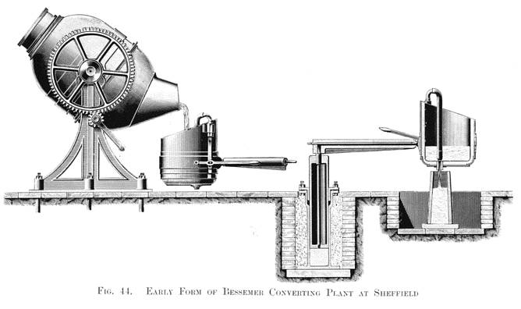
Iron Ore
Steel
To further help Britain dominate the metals market, Henry Bessemer developed a process to make steel, a harder and more malleable metal than iron, quickly and cheaply.
So effective was the “Bessemer Process” that between 1856 and 1870 the price of British steel fell to half the amount formerly charged for the best grade of iron.

Slide 31

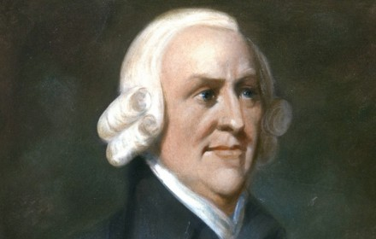
Capitalism
Background
Scottish, 18th century
Influenced by the Enlightenment
Wrote The Wealth of Nations in 1776.

Slide 32

Capitalism
The Wealth of Nations
First collected descriptions of what builds nations’ wealth.
The most efficient economy was a free-market economy, with little government interference.
  Laissez Faire. The market works best on its own.
  The “Invisible Hand.” The market will self-regulate so individuals can make profit, without government intervention.
Role of market competition and entrepreneurial abilities:
  If a company cuts corners to produce low-quality products for a larger profit, consumers will not buy those products (competition!).
  If a company does not treat its employees well, it will lead to unhappy and unhealthy workers, which does not lead to efficient production.

Slide 33

Capitalism
Defining Capitalism
Economic system based on the private ownership of goods and services for profit.
There are varying degrees in regard to how much involvement the government has in capitalism, but the general idea is that businesses left alone can maintain a healthy economy.
Factory owners and other industrialists modeled their businesses on capitalism.

Slide 34
Why England?
People and Government
The British were especially hardworking inventive, and risk-taking – they’ve learned from history that working hard for something can yield great results.
They also got strong support from the government – Parliament represented the people and since the power of government was within Parliament, they worked with the people.
This tie between people and government allowed for innovation and creativity.

Slide 35
Why England?
Social and Political Mobility
The people had social and political mobility, which means they can move up the social and political ladder.
This allowed the people to dream of a better life and actually achieve it.
This was motivation to be innovative; that hard work can lead to a better life.
Transportation
Great Britain had improved transportation – a better road network than any other country in Europe.
They also ruled the seas, had excellent ports, and a large merchant fleet.

Slide 36
Why England?
No Wars
Great Britain was an island, which protected them from the wars raging in Europe.
Great Britain’s history also prevented them from experiencing the violent revolutions that spread throughout Europe in the 19th century. They made reforms through legislation rather than through violence.
The wars raging in Europe created a demand for British goods – other countries were too engaged in war to produce anything. This required Britain to come up with better and more efficient ways to produce goods.

Slide 37
Conclusion
The Age of Reason witnessed inventions and innovations in technology that stimulated trade and transportation.
The social and economic environment changed to accommodate an industrial society in which capitalism dictated the order of the day.
Causes of the Industrial Revolution include:
  Advancements in technology in the production of cotton to cloth, and iron ore to steel.
  Capitalism
The Industrial Revolution began in England and spread to the rest of Western Europe and the United States.
Crash Course: Industrial Revolution

