Slide 1
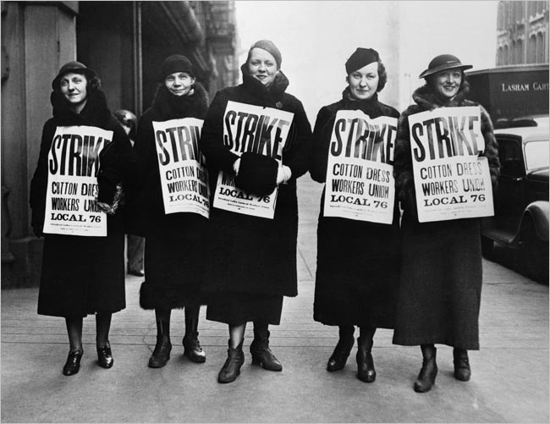
Do Now: Grab today’s Agenda (7:6). Then interpret the cartoon below.

Slide 2
Objective: Rise of the Labor Unions
WHII.9a-c
TSWDK of the effects of the Industrial Revolution during the 19th century by citing scientific, technological, and industrial developments and explaining how they brought about urbanization and social and environmental changes, by explaining the emergence of capitalism as a dominant economic pattern and the subsequent development of socialism and communism, and by describing the evolution of the nature of work and the labor force, including its effects on families, the status of women and children, the slave trade, and the labor union movement.

Slide 3
Rise of the Labor Unions
Urban Crisis
Labor Unions
Impacts of the Industrial Revolution
Communism

Slide 4
Urban Crisis
Cities
Massive growth of European cities beyond a manageable amount.
Families living in squalor, danger, and disease.
Victorian Traffic Report
City leaders were unable to keep up with the demand for:
Maintaining a clean environment
Provide social and sanitation services
Enforce the laws
Furnish transportation
Build housing

Slide 5
Urban Crisis
Dissatisfaction of Working Class
There was no longer a need for the highly skilled; just minimally skilled.
Horrid living and working conditions
First Reaction
Angered by the uselessness of their skills to machines, some, in frustration, fought back and destroyed textile machines.
Strikes, demonstrations, and incidents such as the Peterloo Massacre (August 1819 in which soldiers closed down a political meeting, killing 11 and injuring hundreds) vividly expressed the worker’s rage.

Slide 6
Labor Unions
A Movement
The labor movement began during the Industrial Revolution, when agricultural jobs declined and employment moved to more industrial areas.
The idea met with great resistance. In the early 19th century, groups such as the Tolpuddle Martyrs were punished and transported for forming unions, which was against the laws of the time.
The International Workingman’s Association, the first attempt at international coordination, was founded in London in 1864. The key points were the right of the workers to organize themselves, the right to an 8 hour working day, etc.

Slide 7
Labor Unions
Purpose
Encouraged worker-organized strikes to demand increased wages and improved working conditions.
Lobbied (convincing a government official) for laws to improve the lives of workers, including women and children.
Wanted workers’ rights and collective bargaining (being able to negotiate as a group) between labor and management.
History of Labor Unions

Slide 8
Labor Unions
Help from the English Middle Class
The English Middle Class spearheaded crusades against slavery, alcohol, pornography, child labor, and women’s rights.
Their efforts led to a passage of series of reforms limiting the employment of young children, setting maximum working hours for teenagers, and regulating working conditions for women.

Slide 9
Impacts of the Industrial Revolution
On Slavery
The cotton gin increased demand for slave labor on American plantations.
The United States and Britain outlawed the slave trade and then slavery.

Slide 10
Impacts of the Industrial Revolution
On Society
Women and children entering the workplace as cheap labor
Birthdays and Maid
Introduction of reforms to end child labor
Expansion of education
Women’s increased demands for suffrage (the right to vote)

Slide 11
Impacts of the Industrial Revolution
On Industrialized Countries
Population increase
Urbanization
Environmental pollution
Dissatisfaction of working class with working conditions
Increased standards of living for many but not all
Improved transportation
Increased education
Growth of the Middle Class

Slide 12
Communism
Karl Marx
Came from a Prussian Jewish family who converted to Protestantism in order to climb the social ladder.
Parents wanted him to become a lawyer but he worked for a doctorate in philosophy. When he couldn’t find a university teaching position, he went home to write for a local liberal newspaper.
Very influenced by the utopian philosophers of the Age of Reason. Was very critical of the injustices he saw around him. He decided to concentrate on the economic factors in history and pass from philosophical abstractions to the realities of politics and economics.

Slide 13
Communism
Friedrich Engels
In 1845, Marx continued his work in Paris where he met Engel, whose father owned factories in England and Germany.
Engels had seen firsthand how workers suffered during the first phase of industrialization when he worked at his father’s plant.
Both Engels and Marx became united in their hatred of what they saw as the inhumane nature of capitalism and spent the rest of their lives attacking it.

Slide 14
Communism
The Communist Manifesto
Written by Marx and Engels in 1848.
World drive by class conflict between those who controlled the means of production and those who did not.
History moved in the zigzag pattern through class struggle. Not until the triumph of the proletariat (working class) would this pattern stop. When workers control the means of production, they cannot logically engage in class conflict and hence communism would be achieved.
Communism = a social, political, and economic ideology that establishes a classless, moneyless, and stateless society. Important to communists was the redistribution of wealth.

Slide 15
Communism
The Communist Manifesto (continued)
The bourgeoisie, who had erected the new capitalist society by gaining control of the means of production through organizing trade and industry, created its opposition in the proletariat, the class-conscious workers. This latter group would be according to Marx, “the seeds of the bourgeoisie’s own destruction.”
When workers recognized their true power, they would overthrow the bourgeoisie. Out of this conflict would come the final act of the dialectical process, the classless society in which “each person would work according to his ability and receive according to his need.”

Slide 16
Communism
The Communist Manifesto (continued)
An interim dictatorship might have to occur, because a number of features of the old order would remain and the proletariat would have to be protected. There needed to be a government that protected the proletariat over the bourgeoisie (something that has never happened). A government for the good of society. This is socialism.
Socialism = a social, political, and economic ideology that advocates collective or governmental ownership and administration of the means of production and distribution of goods.
However, as the classless society evolved, the state would wither away.

Slide 17
Communism
Das Kapital
Written by Marx in 1867.
Critical analysis of capitalism; response to the injustices of capitalism.
What motivates capitalism is the exploitation of labor. The employer claims the profit because he owns the means of production while the workers do not. He makes money off the value of his product. So the employer only pays his employees their value – how much it takes to keep them functional, rather than the value of their product.
The workers’ character is negatively affected by the system and their repetitive work makes them little more than machines.

Slide 18
Conclusion
Advancements in technology produced the Industrial Revolution, while advancements in science and medicine altered the lives of people living in the new industrial cities. Cultural changes soon followed.
The Industrial Revolution placed new (and terrible) demands on the labor of men, women, and children.
Workers organized labor unions to fight for improved working conditions and workers’ rights.
Industrialization created the growth of the middle class. Wealth increased the standard of living for some.
Capitalism and market competition fueled the Industrial Revolution. Wealth increased the standard of living for some.
Social dislocation associated with capitalism produced a range of economic and political ideas, including socialism and communism.
Crash Course: Communism and Socialism

