Slide 1
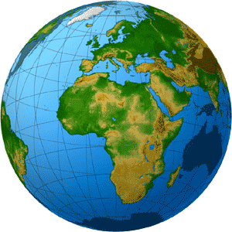
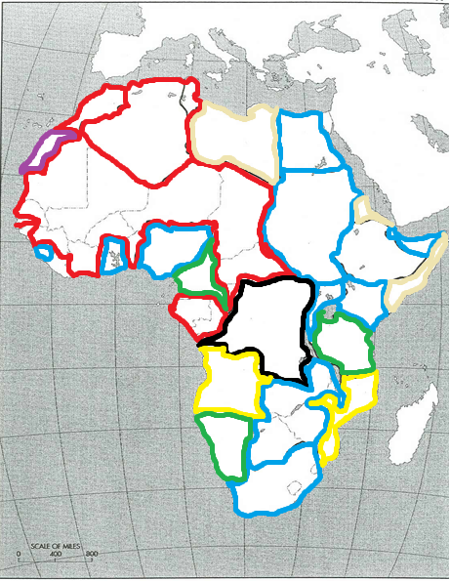
Do Now:
Grab Agenda 7:7 from your Out Box.
Take a map from below and color-code it just as you see it below.

Slide 2
Objective: Imperialism
WHII.9d and e
TSWDK of the effects of the Industrial Revolution during the 19th century by explaining the rise of industrial economics and their link to imperialism and nationalism, and by assessing the impact of European economic and military power on Asia and Africa, with emphasis on the competition for resources and the responses of colonized people.

Slide 3
Imperialism
Imperialism
The Scramble for Africa
Berlin Conference

Slide 4
Imperialism
Define
The creation and/or maintenance of an unequal economic, cultural, and territorial relationship, usually between states and often in the form of an empire, based on domination and subordination.
Why did European countries imperialize?
Industrial nations in Europe needed natural resources and markets to expand their economies.
Nationalism motivated European nations to compete for colonial possessions. These nations competed to control Africa and Asia in order to secure their own economic and political success.

Slide 5
Imperialism
Forms
Colony
A territory under the immediate political control of another country, but does not form part of the country.
Protectorate
A country under the protection of another country, usually in exchange for something else.
They are otherwise politically autonomous.
Sphere of Influence
A country that is predominantly influenced by another country, usually by military and/or economic intervention.
They are politically autonomous.

Slide 6
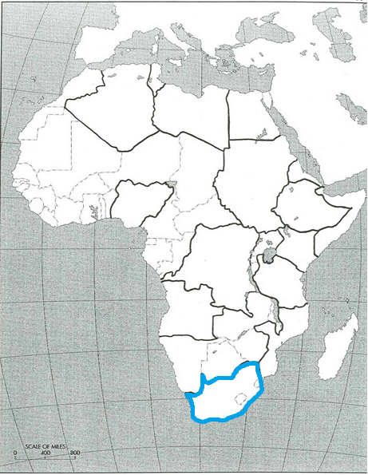
“The Scramble for Africa”
Congress of Vienna
Meeting to clean up the mess left by Napoleon…
And focused on the “Balance of Power” Doctrine.
The Congress of Vienna granted Great Britain the Cape Colony in South Africa, an important port on the sea route to India

Slide 7
“The Scramble for Africa”
The Suez Canal
Before 1867, there was no sea route from the Mediterranean to the Red Sea, other than the long way around the tip of Africa and into the Indian Ocean.
In 1867, Suez Canal was built across Egyptian territory which allowed steamships to get to India without having to go around the southern tip of Africa, decreasing the importance of the Cape Colony.
However, the Egyptian government was unstable and in 1882…

Slide 8
“The Scramble for Africa”
The Suez Canal
Before 1867, there was no sea route from the Mediterranean to the Red Sea, other than the long way around the tip of Africa and into the Indian Ocean.
In 1867, Suez Canal was built across Egyptian territory which allowed steamships to get to India without having to go around the southern tip of Africa, decreasing the importance of the Cape Colony.
However, the Egyptian government was unstable and in 1882…
Britain took over the
administration of the country…
thus beginning the Scramble for
Africa.

Slide 9
“The Scramble for Africa”
The Scramble
Little by little,

Slide 10
“The Scramble for Africa”
The Scramble
Little by little,
the rest of East Africa

Slide 11
“The Scramble for Africa”
The Scramble
Little by little,
the rest of East Africa
was occupied by the British

Slide 12
“The Scramble for Africa”
The Scramble
Little by little,
the rest of East Africa
was occupied by the British
to safeguard the Indian Ocean sea
routes

Slide 13
“The Scramble for Africa”
The Scramble
Little by little,
the rest of East Africa
was occupied by the British
to safeguard the Indian Ocean sea
routes
British colonists in South Africa wanted to extend their territorial possessions northwards, especially since gold and diamonds had been found in the interior region.
Trading stations had been originally set up on the West Africa coast to deal in slaves for the Americas.
By the late 19th century, trade in palm oil and timber became even more interesting…

Slide 14
“The Scramble for Africa”
The Scramble
Little by little,
the rest of East Africa
was occupied by the British
to safeguard the Indian Ocean sea
routes
British colonists in South Africa wanted to extend their territorial possessions northwards, especially since gold and diamonds had been found in the interior region.
Trading stations had been originally set up on the West Africa coast to deal in slaves for the Americas.
By the late 19th century, trade in palm oil and timber became even more interesting… particularly to the French.

Slide 15
“The Scramble for Africa”
The Scramble
Little by little,
the rest of East Africa
was occupied by the British
to safeguard the Indian Ocean sea
routes
British colonists in South Africa wanted to extend their territorial possessions northwards, especially since gold and diamonds had been found in the interior region.
Trading stations had been originally set up on the West Africa coast to deal in slaves for the Americas.
By the late 19th century, trade in palm oil and timber became even more interesting… particularly to the French.
The French wanted to expand eastwards into the Africa interior from Senegal and southwards from Algeria and Tunisia

Slide 16
“The Scramble for Africa”
The Scramble (continued)
The “grab” for land intensified, even if it was impenetrable jungle or waterless desert, simply to prevent a neighbor in Europe from putting up his flag on the same land…

Slide 17
“The Scramble for Africa”
The Scramble (continued)
The “grab” for land intensified, even if it was impenetrable jungle or waterless desert, simply to prevent a neighbor in Europe from putting up his flag on the same land…
More British claims

Slide 18
“The Scramble for Africa”
The Scramble (continued)
The “grab” for land intensified, even if it was impenetrable jungle or waterless desert, simply to prevent a neighbor in Europe from putting up his flag on the same land…
More British claims
Spanish

Slide 19
“The Scramble for Africa”
The Scramble (continued)
The “grab” for land intensified, even if it was impenetrable jungle or waterless desert, simply to prevent a neighbor in Europe from putting up his flag on the same land…
More British claims
Spanish
Italian

Slide 20
“The Scramble for Africa”
The Scramble (continued)
The “grab” for land intensified, even if it was impenetrable jungle or waterless desert, simply to prevent a neighbor in Europe from putting up his flag on the same land…
More British claims
Spanish
Italian
King Leopold of Belgium laid claim to the huge Congo Basin.
Caught in the frenzy

Slide 21
“The Scramble for Africa”
The Scramble (continued)
The “grab” for land intensified, even if it was impenetrable jungle or waterless desert, simply to prevent a neighbor in Europe from putting up his flag on the same land…
More British claims
Spanish
Italian
King Leopold of Belgium laid claim to the huge Congo Basin.
Caught in the frenzy, Portugal felt obliged to extend its old claims, going back to the 16th century, to enormous parts of Angola and Mozambique.

Slide 22
“The Scramble for Africa”
The Scramble (continued)
The “grab” for land intensified, even if it was impenetrable jungle or waterless desert, simply to prevent a neighbor in Europe from putting up his flag on the same land…
More British claims
Spanish
Italian
King Leopold of Belgium laid claim to the huge Congo Basin.
Caught in the frenzy, Portugal felt obliged to extend its old claims, going back to the 16th century, to enormous parts of Angola and Mozambique.
Germany arrived very late in the “Scramble” in 1881, with hardly anything left.

Slide 23
Berlin Conference
Conflict among the European nations?
You bet!
All the European powers and the United States met in Berlin in 1885.
Conference
Rules were set for the division of Africa
Defined “occupation” as a territory defended and administered, and not simply putting up a flag with a claim of ownership.

Slide 24
Conclusion
Industrial nations in Europe needed natural resources and markets to expand their economies.
Nationalism motivated European nations to compete for colonial possessions.
European economic, military, and political power forced colonized countries to trade on European terms.
These nations competed to control Africa in order to secure their own economies and political success.
Crash Course: Imperialism

