Slide 1
Do Now:
Turn in your typed and double spaced Research Paper Rough Draft in one of the following ways:
Turn it into the In Box.
Email it to me (hahecht@henrico.k12.va.us)
Grab today’s Agenda (7:9).
Go to Weebly → Unit 7 → Lesson 9 → “Imperial China”
Play around on the site.
List at least 5 things you learn.

Slide 2
Objective:
The Far East
WHII.9d and e
TSWDK of the effects of the Industrial Revolution during the 19th century by explaining the rise of industrial economics and their link to imperialism, and by assessing the impact of European economic and military power on Asia and Africa, with emphasis on the competition for resources and the responses of colonized people.

Slide 3
The Far East
What’s been going on in China?
Imperialism in China
Chinese Resentment
What’s been going on in Japan
Imperialism in Japan
Japanese Resentment

Slide 4
What’s been going on in China?
Isolation
China was not thrilled about foreigners. They wouldn’t even recognize nor receive representatives of foreign powers.
They preferred that foreign merchants not come into the interior of China. Those that did were treated as inferior people.
China knew that foreigners needed Asian products more than the Chinese required European goods. So they charged high customs tax.
However, foreigners made enough profit to compensate for them being treated as inferiors by the Chinese government.

Slide 5
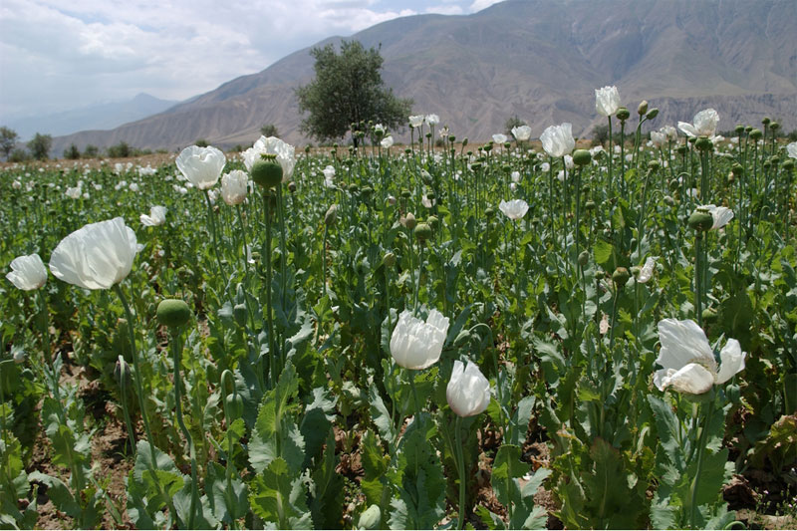
What’s been going on in China?
Opium
A drug that has legitimate purposes. Most opium came from the Ottoman Empire or India.

Slide 6
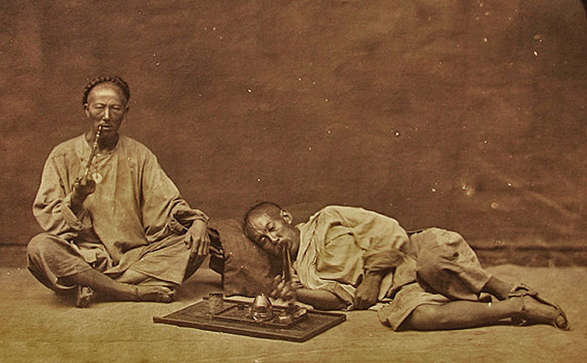
What’s been going on in China?
Opium
A drug that has legitimate purposes. Most opium came from the Ottoman Empire or India.
But in the 17th and 18th centuries, people in all classes began to use it recreationally.

Slide 7
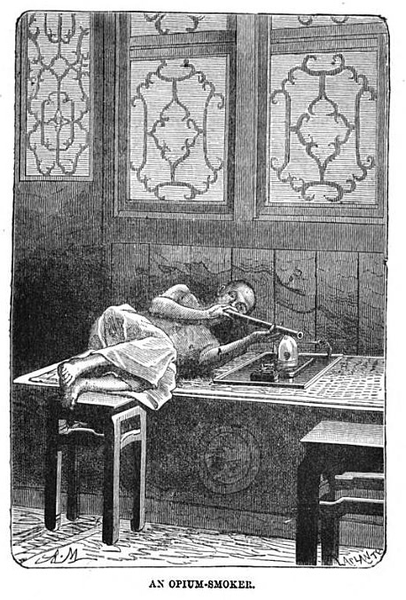
What’s been going on in China?
Opium
A drug that has legitimate purposes. Most opium came from the Ottoman Empire or India.
But in the 17th and 18th centuries, people in all classes began to use it recreationally.
Opium is addictive and leads to crime. So in 1800, the Chinese government made opium illegal.
Opium trade continued, particularly by the British. (The Chinese are easier to control when they are high and weak on opium.)

Slide 8
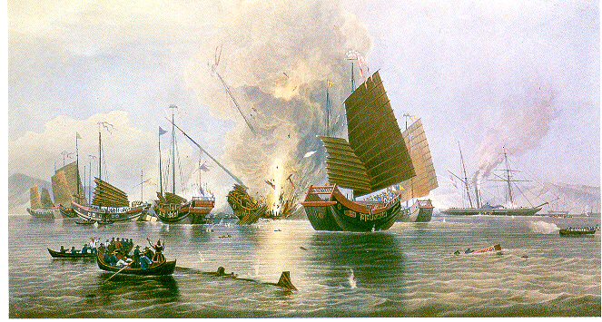
Imperialism in China
Opium Wars
The British used opium to weaken the Chinese.
In 1839, the Chinese destroyed British opium sparking the Opium Wars of 1839-1842.
Easily dominating the backward Chinese forces, the British quickly took control.
The 1842 Treaty of Nanking granted Britain extensive trading and commercial rights in China, marking the first in a series of unequal treaties between China and European powers.

Slide 9
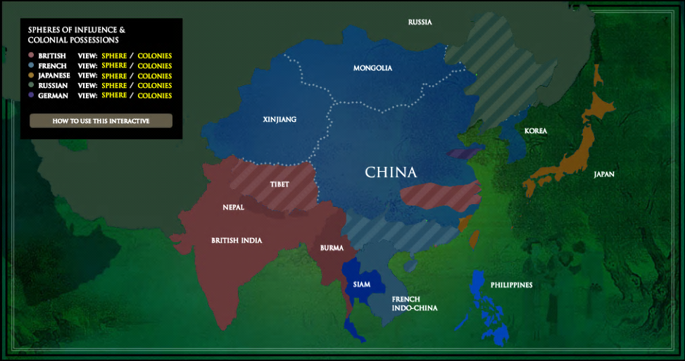
Imperialism in China
Spheres of Influence
By the end of the century, after 5 years of war between China and various European powers, France, Britain, Germany, Japan, and Russia held territorial and commercial advantages in their respective spheres of influence.
Definition - Areas within the country in which one nation held exclusive rights to profits and investments. Included territories, ports, shipping lines, rivers…etc.

Slide 10
Imperialism in China
United States
The U.S. entered the imperialistic race after their win over Spain in the 1898 Spanish-American War.
Secretary of State Hay pushed for an Open Door Policy, which demanded that all nations be given equal and complete rights to Chinese markets. No international power would have total control of the country.
While some European countries agreed to this policy, it was not enforced.

Slide 11
Chinese Resentment
Law and Order
Foreigners were exempt from Chinese law enforcement.
Foreigners could only be judged and tried by officials of their own nation, who generally looked the other way when profit was the goal.
The resulting lawlessness on the part of the Europeans, combined with the actuality of European economic, political, and military domination over the Chinese.

Slide 12
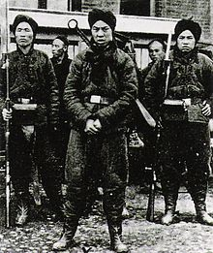
Chinese Resentment
Boxer Rebellion
In 1900, the Boxers, with secret encouragement from the Chinese empress, dedicated themselves to ending foreign exploitation in north China, killing scores of Europeans.

Slide 13
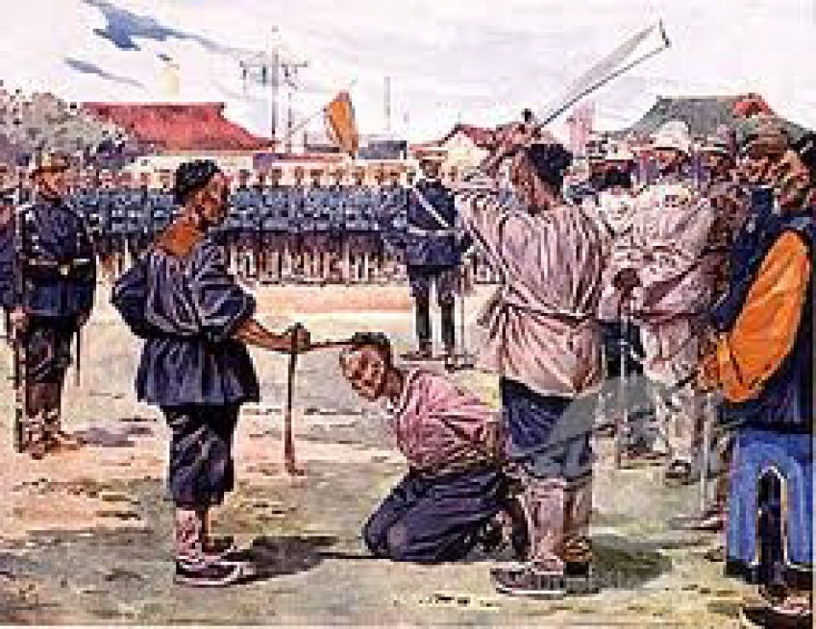
Chinese Resentment
Boxer Rebellion
In 1900, the Boxers, with secret encouragement from the Chinese empress, dedicated themselves to ending foreign exploitation in north China, killing scores of Europeans.
Reacting immediately, an international expeditionary force of Japanese, Russian, British, America, German, French, Austrian, and Italian troops put down the revolt.

Slide 14
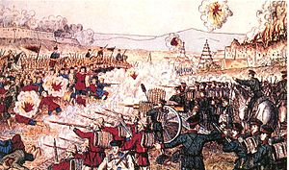
Chinese Resentment
Boxer Rebellion
In 1900, the Boxers, with secret encouragement from the Chinese empress, dedicated themselves to ending foreign exploitation in north China, killing scores of Europeans.
Reacting immediately, an international expeditionary force of Japanese, Russian, British, America, German, French, Austrian, and Italian troops put down the revolt.
European powers propped up a weak central government for their own benefit.

Slide 15
What’s been going on in Japan?
Isolation
The Japanese closed off interaction with the West for fear of corrupting influences. This affected merchants and diplomats.
However, Western innovations were beginning to trickle into Japan so there was discussion in Japan as to how to open up with the West.

Slide 16
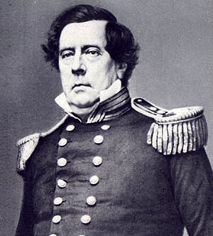
Imperialism in Japan
American Opportunity
In 1853, President Fillmore sent Commodore Matthew Perry to Japan in an attempt to negotiate a trade agreement.

Slide 17
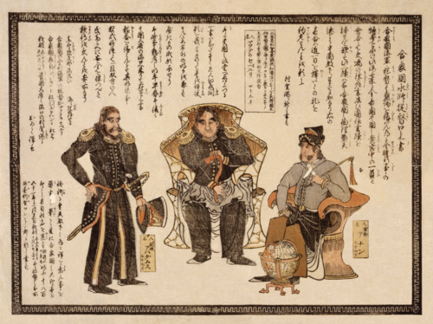
Imperialism in Japan
American Opportunity
In 1853, President Fillmore sent Commodore Matthew Perry to Japan in an attempt to negotiate a trade agreement.
Treaty of Kanagawa – first formal trade agreement between Japan and a Western nation. It was a limited trade agreement, but an agreement nonetheless.
European traders soon obtained similar privileges.

Slide 18
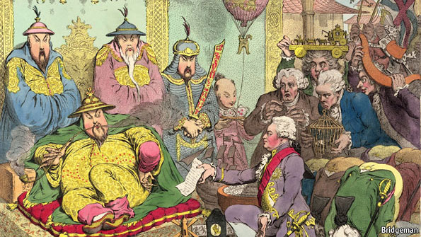
Japanese Resentment
Effects on the Japanese
The entry of the West placed a severe strain on the Japanese political structure.
Anti-foreign sentiment grew… western representatives in Japan were caught in the middle, and there were a number of attacks against them.

Slide 19
Japanese Resentment
Lessons Learned
However, the attacks were limited. Overall, Japan took advantage of Western influence.
They learned from the West:
    A modern military
    Established banks
    Developed factories

Slide 20
Conclusion
Industrial nations in Europe needed natural resources and markets to expand their economies.
China’s attempt to remain mostly isolated failed as European nations selfishly entered to set up shop, turning China into a sphere of influence.
Chinese resistance to imperialism took many forms, including armed conflict like the Boxer Rebellion.
In the end, the Chinese failed to throw off foreign rule.

Slide 21
Conclusion
As Japanese interest in foreign goods grew, their willingness to let the West in grew as well.
The United States took advantage of this opportunity, as well as European nations.
Although the Japanese went to the West to find the best ways to modernize their country, they themselves, and not foreigners, made the major changes. Foreigners may have built the railways, telegraph, lighthouses, dockyards, and warships, but it was the Japanese that initiated the change.

