Slide 1
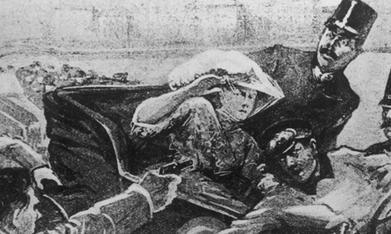
Do Now:
Take out your homework but DO NOT turn it in!
Grab today’s Agenda (8:1) and complete the Do Now.

Slide 2
Objective: Causes of World War I
SOL WHII.10a
TSWDK of the worldwide impact of World War I by explaining economic causes, political causes, and major events and identifying major leaders of the war, with emphasis on Woodrow Wilson and Kaiser Wilhelm II.

Slide 3
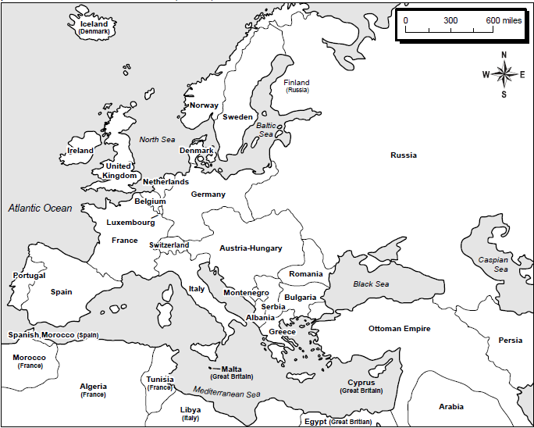

Slide 4
Causes of World War I
MILITARISM | ALLIANCES | IMPERIALISM | NATIONALISM

Slide 5
The Spark of World War I
The Assassination
Serbia, of Slavic origin, hoped one day to be a part of a larger Slavic state. (Pan-Slavism) This included Bosnia and Herzegovina.
Germany wanted to annex Bosnia and Herzegovina for a greater German state.
Serbian nationalists had been outraged by German imperialistic actions for a decade.
Archduke Franz Ferdinad was heir to the Austron-Hungarian throne.
In June 1914, he traveled to Sarajevo, Bosnia, to inspect the imperial armed forces.
On June 28, the Archduke and his wife Sophie were touring Sarajevo in an open car with surprisingly little security. Serbian nationalist Nedjelko Cabrinovic threw a bomb at the car. While it rolled of the back of the vehicle and wounded an officer and some bystanders, it did not harm the royal couple.
Later that day, on the way to visit the injured officer, the archduke’s procession took a wrong turn at a corner where one of Cabrinovic’s cohorts happened to be loitering. This was 19-year old Gavrilo Princip.
Seeing his opportunity, Princip fired into the car, shooting the Archduke and his wife, and killing them both.

Slide 6
The Spark of World War I
The Ultimatum
Austria-Hungary, obviously angry, blamed Serbia for the assassination (even though the Serbian government played no role in the assassination). Germany promised to Austria-Hungary any support they needed in order to punish Serbia.
Austria-Hungary presented to Serbia an ultimatum:
Serbia must take full responsibility for the murder (even though Pricip wasn’t even Serbian!)
Serbia must agree to ban ‘anti-Austrian’ groups within Serbia
Serbia must allow Austria to prosecute these and other conspirators in Austrian courts.
Serbia agreed to all parts of the ultimatum except the last part. They felt that if a crime was committed in their country, they have the right to investigate, prosecute, and punish the criminals. After all, they were their own country!

Slide 7
The Spark of World War I
The Domino Effect:
Serbia declined the ultimatum → Austria-Hungary declares war on Serbia
Russia was allied with Serbia → Rushes to protect Serbia
Germany was allied with Austria-Hungary → August 1, 1914, Germany declares war on Russia (to stop Russian troops from mobilizing)
Russia was allied with France → August 3, 1914, Germany declares war on France (to defeat them before they had a chance to mobilize, thereby depriving Russia the hope of a two-front war with Germany)
France was heavily fortified (Militarism) → Germany goes through Belgium to get to France
Great Britain promised to maintain Belgium neutrality (1839) → August 4, 1914 Great Britain declares war on Germany
The Great War has started!

Slide 8
Conclusion
World War I (1914-1918) was caused by competition among industrial nations in Europe and a failure of diplomacy.
Causes of World War I include:
Militarism
Alliances
That divided Europe into competing camps
Diplomatic failures
Imperialism
The quest for colonies
Competition over colonies
Nationalism

