Slide 1
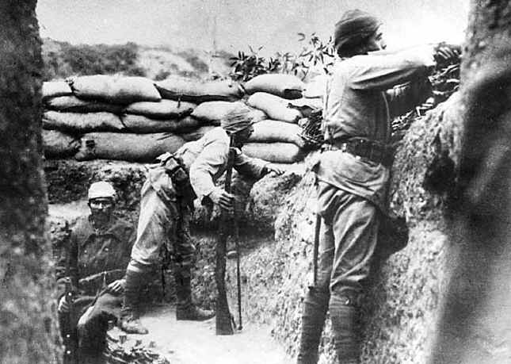
Do Now:
Turn in your homework – “Starting the War” questions - and grab today’s Agenda (8:2).
Go to Kahoot and get ready! You have until after attendance is taken to quickly study up on the start of WWI in order to win extra credit!

Slide 2
Objective: Starting World War I
SOL WHII.10a and b
TSWDK of the worldwide impact of World War I by explaining economic causes, political causes, and major events and identifying major leaders of the war, with emphasis on Woodrow Wilson and Kaiser Wilhelm II, and by explaining the outcomes and global effect of the war and the Treaty of Versailles.

Slide 3
Crash Course
Part I
Part II

Slide 4
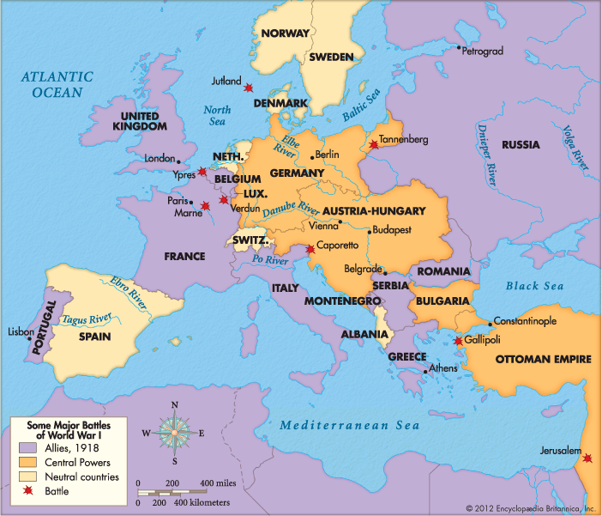
The Sides
Allied Powers
France
Great Britain
Russia
Serbia
Italy
Portugal
Romania
Greece

Slide 5
The Sides
Central Powers
Germany
Austria-Hungary
Ottoman Empire
Bulgaria

Slide 6
The Sides
Neutral Countries
Spain
Netherlands
Switzerland
Denmark
Norway
Sweden
Albania

Slide 7
Game Break!
One of you needs a computer - Google “dice roller.” You need dice for this game! With your tablemate, play the game together. You are not playing against each other. The two of you form one player. Roll the dice and see how far you get!
How many of you got to Victory?
Why not?

Slide 8
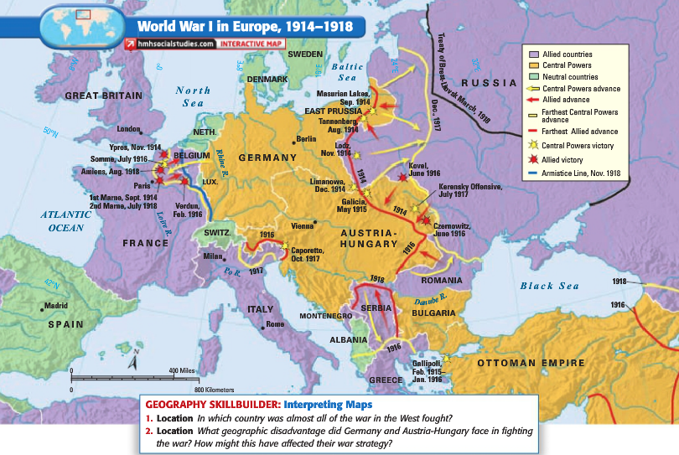
The Sides
Fronts
Western Front
First opened in 1914 when the German Army invaded Luxembourg and Belgium (Schlieffen Plan).
The German Army gained military control of important industrial regions in France.
Then both sides dug along a meandering line of fortified trenches, stretching from the North Sea to the Swiss frontier with France.

Slide 9
The Sides
Fronts
Eastern Front
Theater (area) of operations that encompassed at its greatest extent the entire frontier between the Russian Empire and Romania on one side and the Austro-Hungarian Empire, Bulgaria, and Germany on the other.
It stretched from the Baltic Sea in the north to the Black Sea in the south, included most of Eastern Europe and stretched deep into Central Europe as well.

Slide 10
Conclusion
There were many causes to the Great War – MAIN causes!
As a result, Europe was divided into two competing camps.
All plans for a short war were quickly quashed and the continent found itself a long four-year war.

