Slide 1
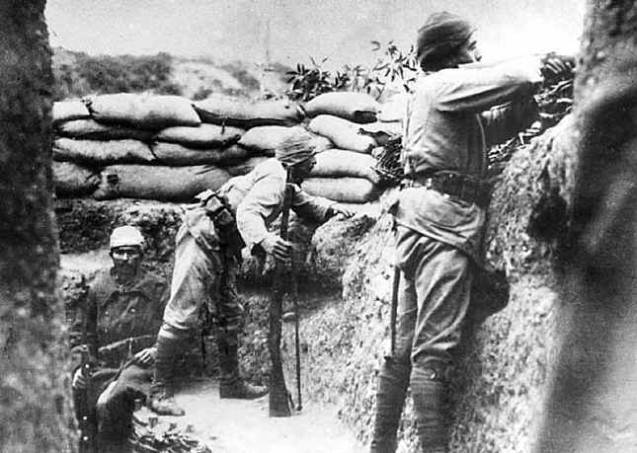
Do Now:
Turn in your Schlieffen Plan worksheet and grab today’s Agenda (8:6).
Without looking it up, what does “stalemate” mean? How would a war get to a stalemate?

Slide 2
Objective: Stalemate
SOL WHII.10a and b
TSWDK of the worldwide impact of World War I by explaining economic causes, political causes, and major events and identifying major leaders of the war, with emphasis on Woodrow Wilson and Kaiser Wilhelm II, and by explaining the outcomes and global effect of the war and the Treaty of Versailles.

Slide 3
Stalemate
Definition:
A situation in which no progress can be made or no advancement is possible.
A situation in which further action is blocked; a deadlock.
What would need to happen for a war to get to a stalemate?

Slide 4
The Sides
Allied Powers
France
Great Britain
Russia
Serbia
Italy
Portugal
Romania
Greece

Slide 5
The Sides
Central Powers
Germany
Austria-Hungary
Ottoman Empire
Bulgaria

Slide 6
The Sides
Neutral Countries
Spain
Netherlands
Switzerland
Denmark
Norway
Sweden
Albania

Slide 7
The Sides
Fronts
Western Front
First opened in 1914 when the German Army invaded Luxembourg and Belgium.
The German Army gained military control of important industrial regions in France.
Then both sides dug along a meandering line of fortified trenches, stretching from the North Sea to the Swiss frontier with France.

Slide 8
The Sides
Fronts
Eastern Front
Theater (area) of operations that encompassed at its greatest extent the entire frontier between the Russian Empire and Romania on one side and the Austro-Hungarian Empire, Bulgaria, and Germany on the other.
It stretched from the Baltic Sea in the north to the Black Sea in the south, included most of Eastern Europe and stretched deep into Central Europe as well.

Slide 9
Stalemate Readings
Why did the Germans think this would be a short war? Why wasn’t it a short war?
What made this war different from previous wars?
How did WWI reach a stalemate?

Slide 10
I’ve a Little Wet Home in a Trench
I’ve had a little wet home in a trench
Where the rainstorms continually drench,
There’s a dead cow close by
With her feet in towards the sky
And she gives off a terrible stench
Underneath, in the place of a floor,
There’s a mass of wet mud and some straw,
But with shells dropping there,
There’s no place to compare
With my little wet home in the trench

Slide 11
Trench Warfare
Organization of the Trenches
The first major trench lines were completed in late November 1914.
The Allies used four “types” of trenches.

Slide 12
Trench Warfare
Organization of the Trenches
The first major trench lines were completed in late November 1914.
The Allies used four “types” of trenches.
The front-line trench (or firing-and-attack trench) that was located from 50 yards to 1 mile from the German’s front trench.
Several hundreds yards behind the front-line trench was the support trench, with men and supplies that could immediately assist those on the front line.
The reserve trench was dug several hundred yards back and contained men and supplies that were available in emergencies should the first trenches be overrun.
Connecting these trenches were communication trenches, which allowed movement of messages, supplies, and men among the trenches. Some underground networks connected gun emplacements and bunkers with the communication trenches.

Slide 13
Trench Warfare
Organization of the Trenches
The first major trench lines were completed in late November 1914.
The Allies used four “types” of trenches.
The front-line trench (or firing-and-attack trench) that was located from 50 yards to 1 mile from the German’s front trench.
Several hundreds yards behind the front-line trench was the support trench, with men and supplies that could immediately assist those on the front line.
The reserve trench was dug several hundred yards back and contained men and supplies that were available in emergencies should the first trenches be overrun.
Connecting these trenches were communication trenches, which allowed movement of messages, supplies, and men among the trenches. Some underground networks connected gun emplacements and bunkers with the communication trenches.
German trench life was much different. They constructed elaborate and sophisticated tunnel and trench structures, sometimes with living quarters more than 50 feet below the surface. These trenches had electricity, beds, toilets, and other niceties of life that contrasted sharply with the open-air trenches of the Allies.

Slide 14
Trench Warfare
Morale Booster
On average, daily losses for the British soldiers were nearly 7,000 men killed, disabled, or wounded. This figure remained fairly constant throughout the war.
To keep morale as high as possible and to keep the soldiers on the front as fresh as possible, the British established a three-week rotation schedule. A week in the front trench was followed by a week in the support trench, which was followed by a week in the reserve trenches.
During this third week, the men could relax with sports, concerts and plays, keeping their minds away from life on the front.

Slide 15
Trench Warfare
No Man’s Land
This was the territory between the trenches.
By mid-November 1914, the territory between the opposing front trenches was marked with huge craters caused by the shelling; nearly all vegetation was destroyed.

Slide 16
Trench Warfare
No Man’s Land
This was the territory between the trenches.
By mid-November 1914, the territory between the opposing front trenches was marked with huge craters caused by the shelling; nearly all vegetation was destroyed.
Whenever possible, both sides filled this land with barbed wire to slow down any rapid advances by the enemy.
The machine gun and the new long-range rifles made movement in this area almost impossible.

Slide 17
Trench Warfare
Movements at the Front
Both sides quickly recognized that assaults against the enemy trenches were suicide if begun in broad daylight, so attacks tended to take place just before dawn or right at dawn.
Poison gases tended to be more effective in the mornings, as the colder air and absence of wind allowed the gases to stay closer to the ground for longer periods of time.
Except for artillery shelling, daytime was relatively safe for the soldiers on the front line. Once the sun went down, men crawled out of their trenches to conduct raids, investigate the layouts of the terrain, and eavesdrop near the enemy lines to pick up information on their strength, weakness and strategies.

Slide 18
Trench Warfare
Trench Facts
Each battalion had its own supply of rum that it distributed to its soldiers. Each division of 20,000 men received 300 gallons.
Every soldier carried iron rations – emergency food that consisted of a can of bully beef (canned corned beef), biscuits, and tin of tea and sugar.
A single pair of rats could produce up to 880 offspring in a year. There were a lot of rats in the trenches.
A total of 3,894 men in the British Army were convicted of self-inflicted wounds to get out of the front lines. A firing-squad offense, none were executed, but all served prison terms.
One-third of all casualties on the Western Front may have been killed or wounded in a trench.
A lit candle was fairly effective in removing lice, but the skill of burning the lice without setting yourself on fire was difficult to learn.
Soldiers in the trenches often depended on the impure water collected from shell-holes or other cavities, causing dysentery.

Slide 19
Conclusion
The Great War was expected to be a short war but trench warfare prolonged it into a stalemate.
By the war’s end, each side had dug at least 12,000 miles of trenches. Experts calculate that along the Western Front, the Allies and Central Powers dug nearly 6,250 miles of trenches by the end of 1914.
Life in the trenches was miserably and deadly.

