Slide 1
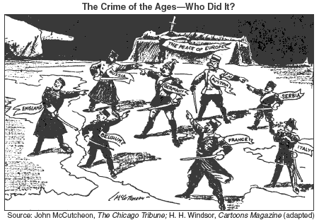
Do Now:
Grab today’s Agenda (8:4).
Look at the cartoon below. What is the message?

Slide 2
Objective:
The Great War Ends
WHII.10a and b
TSWDK of the worldwide impact of World War I by explaining economic causes, political causes, and major events, and identifying major leaders of the war, with emphasis on Woodrow Wilson and Kaiser Wilhelm II and by explaining the outcomes and global effect of the war and the Treaty of Versailles.

Slide 3
The Great War Ends
Players of the War
Nature of the Great War
The End

Slide 4
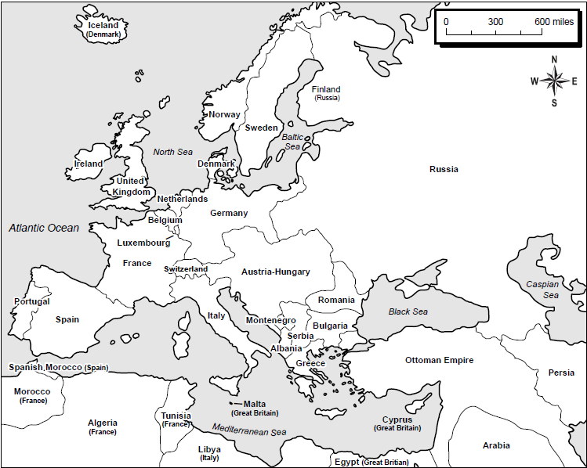
Players of the War
Allied Powers
Mobilized 40 million men, including 12 million Russians

Slide 5
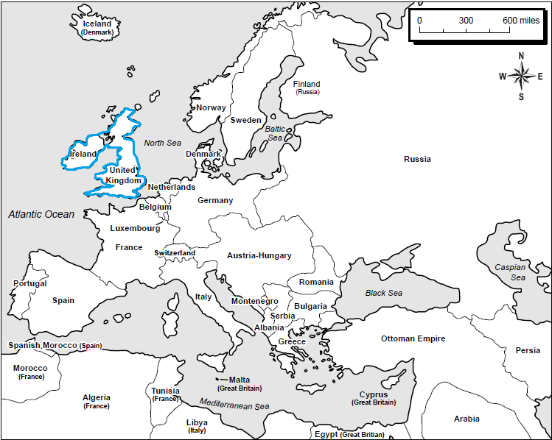
Players of the War
Allied Powers
Mobilized 40 million men, including 12 million Russians
  Great Britain

Slide 6

Players of the War
Allied Powers
Mobilized 40 million men, including 12 million Russians
  Great Britain
  France

Slide 7
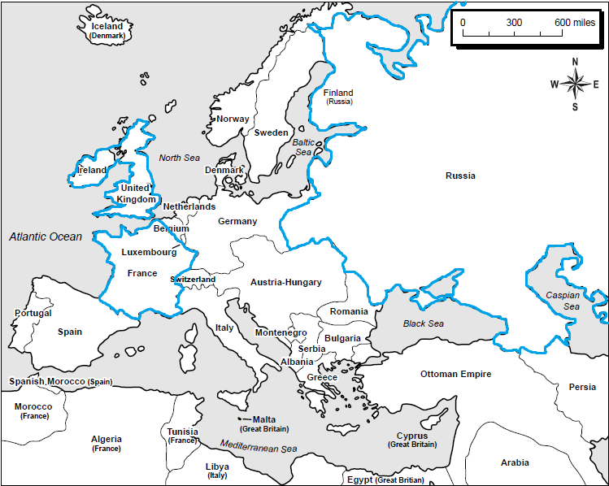
Players of the War
Allied Powers
Mobilized 40 million men, including 12 million Russians
  Great Britain
  France
  Russia (left 1917)

Slide 8
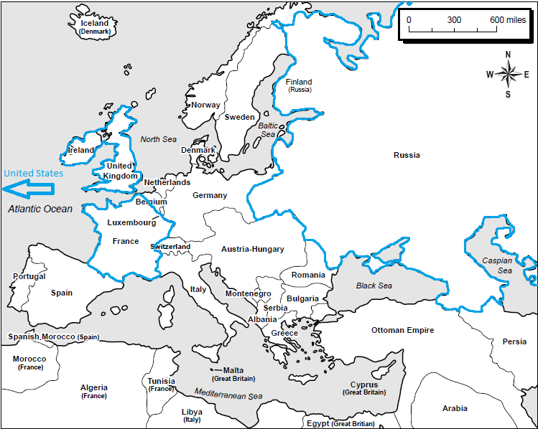
Players of the War
Allied Powers
Mobilized 40 million men, including 12 million Russians
  Great Britain
  France
  Russia (left 1917)
  United States (entered 1917)

Slide 9
Players of the War
Allied Powers
Mobilized 40 million men, including 12 million Russians
  Great Britain
  France
  Russia (left 1917)
  United States (entered 1917)
Central Powers
Mobilized 21 million men

Slide 10
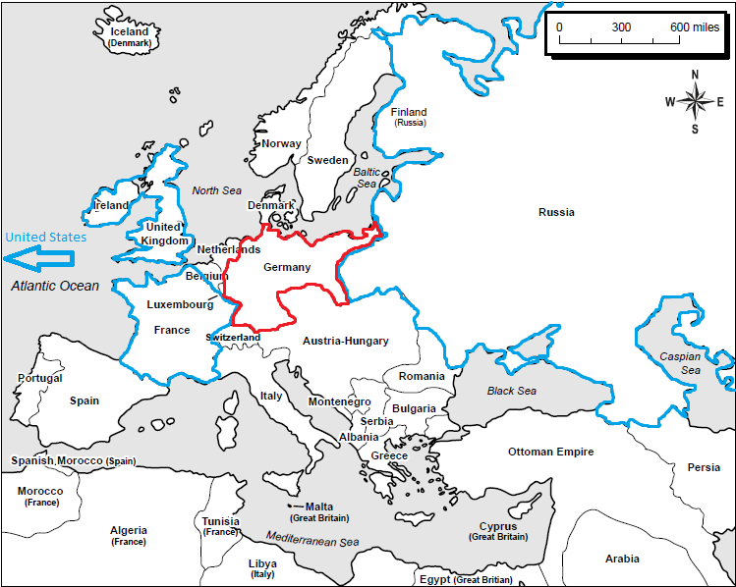
Players of the War
Allied Powers
Mobilized 40 million men, including 12 million Russians
  Great Britain
  France
  Russia (left 1917)
  United States (entered 1917)
Central Powers
Mobilized 21 million men
  Germany

Slide 11
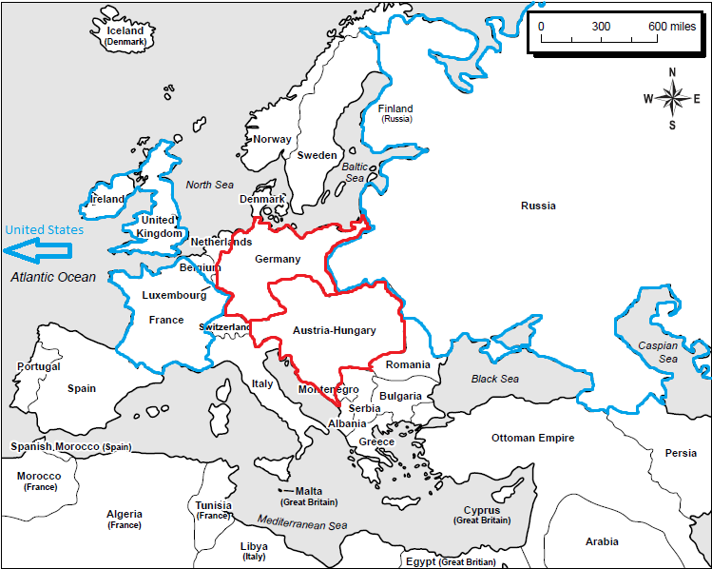
Players of the War
Allied Powers
Mobilized 40 million men, including 12 million Russians
  Great Britain
  France
  Russia (left 1917)
  United States (entered 1917)
Central Powers
Mobilized 21 million men
  Germany
  Austria-Hungary

Slide 12
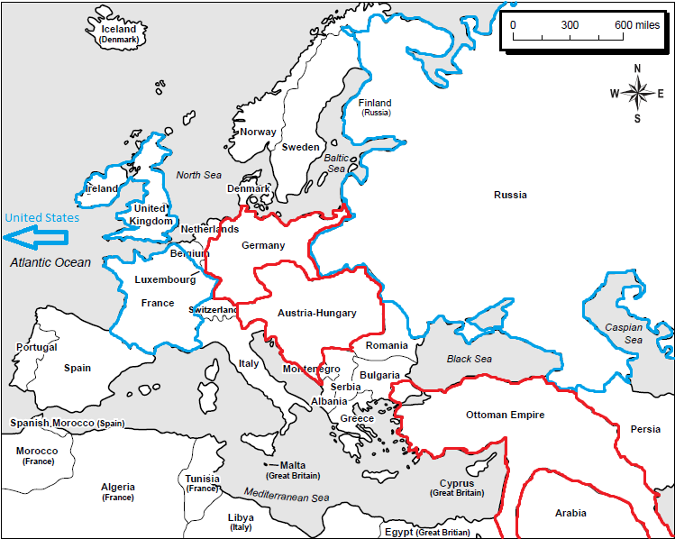
Players of the War
Allied Powers
Mobilized 40 million men, including 12 million Russians
  Great Britain
  France
  Russia (left 1917)
  United States (entered 1917)
Central Powers
Mobilized 21 million men
  Germany
  Austria-Hungary
  Ottoman Empire

Slide 13
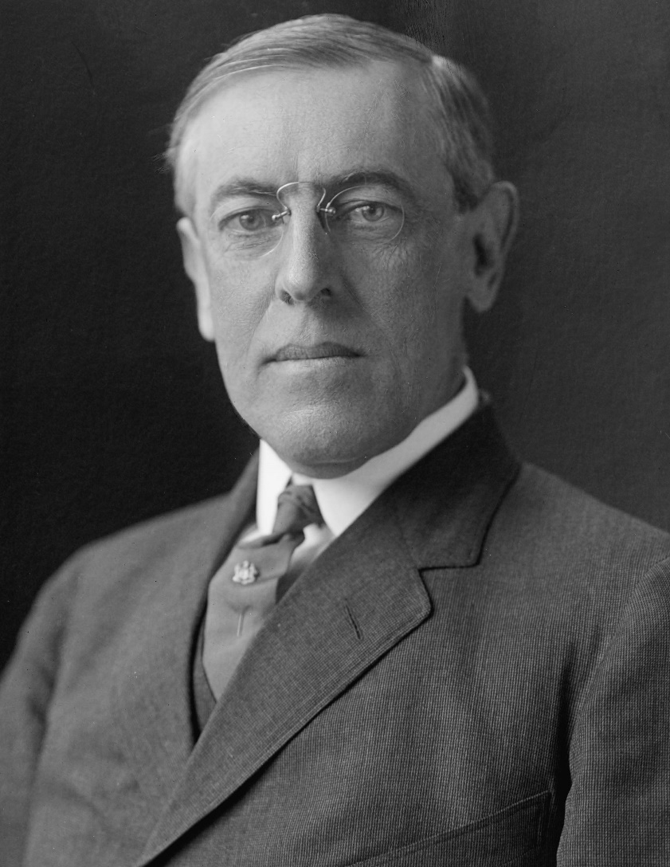
Players of the War
American Entry
Americans declared neutrality in 1914 when President Woodrow Wilson announced that the American people “must be impartial in thought as well as in action.”

Slide 14
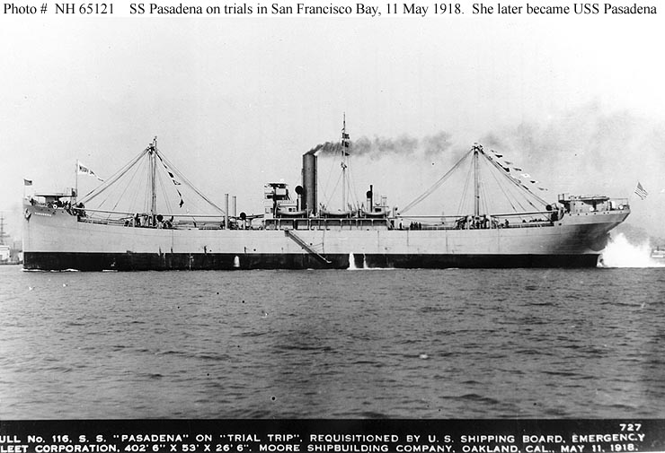
Players of the War
American Entry
Americans declared neutrality in 1914 when President Woodrow Wilson announced that the American people “must be impartial in thought as well as in action.”
At the beginning of the war, the U.S. continued to trade with both sides.
The British blockade essentially ended U.S. trade with Germany. By the middle of the war, American factories and farmers were producing weapons and food solely for Great Britain and France.

Slide 15
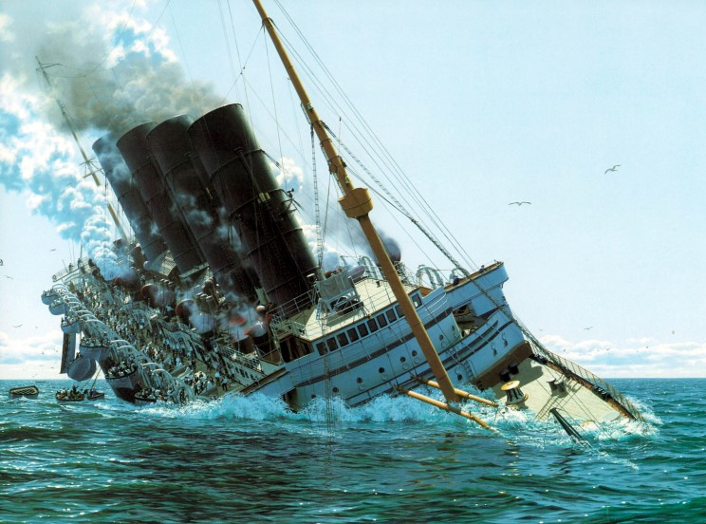
Players of the War
American Entry (continued)
It was clear to the Germans that despite America’s statement of neutrality, there was little neutrality on the economic front.
  Germans retaliated to British blockade with sinking of Lusitania. British ship carrying 1,959 passengers, of which 1, 195 died, and of which 128 were Americans.

Slide 16
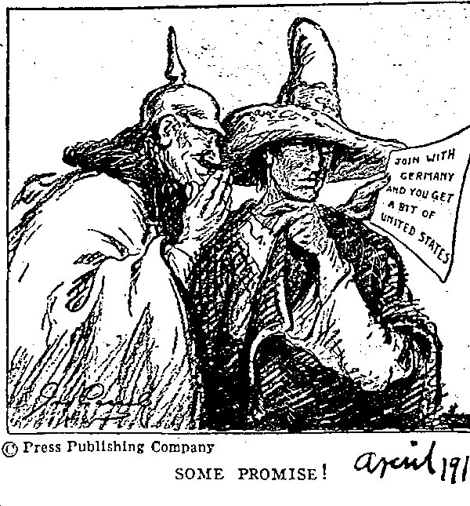
Nature of the Great War
American Entry (continued)
It was clear to the Germans that despite America’s statement of neutrality, there was little neutrality on the economic front.
  Germans retaliated to British blockade with sinking of Lusitania. British ship carrying 1,959 passengers, of which 1, 195 died, and of which 128 were Americans.
  Zimmerman Telegram, 1917. Diplomatic proposal from German Empire to Mexico to make war against the U.S.
By this point Americans were outraged.

Slide 17
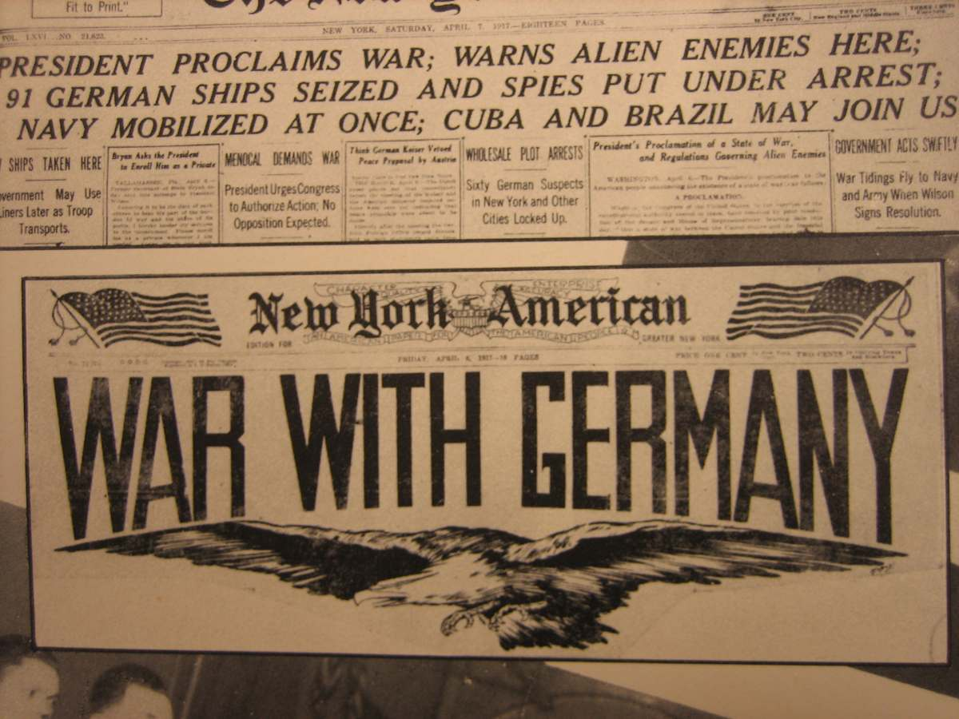
Nature of the Great War
American Entry (continued)
It was clear to the Germans that despite America’s statement of neutrality, there was little neutrality on the economic front.
  Germans retaliated to British blockade with sinking of Lusitania. British ship carrying 1,959 passengers, of which 1, 195 died, and of which 128 were Americans.
  Zimmerman Telegram, 1917. Diplomatic proposal from German Empire to Mexico to make war against the U.S.
By this point Americans were outraged.
April 6, 1917, President Wilson asked Congress to declare war on Germany.

Slide 18
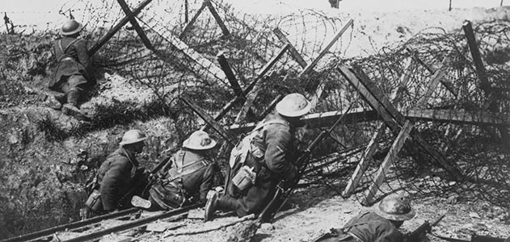
Nature of the Great War
Trench Warfare
We spoke about this.

Slide 19
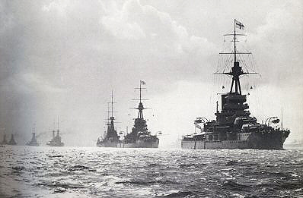
Nature of the Great War
Naval War
From the very beginning of the war the German Empire had ships scattered across the world, some of which were used to attack merchant ships headed for the Allies.

Slide 20
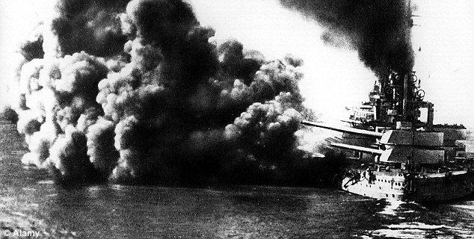
Nature of the Great War
Naval War
From the very beginning of the war the German Empire had ships scattered across the world, some of which were used to attack merchant ships headed for the Allies.
The British navy hunted them down. They created a naval blockade and mined international waters to prevent any ships from entering entire sections of ocean.

Slide 21
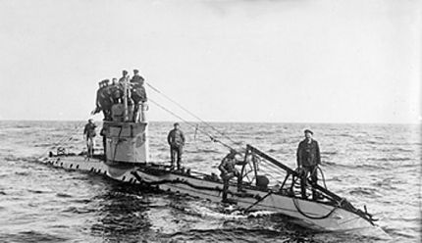
Nature of the Great War
Naval War (continued)
U-boats (submarines) were first used by the Germans in an attempt to cut the supply line between North American and Britain. Attacks often came without warning, giving the crews of the merchant ships little hope of survival.

Slide 22
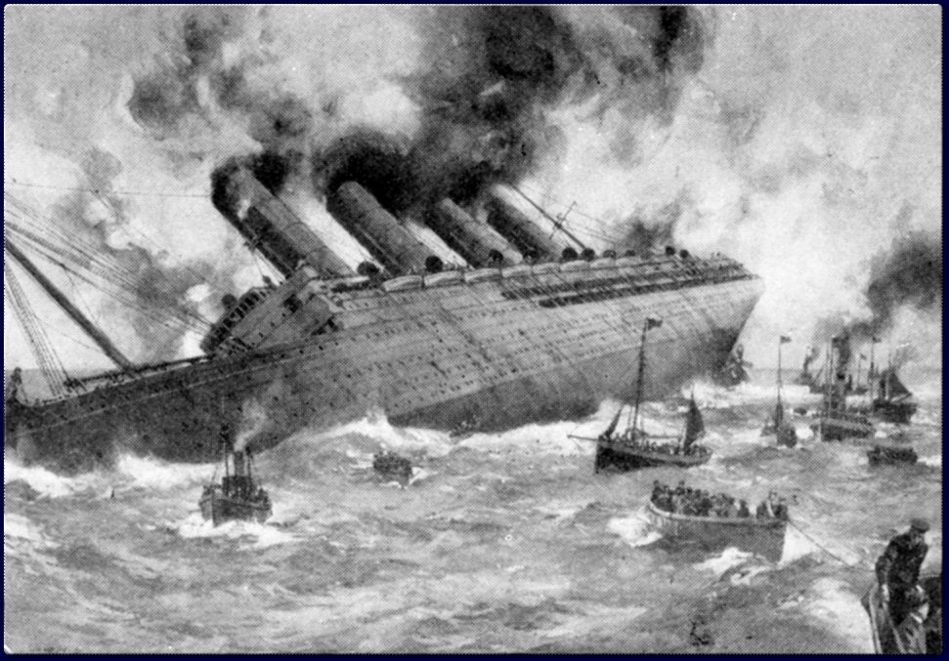
Nature of the Great War
Naval War (continued)
U-boats (submarines) were first used by the Germans in an attempt to cut the supply line between North American and Britain. Attacks often came without warning, giving the crews of the merchant ships little hope of survival.
The Lusitania in 1915.

Slide 23
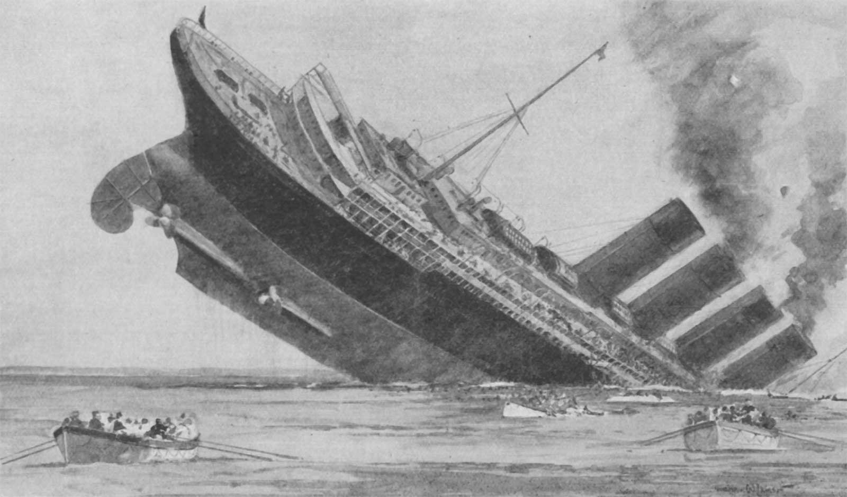
Nature of the Great War
Naval War (continued)
U-boats (submarines) were first used by the Germans in an attempt to cut the supply line between North American and Britain. Attacks often came without warning, giving the crews of the merchant ships little hope of survival.
The Lusitania in 1915.
The U-boats sunk more than 5,000 Allied ships.

Slide 24
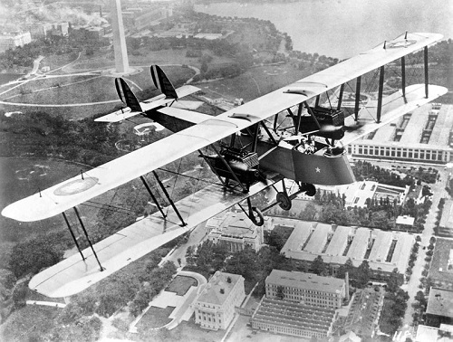
Nature of the Great War
Air Warfare
Airplanes a the time were primarily made of canvas, wood, and wire. And they were used at first to observe enemy troops.

Slide 25
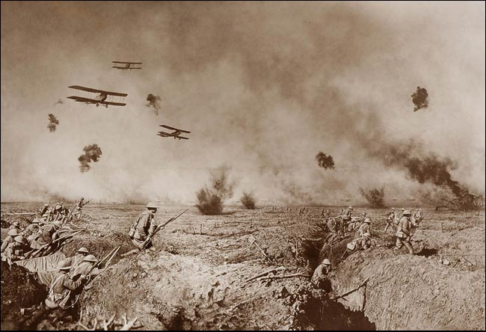
Nature of the Great War
Air Warfare
Airplanes a the time were primarily made of canvas, wood, and wire. And they were used at first to observe enemy troops.
As their effectiveness became apparent, both sides shot planes down with artillery from the ground.

Slide 26
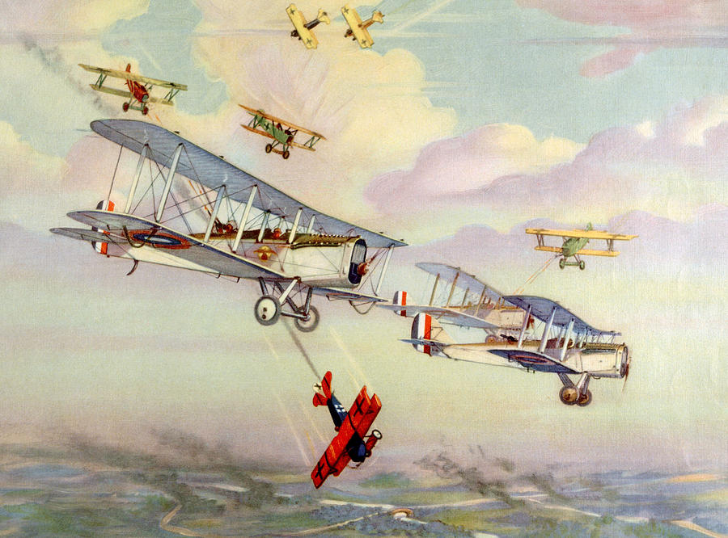
Nature of the Great War
Air Warfare
Airplanes a the time were primarily made of canvas, wood, and wire. And they were used at first to observe enemy troops.
As their effectiveness became apparent, both sides shot planes down with artillery from the ground.
In 1916, the Germans armed planes with machine guns that could fire forward without shooting the propellers.

Slide 27
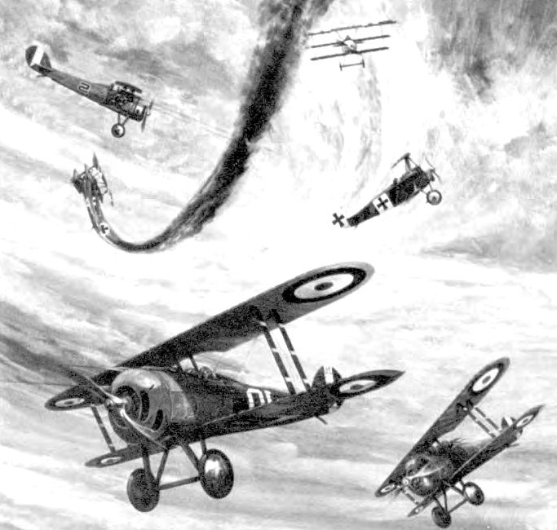
Nature of the Great War
Air Warfare
Airplanes a the time were primarily made of canvas, wood, and wire. And they were used at first to observe enemy troops.
As their effectiveness became apparent, both sides shot planes down with artillery from the ground.
In 1916, the Germans armed planes with machine guns that could fire forward without shooting the propellers.
The Allies soon armed their airplanes and battle in the air became deadly.

Slide 28
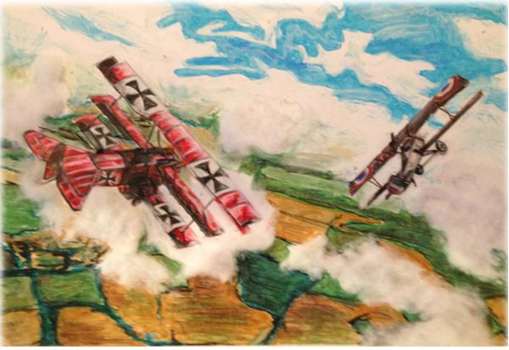
Nature of the Great War
Air Warfare
Airplanes a the time were primarily made of canvas, wood, and wire. And they were used at first to observe enemy troops.
As their effectiveness became apparent, both sides shot planes down with artillery from the ground.
In 1916, the Germans armed planes with machine guns that could fire forward without shooting the propellers.
The Allies soon armed their airplanes and battle in the air became deadly.
These light, highly maneuverable fighter-planes attacked each other in wild air battles called “dogfights.”

Slide 29
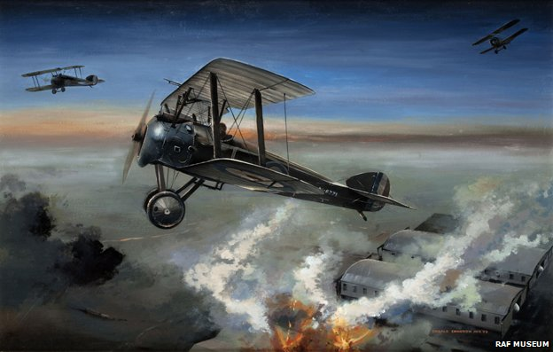
Nature of the Great War
Air Warfare
Airplanes a the time were primarily made of canvas, wood, and wire. And they were used at first to observe enemy troops.
As their effectiveness became apparent, both sides shot planes down with artillery from the ground.
In 1916, the Germans armed planes with machine guns that could fire forward without shooting the propellers.
The Allies soon armed their airplanes and battle in the air became deadly.
These light, highly maneuverable fighter-planes attacked each other in wild air battles called “dogfights.”
Pilots who were shot down often remained trapped in their falling, burning planes, for they had no parachutes.

Slide 30
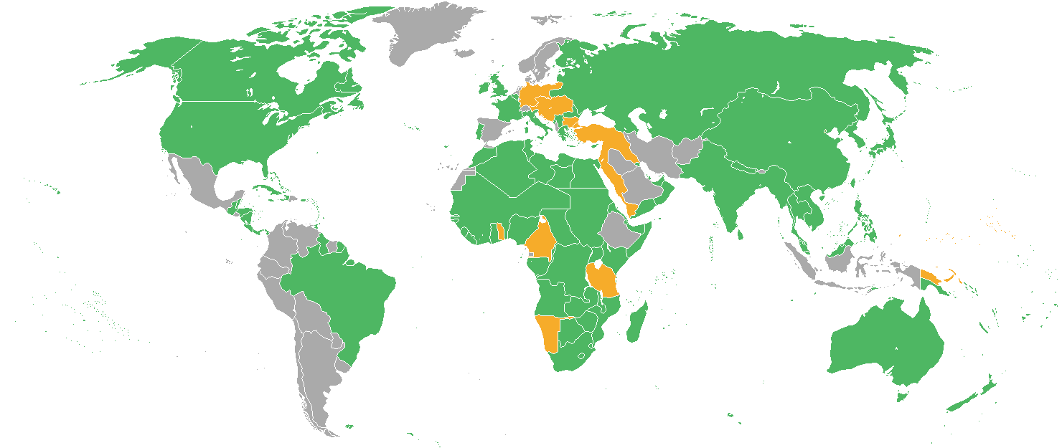
Nature of the Great War
World War
Although the war was fought mainly in Europe, it is rightly called a World War.
While European powers had competed across the globe, never had so many fighters and such enormous resources been brought together in a single conflict.
Many colonies fought on behalf of mother countries; colonial participation in war inspired future fight for independence.
Altogether, 27 nations became belligerents, ranging the globe from Japan to Canada and from Argentina to South Africa and Australia.

Slide 31
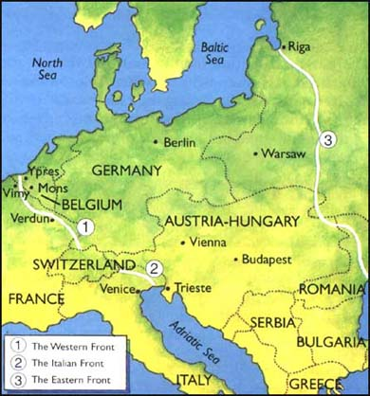
Nature of the Great War
Total War
War was fought on the Western Front (France) and on the Eastern Front (Russia).

Slide 32
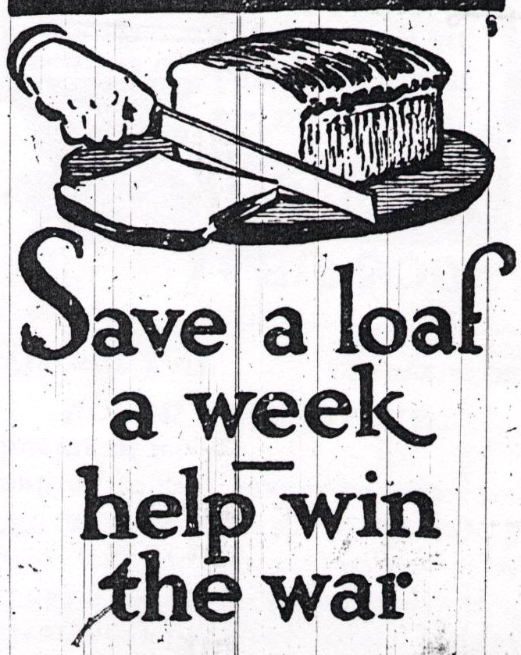
Nature of the Great War
Total War
War was fought on the Western Front (France) and on the Eastern Front (Russia).
There was also a Home Front:
  Rationing of supplies to ensure soldiers got what they needed.

Slide 33
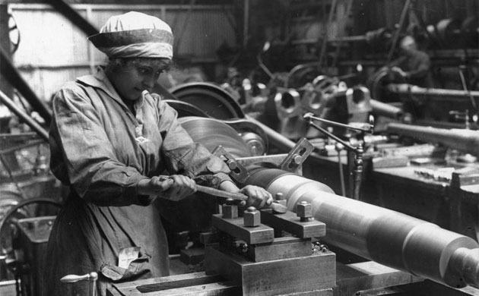
Nature of the Great War
Total War
War was fought on the Western Front (France) and on the Eastern Front (Russia).
There was also a Home Front:
  Rationing of supplies to ensure soldiers got what they needed.
  Women went to work in jobs traditionally for men because the men were off to war.

Slide 34
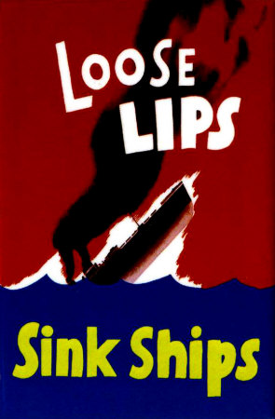
Nature of the Great War
Total War
War was fought on the Western Front (France) and on the Eastern Front (Russia).
There was also a Home Front:
  Rationing of supplies to ensure soldiers got what they needed.
  Women went to work in jobs traditionally for men because the men were off to war.
  Nations unleashed a barrage of propaganda inciting total hatred of the enemy, belief in the righteousness of the case, and unquestioned support for the war effort.

Slide 35
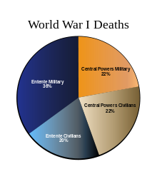
Nature of the Great War
Total War (continued)
Casualties
  17 million deaths
    10 million military
      6 million Allies
      4 million Central
    7 million civilians
  20 million wounded

Slide 36
The End
1918 Flu Pandemic
January 1918 – December 1920, there was an unusually deadly flu pandemic.
It infected 500 million people across the world and killed 50 to 100 million of them (3-5% of the world’s population).
One of the deadliest natural disasters in human history.
Germany should have been able to have done better in the war once the Eastern Front had ended and could focus on only the Western Front. However, the flu pandemic severely weakened the Germany military.

Slide 37
The End
End of War
Peace treaty was signed on the morning of November 11, 1918.
Fighting stopped by 11 AM of the same day.
“The eleventh hour of the eleventh day of the eleventh month.”

Slide 38
Conclusion
World War I (1914-1918) was caused by competition among industrial nations in Europe and a failure of diplomacy.
Outcomes and global effect
  Colonies’ participation in the war, which increased demands for independence
  End of Empires:
    Imperial Russia
    Ottoman
    German
    Austria-Hungary
  Enormous cost of the war in lives, property, and social disruption

