Slide 1
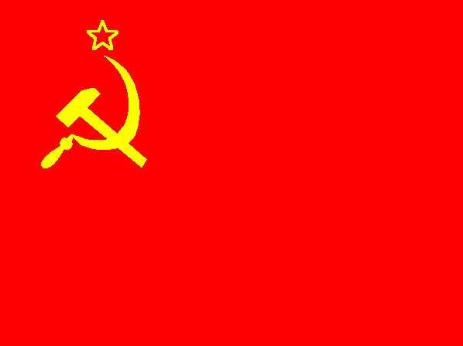
Do Now:
Grab today’s Agenda (9:4)
“Either perish, or overtake and outstrip the advanced capitalist countries.”
What do you think this means? Who might have said this?

Slide 2
Objective: Stalin’s Russia
WHII.11c
TSWDK of the political, economic, social, and cultural developments during the Interwar Period by examining events related to the rise, aggression, and human costs of dictatorial regimes in the Soviet Union… and by identifying their major leaders, i.e. Joseph Stalin.

Slide 3
Stalin’s Russia
Lenin
Stalin

Slide 4
Lenin
The Communist Party
After Lenin seized power, all other parties were suppressed.

Slide 5
Lenin
The Communist Party
After Lenin seized power, all other parties were suppressed.
Russia became the Union of Soviet Socialist Republics (USSR).

Slide 6
Lenin
The Communist Party
After Lenin seized power, all other parties were suppressed.
Russia became the Union of Soviet Socialist Republics (USSR).
The Bolsheviks, after changing their name to the Communist Party, had to now govern a country rather than carry out a revolution.
Within the party itself, a small group called the Politburo, set policy and consolidated power in its hands. (This was the group of professional elites that Lenin wrote about!)

Slide 7
Lenin
War Communism
1918-1921, Lenin tried to apply undiluted Marxist principles to get rid of elements of capitalism:
Eliminate private ownership of land; farmers had to give what they grew to the state (to redistribute as they see fit)
Nationalize all private businesses, including banks
Nationalize all transportation, including railways and shipping
Restrict the money economy

Slide 8
Lenin
War Communism (continued)
This was widely unpopular.
Peasants just got their land! And now the governments wants to take it back?!
Many workers did not want to be forced to work in factories.
Why would any manager be enthusiastic about running their business for the state’s benefit?!

Slide 9
Lenin
War Communism (continued)
This was destructive to the state.
Russia was already exhausted by 6 years of war and civil strife.
Industrial production was 13% of what it had been in 1914.
Crop failures, poor management, and transportation breakdowns…
Famine brought more than 20 million people to the brink of starvation

Slide 10
Lenin
War Communism (continued)
Lenin acknowledges the failure of War Communism
Too much too soon
No complementary communist revolutions sweeping the globe like he hoped; Russia was alone.
Compromise was necessary to survive.

Slide 11
Lenin
NEP
New Economic Policy
1921-1928
The Plan
Peasants no longer had to give up surplus to the state. After paying a tax, they could keep their surplus and sell on open market.
Businesses with less than 20 employees can be privately owned.

Slide 12
Josef Stalin
Rise to power
Stalin, along with Leon Trotsky, were disciples of Lenin.

Slide 13
Josef Stalin
Rise to power
Stalin, along with Leon Trotsky, were disciples of Lenin.
Lenin did not specify who was to take power after his death (1924) so Stalin and Trotsky fought for control.

Slide 14
Josef Stalin
Rise to power
Stalin, along with Leon Trotsky, were disciples of Lenin.
Lenin did not specify who was to take power after his death (1924) so Stalin and Trotsky fought for control.
Through whatever means necessary, (and he was ruthless!) Stalin took control 1928

Slide 15
Josef Stalin
War on the Peasants
Wanted to transform peasants into a rural proletariat with collective farms.

Slide 16
Josef Stalin
War on the Peasants
Wanted to transform peasants into a rural proletariat with collective farms.
Farms to produce everything for the state to be redistributed as they see fit.

Slide 17
Josef Stalin
War on the Peasants
Wanted to transform peasants into a rural proletariat with collective farms.
Farms to produce everything for the state to be redistributed as they see fit.
Marx left little guidance on this so Stalin returned to Lenin’s war communism.

Slide 18
Josef Stalin
War on the Peasants
Wanted to transform peasants into a rural proletariat with collective farms.
Farms to produce everything for the state to be redistributed as they see fit.
Marx left little guidance on this so Stalin returned to Lenin’s war communism.
Peasants reacted violently… to which Stalin reacted harshly. He sent the secret police and the army to the villages to quiet them down (kill them).

Slide 19
Josef Stalin
War on the Peasants
Wanted to transform peasants into a rural proletariat with collective farms.
Farms to produce everything for the state to be redistributed as they see fit.
Marx left little guidance on this so Stalin returned to Lenin’s war communism.
Peasants reacted violently… to which Stalin reacted harshly. He sent the secret police and the army to the villages to quiet them down (kill them).
Millions died from direct attack, starvation, or in work camps (you were sent to work camps if you didn’t behave!)

Slide 20
Josef Stalin
War on the Peasants
Wanted to transform peasants into a rural proletariat with collective farms.
Farms to produce everything for the state to be redistributed as they see fit.
Marx left little guidance on this so Stalin returned to Lenin’s war communism.
Peasants reacted violently… to which Stalin reacted harshly. He sent the secret police and the army to the villages to quiet them down (kill them).
Millions died from direct attack, starvation, or in work camps (you were sent to work camps if you didn’t behave!)
After 9 years of war on the peasants, 90% of the land and 100 million peasants were in collective and state farms. 14 million were dead.

Slide 21
Josef Stalin
The Five-Year Plans
First Plan – 1928
Increased state industrialization by 250%
State Police enforced - costs were disastrous

Slide 22
Josef Stalin
The Five-Year Plans
First Plan – 1928
Increased state industrialization by 250%
State Police enforced - costs were disastrous
Second Plan – 1933
Placed greater emphasis on improving quality of products and making more consumer goods

Slide 23
Josef Stalin
The Five-Year Plans
First Plan – 1928
Increased state industrialization by 250%
State Police enforced - costs were disastrous
Second Plan – 1933
Placed greater emphasis on improving quality of products and making more consumer goods
Third Plan – 1938
Emphasized national defense

Slide 24
Josef Stalin
The Great Purges
Stalin established an all-powerful totalitarian (absolute dictatorship) rule by doing away with all his rivals in purges.
Totalitarianism = political system in which the state holds total authority over society and seeks to control all aspects of public and private life wherever possible.

Slide 25
Josef Stalin
The Great Purges
Stalin established an all-powerful totalitarian (absolute dictatorship) rule by doing away with all his rivals in purges.
Totalitarianism = political system in which the state holds total authority over society and seeks to control all aspects of public and private life wherever possible.
The long arm of the secret police gathered in thousands of Soviet citizens to face “trial” and the firing squad.

Slide 26
Josef Stalin
The Great Purges
Stalin established an all-powerful totalitarian (absolute dictatorship) rule by doing away with all his rivals in purges.
Totalitarianism = political system in which the state holds total authority over society and seeks to control all aspects of public and private life wherever possible.
The long arm of the secret police gathered in thousands of Soviet citizens to face “trial” and the firing squad.
He also took the opportunity to remove all scientific, cultural, and educational figures who did not fit in with his plans for the future.

Slide 27
Conclusion
Economic disruption following World War I led to unstable political conditions. Worldwide depression in the 1930s provided opportunities for the rise of dictators in the Soviet Union.
A communist dictatorship was established by Vladimir Lenin and continued by Josef Stalin in the Soviet Union.
Under Stalin, the USSR was entrenched in communism. His policies include:
Five-year plans
Collectivization of farms
State industrialization
The secret police.
Stalin maintained his totalitarian dictatorship through the Great Purge.

